Slide 1
Spain, Melilla 2017
Starter with smoked salmon and potatoes on rye bread for 35-40 pers.

Slide 2
STARTER: Rye bread with cold potatoes and salmon
1 kg potatoes (boiled)
500 g smoked salmon
2 carrots
300 g crème fraiche
200 g mayonnaise
2 handfuls of dill
salt and pepper
rye bread

Slide 3
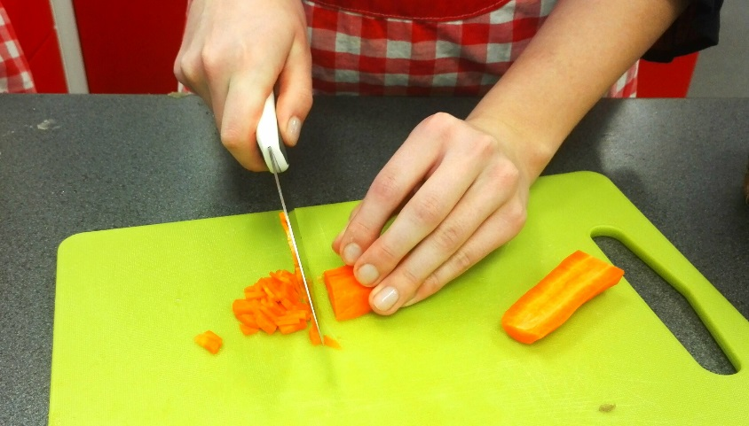
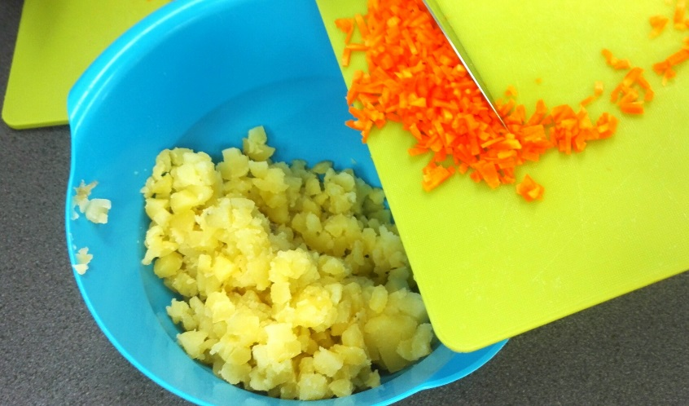
Peel the potatoes and carrots. Chop them. The carrot pieces have to be really small. Put everything in a big bowl.

Slide 4
Take away the skin of the salmon. Rip pieces and put them to the same bowl with the other ingredients.

Slide 5
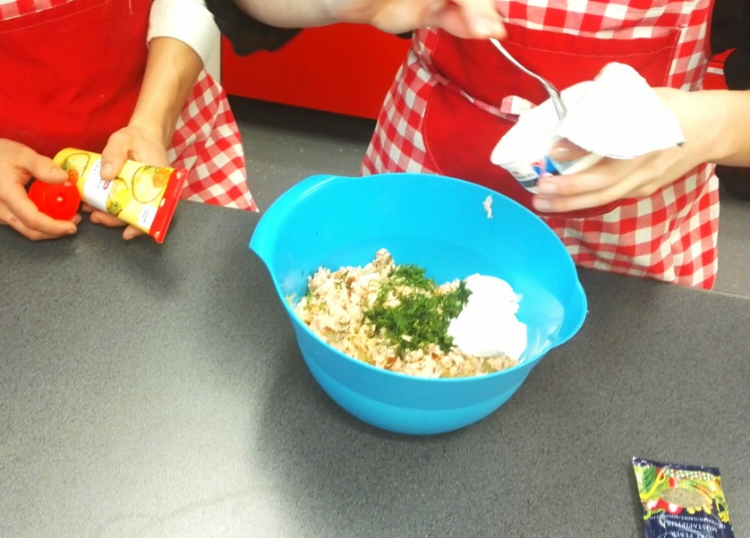
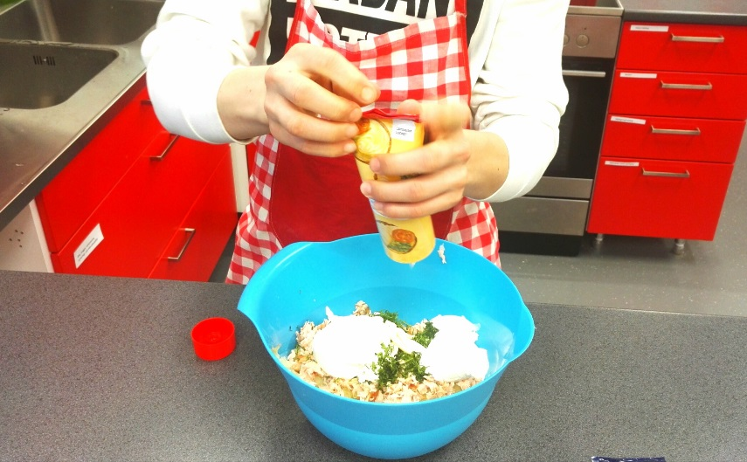
Chop the dill and put it to the bowl. Add crème fraiche and mayonnaise.

Slide 6
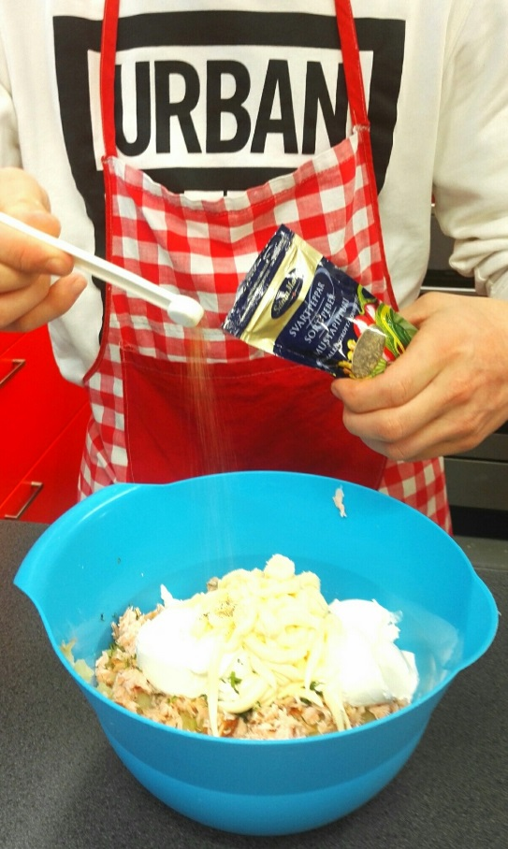
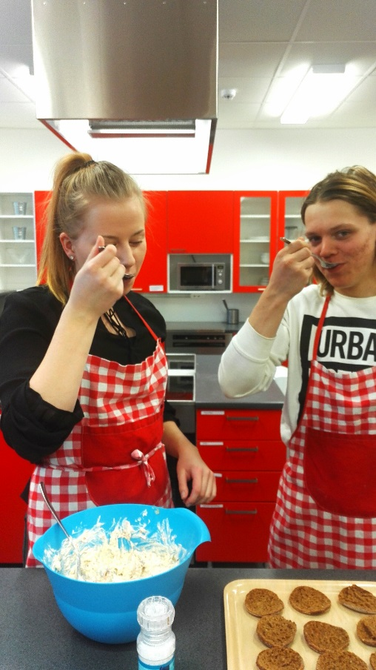
Add salt and pepper and mix everything carefully. Taste.

Slide 7
Spread the mixture on the rye breads. Decorate with dill. Enjoy!

Slide 8
Gastronomical aspects
Rye bread is very typical in Finland and all over Scandinavia.
Finnish people can’t live without rye bread, so they often take it with them on their vacations abroad.
Rye bread is like the baguette for the French people. It’s like the synonym to ordinary.
Potatoes and salmon are very typical summer food, especially for the Swedish-speaking Finns.
The first harvest of new potatoes is like a feast for Finns (around midsummer time).
We have a lot of wild and raced salmon because of our thousand lakes, rivers and the sea.

