Slide 1
Keith Towler Rights and Citizenship
Erasmus +
KA2 Project “LEADING LIGHTS”
Ysgol Dyffryn Taf, 8th October 2018

Slide 2
Remember yourself as a child … love, needs, vulnerability, rights

Slide 3
Human Rights & Children’s Rights
What is a right?
They are the basic things we need in order to survive, grow and to fulfill our potential
Universal – for everyone
Indivisible – permanent
Interdependent - connected
Inalienable – can’t be taken away

Slide 4
Human Rights … think FREDA
Fairness (article 6 fair trail)
Respect (article 8 private and family life)
Equality (article 14 no discrimination)
Dignity (article 3 freedom from inhumane treatment)
Autonomy (article 8)

Slide 5
We have Human Rights so why do we need Children’s Rights?
Children are more vulnerable to abuse and exploitation
Young age places a dependency on adults – exercise of ‘best interest’
Children face an array of legal minimum ages at which they are considered capable of making decisions
Children are often voiceless

Slide 6
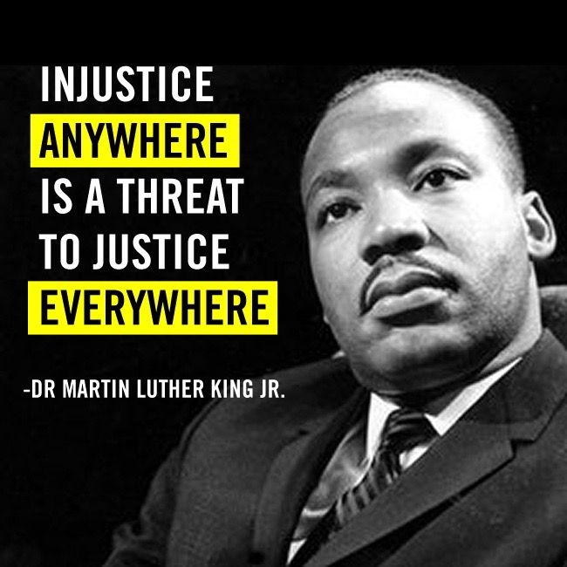

Slide 7
Treatment of Refugees
https://twitter.com/ambertreharne_/status/1016336615101394945
Film by Glan Y Mors ChangeMakers 2018

Slide 8
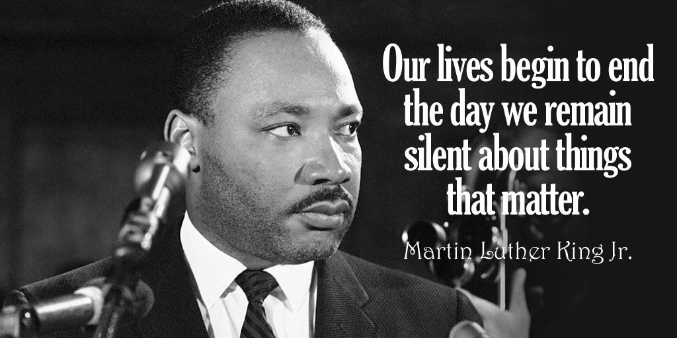
Complexity of silence

Slide 9
The UNCRC
United Nations Convention on the Rights of the Child
All human, social and economic rights of all children (under18) across the world
Created in 1989 ratified by the UK on 16th December 1991
There are 54 articles in the convention
Art 1 – 42 specific rights for children
Art 43-54 obligations on State Parties and duty bearers

Slide 10
United Nations Convention on the Rights of the Child (UNCRC) Confensiwn y Cenhedloedd Unedig ar Hawliau’r Plentyn (CCUHP)
PROVISION of appropriate health care, standard of living, education, facilities + support for special needs
DARPARU lefel briodol o ofal iechyd, safon byw, addysg, cyfleusterau a chefnogaeth ar gyfer anghenion arbennig
UNCRC sets minimum standards for children and young people’s civil, political, economic, social and cultural rights
Mae CCUHP yn gosod safonau gofynnol ar gyfer hawliau sifil, gwleidyddol, economaidd, cymdeithasol a diwylliannol plant a phobl ifanc
PARTICIPATION in society as active members of community
CYFRANOGIAD yn y gymdeithas fel aelodau gweithredol o’r gymuned
PROTECTION from violence, dangerous work, abuse and abduction, prevention of harm
AMDDIFFYNIAD rhag trais, gwaith peryglus, camdriniaeth a herwgipio, atal niwed

Slide 11
United Nations Convention on the Rights of the Child (UNCRC) Confensiwn y Cenhedloedd Unedig ar Hawliau’r Plentyn (CCUHP)
Pedwar o Egwyddorion Tywys
Four Guiding Principles
BEST INTERESTS
LLES PENNAF
(Article/Erthygl 3)
SURVIVAL & DEVELOPMENT
GOROESI A DATBLYGU (Article/Erthygl 6)
PARTICIPATION
CYFRANOGIAD
(Article/Erthygl 12)
NON – DISCRIMINATION
PEIDIO Â CHAMWAHANIAETHU
(Article/Erthygl 2)

Slide 12
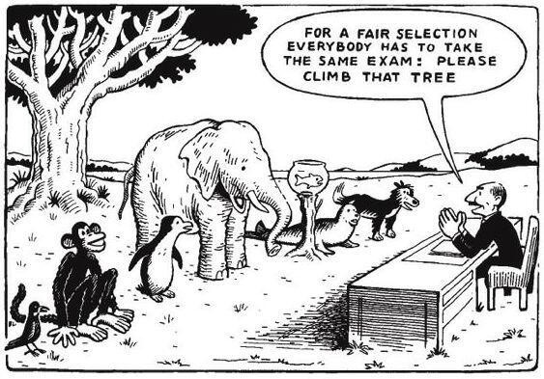
UNCRC – establishes rights to support individual potential

Slide 13
“Their eyes sparkle and they are kids again”
https://www.bbc.co.uk/programmes/p05c4jjy
BBC Three Film Amazing Humans
Play practitioners bring joy to child refugees

Slide 14
BREXIT IMPLICATIONS

Slide 15
Likes, loves and friends

Slide 16
We the People
https://www.youtube.com/watch?v=RpqVmvMCmp0&feature=youtu.be
Film about the The Global Development Goals for Sustainable Development

Slide 18
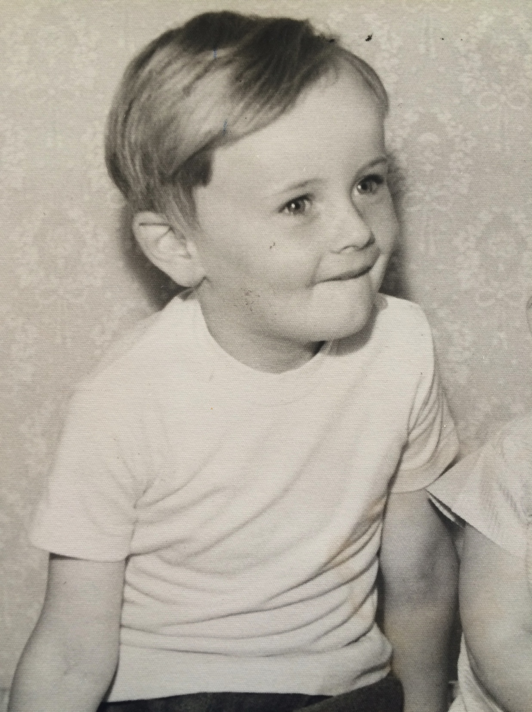
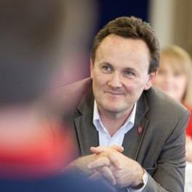
THANKS FOR LISTENING!
Contact details:
Email: keith.towler@gmail.com
Twitter: @KeithJTowler

