Slide 1
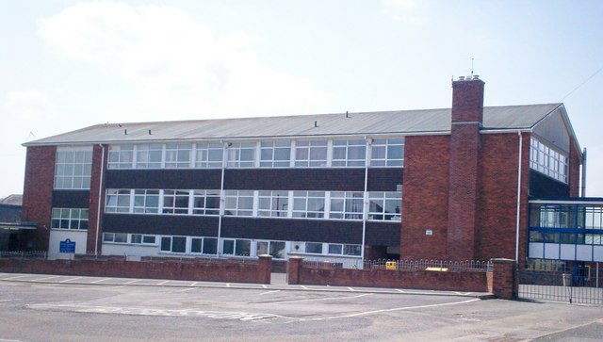
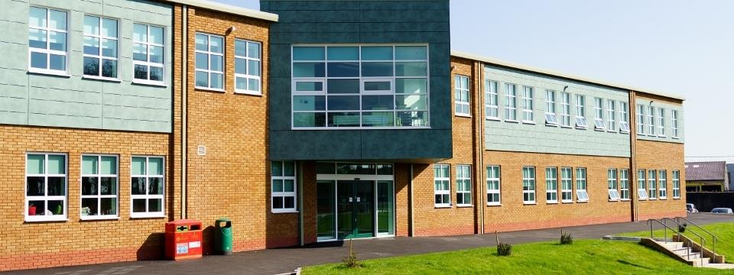
Wales Visit
Information we will need & what you need to prepare
Dyffryn Taf
Ysgol y Strade

Slide 2
What we need from you by Friday 11th May 2018:
Number of staff and students who will be visiting (and genders). Liz will post a google document onto the Facebook page
Whether or not staff want twin or single rooms
What airport you intend on flying to (London Heathrow or Bristol - please coordinate airports/flight times if possible) and what day (ideally we would like you to arrive on Saturday 6th and depart Saturday 13th). Airports are a long distance away from West Wales so will require a co-ordinated pick up.
What your students will need to prepare for the visit:
Equality video - outlining equality issues/positives from your schools/countries. 4 minutes max.
A song in their language that they wish to play on the school radio on USB. General greetings in their language such as hello/my name is/what’s your name/how are you. They’ll introduce the song on the radio.

Slide 3
Current Accomodation Options (Carmarthen - central to both schools):
The Falcon Hotel (£80 single/£85 twin):
http://www.falconcarmarthen.co.uk/
The Ivy Bush Hotel (£100):
http://www.ivybushroyal.co.uk/
The Spilman Hotel (£55 single/£77 twin but limited availability - may not be able to secure):
https://spilmanhotel.co.uk/
*All prices include breakfast
Reunion teachers will be hosted by teachers - TBC

Slide 4
Weather & Activities - Ideas of what to pack:
October in Wales is changeable - it could be mild or cold (for everyone except the Finnish teachers), dry or wet, so be prepared for it! We will of course update you closer to the time. Bring a waterproof jacket and an umbrella!
We plan walking, dancing and coasteering (for students) activities so sensible footwear required and swimming gear for students.

Slide 5
The UN Sustainable Development Goals
(SDG’s)

Slide 6
Who are the UN? http://www.un.org/en/about-un/
The United Nations is an international organization founded in 1945. It is currently made up of 193 Member States. The mission and work of the United Nations are guided by the purposes and principles contained in its founding Charter.
Each of the 193 Member States of the United Nations is a member of the General Assembly. States are admitted to membership in the UN by a decision of the General Assembly upon the recommendation of the Security Council.
The main organs of the UN are the General Assembly, the Security Council, the Economic and Social Council, the Trusteeship Council, the International Court of Justice, and the UN Secretariat. All were established in 1945 when the UN was founded.
The Secretary-General of the United Nations is a symbol of the Organization's ideals and a spokesman for the interests of the world's peoples, in particular the poor and vulnerable. The current Secretary-General of the UN, and the ninth occupant of the post, is Mr. António Guterres of Portugal, who took office on 1 January 2017. The UN Charter describes the Secretary-General as "chief administrative officer" of the Organization.
The Secretariat, one of the main organs of the UN, is organized along departmental lines, with each department or office having a distinct area of action and responsibility. Offices and departments coordinate with each other to ensure cohesion as they carry out the day to day work of the Organization in offices and duty stations around the world. At the head of the United Nations Secretariat is the Secretary-General.
The UN system, also known unofficially as the "UN family", is made up of the UN itself and many affiliated programmes, funds, and specialized agencies, all with their own membership, leadership, and budget. The programmes and funds are financed through voluntary rather than assessed contributions. The Specialized Agencies are independent international organizations funded by both voluntary and assessed contributions.

Slide 7
UN'S MILLENNIUM DEVELOPMENT GOALS
The eight Millennium Development Goals (MDGs) were agreed on by world leaders at a UN summit in 2000 and set targets to:
to eradicate extreme poverty and hunger;
to achieve universal primary education;
to promote gender equality and empower women;
to reduce child mortality;
to improve maternal health;
to combat HIV/AIDS, malaria, and other diseases;
to ensure environmental sustainability; and
to develop a global partnership for development.
15 years after they were created they reached their expiration date and the UN created the Sustainable Development Goals to focus their attention on over the next 15 years.

Slide 8
The MDG’s

Slide 9
The Sustainable Development Goals 2015-2030

Slide 11
‘We The People’ for The Global Goals

Slide 13
UN’s Sustainable Development Goals:
17 STEPS TO A BETTER WORLD
End poverty in all its forms everywhere
End hunger, achieve food security and improved nutrition and promote sustainable agriculture
Ensure healthy lives and promote well-being for all at all ages
Ensure inclusive and equitable quality education and promote lifelong learning opportunities for all
Achieve gender equality and empower all women and girls
Ensure availability and sustainable management of water and sanitation for all
Ensure access to affordable, reliable, sustainable and modern energy for all
Promote sustained, inclusive and sustainable economic growth, full and productive employment and decent work for all
Build resilient infrastructure, promote inclusive and sustainable industrialization and foster innovation
Reduce inequality within and among countries
Make cities and human settlements inclusive, safe, resilient and sustainable
Ensure sustainable consumption and production patterns
Take urgent action to combat climate change and its impacts
Conserve and sustainably use the oceans, seas and marine resources for sustainable development
Protect, restore and promote sustainable use of terrestrial ecosystems, sustainably manage forests, combat desertification, and halt and reverse land degradation and halt biodiversity loss
Promote peaceful and inclusive societies for sustainable development, provide access to justice for all and build effective, accountable and inclusive institutions at all levels
Strengthen the means of implementation and revitalize the global partnership for sustainable development

Slide 14
SDG Equality Videos for Wales Visit
The video should:
Be no longer than 4 minutes
Cover equality issues/positives in your schools/countries.
Be presented either in English or in your own language with English subtitles

