Slide 1
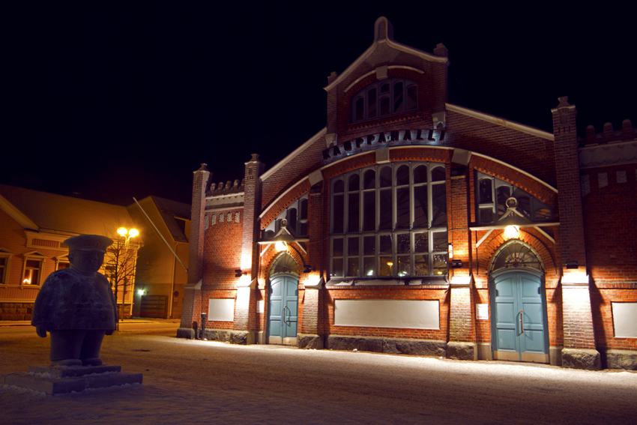
Traditional specialities from Finland

Slide 2
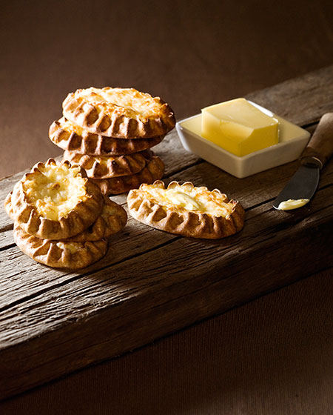
Historical aspects
Before Finland’s independency, Finland was under the maintenance of Sweden and Russia.
Finnish food culture has had a lot of influence from east (Russia) and west (Sweden).
The Finnish food is overall very modest and it is based on basic ingredients that would stay eatable over the long and cold winter.
Karelian pastry as seen on the picture left is one good example of traditional Finnish food.

Slide 3
Gastronomical aspects
The Finnish food culture is based over functionality and good nutriotional value
Spicing has been very moderate among the Finnish food culture and many of our traditional foods include mainly salt.
Finnish people consume very much dairy products and milk is very popular drink among all the Finns.

Slide 4
Reindeer stew with mashed potatoes and cranberry

Slide 5
Blueberry pie

Slide 6
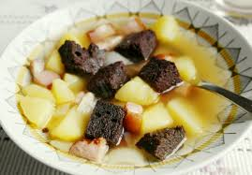
Rössypottu
Rössypottu is a soup which is made of potatoes, pork and black pudding
Rössy or black pudding is made of reindeers- , pigs-, or cows blood

Slide 7
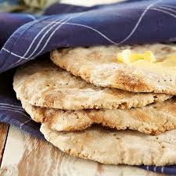
Rieska
Rieska is a bread which is made of either barley-, oat- or potato flour
Rieska is made differently in different parts of Finland

Slide 8
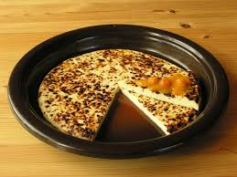
Leipäjuusto
Leipäjuusto is a cheese curd which is processed into a flat cake
Leipäjuusto is a dessert which is served usually with cloudberry jam

Slide 9
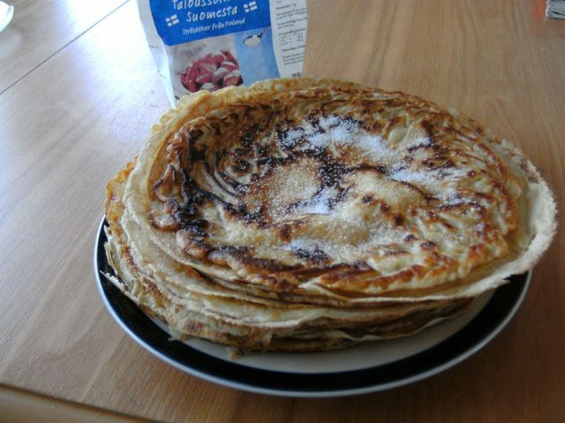
The Finnish pancake
The Finnish version of a pancake is called a “Lätty” or “Ohukainen”.
The pancakes are made from milk, flour and eggs(and a bit of salt)
You can cook the pancakes with a frying pan or a cast iron pan on a campfire or a stove.
On a proper pancake you sprinkle some sugar on top of the pancake right after you have fried it
You eat the pancakes when they are warm and you can put jams, whip cream or ice cream on it.

Slide 10
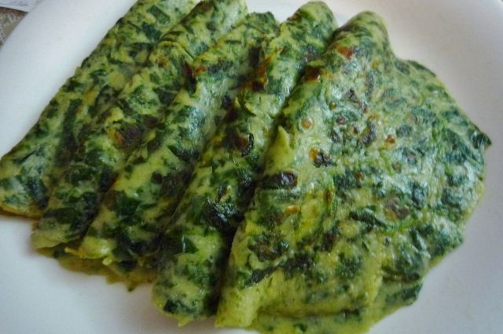
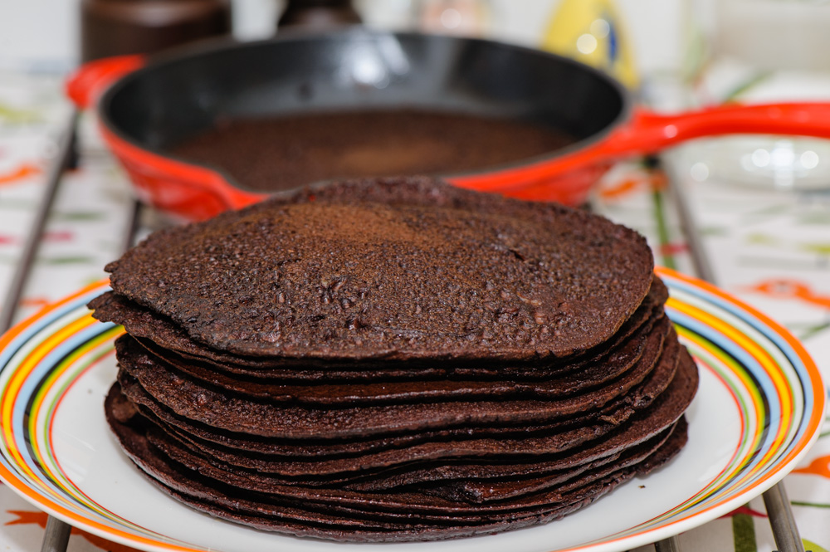
Closest to the Finnish pancake might be the French crêpe or the Russian bliny. But they are not the same. These ones are more salty.
You can have many different varieties of a finnish pancake.
They make ones from spinach or blood and make a great main course instead of the most common dessert version.

Slide 11
http://www.kaleva.fi/teemat/ruoka/oululaista-perinneruokaa-ravintolasta/193440/
https://fi.wikipedia.org/wiki/Leip%C3%A4juusto
https://fi.wikipedia.org/wiki/Rieska
https://fi.wikipedia.org/wiki/R%C3%B6ssypottu

Slide 12
http://www.kylmanen.fi/media/rossypottu-ke.jpg
https://upload.wikimedia.org/wikipedia/commons/thumb/4/42/Leip%C3%A4juusto_cheese_with_cloudberry_jam.jpg/1200px-Leip%C3%A4juusto_cheese_with_cloudberry_jam.jpg
https://www.google.fi/imgres?imgurl=http%3A%2F%2Fyllapito.maku.fi%2Fsites%2Fmaku%2Ffiles%2Fstyles%2Fwide%2Fpublic%2Fmediaserver%2Freseptikuvat%2Fmaku_42010%2Fohrarieskat.jpg%3Fitok%3DIMK1PgjO&imgrefurl=http%3A%2F%2Fwww.maku.fi%2Freseptit%2Fohrarieskat&docid=sOLMcBUaFmV-7M&tbnid=dg-38QSNsTZ1RM%3A&vet=10ahUKEwiyoMLwj7PTAhWDDywKHY6SCocQMwgqKAEwAQ..i&w=700&h=700&bih=613&biw=1366&q=oharieska&ved=0ahUKEwiyoMLwj7PTAhWDDywKHY6SCocQMwgqKAEwAQ&iact=mrc&uact=8
https://www.google.fi/url?sa=i&rct=j&q=&esrc=s&source=images&cd=&cad=rja&uact=8&ved=0ahUKEwj0mqfPkrPTAhUFGCwKHagmCeAQjRwIBw&url=http%3A%2F%2Fwww.imgrum.net%2Ftag%2Fjankki&psig=AFQjCNGlmPo_Emh89IlmfxeikYL9xTYJTg&ust=1492781507814209
http://ouluphotos.com/talvi/files/page2-1012-full.jpg

