Slide 1
Croeso!!!

Slide 2
Sgwrsio!
Shwmae?
Helo!
Bore da – Good morning
Prynhawn da – Good afternoon
Nos da – Good night
Diolch – Thank you

Slide 3
Yr Wyddor Gymraeg
Can you say the Welsh alphabet?
A B C Ch D Dd E F Ff
G Ng H I J L Ll M N
O P Ph R Rh S T Th U
W Y

Slide 4
Pronunciation!
Can you say these words?

Slide 5
Enw - Name
Beth yw dy enw di? –
What is your name?
Fy enw i yw…
My name is…

Slide 6
Byw - Live
Ble wyt ti’n byw? – Where do you live?
Rydw i’n byw yn… - I live in…
Y Ffindir - Finland Sweden
Portiwgal – Portugal Yr Eidal - Italy
Melilla yn Sbaen (Spain) Le Reunion yn Ffrainc (France)

Slide 7
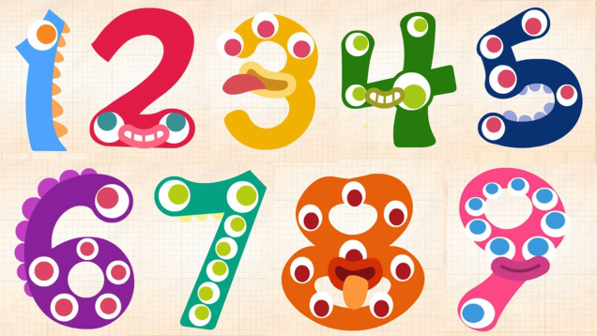
Rhifau

Slide 8
0 dim
1 un
2 dau
3 tri
4 pedwar
5 pump
6 chwech
7 saith
8 wyth
9 naw
10 deg
11 un deg un
12 un deg dau
13 un deg tri
14 un deg pedwar
15 un deg pump
16 un deg chwech
17 un deg saith
18 un deg wyth
19 un deg naw
20 dauddeg

Slide 9
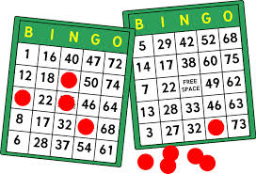
Bingo!
Llinell! Line!
Bingo!

Slide 10
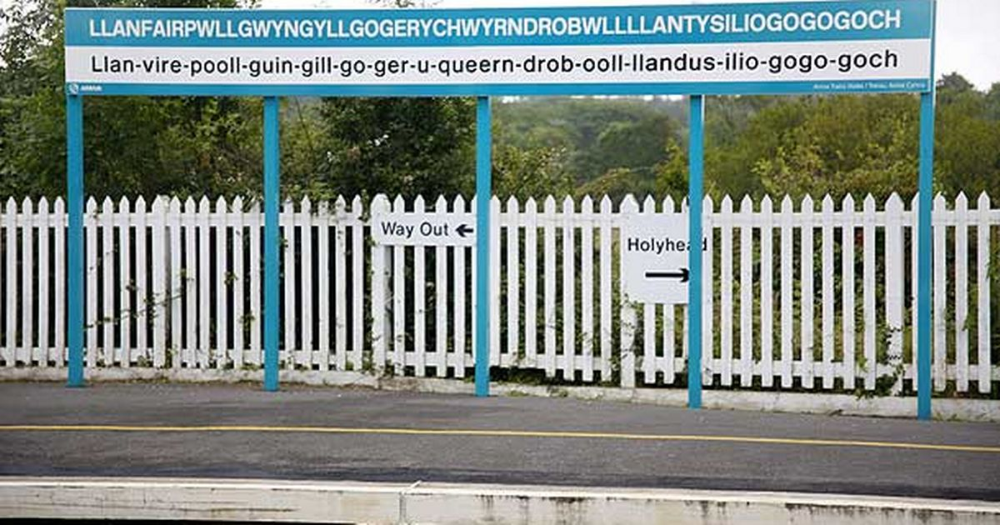
The longest place name in Europe is in Wales!

Slide 11
Meaning?
"St Mary's church in the hollow of the white hazel near to the fierce whirlpool and the church of St Tysilio of the red cave"

Slide 12
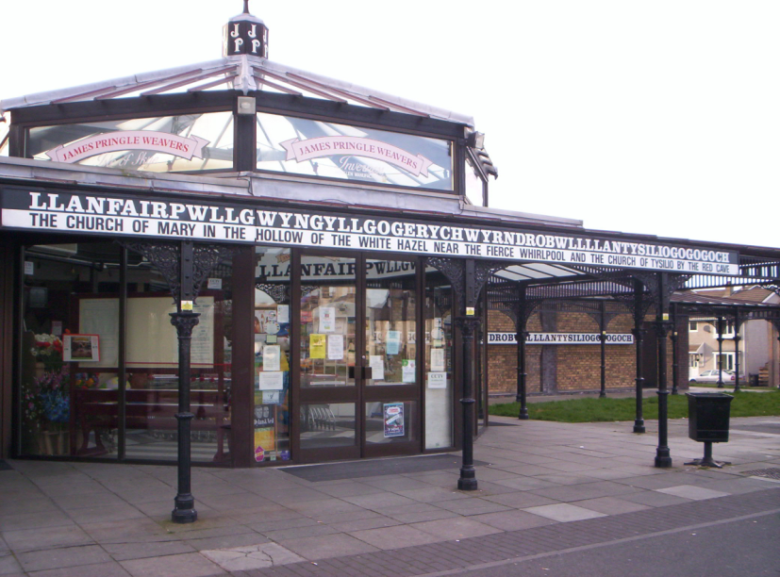
Enw hir - Cymru
https://www.youtube.com/watch?v=fHxO0UdpoxM
https://www.youtube.com/watch?v=1BXKsQ2nbno
The longest place name in Europe.

Slide 13
Diolch! Hwyl!
Mwynhewch eich amser yma yng Nghymru.

