Slide 1
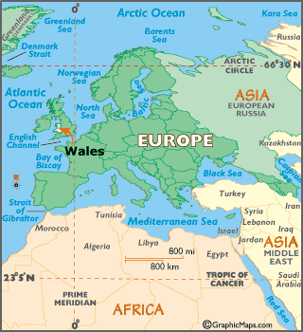
WALES CYMRU

Slide 2
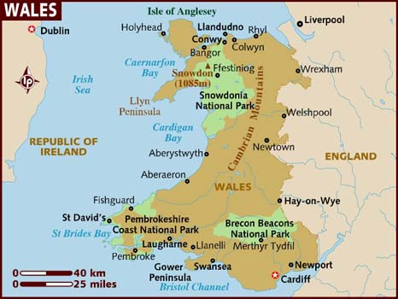
FACTS ABOUT WALES
CAPITAL- Cardiff
OFFICIAL LANGUAGES-Welsh and English
POPULATION-3,063,456
CURRENCY-Pound Sterling
ANTHEM~Hen Wlad Fy Nhadau
FLAG~

Slide 3
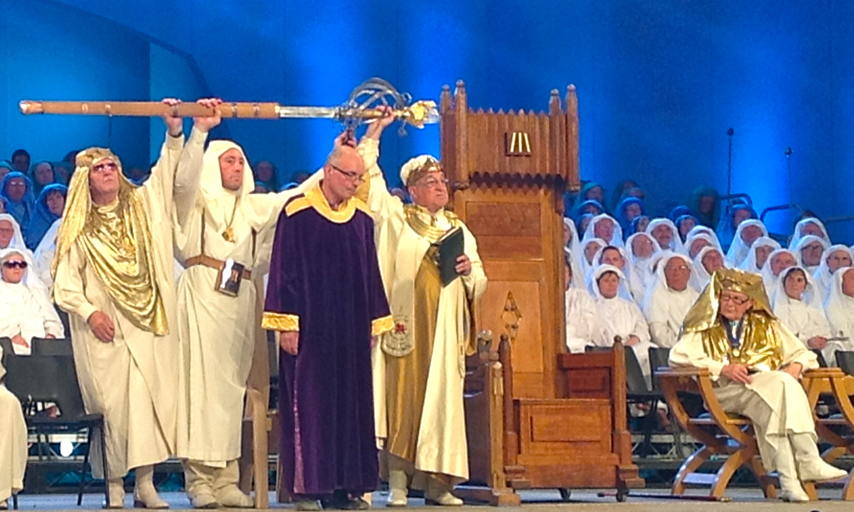
TRADITIONS
Welsh Love Spoons are a tradition dating back to the 17th century and make a great gift for many occasions.
Welsh recipes include Welsh cakes and cawl which is similar to a thick, chunky soup.
St Dwynwen’s Day, each year on the 25th January we celebrate Diwrnod Santes Dwynwen to show our love to one another.
The Harp is regarded as our national instrument.
Each year, many people in Wales enjoy participating in the National Eisteddfod. It is a national celebration of the Arts (music, literature, dance and drama)

Slide 4
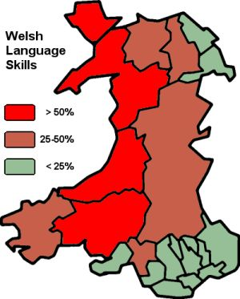
WELSH LANGUAGE
Welsh is a Celtic language spoken in Wales by about 740,000 people, and in the Welsh colony in Patagonia, Argentina by several hundred people.
Some Simple Welsh Phrases:
‘Shwmae’ - This is the general polite greeting. It means hello or how are you?.
‘Bore da’ - Good morning
‘Llanfair­pwllgwyngyll­gogery­chwyrn­drobwll­llan­tysilio­gogo­goch’ - a town in north Wales

Slide 5
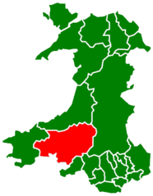
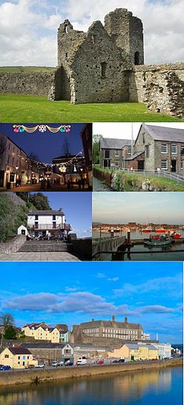
CARMARTHENSHIRE - Where we live
County Town: Carmarthen
Largest Town: Llanelli
Population: 185,000
Language: Welsh/English

Slide 6
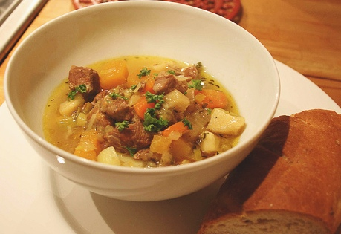
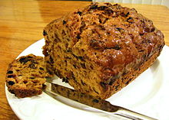
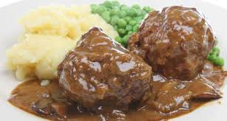
Traditional Welsh Dishes
A traditional dish that most people in Wales like to eat is Cawl, this is a type of broth(thinner than soup) with pieces of cut up vegetable and meat in it. It is served warm and usually with homemade bread.
A traditional dessert is Bara Brith, this is a fruit loaf with raisins and currents but also sometimes with dried red fruits.
Many people also like the meal faggots, chips, peas and gravy. Faggots are basically scraps of meat wrapped in bacon with onions and breadcrumbs.

Slide 7
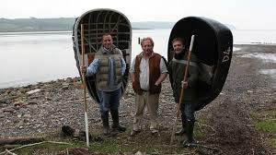
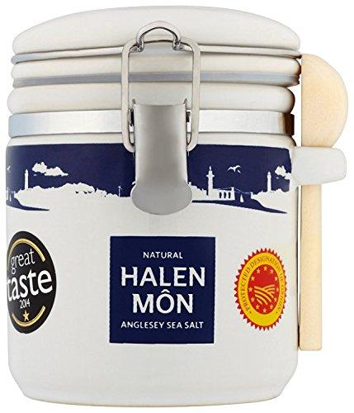
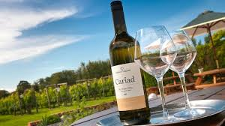
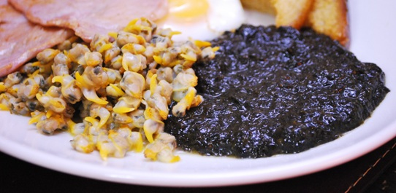
Agricultural Products
Wales is a wet and mountainous country with much land unsuitable for growing crops. The Welsh countryside is dominated by one animal in particular - the sheep.
Many Welsh products now have European Union protected status. This includes Welsh lamb and beef, coracle caught salmon, Halen Môn, Carmarthen Ham and even Welsh Wine!
As many Welsh towns are by the coast, fish and seafood products such as cockles and laverbread (seaweed) were eaten traditionally throughout Wales. The full Welsh breakfast typically includes these two ingredients along with bacon, eggs, mushrooms and beans.

Slide 8
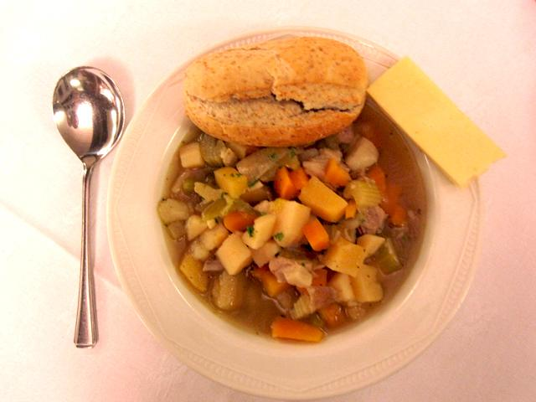
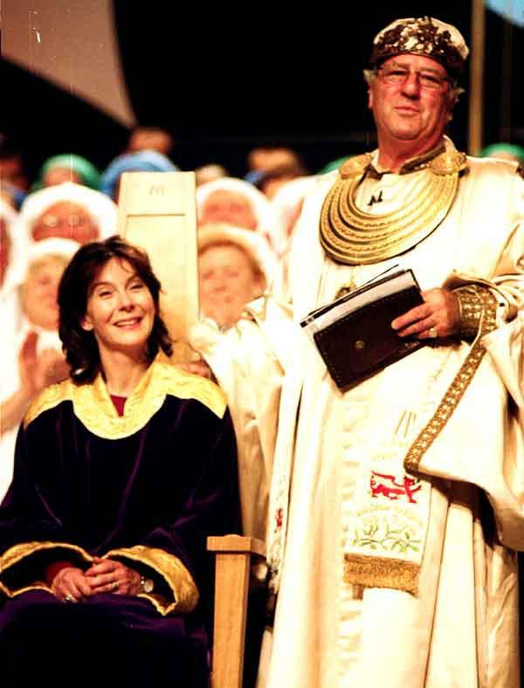
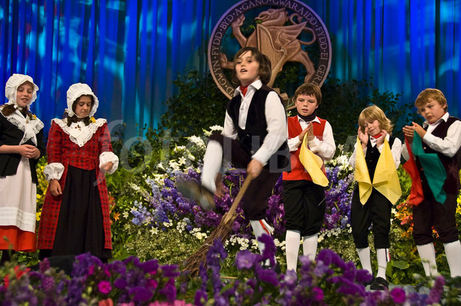
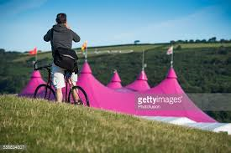
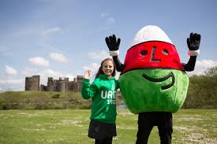
Special Occasions - Eisteddfod/Cawl a Chân
https://www.youtube.com/watch?v=15ehsXVghr0
The Eisteddfod is one of Wales’ most ancient traditions. Its roots date back to 1167 when the Lord Rhys invited poets and musicians to Cardigan Castle. The Eisteddfod is an arts competition where people of all ages compete in poetry, reciting, singing and playing instruments. Every school, village and town has its own Eisteddfod.
Llangollen International Eisteddfod sees choirs and folk dancers from around the world compete. The most prestigious prizes awarded at these Eisteddfodau are the Chair and the Crown which are awarded for the best traditional and free verse poetry.
Another special occasion is ‘Cawl a Chân’. This is a tradition where people get together to eat our national dish ‘Cawl’, sing traditional Welsh songs and meet friends. This normally happens around St David’s day (March 1).

Slide 9
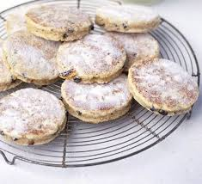
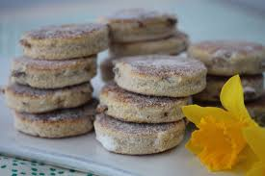
Welsh Cakes
http://www.visitwales.com/explore/traditions-history/recipes/welsh-cakes

Slide 10
What are Welsh Cakes?
Welsh cakes are traditional in Wales.
They are a cross between a cookie, scone and a pancake.
They are also known as bakestones because they are traditionally cooked on a bakestone which is a cast iron griddle.
They can served hot or cold and are roughly circular.
They contain dried fruits such as raisins or currants.

Slide 11
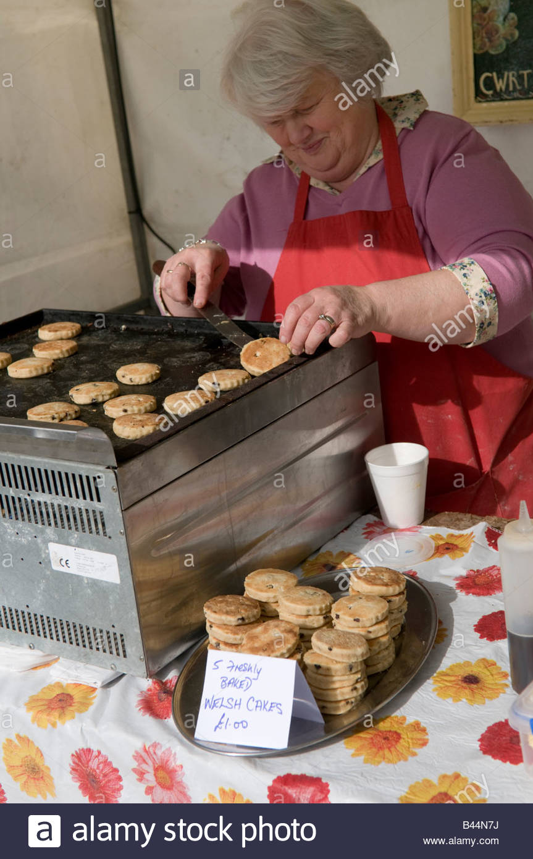
Ingredients
These ingredients make enough for 16:
225g plain flour
½ a teaspoon of baking powder
A pinch of salt
75g caster sugar
1 teaspoon of mixed spice
110g of butter cut into small pieces
75g currants/sultanas
1 large egg, beaten
A splash of milk if needed
*This is the traditional welsh cake recipe but some people like to swap the currants for other ingredients such as glacier cherries.

Slide 12
How To Make Welsh Cakes?
Sift the dry ingredients (flour, baking powder, mixed spice) together into a mixing bowl.
Cut up the butter and add to the flour. Rub in.
Stir in the sugar and fruit, pour in the egg and mix to form a dough. Use a little milk if the mixture is a little dry.
Roll the dough out on a lightly floured surface to about the thickness of 1cm. Use a pastry cutter to cut out rounds of diameter 5-6cm.
Cook the cakes on a greased bakestone or griddle until golden, turning halfway through. The heat should not be too high, as the cakes will cook on the outside too quickly, and not in the middle.
Once cooked, sprinkle with caster sugar.

Slide 13
