Slide 1
LEADING LIGHTS IN EUROPE
MELILLA, 24-28 DE ABRIL DE 2017

Slide 2
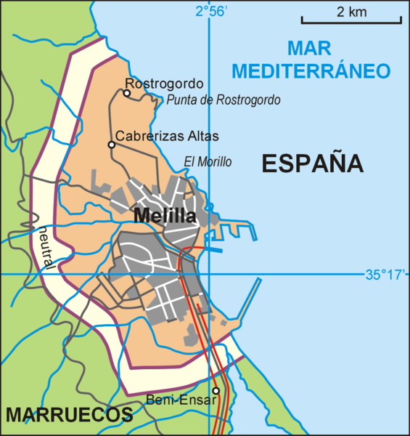
MELILLA: ONE CUISINE, TWO CONTINENTS, SEVERAL CULTURES

Slide 3
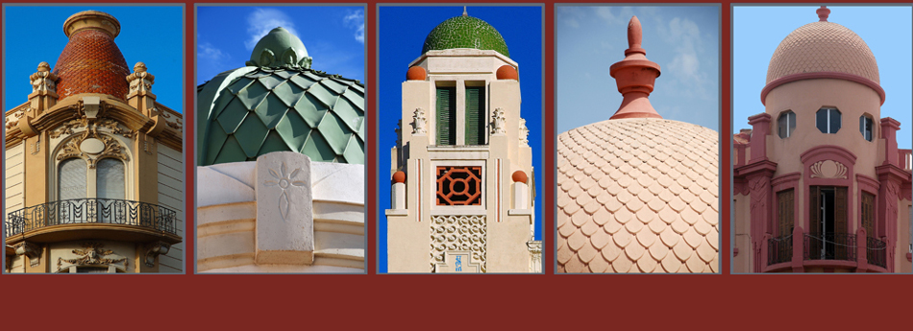
MELILLA HAS GOT A RICH AND VARIED GASTRONOMY, REFLECTION OF THE DIFFERENT CULTURES WHICH LIVE TOGETHER IN THE CITY ( MAINLAND SPANISH, ARAB, BEREBER, HEBREW AND HINDU)

Slide 4
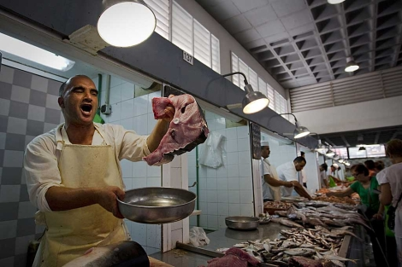
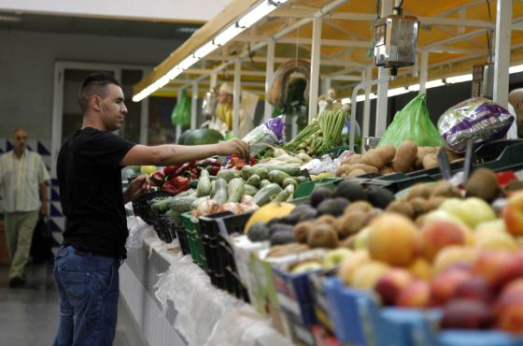
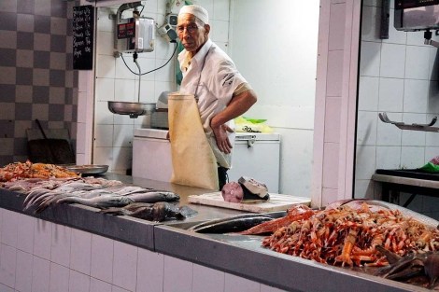
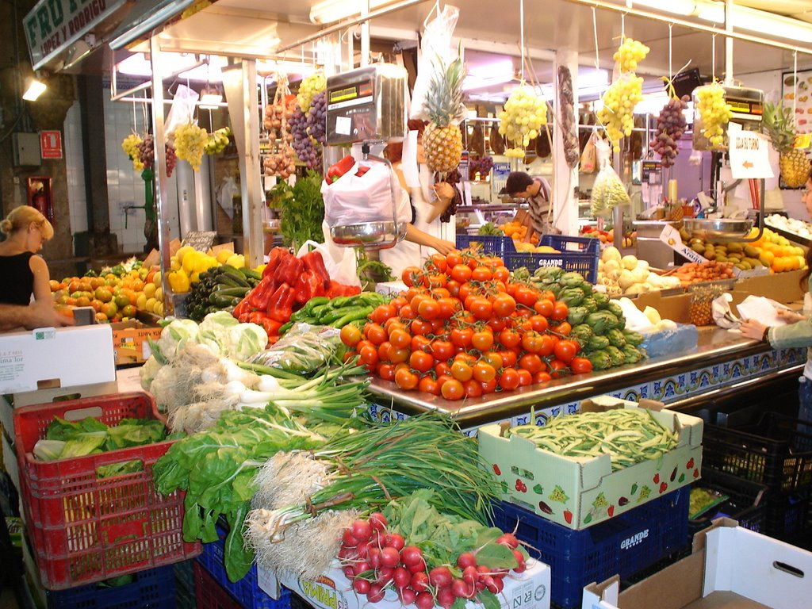
MARKETS OFFER ALL KINDS OF FOOD COMING FROM EUROPE AND AFRICA , THAT ARE MIXED IN THE KITCHEN.

Slide 5
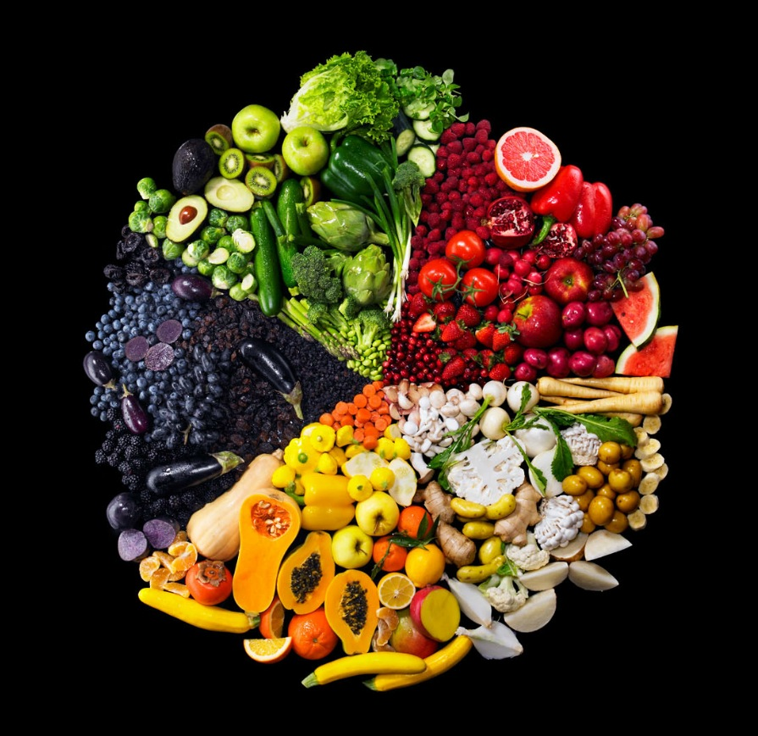
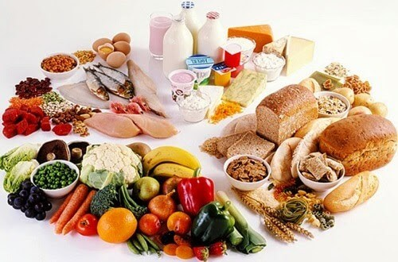
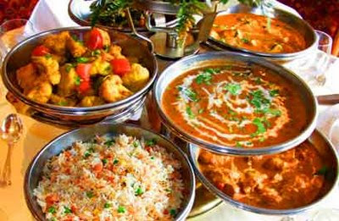
THE RESULT IS A BIG VARIETY OF DISHES AND INGREDIENTS FROM DIFFERENT ORIGINS, WHICH IF WELL COMBINED, PROVIDE A COMPLETE, BALANCED AND HEALTHY DIET.

Slide 6
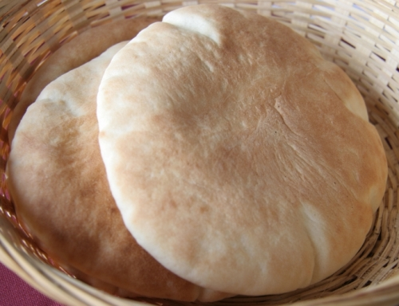
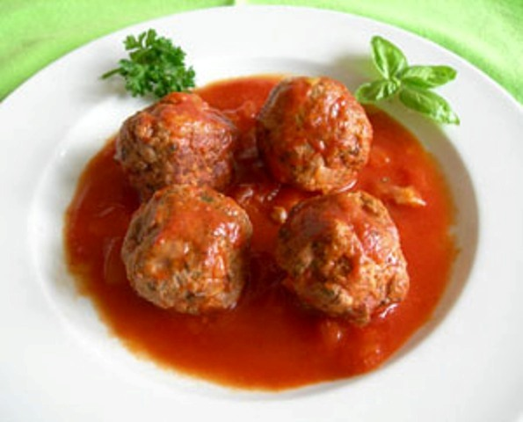
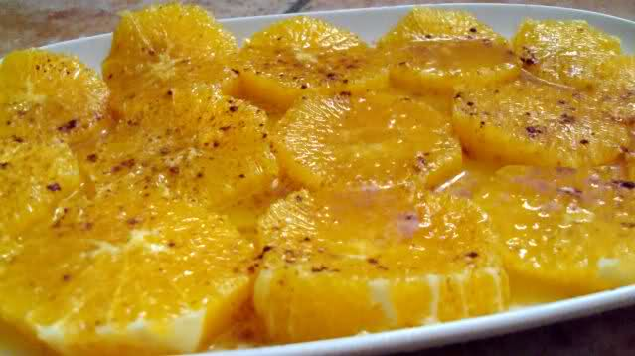
THE MODEST DISHES ARE PREPARED AT HOME EVERY DAY, ECONOMIC AND NUTRITIVE.

Slide 7
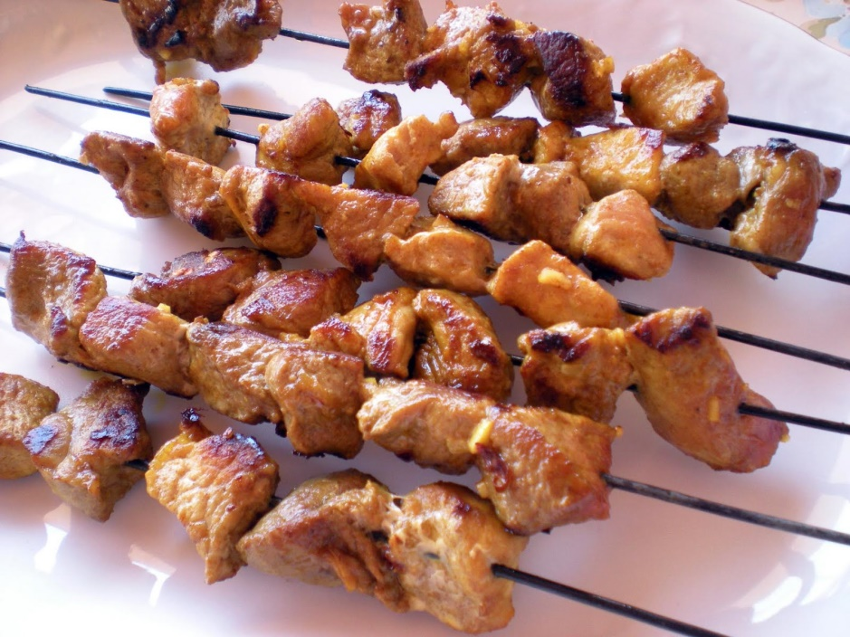
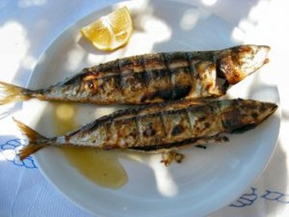
THE MOST POPULAR ONES ARE OFFERED IN RESTAURANTS AND BARS TO BE TASTED BY ALL (IN TAPAS AND RACIONES).

Slide 8
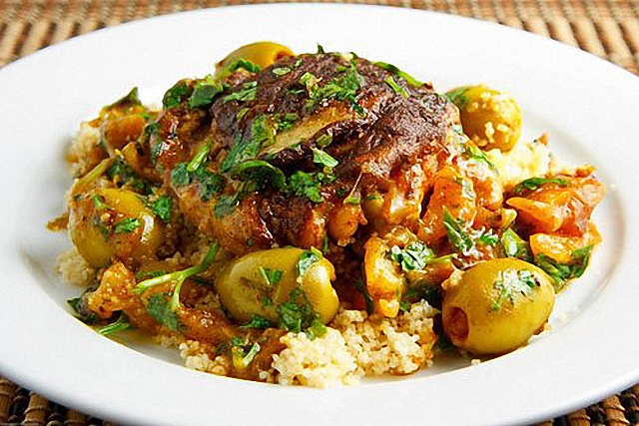
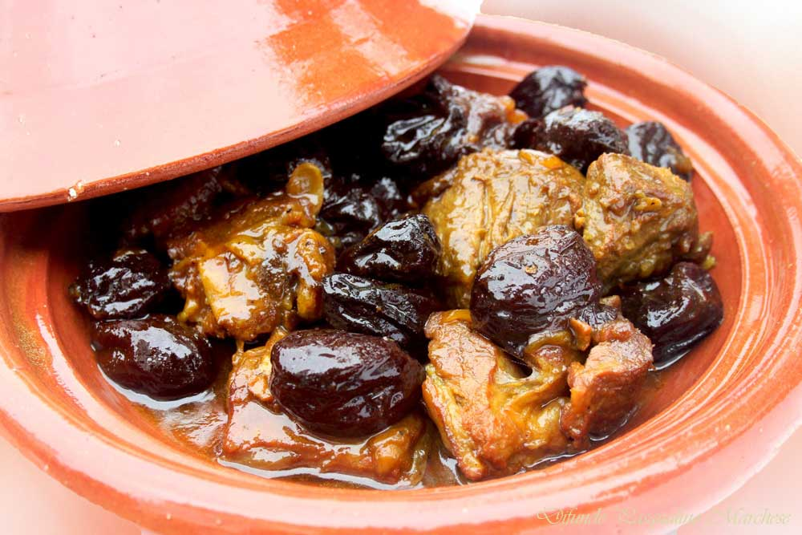
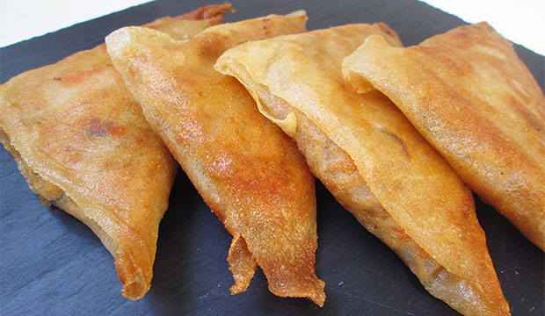
AND THE MOST COMPLETE AND ELABORATE DISHES ARE TASTEED AND SHARED IN THE RELIGIOUS CELEBRATIONS.

Slide 9
THE COEXISTENCE BETWEEN CULTURES IS ESPECIALLY REFLECTED IN A DRINK AND A DISH...

Slide 10
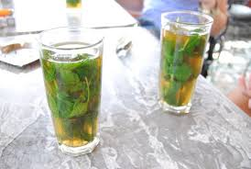
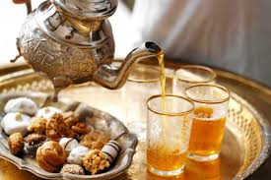
ONE IS THE MINT TEA: A BEREBER HOT DRINK, VERY POPULAR IN MELILLA, WHICH IS DRUNK IN BREAKFASTS, AFTER LUNCH OR IN THE AFTERNOONS, TOGETHER WITH BEREBER PASTRIES.

Slide 11
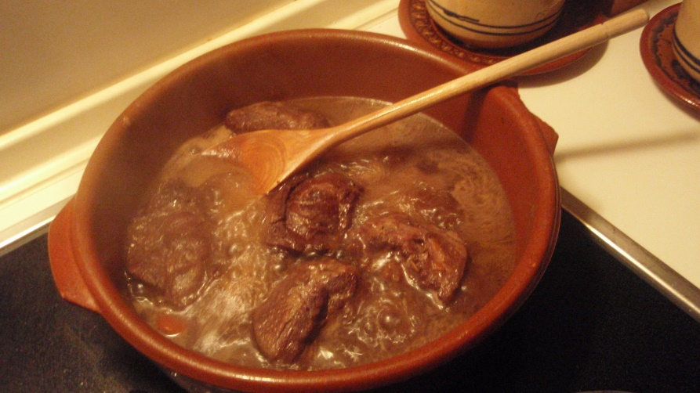
THE OTHER IS THE FOUR COMMUNITIES STEW: A DISH WHICH IS MADE WITH INGREDIENTS FROM THE 4 DIFFERENT CULTURES: HEBREW BISCUITS, MOROCCAN CARROTS AND PEPPERS, HINDU SPICES AND BEEF TONGUE.

Slide 12
And although each dish has a different origin, everyone likes to taste ...

Slide 13
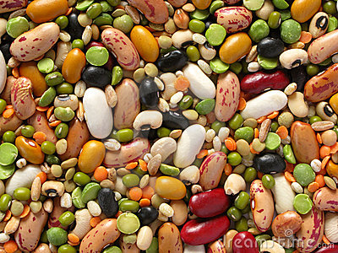
CEREALS AND LEGUMES
THEY ARE PRESENT IN MOST OF THE DISHES BECAUSE THEY PROVIDE US WITH A LOT OF ENERGY.

Slide 14
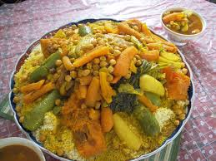
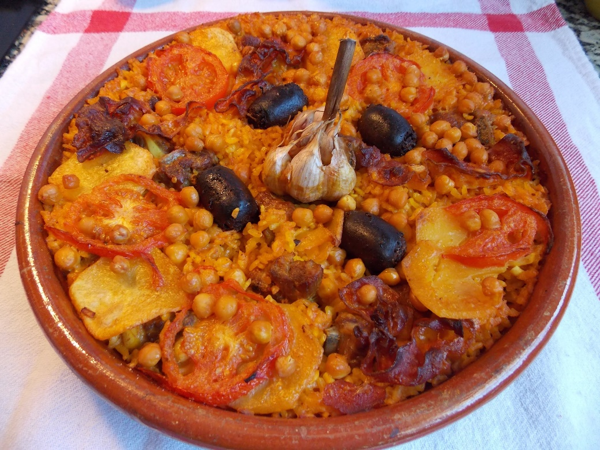
WE CAN TRY TWO SPICED DISHES WITH BEREBER AND ARAB INFLUENCE…
VEGETABLES AND MEAT COUS COUS
BAKED RICE

Slide 15
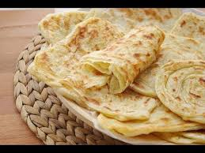
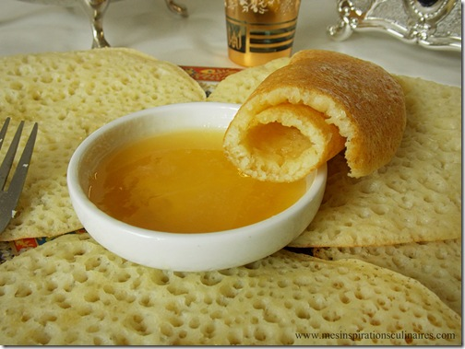
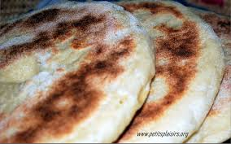
FROM THE SAME ARAB AND BEREBER ORIGIN, WE HAVE DIFFERENT TYPES OF BREADS AND DOUGHS:
PAÑUELOS O MSEMMEN
JERINGOS O BAGHRIR
TASH-NIF O MATLOUA

Slide 16
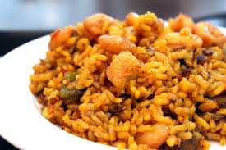
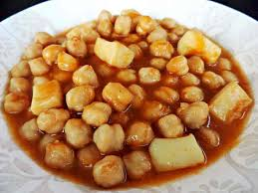
UNDER ANDALUSIAN INFLUENCE WE HAVE DELICIOUS DISHES SUCH AS…
RICE COOKED WITH CHICKEN AND SEAFOOD
STEWED CHICKPEAS WITH CUTTLEFISH

Slide 17
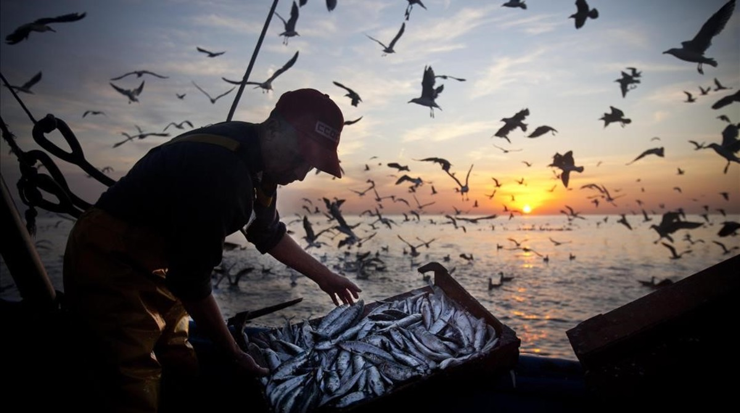
FISH AND SEAFOOD
BY TRADITION AND RESOURCES, FISH IS PREFERRED TO MEAT, AND EACH CULTURE COOKS IT ACCORDING TO THEIR LIKES…

Slide 18
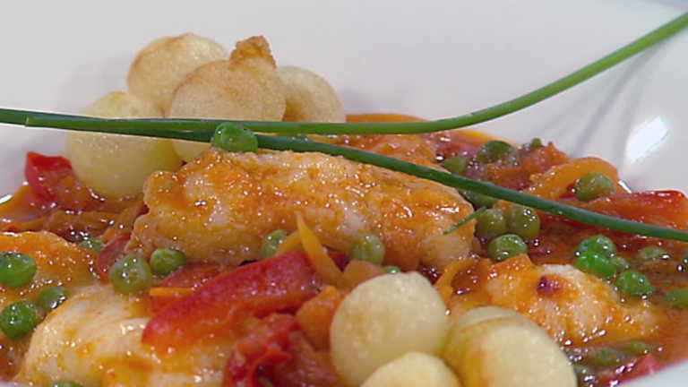
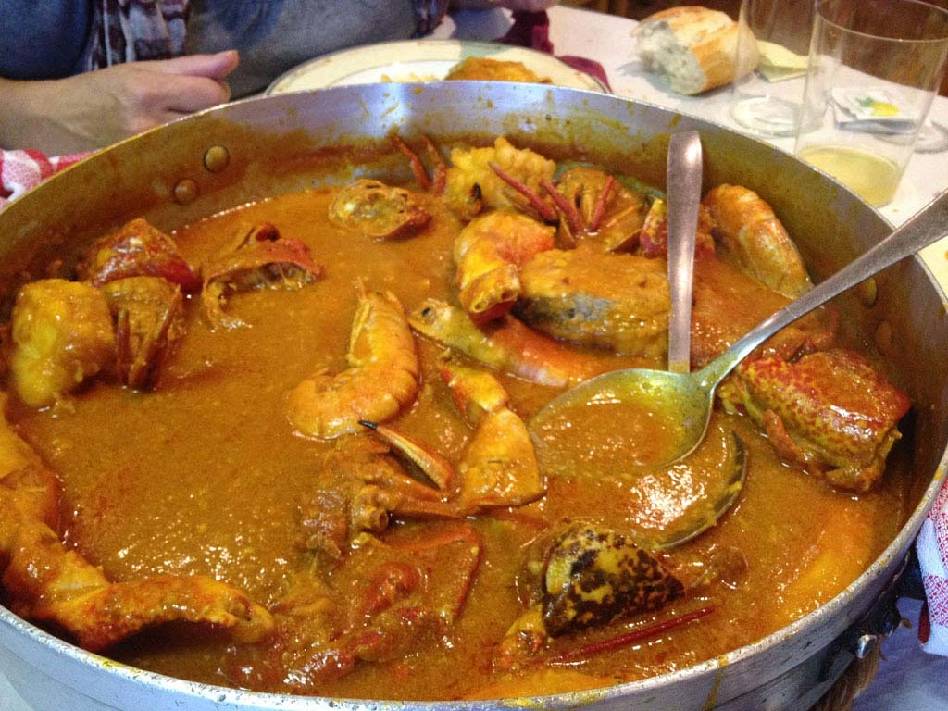
STEWED FISH AND POTATOES ( ANDALUSIAN STYLE)
STEWED FISH ( GALICIAN STYLE)

Slide 19
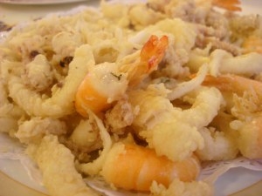
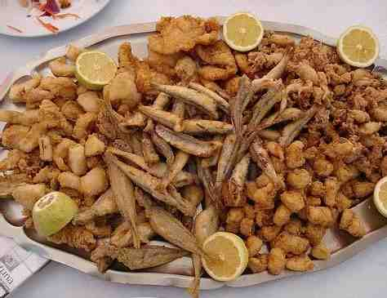
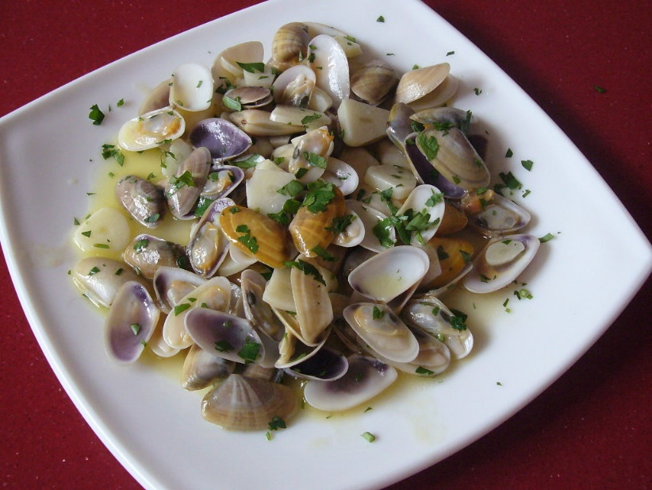
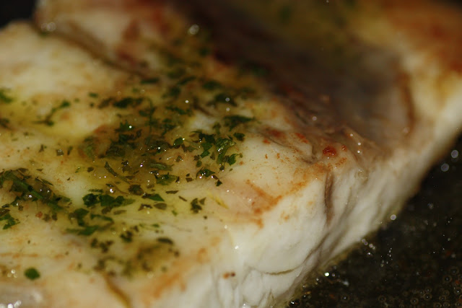
FRIED FISH ( ANDALUSIAN STYLE)
GRILLED FISH AND SEAFOOD ( MAINLAND SPAIN INFLUENCE)

Slide 20
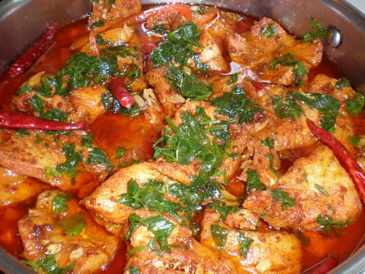
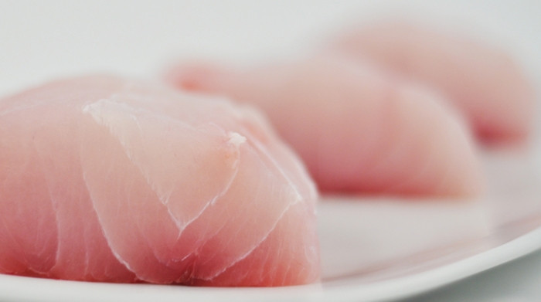
“COCHO” FISH (HEBREW STYLE)

Slide 21
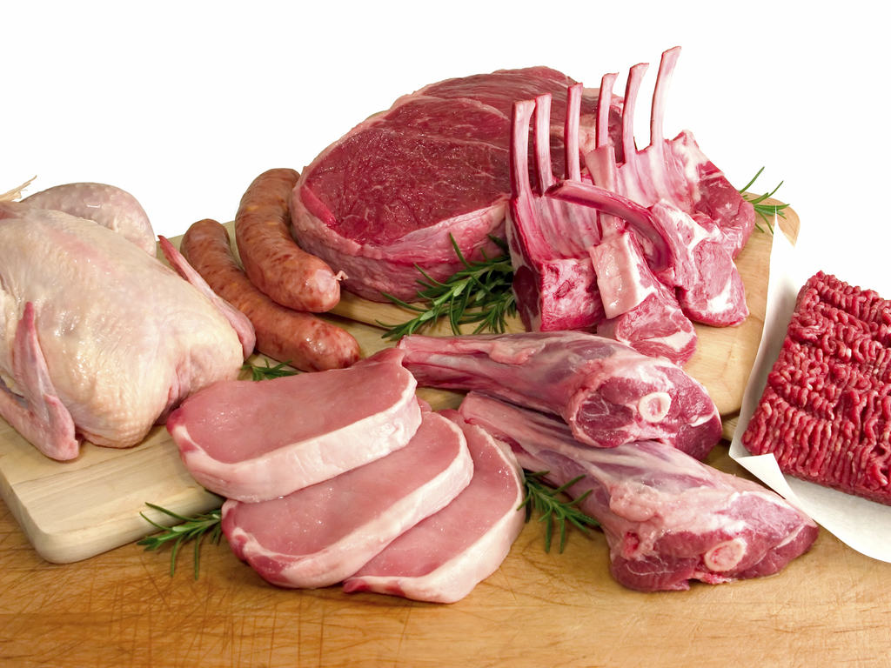
MEAT AND POULTRY
CHICKEN, LAMB AND BEEF ARE PREFERRED TO PORK BECAUSE OF RELIGIOUS AND HEALTHY HABITS REASONS.

Slide 22
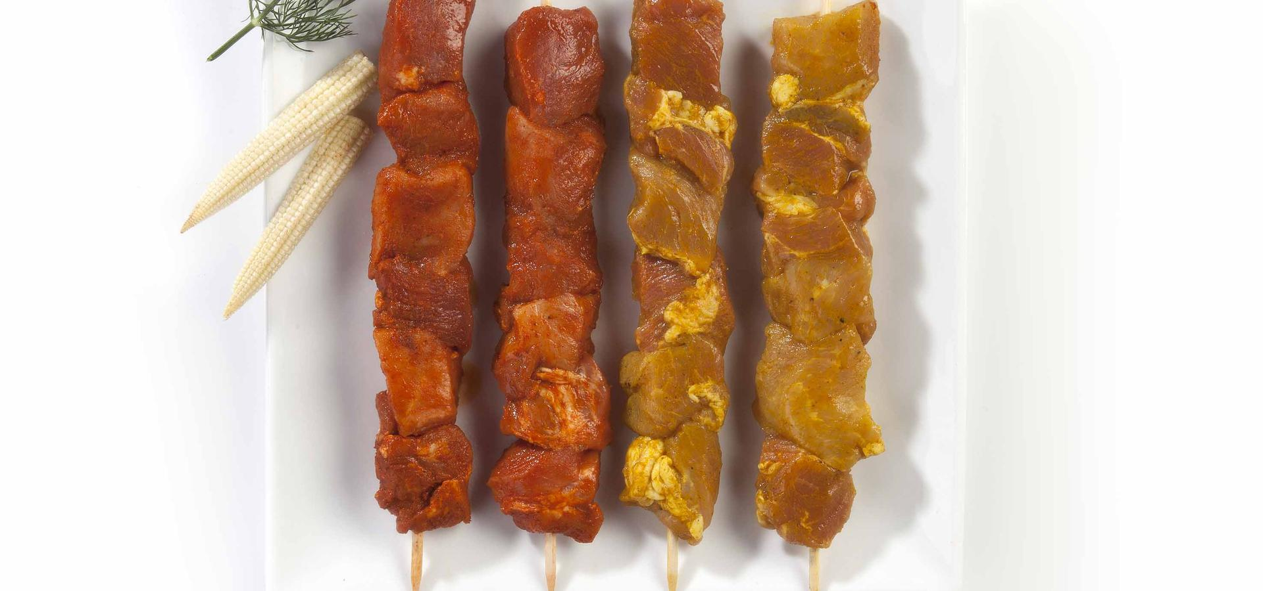
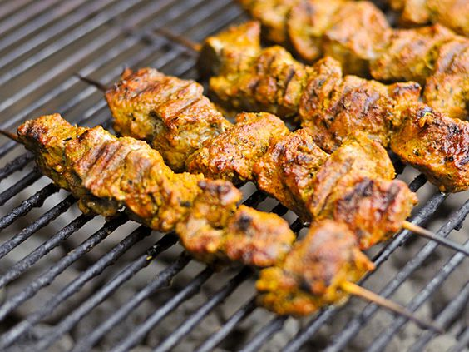
BEREBER BROCHETTES ARE SPICED PORTIONS OF MEAT, SKEWED ON A STRING TO BE GRILLED SLOWLY

Slide 23
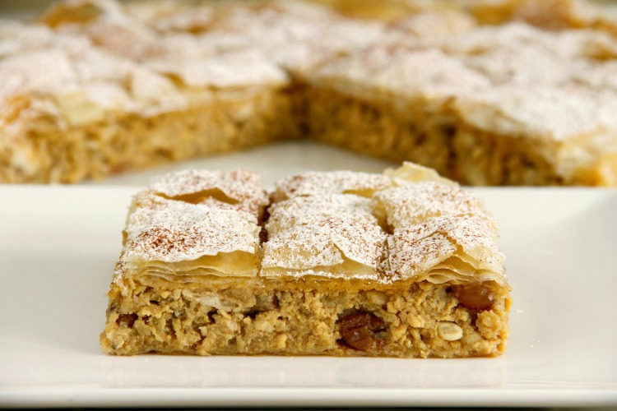
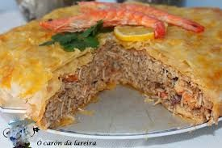
BEREBER PASTELA IS A STUFFED CAKE, WITH A TOUCH OF CINNAMON AND SUGAR

Slide 24
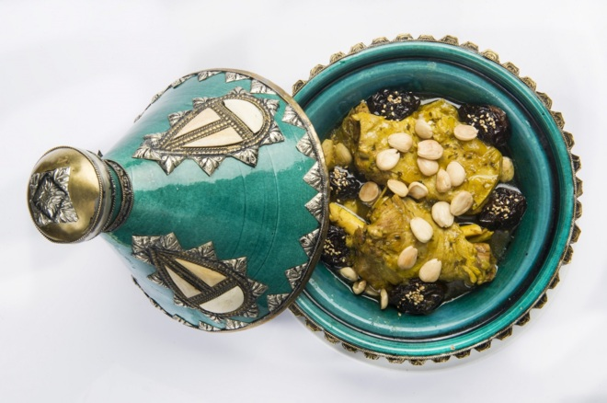
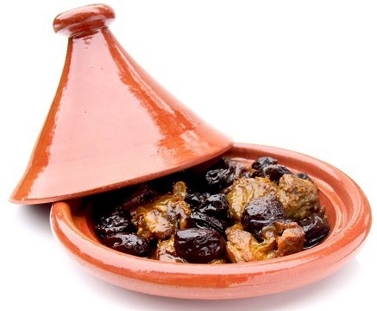
LAMB, CHICKEN OR BEEF TAJINE IS A DISH ELABORATED WITH SEASONED MEAT, VEGETABLES, RAISINS, AND DRIED FRUITS. ITS NAME COMES FROM THE TYPICAL ARAB POT WHERE IT MUST BE COOKED

Slide 25
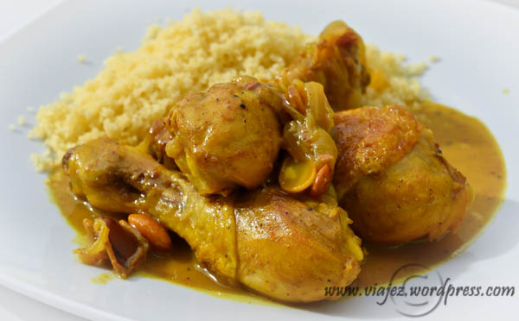
MOROCCAN STYLE CHICKEN IS MADE WITH ONIONS, SPECIES, FRIED FRUITS (RAISINS AND ALMONDS) AND CINNAMON

Slide 26
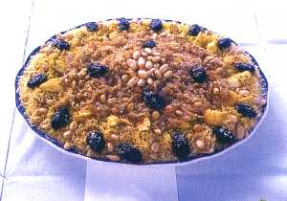
CORINTO NOODLES IS A BEREBER DISH MADE OF CHICKEN, ONION SAUCE, SPECIES AND FRIED FRUITS

Slide 27
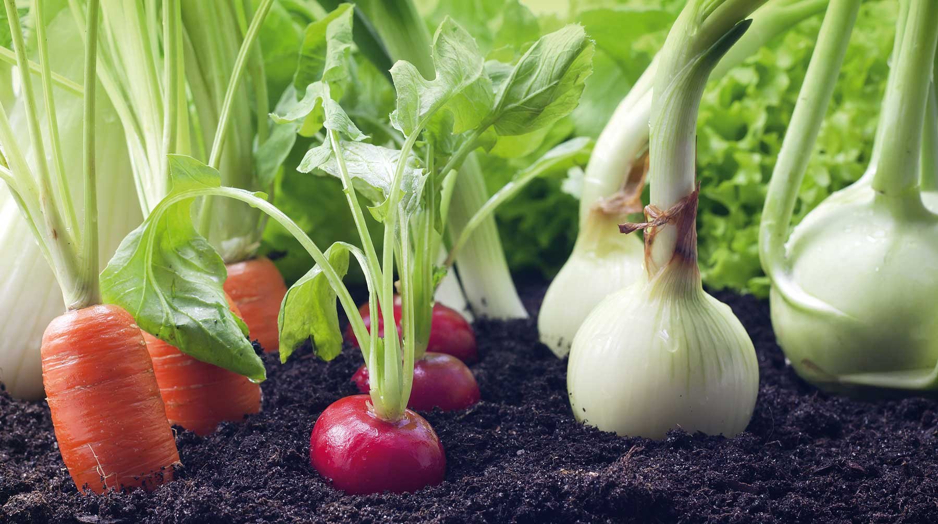
VEGETABLES
THE BEST VEGETABLES COME FROM AFRICA AND MAKE RECIPES COLOURFUL AND TASTY.

Slide 28
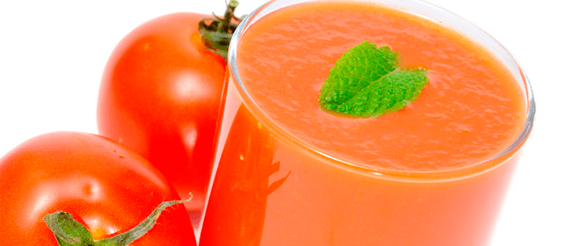
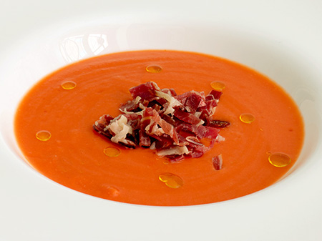
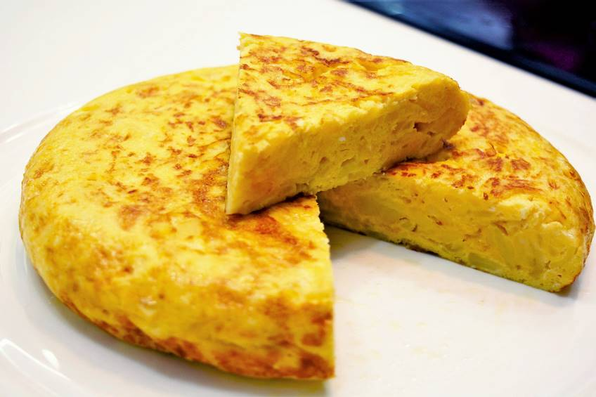
UNDER ANDALUSIAN AND MAINLAND SPANISH INFLUENCE WE FIND:
GAZPACHO, COLD TOMATO SOUP
SALMOREJO, COLD TOMATO CREAM WITH BREAD AND OLIVE OIL
SPANISH OMELETTE

Slide 29
OF HEBREW ORIGIN…
WE HAVE THE COLORED OMELETE, MADE WITH PEAS, CARROTS AND POTATOES
AND OF HINDU ORIGIN, WE HAVE THE SAMOSAS, CRUNCHY PASTIES STUFFED WITH VEGETABLES AND SPICES

Slide 30
IN MELILLA, TO TRAVEL TO FAR AWAY COUNTRIES, YOU ONLY HAVE TO SIT AT THE TABLE, TASTE, SHARE AND ENJOY.

Slide 31
IN THIS PRESENTATION HAVE COLLABORATED ...
THE STUDENTS OF THE
TEMPORARY ATTENTION CLASS (AAT)

Slide 32
AICHÄ SALGADO
MARTÍNEZ
FIRDAOUSSE BENNAKRITA
IKRAM JAMAIL
ALANIS DOMÍNGUEZ
SALGADO
HAYAR MAAROUF
AMINA EL ASBAHANI BADR
HOUDA OUALI
ASSIA NAZIL
SARA LAICH
DUNIA MAÁROUF
YASMINA EL GHOUL
DUNIA WARDA
FATIMA RAWAN
YOUSRA EL BOUARFAOUI

