Slide 1
Italian CUISINE
A MUST-TRY FOOD

Slide 2
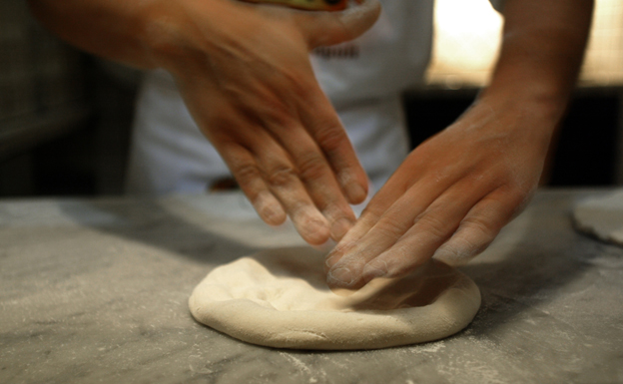
THE MAIN
ASPECTS
Conviviality and joy
Three main courses for lunches
Traditions
Endless chats and family gatherings

Slide 3
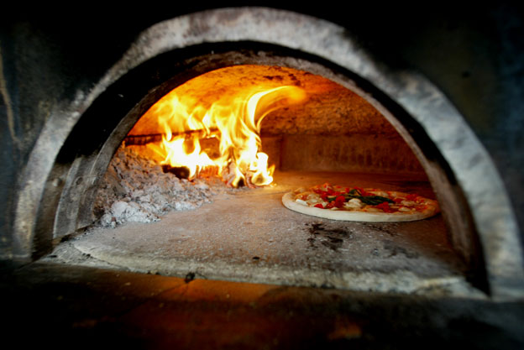
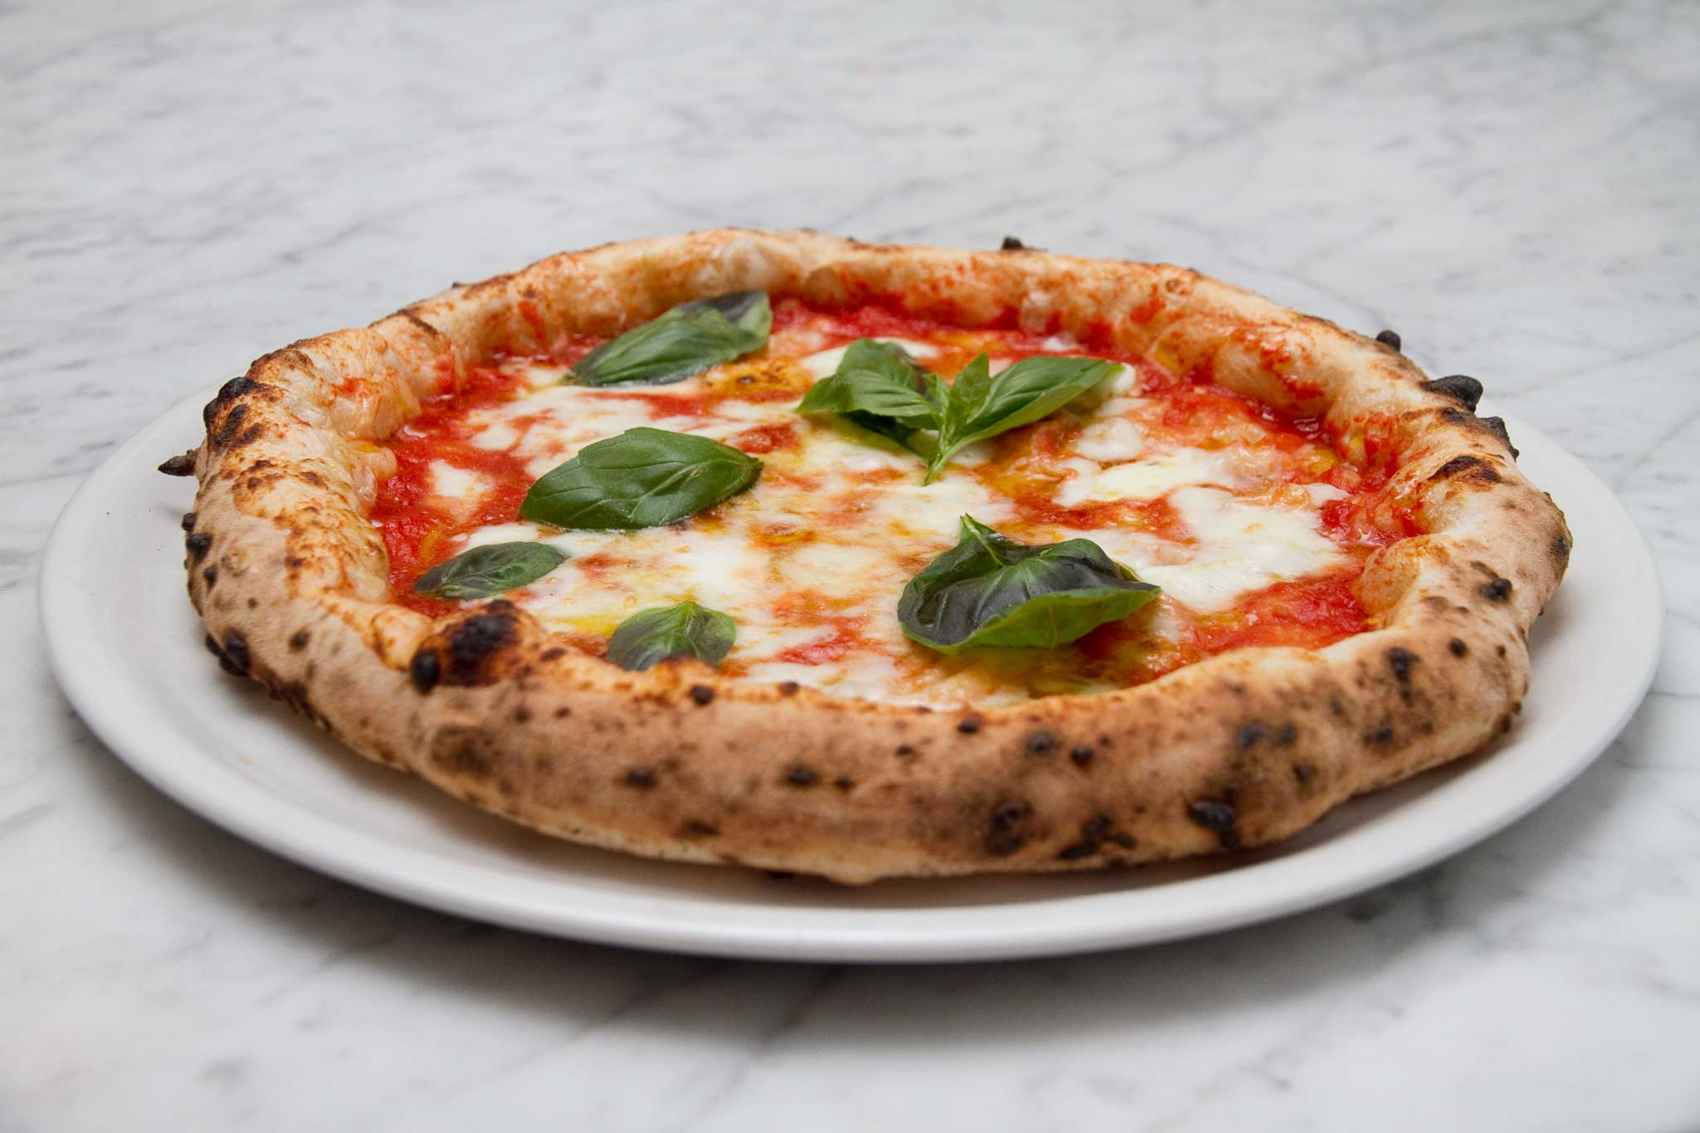
pizza
The italian flag
Born in 1889, but still tasty!
Recipe
Cooking
Eating methods

Slide 4
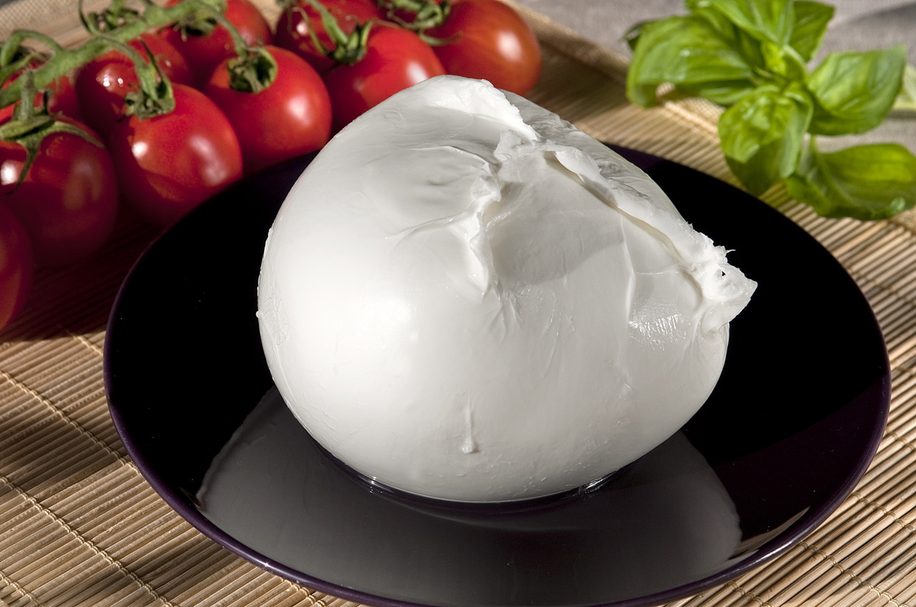
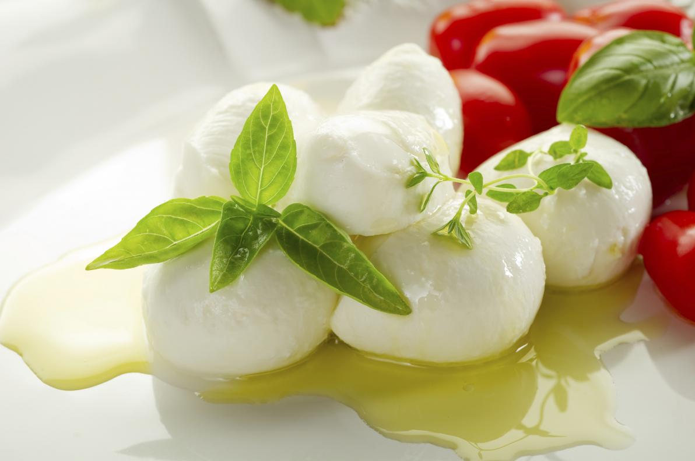
MOZZARELLA
A success story!
Born in Caserta
The name and its meaning
The daughter of buffalo

Slide 5
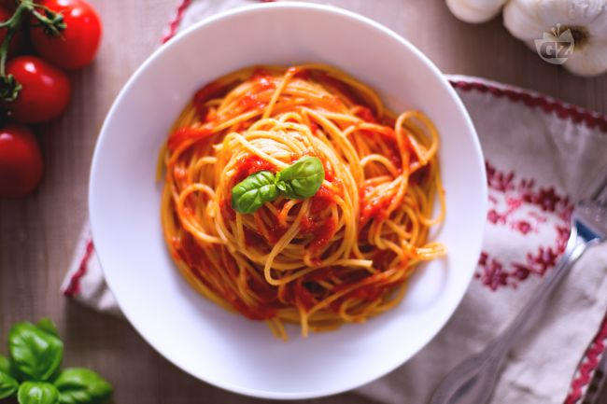
pasta
INGREDIENTS
1 tablespoon olive oil
1 brown onion, chopped
2 garlic cloves, crushed
1 x 800g can Italian diced tomatoes
A pinch of salt
… and of course, a lot of pasta

Slide 6
pasta
HOW TO COOK
Step 1: heat the oil, add the onion and garlic
Step 2: stir the tomatoes and bring to the boil
Step 3: stir in the parsley ,add salt and taste
Step 4: cook the pasta and drain it
Step 5: add the sauce to the pasta and serve it

Slide 7
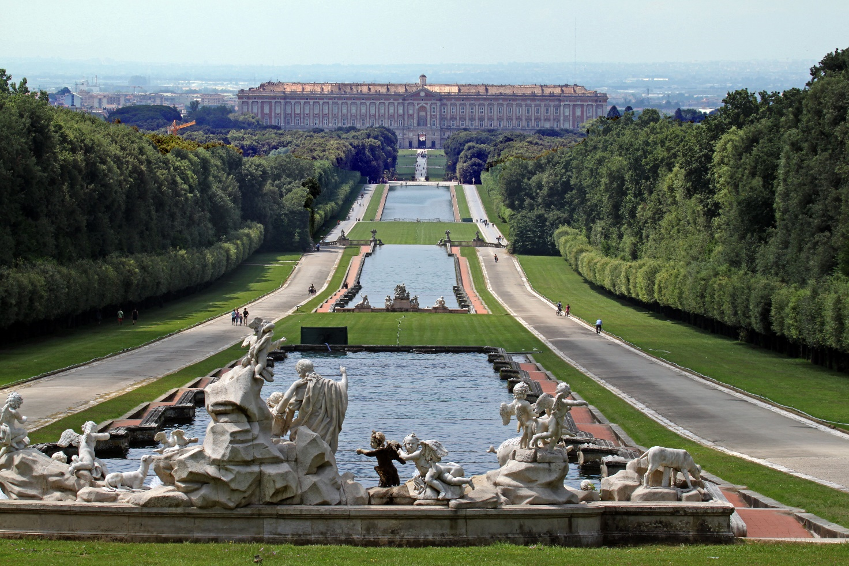
Now that you know our TRADITIONS,
Just come and visit our country!

