Slide 1
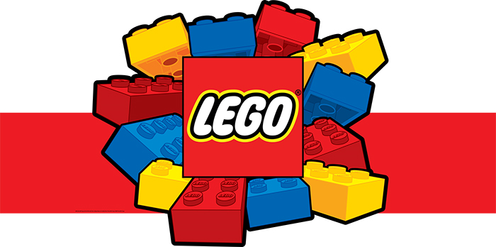
Notes:
Good morning and welcome to LEGO intervention.

Slide 2
Lego Intervention Training
Aims of this session
Is to give you an insight of what is LEGO Intervention is,
To give you a brief explanation of the theory behind the use of LEGO kit buildings as an intervention and developing communications skills in children,
How to set up and run a LEGO based intervention group.
And finally how is a LEGO intervention different from other social skill interventions?
Notes:
My aims are to ensure that at the end of this session you will all have an insight of what a Lego intervention is, the theory behind the use of Lego and how it can develop communication skills in children, how to set up and run a Lego intervention group and how this intervention is different from other social skill ineterventions.

Slide 3
Who Benefits from LEGO Interventions?
Pupils with speech and language communication difficulties,
Foundation phase pupils,
Pupils with an Autistic Spectrum Condition,
Pupils with a Hearing Impairment.
Notes:
As you can see the people that would benefit from an intervention like this would be pupils we work with on a regular basis, these include list from the above.

Slide 4
Lego Intervention Training
What Is LEGO Intervention?
Lego intervention is a social development programme.
It is a collaborative play based intervention where children will work together to create or build models.
This type of intervention supports joint attention, shared goals, social communication and interaction.
This intervention can be modified to suit the needs of the children in the group and therefore may never be done the same way.
As children learn best through play this is an excellent activity to get the best out of the child.
Notes:
Lego intervention a social development programme, it is collaborative play based intervention where children work together to build Lego models, it supports joint attention, shared goals, social communication and interaction, it’s common purpose and shared interest can be emphasised and can also be tailored to the needs of the children in the group.
As we all know children learn best through play and this is a good way to ensure that the children are developing as well as ensuring that they are having fun.

Slide 5
Lego Intervention Training
Why do we do LEGO?
Notes:
The reason we do Lego is…….. Use the sheet.

Slide 6
Lego Intervention Training
Background into Lego Intervention
Daniel LeGoff
Developed this idea from the interaction between two boys in his clinic,
Developed joint sessions
Supplemented with individual therapy.
Notes:
Lego-based therapy is a social development programme for young people with autism spectrum disorders or related social communication difficulties. Young people work together to build Lego® models and through this have the opportunity to develop social skills such as turn taking, collaboration and social communication.
Lego, based therapy can be used individually or in groups. Natural opportunities for developing social competence are facilitated by the therapist.
Key to this approach is how engaging and enjoyable it is for the participants! Building Lego collaboratively is great fun, and young people develop social skills while enjoying themselves.

Slide 7
Lego Intervention Training
ACTIVITY
Using the LEGO in front of you get your partner to make a model of your choice.
For this activity you can ONLY use your words. You are NOT to use any other form of communication e.g. no pointing or finding the parts.
Notes:
In this activity we need to remember to use ONLY our words. We are not to use any gestures. This is a difficult task for some people and can lead to children to become frustrated. In this activity I would like you to work in groups of three, you will need a part finder, engineer and builder. ONLY the builder is allowed to put the pieces together.

Slide 8
Lego Intervention Training
In this Activity what social skills did you and your partner use to build your model?
Negotiation
Receptive language
Joint Problem-solving
Conflict resolution
Expressive language
Patience
Tolerance
Self control
Joint attention
Collaboration
Turn taking
Persuasion
Sharing
Empathy
Interacting
Pointing
Notes:
During that activity what social skills did you and your group use?

Slide 9
Lego Intervention Training
What makes a typical LEGO group?
2-3 pupils in a group
1 full Lego kit to build
A teacher/LSA
1 set of rules
1 visual time table
Other visual props as needed (this depends on the group)
Pupil target and assessment sheet
An observation and evaluation form.
Notes:
As you can see from the list on the board this is for a small group only at one time. It is important to allow the children to work together while only being observed by a staff member however the staff member will intervene if needed and this intervention is not a free play session.
A rule card is also given, these rule cards are to be done by the children before the session begins.
The target and assessment sheet should be done at the start of each term and also at the end of the term to check the development of the child. I have a copy of the target and assessment sheet on slide 13.

Slide 10
Lego Intervention Training
LEGO club rules
Notes:
As with any intervention there are rules and this intervention is no different. The rules for these sessions would be as above.

Slide 11
Lego Intervention Training
How to structure a session?
Greetings
Group review
Go over the rules
Role assignment
Building (10 minutes per role)
Discuss the model
Praise and evaluate.
Notes:
It is important to start the session off with a good morning how are you all feeling, this will give you an idea of how the session will run, during the group review we would discuss the activities for this session, we would also go over the rules and check that they all understand.
We would then decide who was going to be assigned each role, discuss what each role involves. They would work in these roles for 10 minutes before swapping to play another role.
At the end of the 30 minutes you have a discussion about what they have built and possibly take pictures so that they can keep. Once that has been done the model would need to be dismantled and put away. You would praise the children and give them a What Went Well and an Even Better If (those would need to be specific). The children would also have a chance to praise eachother.

Slide 12
Lego Intervention Training
LEGO kit building
Part Finder
Engineer
Builder
Notes:
The builder role: the builder is the only person in the group that is allowed to build the model, the part finder is the only person in the group that is able to search for the lego part required and the engineer is the one that gives the instructions to the rest of the group. This is beneficial to Numeracy and literacy. It also allows turn taking, patience negotiation, listening and problem solving.

Slide 13
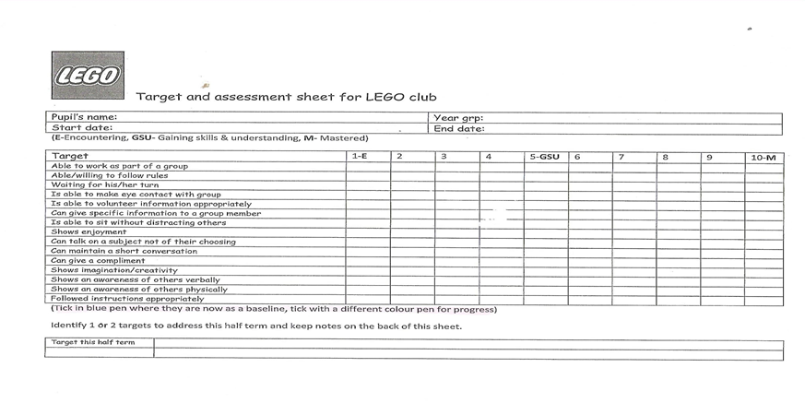
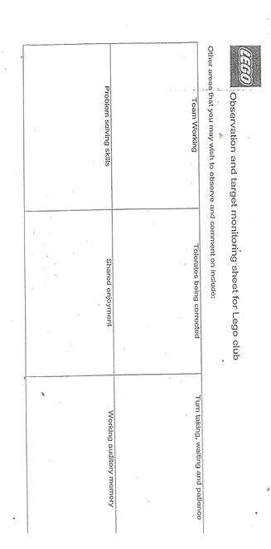
Lego Intervention Training
How to measure progress?
We measure progress through using these sheets.
Notes:
Show the sheet to all staff
The sheet is to be completed by the same member of staff, this is due to the fact that everyone has a different way of marking. There is no right or wrong was to do it its just how you think .

Slide 14
Lego Intervention Training
LEGO intervention is also a good way to help develop language. As well as language for social needs you should also consider:
Colours
Numbers
Shapes and sizes
Prepositions
Patterns
Questions
Instructions.
This is a great tool for barrier games.

Slide 15
Lego Intervention Training
How is LEGO intervention different from other social skills interventions?
Notes:
This is a more natural intervention and is more realistic. It is also different in the way that it is lead by the children not the adult.

Slide 16
Lego Intervention Training
What Next?
LEGO intervention should be set up and timetabled for once a week.
Baseline assessments need to be filled in every half term.
Set at least 1 target for each pupil
Reassess at the beginning of a new term to measure pupil/s progress and set new targets.

Slide 17
Lego Intervention Training
Online Resources
http://club.lego.com/en-gb/
You can join an online club and send pictures of the work/models you and your peers have created,
Design your own models online
Play LEGO games
And plenty more ☺

Slide 18
Lego Intervention Training
THANK YOU FOR LISTENING, ANY QUESTIONS??

