Slide 1
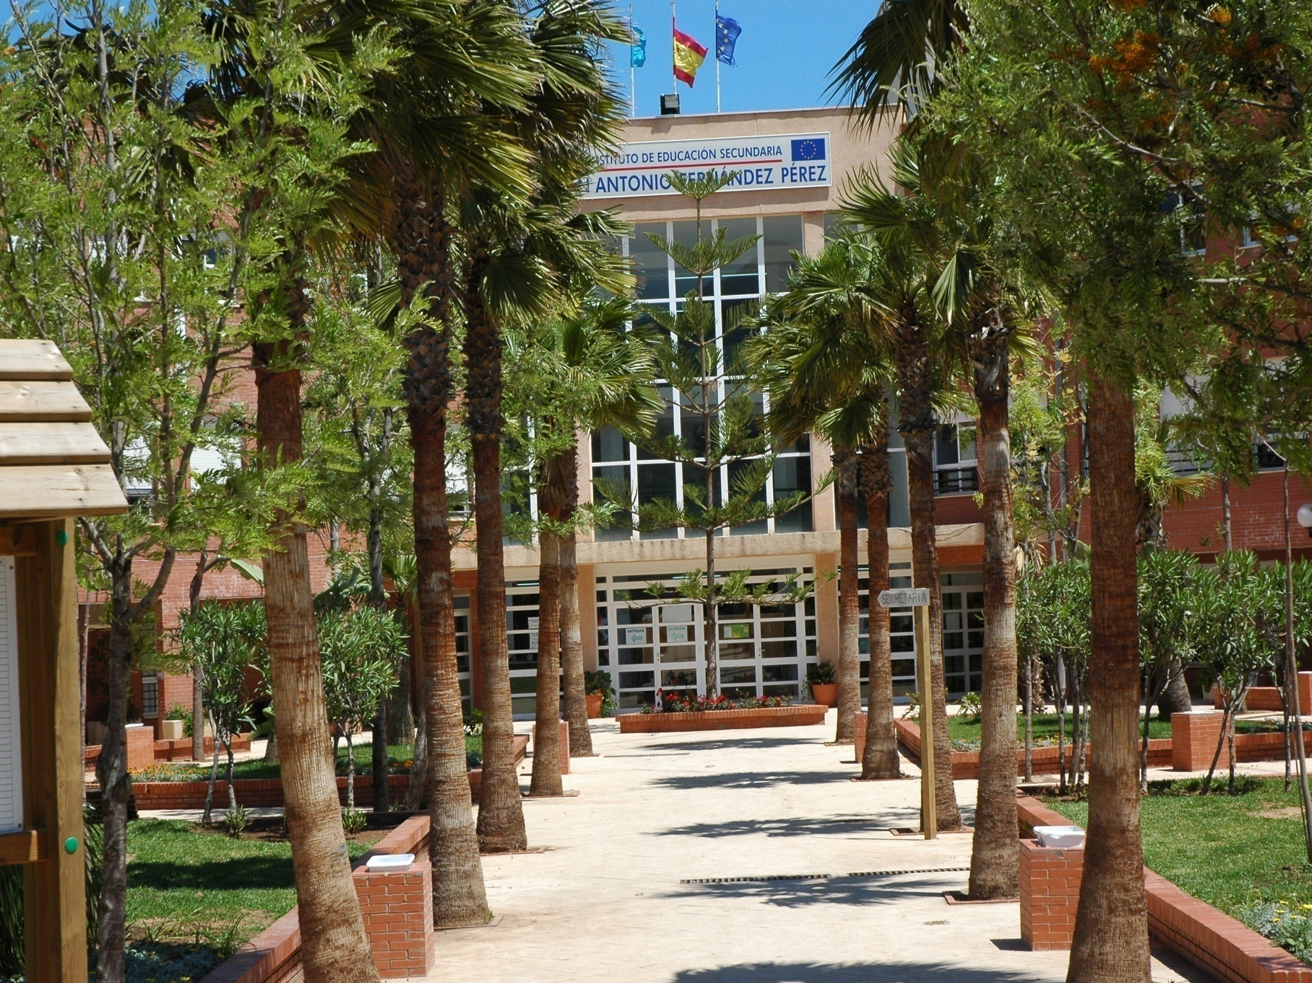

Slide 2
IES JUAN A. FERNANDEZ: FACTS & FIGURES
School situation: Residential suburb, surrounded by the Forestal Park
Heterogeneus origin of our students:
Most of them live nearby (middle-class, school and society integrated)
Some others live far away, depressed city areas (low economic level, family disintegration, school dificulties)
School transport: subsidized by Melilla local government
Our high school challenges: fight against lack of interest, motivation of a significant number of our students.
Fight against early school leaving , school failure and discrimintation.
Importance of European Projects.

Slide 3
EDUCATION
Compulsory Secondary Education: from 12 to 16 years
Post-compulsory Education : from 16 to 18
Professional Initiation Programmes
Waiter
Cook assistant
Gardening assistant
Vocational Training ( Diploma)
Gardening
Cook
Vocational Training (Higher Degree)
Travel Agent’s
Social Inclusion
Nursery School
Support classes for Migrants

Slide 4
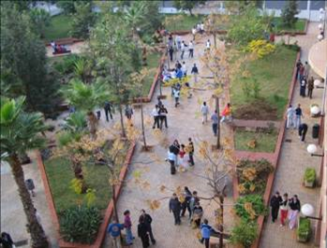
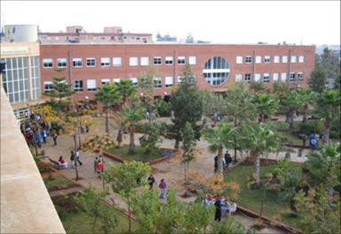
OUR SCHOOL IN NUMBERS
STUDENTS: 1200
TEACHERS: 110
MANAGEMENT BOARD:
Principal
Head of Studies
3 Assistants to the Head of Studies
Administrator/Secretary
Non-teaching staff:
4 caretakers
4 cleaners
2 administrative officers

Slide 5
A SCHOOL DAY:
Starts: 8.30
Finishes: 14.30
6 teaching periods of 55 minutes
A 25 minute break
Each teacher teaches a subject. We are all specialists.
For teachers: 20 teaching periods a week + 9 complementary periods.
For students: 30 lessons a week.

Slide 6
INSTITUTIONAL PROGRAMMES
Compensatory Educational Programme. (National Award)
Action plan for reading encouragement. (3rd National Award for Projects for the Innovation and Improvement of School Libraries)
Temporary class for foreigners’ inclusion:
Undocumented students
They come from Morocco
They can’t speak Spanish
They are fostered by the social services
Objective: to learn Spanish and become part of the Standard Educational System

Slide 7
MACONDO: THE SCHOOL LIBRARY
Compilation, registering, purchase, custody of bibliographic resources.
Project to encourage reading for pleasure and activities to promote the use of the library:
Reading workshop.
Monthly literature reviews from young readers
Theatre Club: “Macondo a Escena”
Books into the corridors
Press Workshop
Radio Workshop
Cultural Center of School.

Slide 8
OUR CONCEPT OF INTERCULTURALITY
Most our students are perfectly integrated in our High School and in the socio-cultural context of Melilla

Slide 9
OUR OBJETIVES
MAKE SURE ALL ETHNIC, CULTURAL GROUPS HAVE THE SAME RIGHTS AND EQUAL OPPORTUNITIES

Slide 10
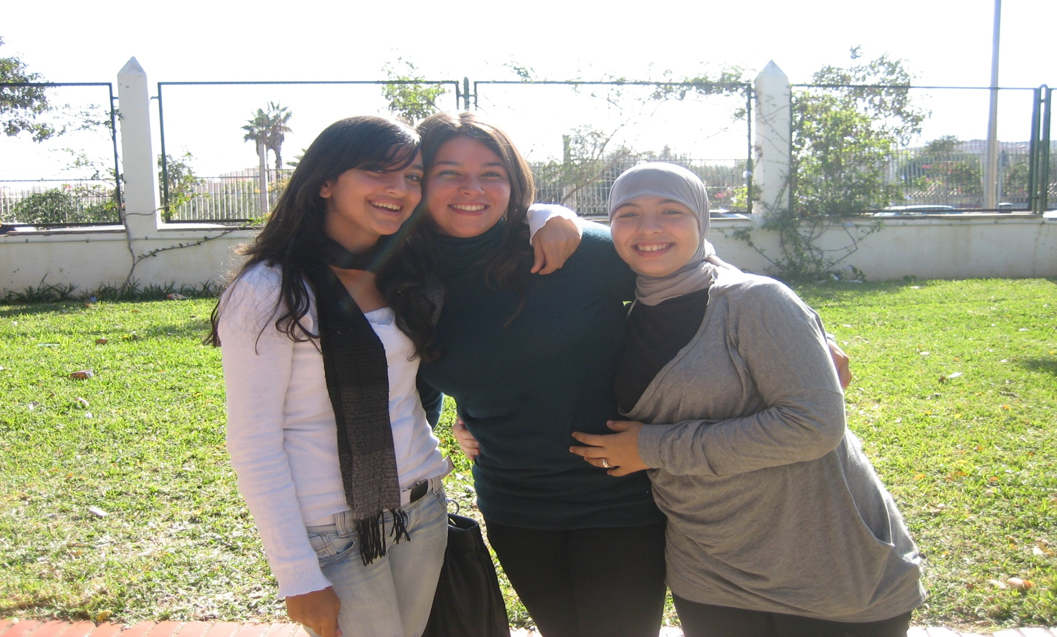
WHAT WE HAVE ACHIEVED

Slide 11
OUR STUDENTS
Most of them have bereber origin, they are Muslim and speak Spanish and tamazigh
Migrants who hardly speak Spanish
Christian students who only speak Spanish.

Slide 12
I.E.S. “JUAN ANTONIO FERNÁNDEZ PÉREZ”
CHARACTERISTICS OF THE CENTER
USUAL PROBLEMS
IN EDUCATIVE
CENTERS
TEACHERS AUTHORITY
IS UNDERSTIMATED
FIGHTS IN THE BREAK
SCHOOL ABSENTISM
LACK OF MOTIVATION
LACK OF IMPLICATION
OF THE STUDENTS
Notes:
12

Slide 13
I.E.S. “JUAN ANTONIO FERNÁNDEZ PÉREZ”
OTHER CIRCUNSTANCES
MOROCCAN MIGRANT MINORS STAY IN THE GOVERNMENT-RUN SHELTERS FOR IMMIGRANTS.
PROBLEMS
LANGUAGE
LACK OF EMOTIONAL
ATTACHMENT
LACK OF MOTIVATION
SELF-SUFFICIENCY
LONELINESS
REFUGE FOR SOME OF THEM
These centers are run by local authorities with public money

Slide 14
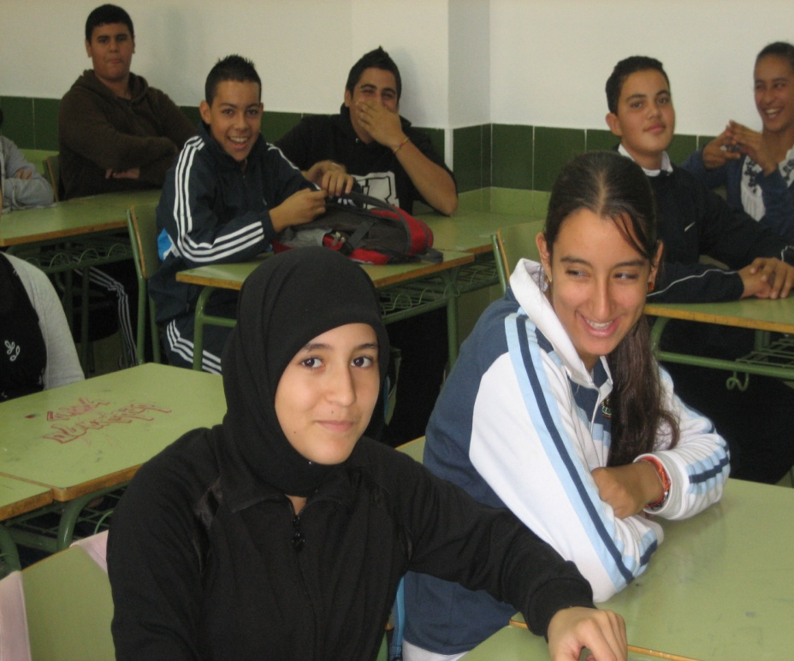
I.E.S. “JUAN ANTONIO FERNÁNDEZ PÉREZ”
OUR INTERCULTURALITY
INTEGRATE STUDENTS FROM DIFFERENT CULTURES
HELP IMMIGRANT STUDENTS INTEGRATE INTO SOCIETY AND SPANISH EDUCATIVE SYSTEM
WHERE WE NEED TO WORK HARDER
Notes:
14

Slide 15
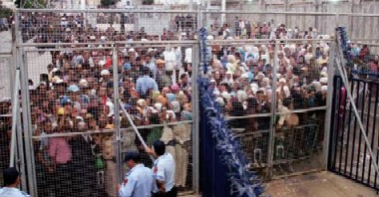
OUR class of Migrant students
STUDENTS WHO HAVE CROSSED THE FRONTIER “ALONE”.
THEY COME FROM MOROCCO AND ARGELIA.
THEY CANNOT SPEAK SPANISH.
THEY HAVE BEREBER ORIGINS. THEY ARE MUSLIMS.
THEY ARE UNDER THE PROTECTION OF THE AUTONOMOUS CITY
AGES: FROM 12 TO 16.
NUMBER:15 girls who
Participate in this Erasmus.

Slide 16
Areas of attention to the migrant
student
There are two teachers in every class
Basic general education formation- teacher specialised in students
with educative needs.
Basic professional qualifications- Certificate for the restaurant
Industry ( waiters and cook´s assistant)
Social habilities- Department of School Counselling
ACCORDING TO THE CURRENT EDUCATION LAW, THEY MUST BE
UNDER THE NORMAL SCHOOLING PROGRAM.
They present defiencies in: language, social skills and affection
needs

Slide 17
OBJECTIVES
SUPPORT T HE SCHOOLING PROCESS OF THE MIGRANT STUDENTS
FAVOUR AND PROMOTE INTEGRATION OF THESE STUDENTS
IN THEIR SCHOOL CONTEXT
MAKE THEIR ACQUISITION OF SPANISH POSSIBLE
PROMOTE CULTURAL VARIETY AS SOURCE OF INTELLECTUAL RICHNESS
PROMOTE INTEGRATION IN SOCIO-CULTURAL , ECONOMIC CONTEXT AS EUROPEAN CITIZENS

Slide 18
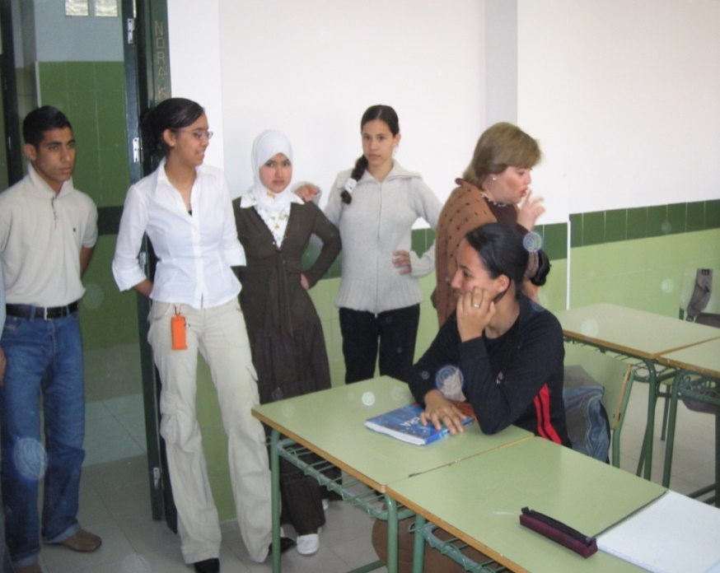
OBJECTIVES OF THE
PROCESS OF INTEGRATION
To promote their integration in normal
classes.
-Flexibility in : class organisation and
selection of contents.
-Integration in normal classes
depending on their own rythms
of learning.
-Permanent contact with their tutors
In their shelters.
-working together with UNESCO ,
WAR CHILD and Movement for Peace.

Slide 19
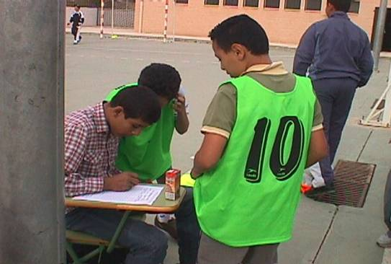
Class activities
Acquisition of Spanish language.
Integration in school life, activities.
Basic vocational, professional
Training and counselling.
ICT skills.
Social habilities.
Sports club.
Sports during the break.

Slide 20
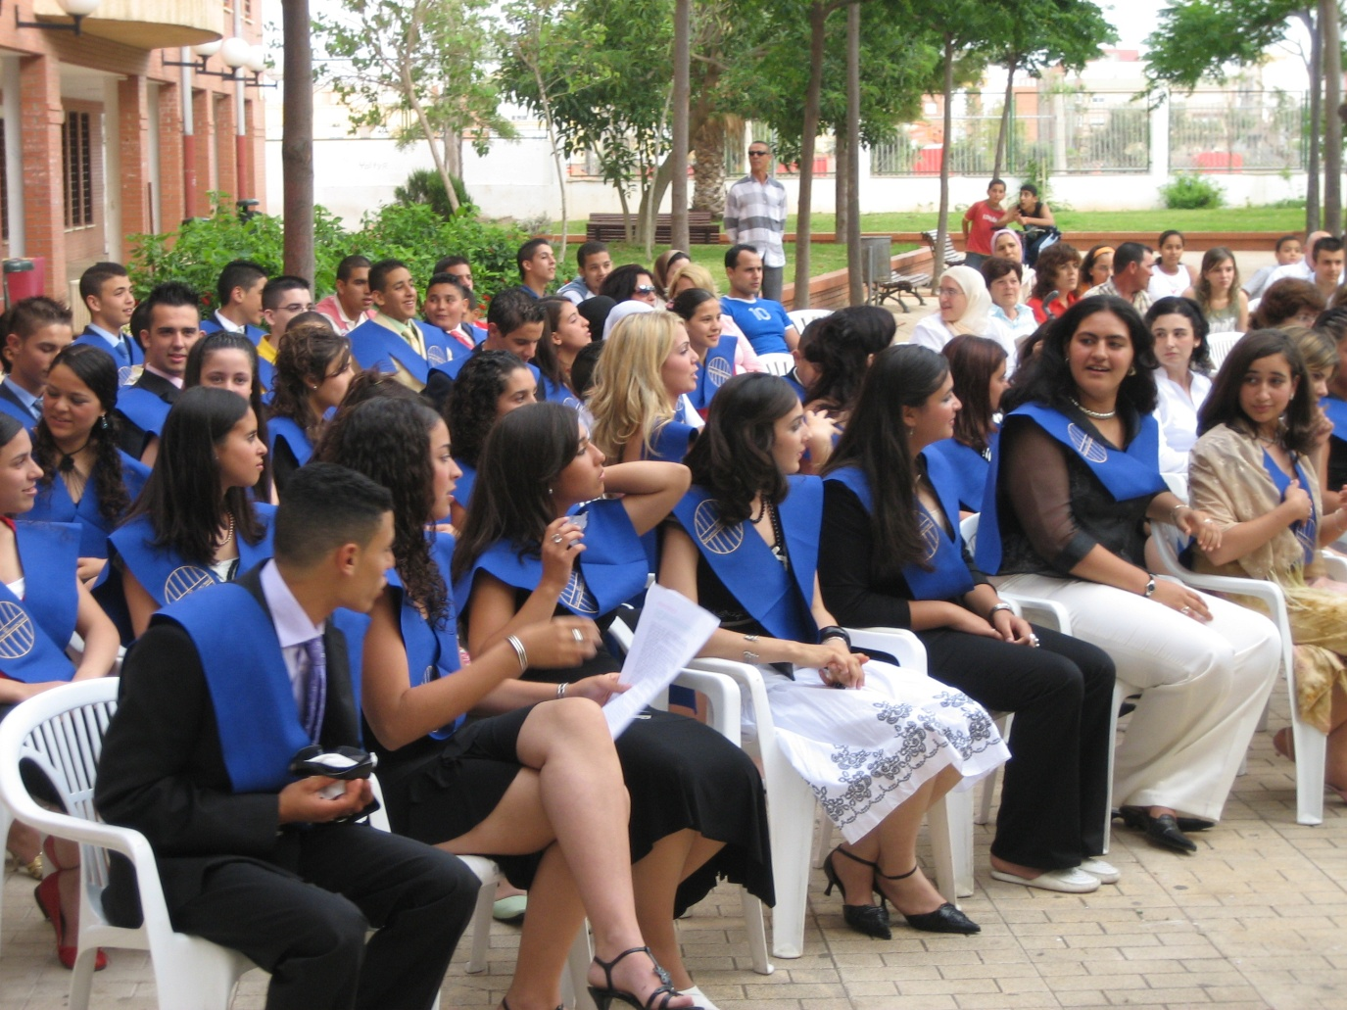
IS THIS SCHOOL SUCCESS?

Slide 21
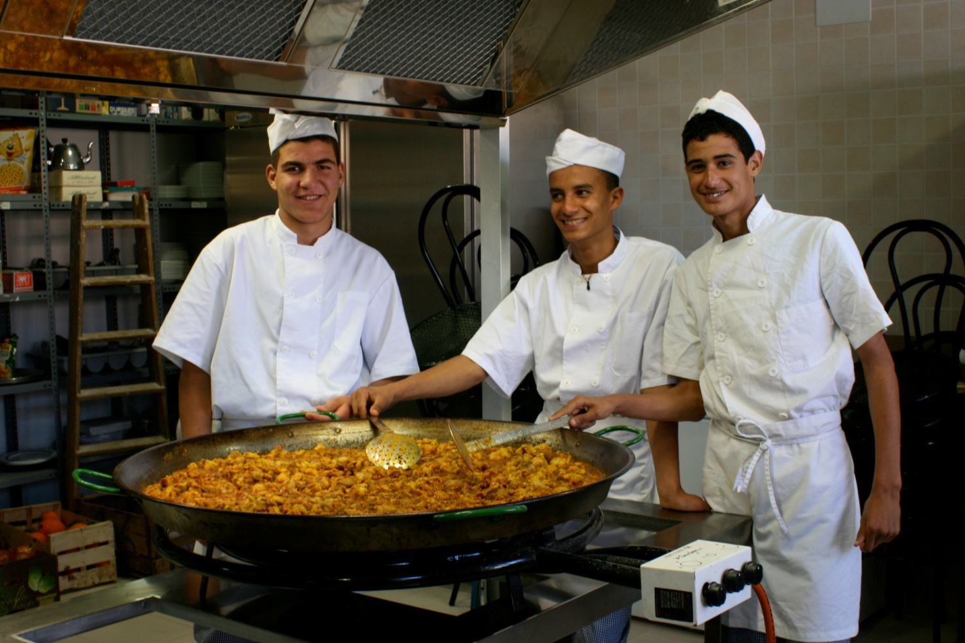
WE PREFER THIS…

Slide 22
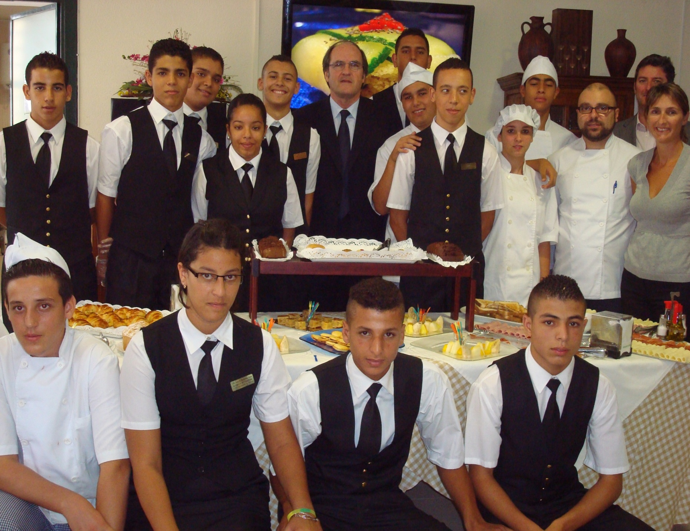

Slide 23
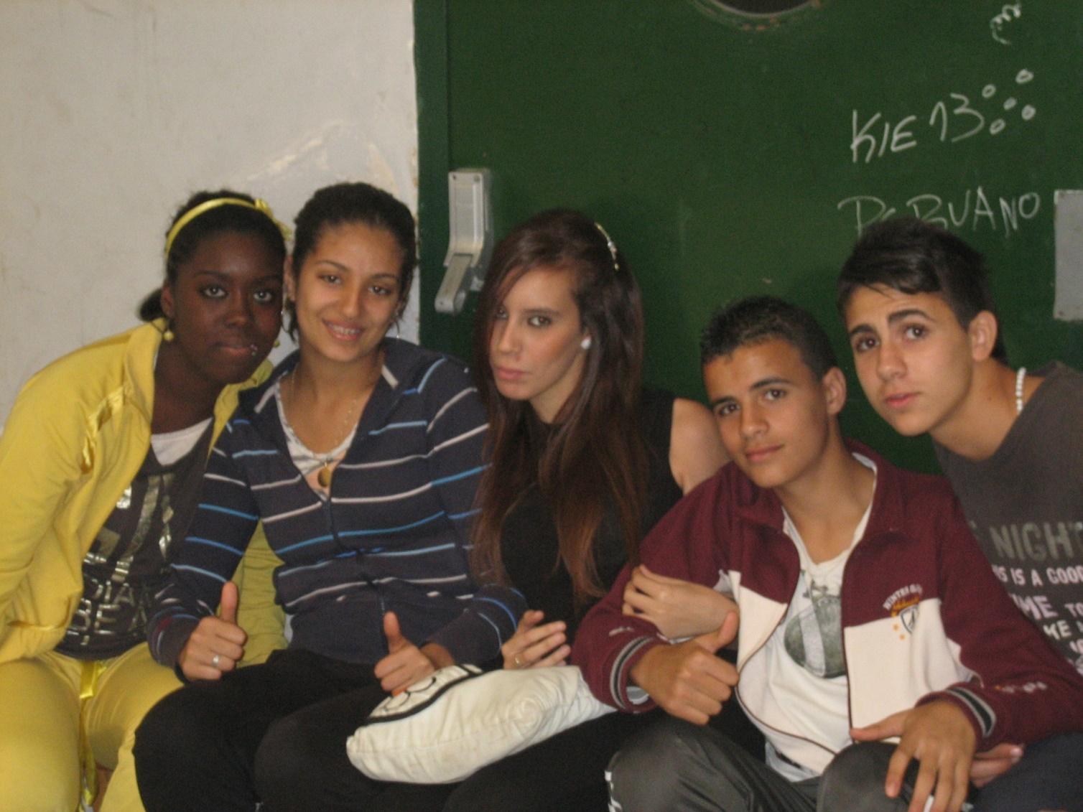

Slide 24
THANKS FOR YOUR ATTENTION

