Slide 1
MELILLA
MULTICULTURAL
CITY

Slide 2
MELILLA: FACTS & FIGURES
HERE WE ARE: North of Africa
DISTANCES TO MAINLAND SPAIN:
Almería: 97 miles (180 km)
Málaga: 114 miles (210 km)
SURFACE: 12’33 km²;
MEANS OF TRANSPORT TO MAINLAND SPAIN:
Boat (to Almería and Málaga)
Airplane (to Almería, Barcelona, Granada, Madrid, Málaga,Sevilla and Palma de Mallorca)
INHABITANTS: 82.000 people

Slide 3
MELILLA: FACTS & FIGURES
Origin of the Majority of Inmigrants: Morocco (93%) - important flowing to Melilla - 25.000 and 5.000 cars go through the border daily.
Interculturality: Mixture of ethnic groups (cultures and religions) - Majority of Christians and Muslims; minority of Hindu, Hebrews and gypsies.
Secondary Education Centres: 7

Slide 4
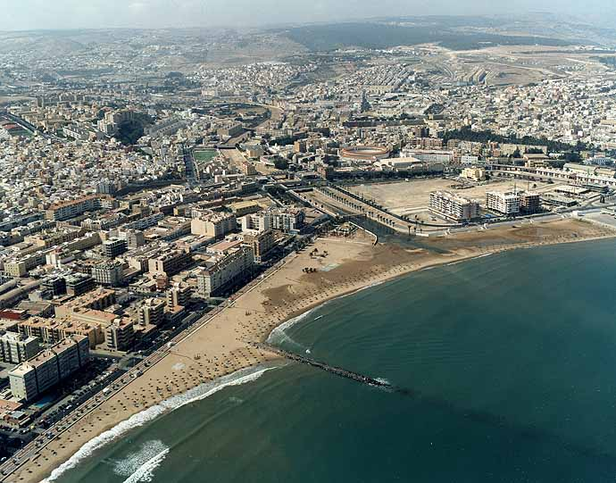
FOUR CULTURES
ONE CITY

Slide 5
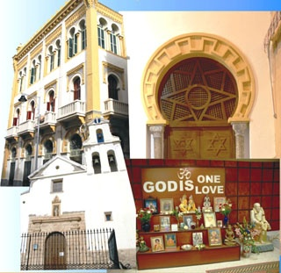
MUSLIMS
JEWS
CHRISTIANS
HINDU

Slide 6
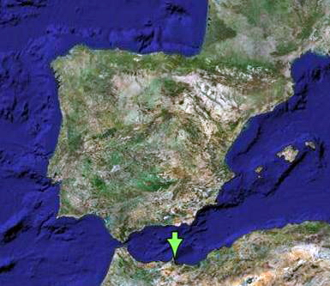
CIUDAD AUTÓNOMA DE MELILLA
SITUATION: Northern coast of Africa
DISTANCE FROM mainland Spain:
ALMERÍA: 97 mlies (180 Km.) MÁLAGA: 114 miles (210 Km.)
SURFACE: 12,33 Km² – Radio 3 Km.
TRANSPORTS: PLANE and BOAT
REGISTERED POPULATION: 75.000 inhabitants

Slide 7
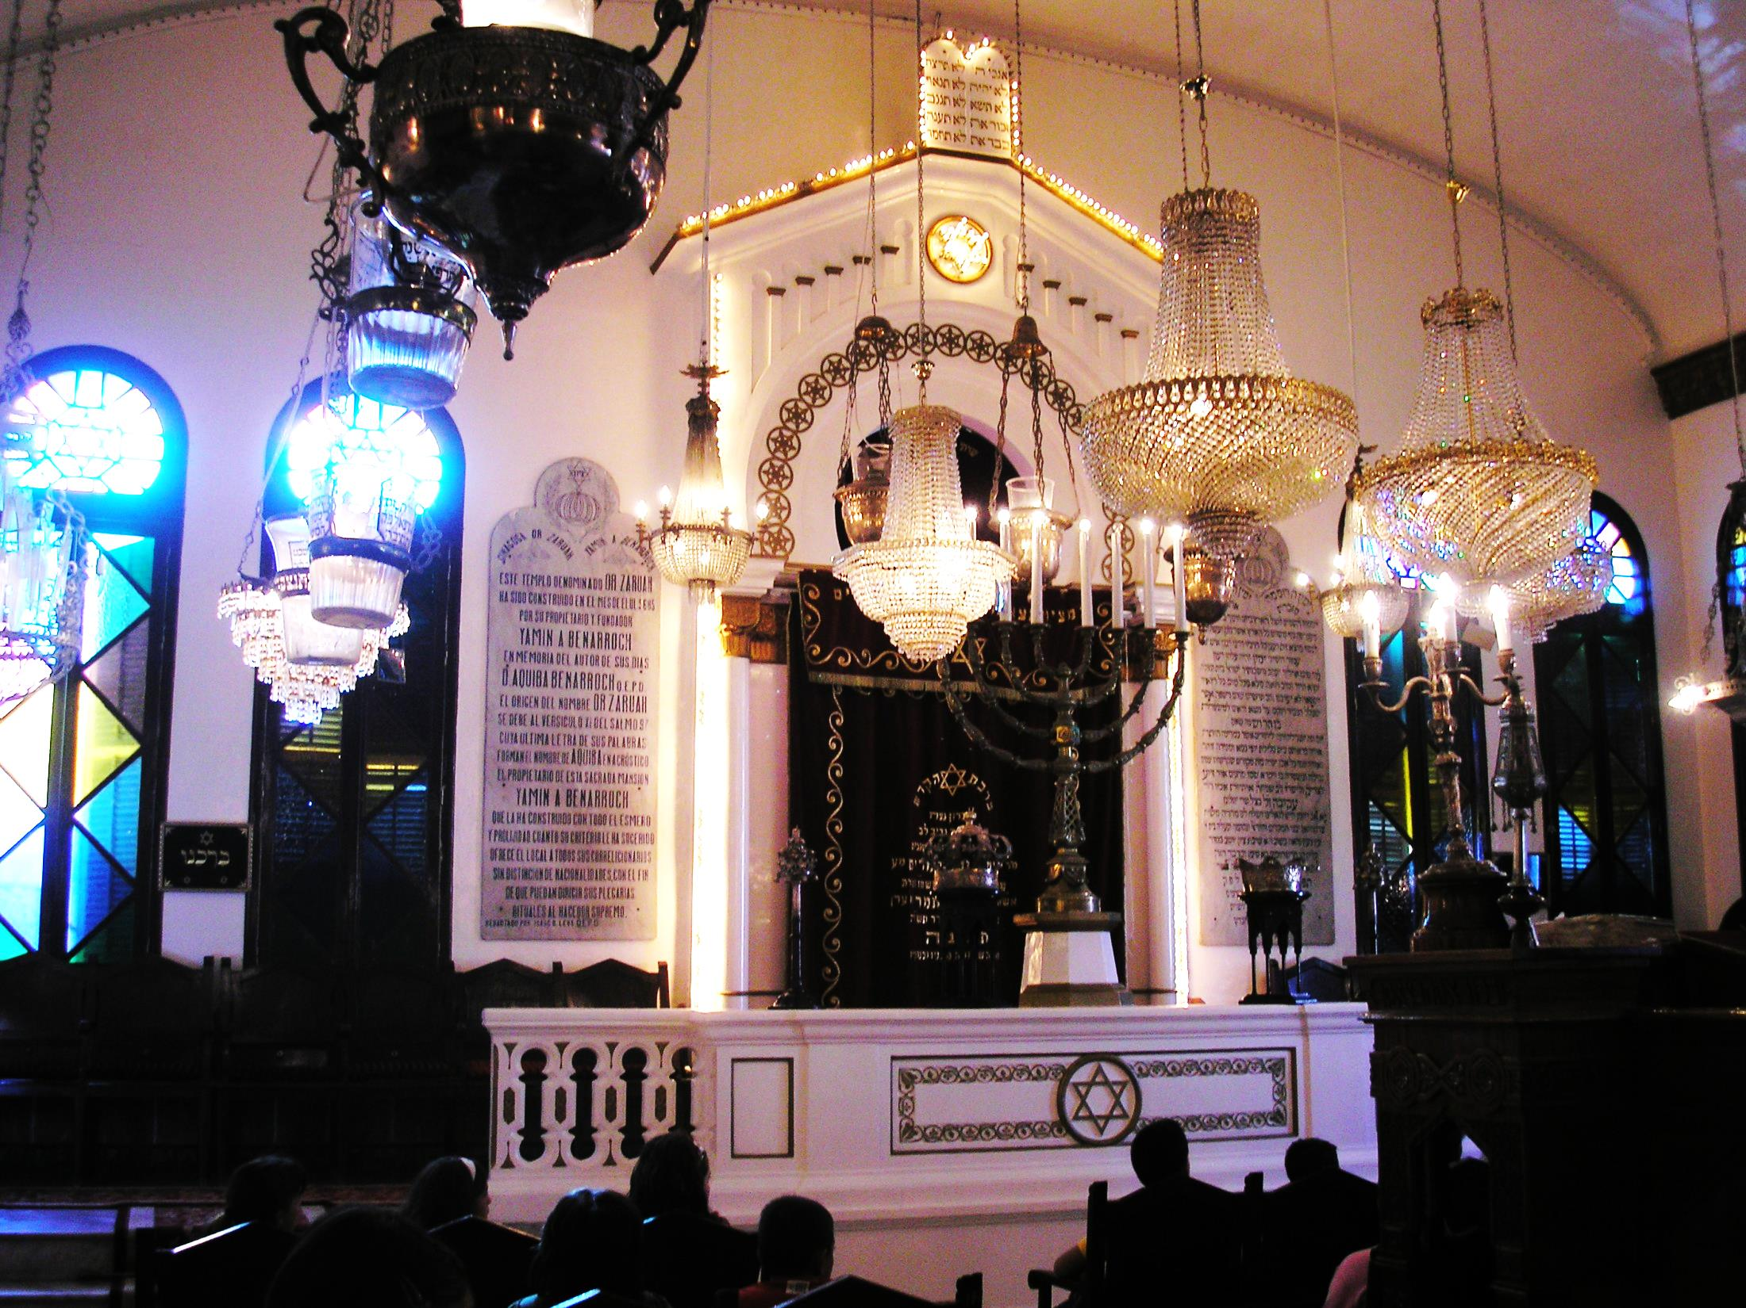
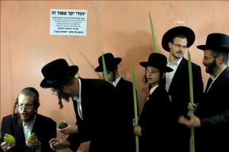
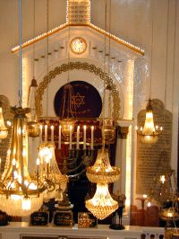
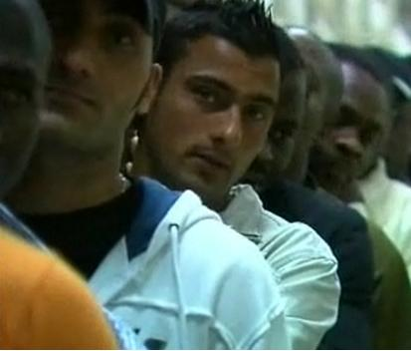

Slide 8
CIUDAD AUTÓNOMA DE MELILLA
ORIGIN OF FOREIGNERS RESIDENTS IN MELILLA: Moroccan 93%.
- IMPORTANT MIGRATORY FLUX: BORDER WITH MOROCCO
25.000 PEOPLE 5000 CARS
KEY WORD DESCRIBING MELILLA POPULATION: INTERCULTURALITY
PEACEFUL LIVING TOGETHER
- DISTRIBUTION OF POPULATION ACCORDING TO ITS ORIGIN
MAJORITY: Half bereber origin (MUSLIMS),half Christians.
MINORITY: Hindu, Jews and gypsies
EDUCATIVE CENTERS: 12 primary schools and 7 Secondary .
Notes:
8

Slide 9
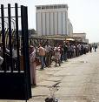
MELILLA RECEIVES DAILY THOUSANDS OF PEOPLE COMING THOROUGH ITS BORDER WITH MOROCCO.
IT IS A WORKING AND COMMERCIAL
BILATERAL RELATION WHICH BENEFITS BOTH COUNTRIES.

Slide 10
MELILLA: PICTURES

