Slide 2
Aims
To understand the meaning of ‘Growth Mindset’
To understand why Growth Mindset is key to developing independent learners, learners who are ready to make decisions and choices in relation to their learning
To be able to recognise the type of Mindset that individuals have
To discuss how to encourage and develop a Growth Mindset in the classroom

Slide 3
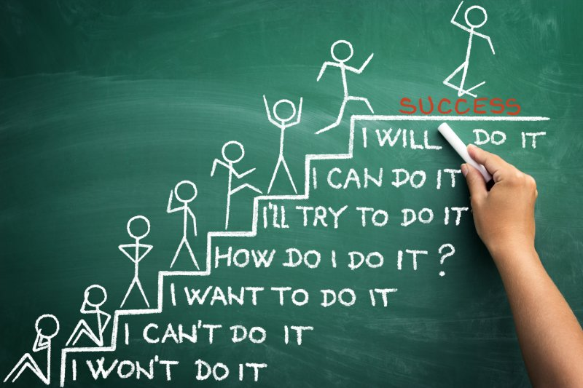
Carol Dweck’s discovery of fixed and growth mindsets have shaped our understanding of learning.
Notes:
Carol Dweck – Professor of Psychology - primary research interests in motivation, personality, and development
* Jayden – fixed mindset

Slide 4
Fixed Mindset Growth Mindset
The understanding is stable
I want to look clever!
Avoids challenges
Ready to give up
Cannot see the point of making an effort
Ignores constructive feedback
Likely to reach a ‘plateau’ early and to fail to realise his/her full potential
The understanding expands
I want to learn more
Eager to accept a challenge
Ready to persevere
Understands that effort is required
Learns from criticism and feedback
Attains high levels of achievement
Notes:
Not always ability driven

Slide 5
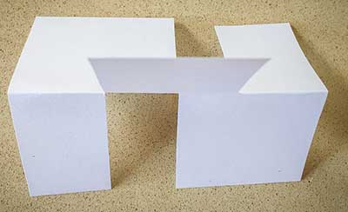
Teaching children to struggle!
Notes:
Paper activity

Slide 7
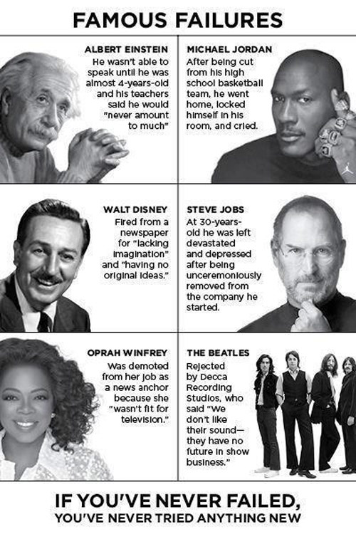

Slide 8
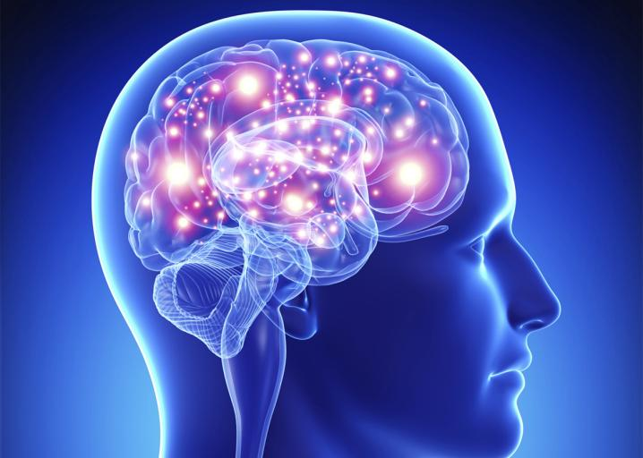
Neuroplasticity “neurons that fire together wire together… and neurons that fire apart wire apart”
Notes:
https://www.youtube.com/watch?v=d0jEF66xSBA – pathways
https://www.youtube.com/watch?v=Fj5k6KAvt18 – high priority pathways
With every repetition of a thought or emotion, we reinforce a neaural pathway.
‘Muscle building’ part of the brain
Connections within the brain are constantly becoming stronger or weaker.
Younger brains change easily – their brains are very plastic. As we age, the brain loses some of its plasticity and we become more fixed in how we think, leanr and perceive.

Slide 10
How do we respond …?
When a child succeeds?
When a child fails?
Notes:
* Discuss

Slide 11
Messages that children hear
Adult: Well done! You didn’t have to think about that at all. You’re so clever!
The child hears: If I don’t learn something quickly, I’m not clever!
Adult: You’re so clever! You got it all correct without having to make an effort!
The child hears: If I have to make an effort, people won’t think that I’m clever!

Slide 12
Feedback to pupils
In order for the feedback to be powerful, the following must be incorporated:
A culture that welcomes mistakes
The feedback must be directly connected to the learning in the lesson
The feedback should give comments on the success so far, and on what needs to be done to move the learning forward
Feedback closes the gap between where the pupil is now and where he/she should be

Slide 13
Praise/Feedback
“Well done ... you’ve learnt...”
“Each time you practise, you’re strengthening the connections in your brain."
“A good effort. You understand how to ..."
“Use this mistake. Think about why it didn’t work, and learn from it.”
“You need more challenging work ...”
“This is going to take time and effort”
I can’t do this ... yet. I’m learning to ...

Slide 14
Challenge
The language of challenge is very powerful and a very effective tool in motivating pupils
Pupils should regard challenge as part of their learning journey
Pupils should be challenged as individuals, and encouraged to concentrate on their learning journey
confident
challenge
panic!

Slide 15
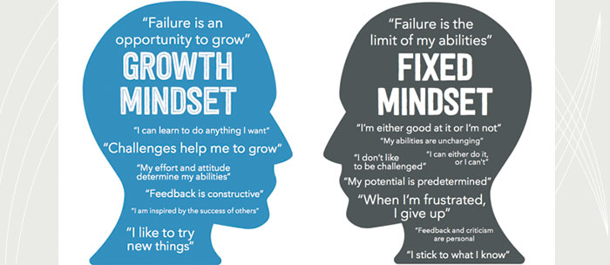
The Next Steps

Slide 16
Classroom Strategies
Teachers/assistants as learning facilitators
Establish the use of talk partners, who change on a regular basis
Small groups/collaborative groups
Using conversation as a vehicle for effective learning
Preparing the pupils to give and receive feedback
Develop coping strategies
Creating “The power of yet!” ethos

Slide 17
Classroom Activities
Use a mindset questionnaire as a tool to understand the mindsets within your class
Introducing children to brain plasticity
Briefly explain the neuroscience
Writing a letter to a future student about a learning-related struggle
Growth vs. Fixed Mindset poster
Projects to showcase how the brain works
Discussions and debates
Notes:
See lesson activities hand-out.

Slide 18
The four purposes of the curriculum for Wales
Ambitious, capable learners, ready to learn throughout their lives
Enterprising, creative contributors, ready to play a full part in life and work
Ethical, informed citizens of Wales and the world
Healthy, confident individuals, ready to lead fulfilling lives as valued members of society.
Notes:
*12 Pedagoical principles – Mindset and power of effort

Slide 19
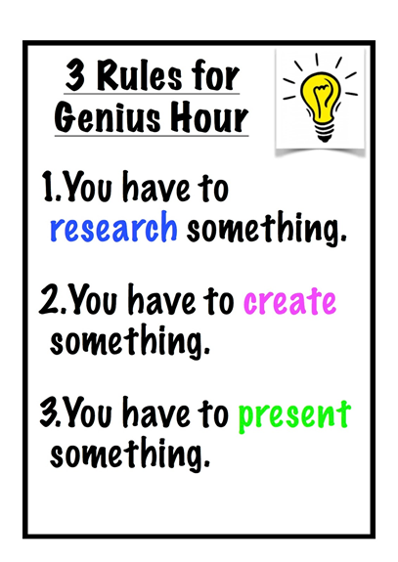
Definition of “Genius”
Creative power
Natural ability
Exceptional skills in a particular area or activity
Very clever
Genius Hour can be used as a small group or class approach to empower children and give them the chance to work on a passion project of their choice.
Notes:
Genius Hour began as a project run by the search-engine Google, they allowed employees to spend 20% of their time to explore a project of their choice. They found that giving this creative time to their staff has increased productivity and it has developed into a variety of outcomes such as Gmail and Google News.
The idea in school is that we adapt this idea into what we call Genius Hour, which is designed to promote pupils creativity and get them excited about learning. I will implement Genius Hour to begin with, which will give pupils a time to develop their own inquiry-based projects around their passions and take ownership of their work.

Slide 20
