Slide 1
Radost Kindergarten Burgas, Bulgaria

Slide 2
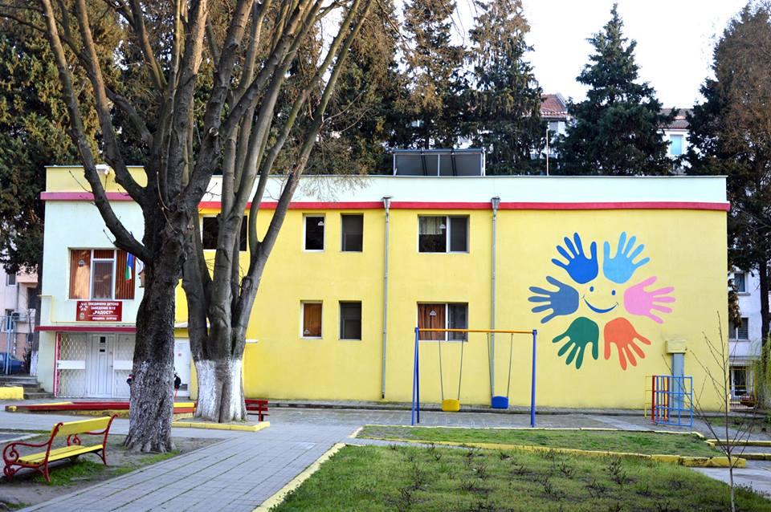
IN OUR KINDERGARTEN WE EDUCATE 250 CHILDREN FROM 2 TO 7 YEARS OF AGE IN 8 GROUPS
6 groups in the main buildings
in the central part of the city

Slide 3
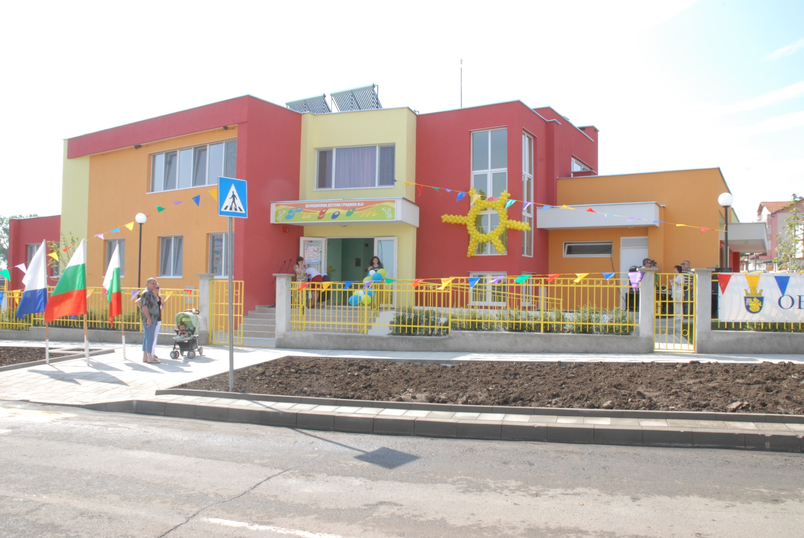
2 groups in the filial by the sea in Kraimorie

Slide 4
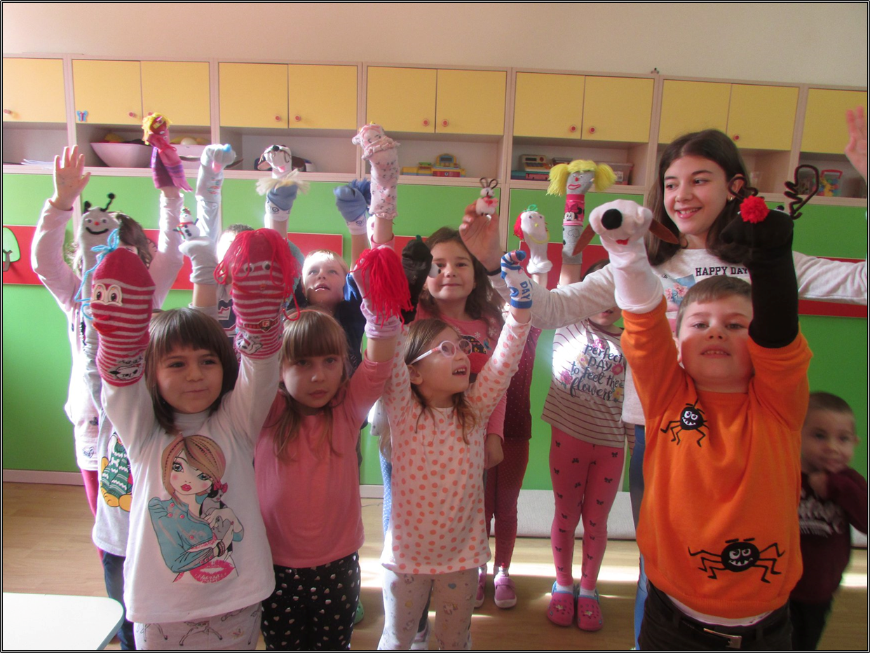
In all our projects and in our work we always strive to do various activities TOGETHER with children and parents

Slide 5
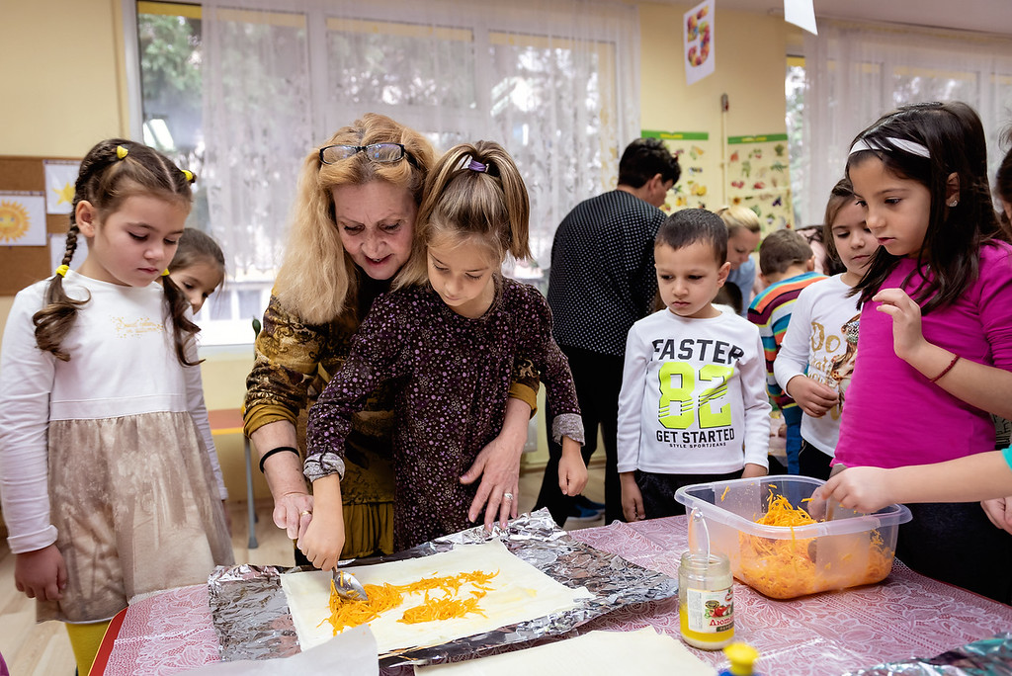
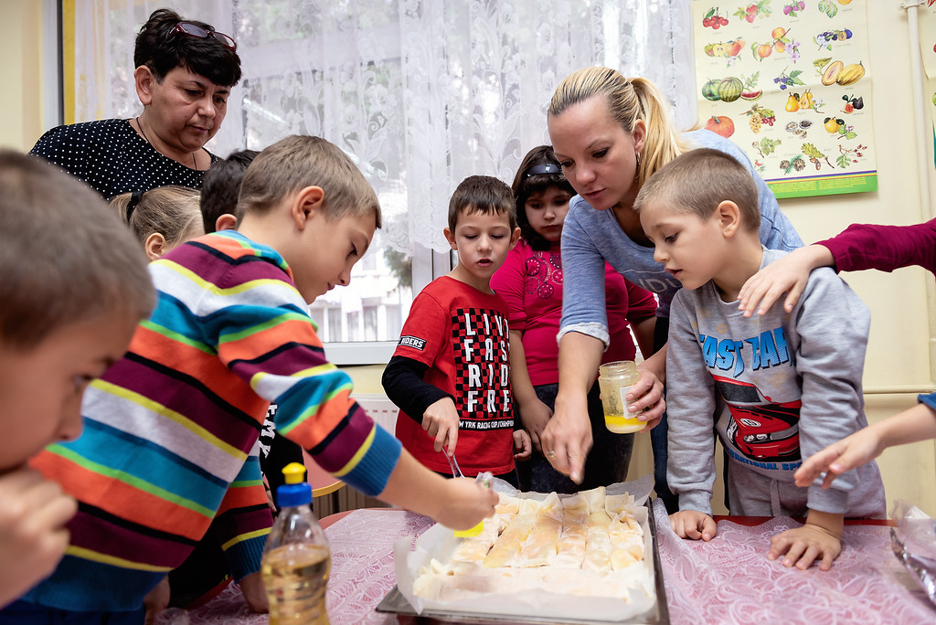
PUMPKIN DAY WITH PARENTS

Slide 6
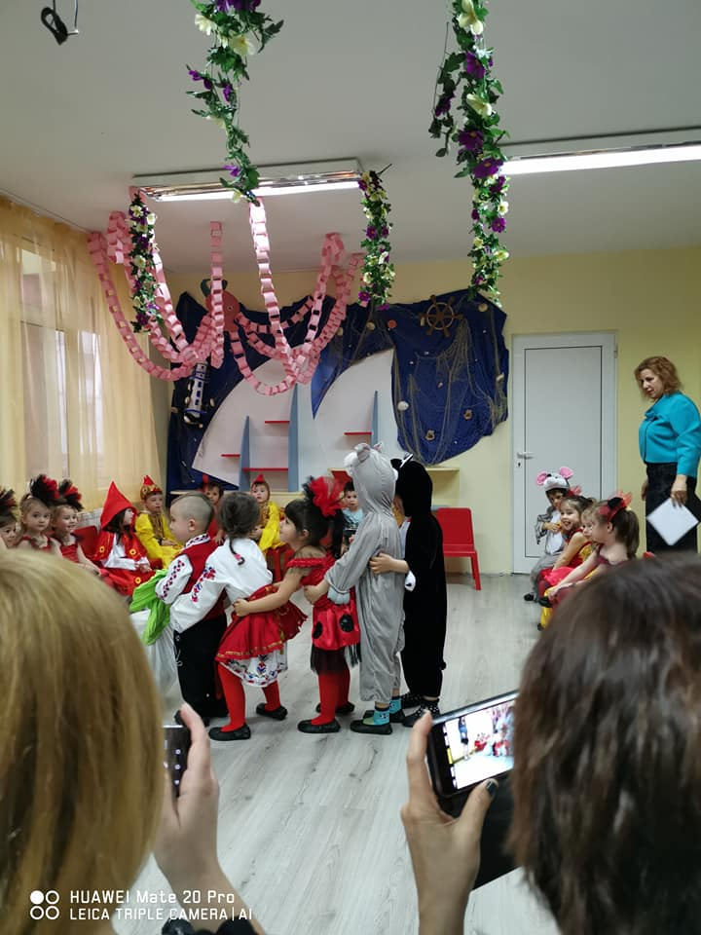
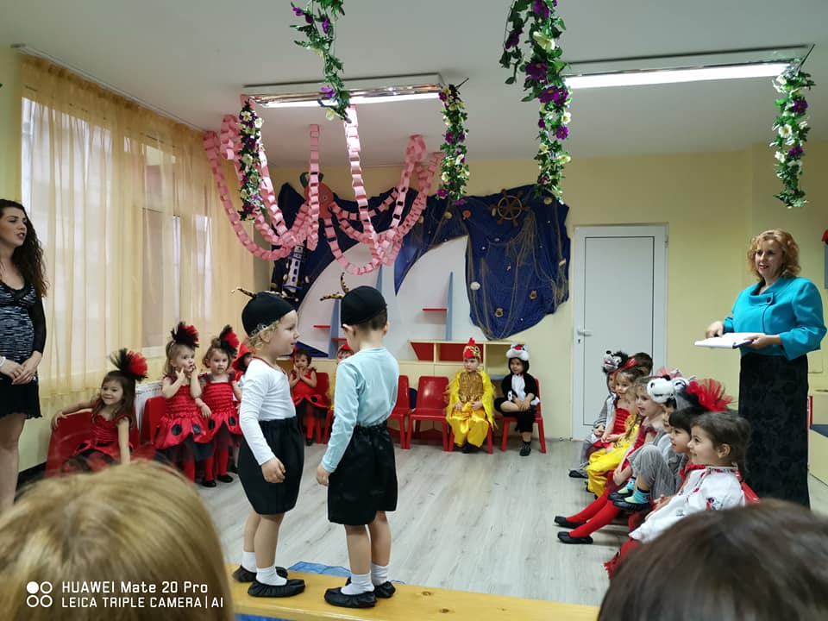
THEATRE WITH THE YOUNGEST CHILDREN

Slide 7
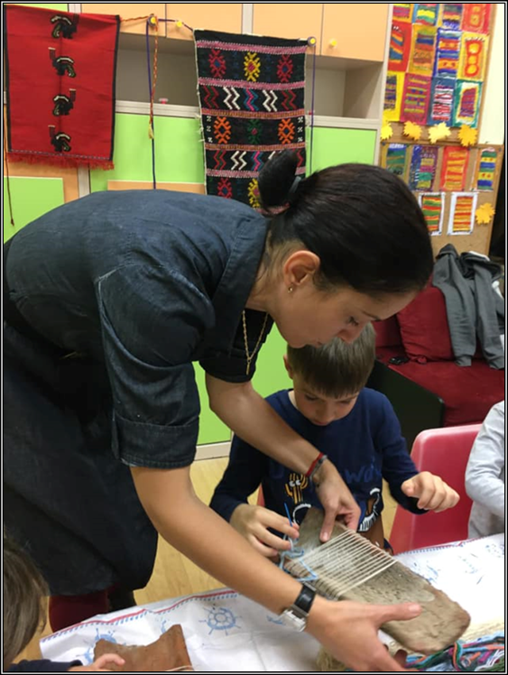
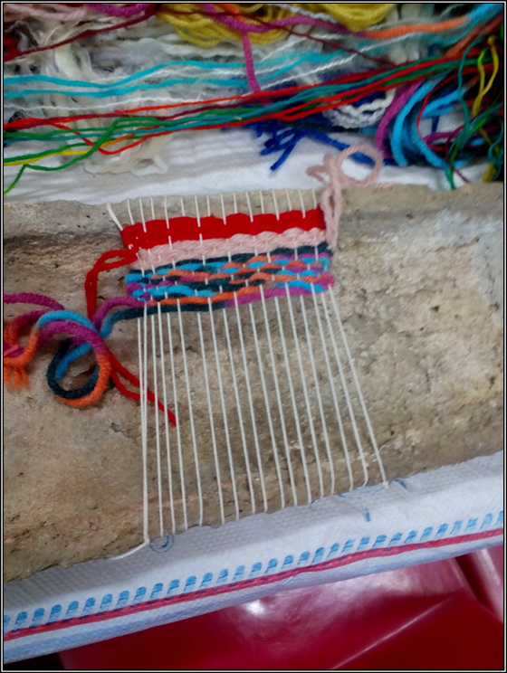
WE MAKE ART TOGETHER

Slide 8
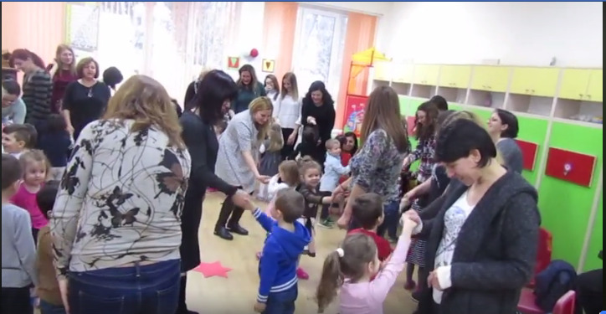
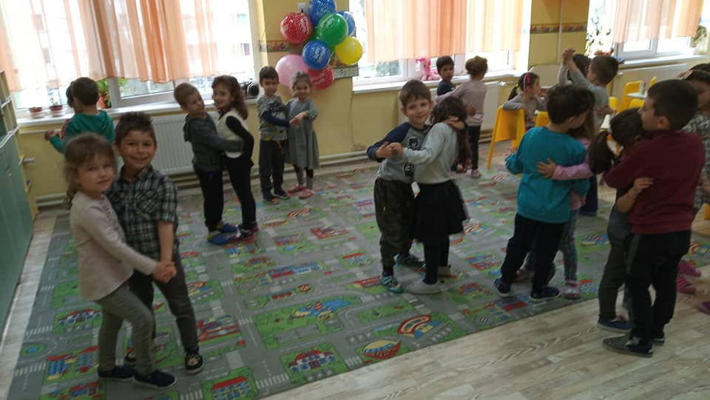
WE DANCE TOGETHER

Slide 9
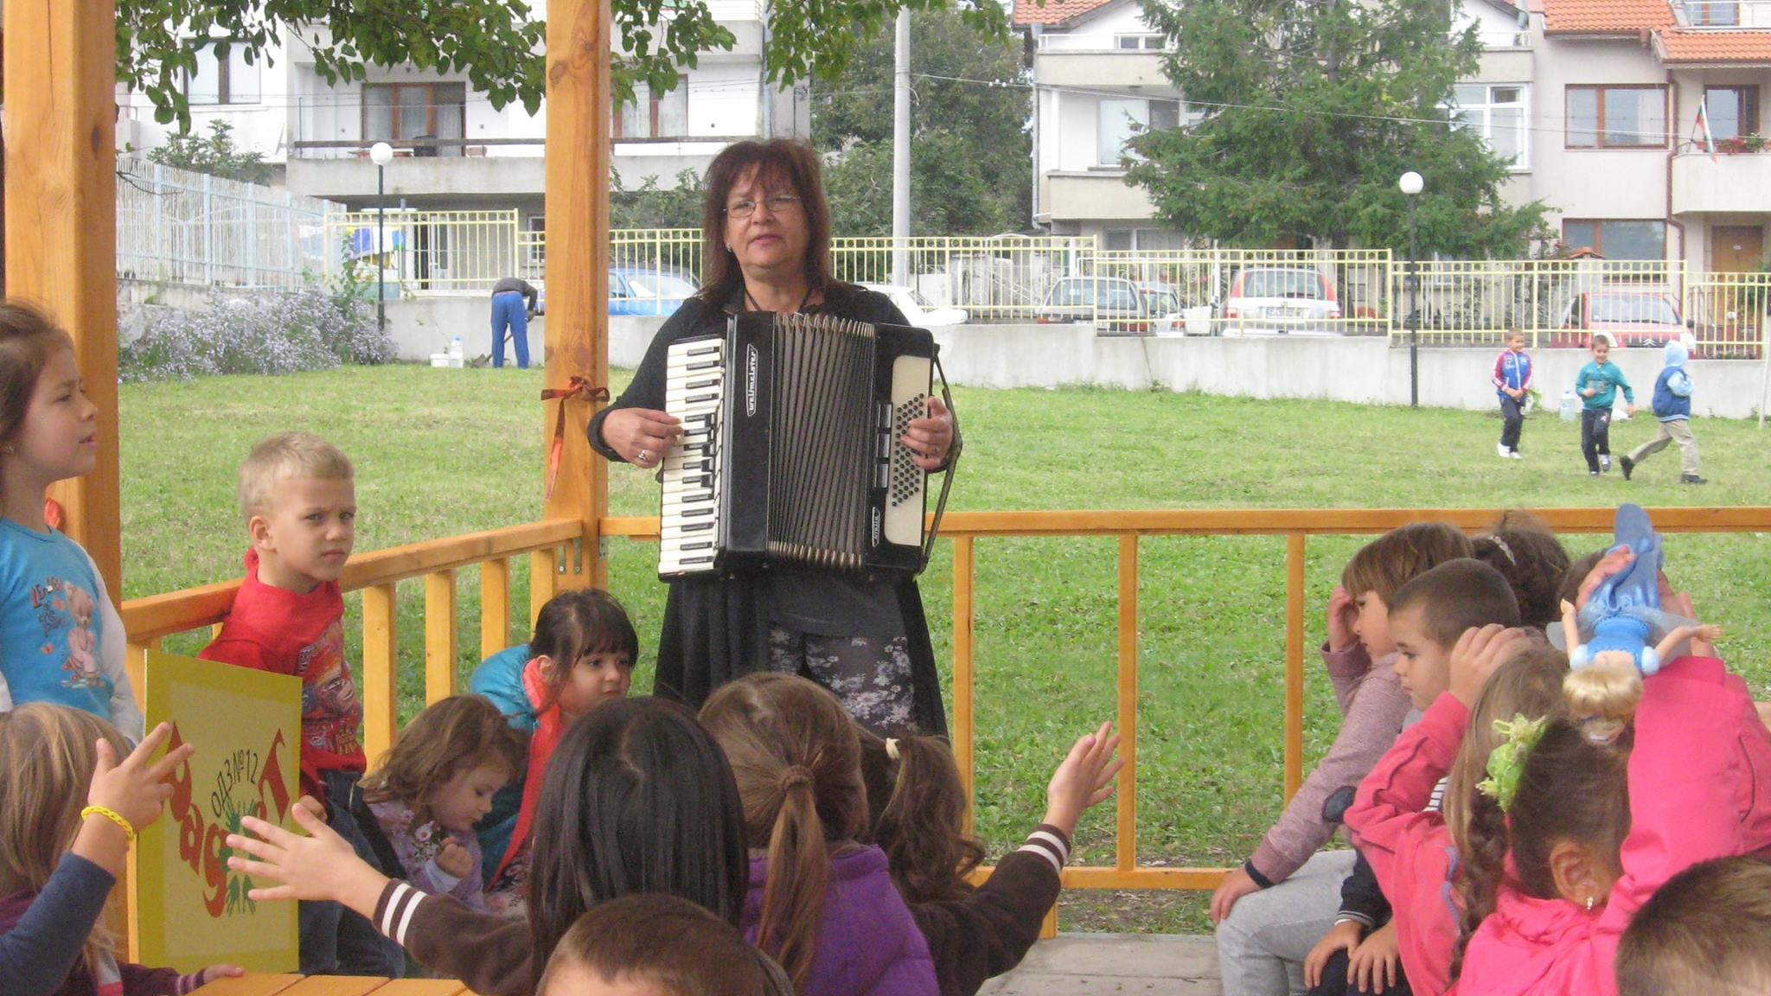
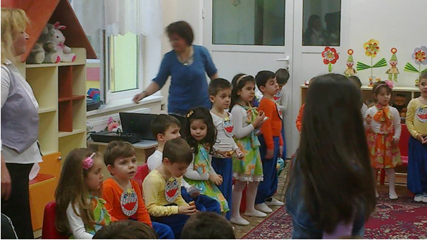
WE PLAY MUSIC TOGETHER

Slide 10
FAST, BOLD, SKILLFUL

Slide 11
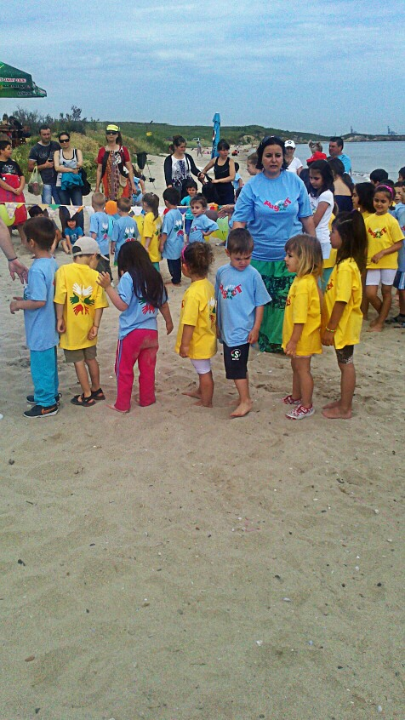
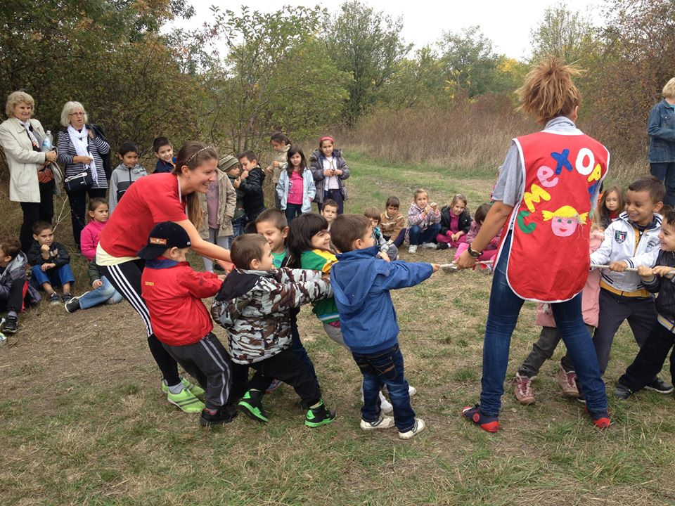
WE PLAY SPORTS TOGETHER

Slide 12
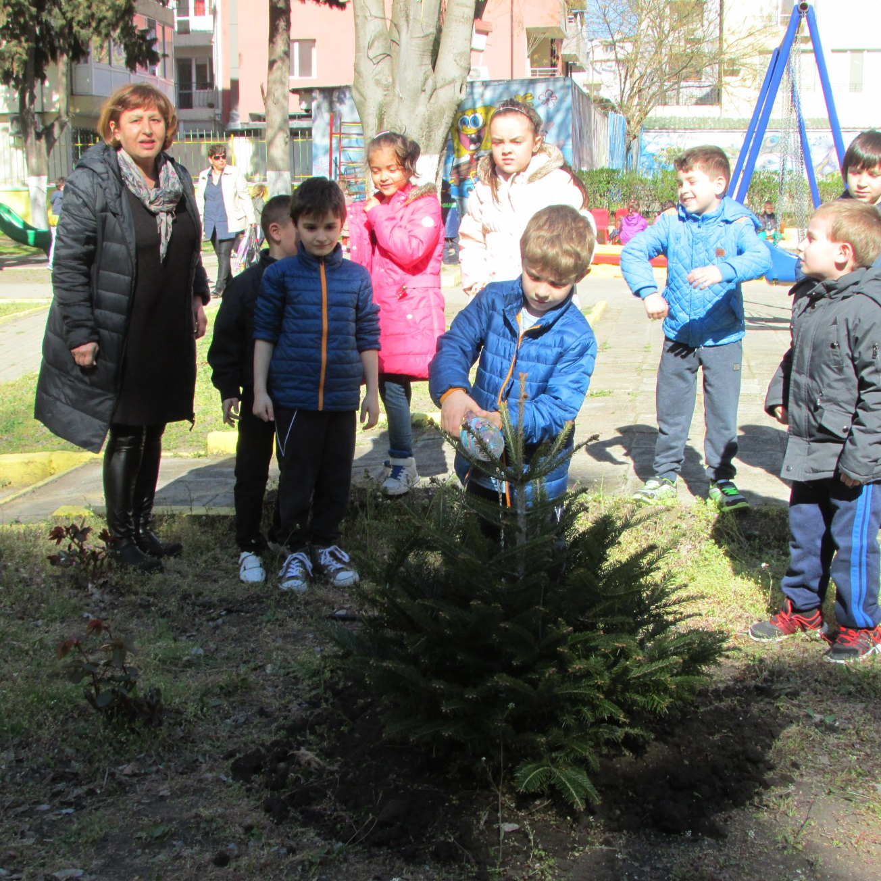
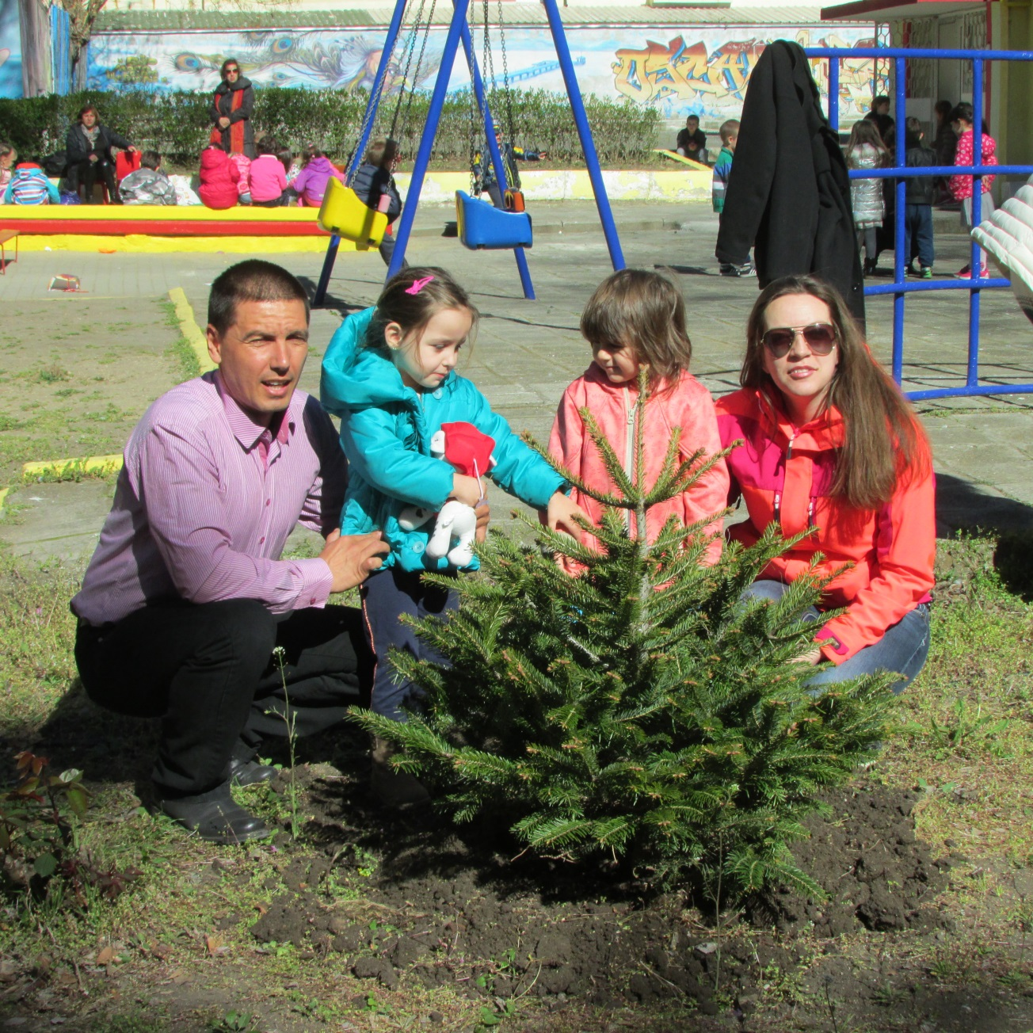
WE TAKE CARE OF NATURE TOGETHER

Slide 13
WE LOVE OUR NATIONAL HOLIDAYS AND TRADITIONS

Slide 14
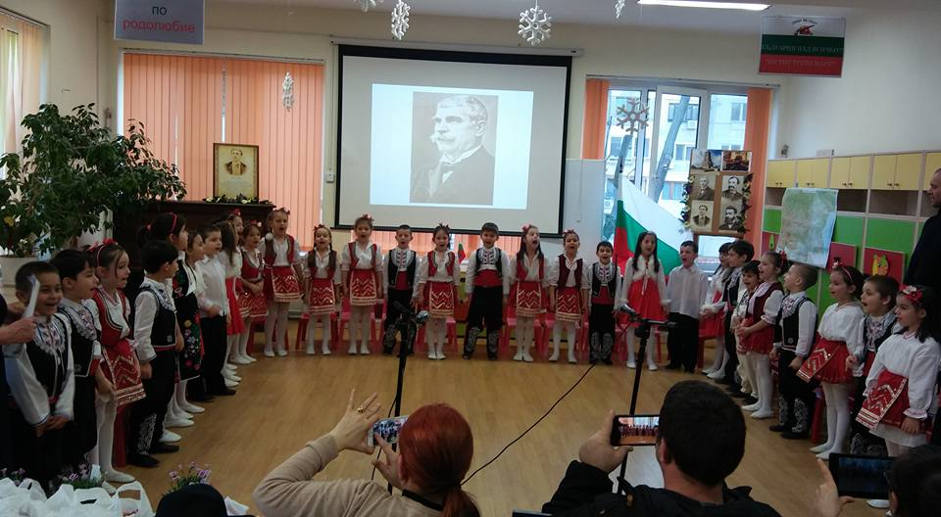
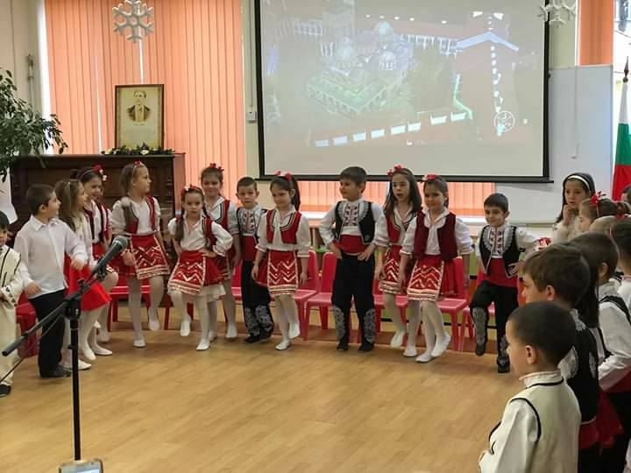
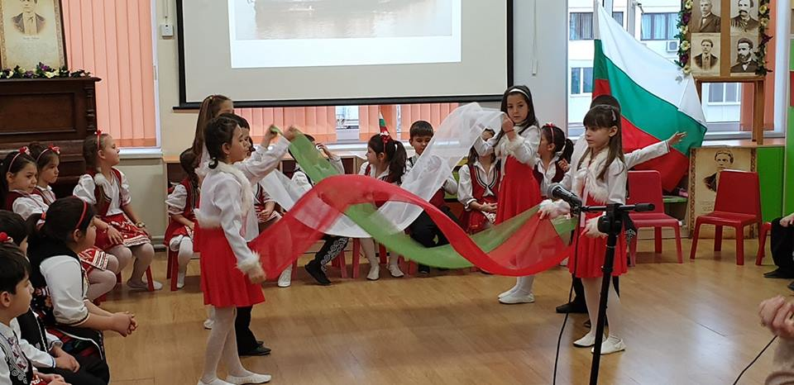
WE CELEBRATE OUR NATIONAL HOLIDAYS TOGETHER

Slide 15
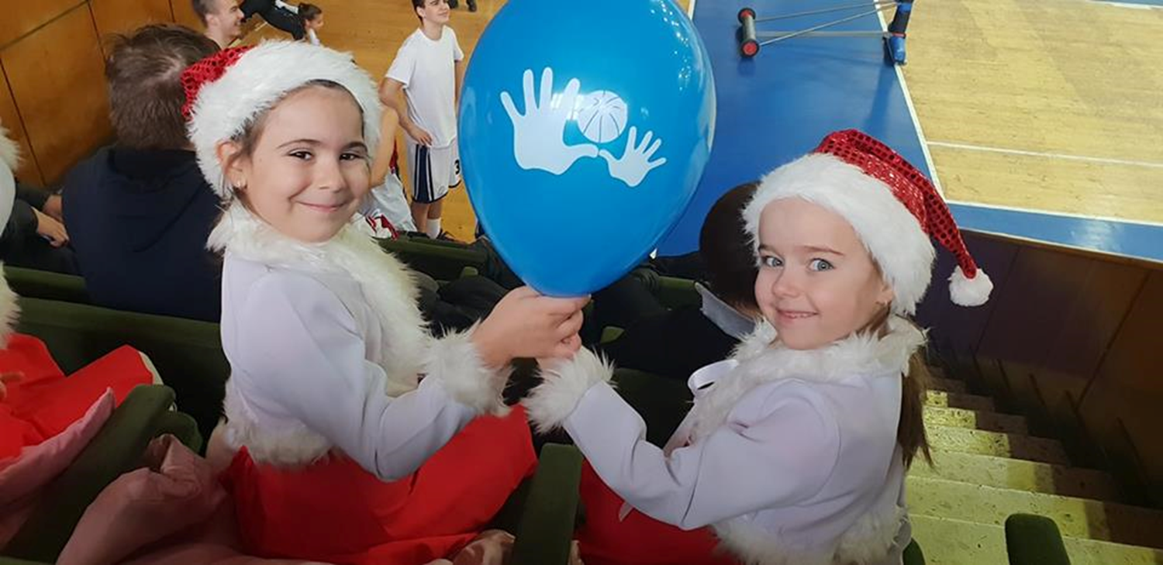
WE MAKE GREAT FRIENDS

Slide 16
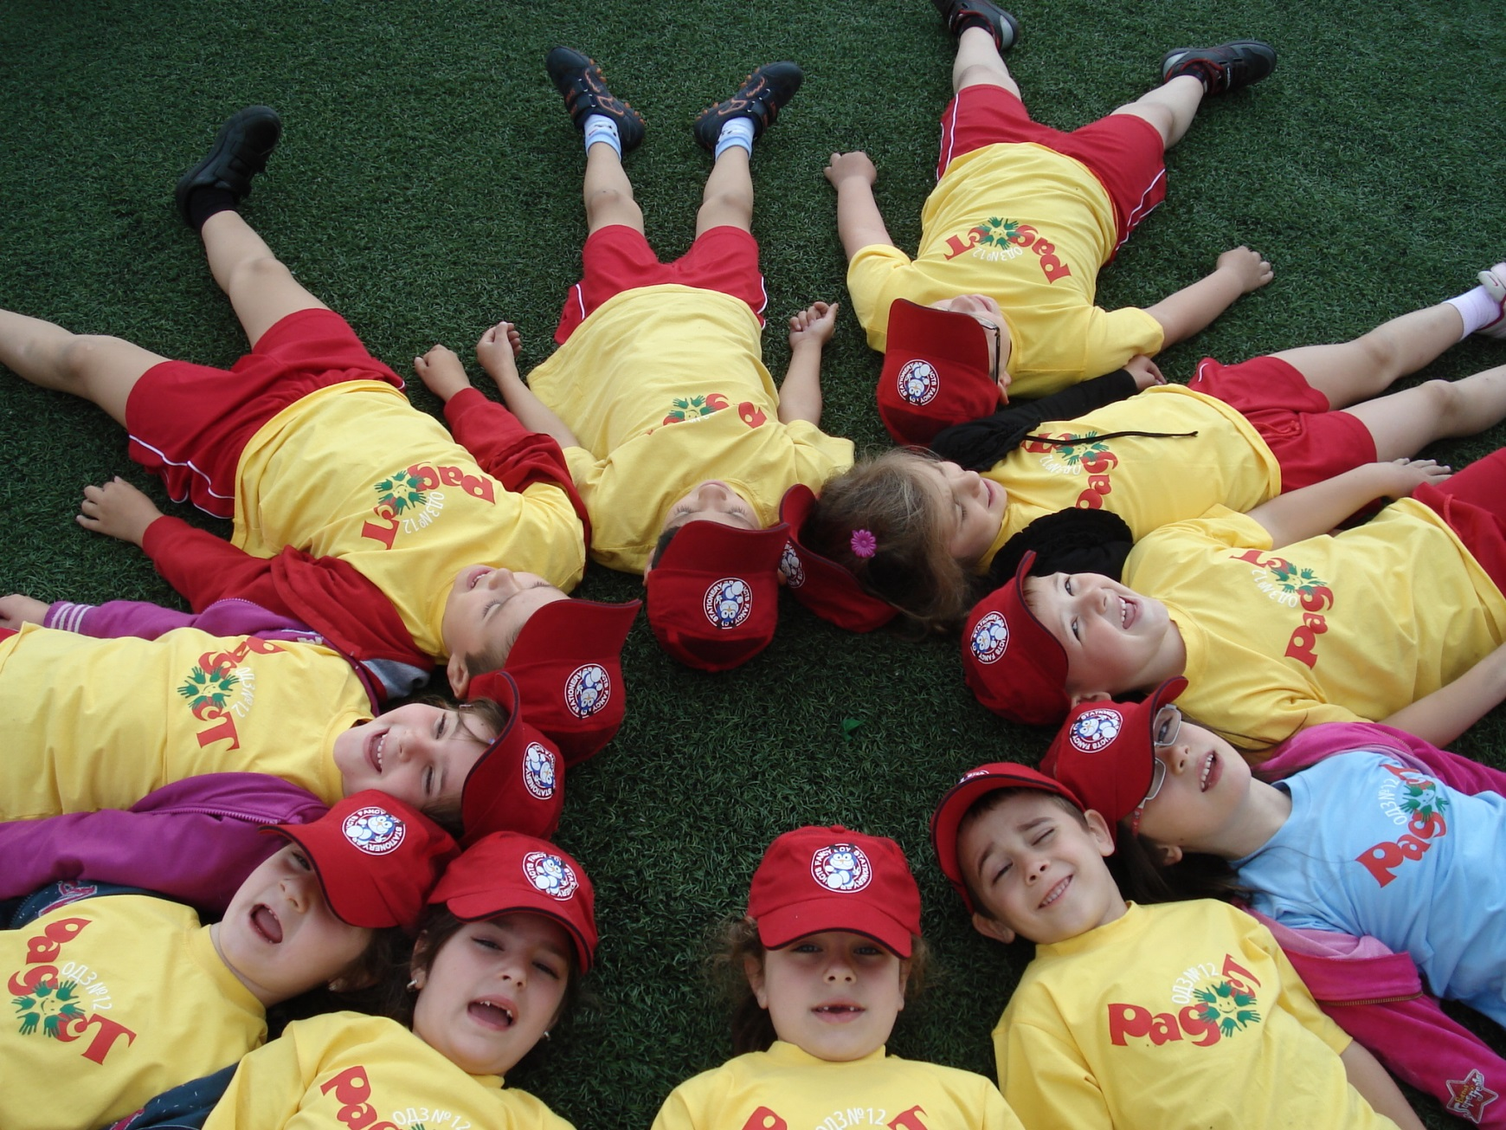
LIFE IS WONDERFUL WHEN WE ARE ONE TEAM

Slide 17
You can follow our facebook page
https://www.facebook.com/profile.php?id=100070817784870

