Slide 1
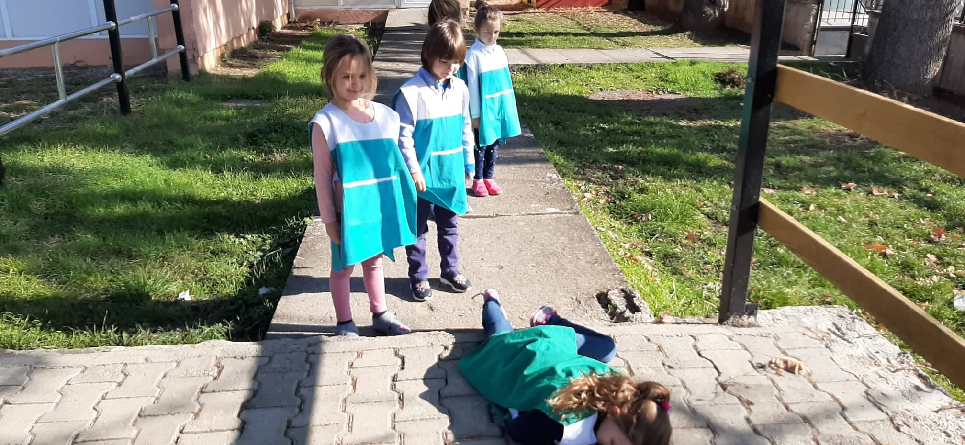
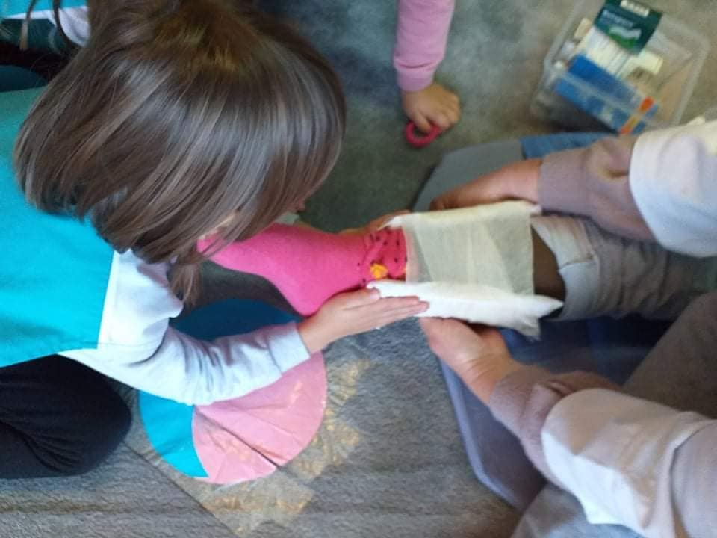
Situation 1: Lower leg fracture
-What has happened?
The girl fell on the stair
-How has happen?
the girl was running, she stumbled on the stairs and fell. She broke her leg
-What could have been done to prevent this accident?
When children run, they should be careful, especially in places where there are stairs in the yard. Talk to children about the dangers of uncontrolled running in places that are not flat

Slide 2
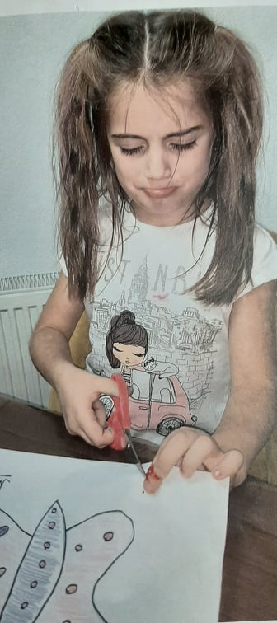
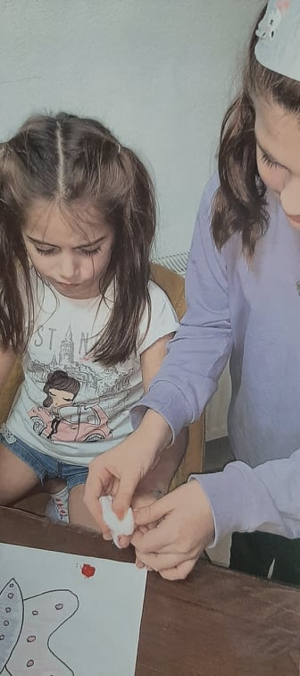
Situation 2: Bleeding
What has happened?
The girl cut her finger with scissors
How has happened?
She cut with scissors the butterfly she had drawn and painted it on paper .
What could have been done to prevent this accident?
Cutting with scissors is an activity that children love to do. sometimes due to carelessness they happen to be cut. Children will need to be told that scissors can be dangerous if not handled properly

Slide 3
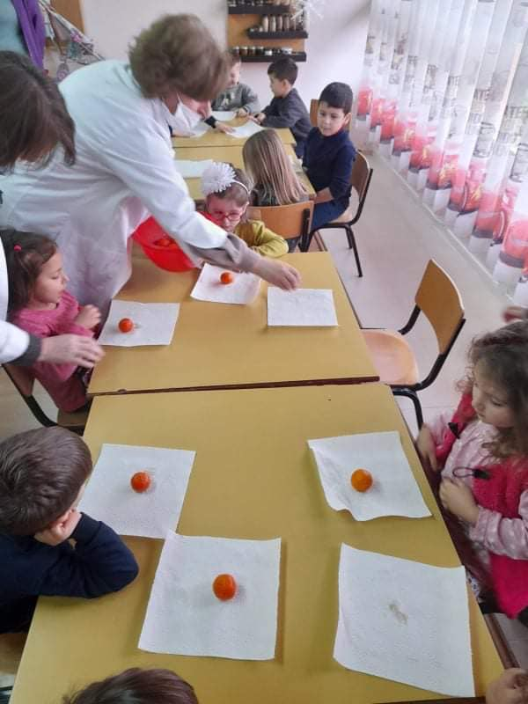
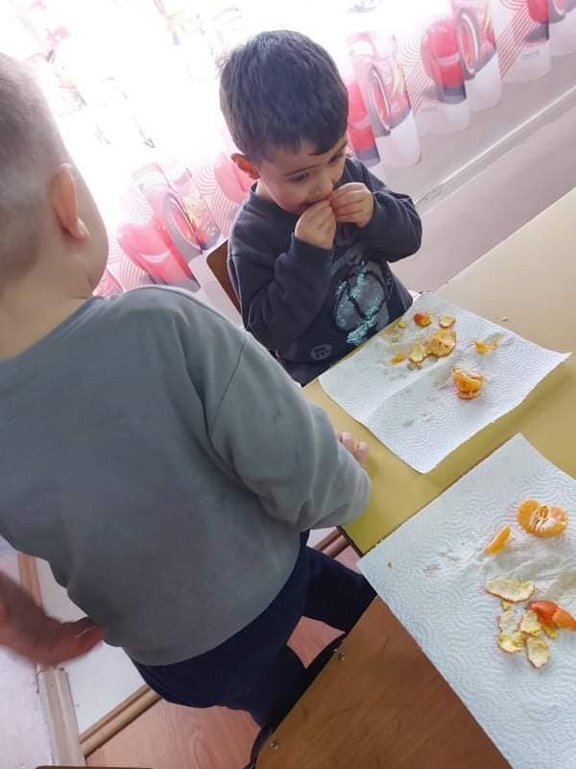
Situation 3:Choking with food
- What has happened?
The child began to choke
How has happened?
During the snack the child ate a tangerine. Small piece of the tangerine stopped in his throat.
What could have been done to prevent this accident?
Children often talk to each other at during the lunch time without paying attention to the food while chewing and swallowing it. Unfortunately, this situations are happening. Then we are discussing with the children at least while they are having lunch to refrain from talking.

