Slide 1
Silk
The silk is a natural protein fiber of animal origin.
Animal is the silkworm and is the larva or caterpillar of the domestic silkmoth, Bombyx mori.
The silk is composed of two proteins : fibroin and sericin.
Fibroin :
Sericin :

Slide 2
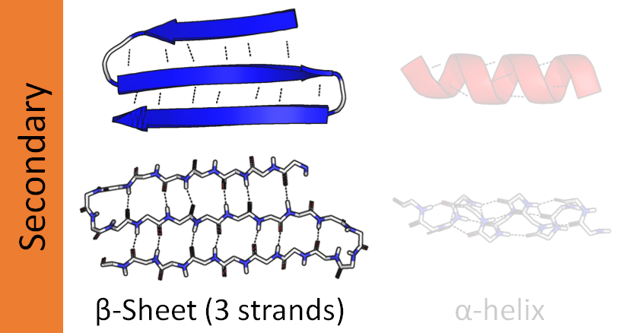
Silk
Uses of fibroin:
65% of the thread
High resistance, ruggedness
Flexible
Uses of sericin:
20%-25% of the thread
Coloring matter
GLYCINE
ALANINE
SERINE

Slide 3
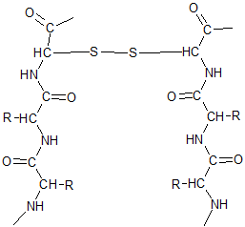
Wool

Slide 4
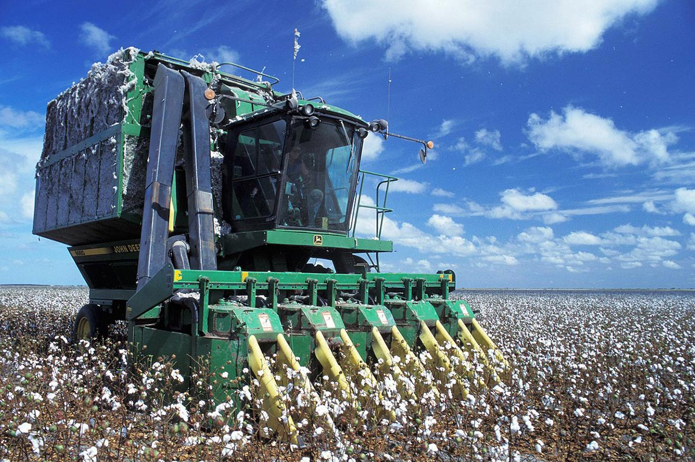
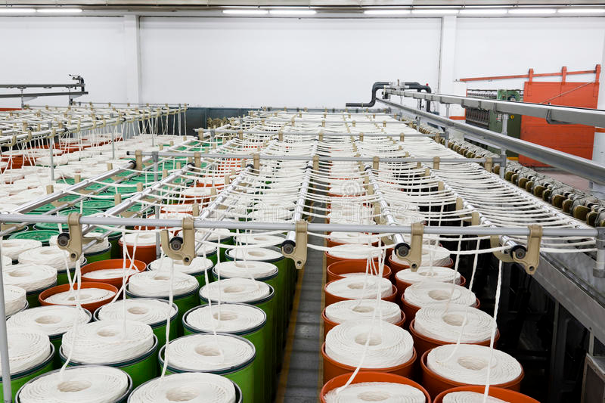
Cotton
Cotton is made of :
Cellulose : around 95 %
Protein : around 1,6 %
Waxes : around 1 %
Other : around 2,4 %

Slide 5
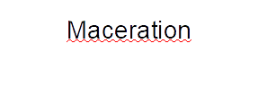
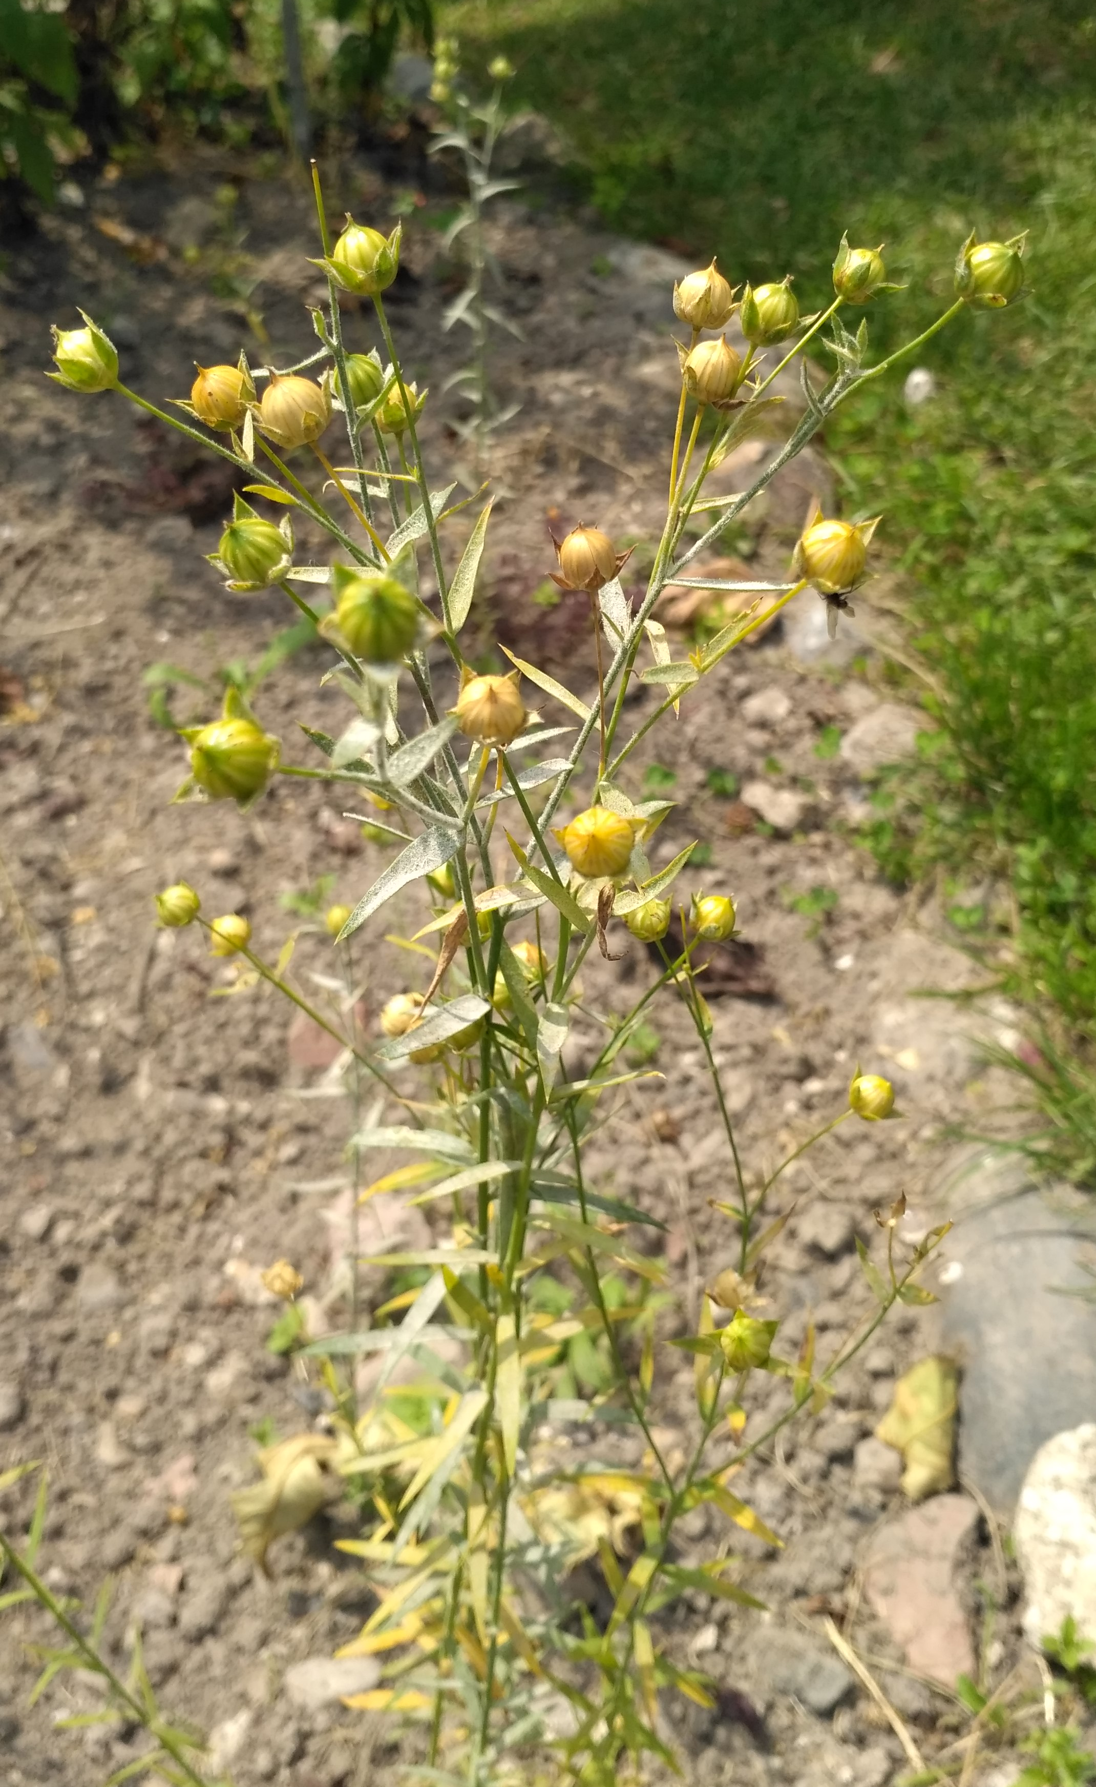
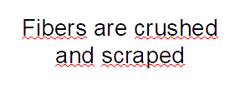
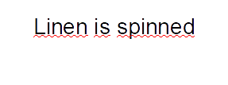
In clothing : Clothing is very much in the forefront of the use of linen in textiles. Linen stay fresh in the summer, is intrinsically antibacterial and hypoallergenic.
In upholstery textile : that is to say the textile that is dedicated to interior decoration, linen represents the natural that soothes us and which we like to surround ourselves with.
In technical fabrics : called flax composites, they are used in automotive, boats, sports equipment. Linen composites are a future alternative to the use of carbon and fiberglass.

Slide 6
