Slide 1
textile industry

Slide 2
Index
Effects for the environment of fibres and fabrics production.
Economics/Social aspects of fibres and fabrics production.

Slide 3
Effects for the environment of fibres and fabrics production
Pollution of rivers
Massive impact on developing countries,
harmful gases, dumping site
Particles in drinking water
Dermatology, stomach problems, signs of cancer
Create digestive problems
The second most polluting industry in the world

Slide 4
Pollution of rivers

Slide 5
Economics/Social aspects of fibres and fabrics production
2.1 Workers' wages
2.2 Labor conditions
2.3 Main brands:
2.4 Effects of globalization:

Slide 6
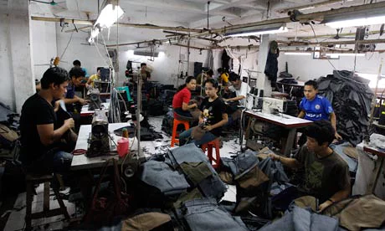
2.1 Workers' wages 2.2 Labor conditions
Workers’: Two dollars a days
Laboral conditions: Workers enslaved, suffering in third world countries, low wages and insecurity

Slide 7
2.3 Main brands
Leading brands: H&M, Zara, Primark, Forever21, Topshop, Mango, Joe fresh.
Alternative brands:
People tree
Hemper
http://www.peopletree.co.uk/
http://www.hemper.es/

Slide 8
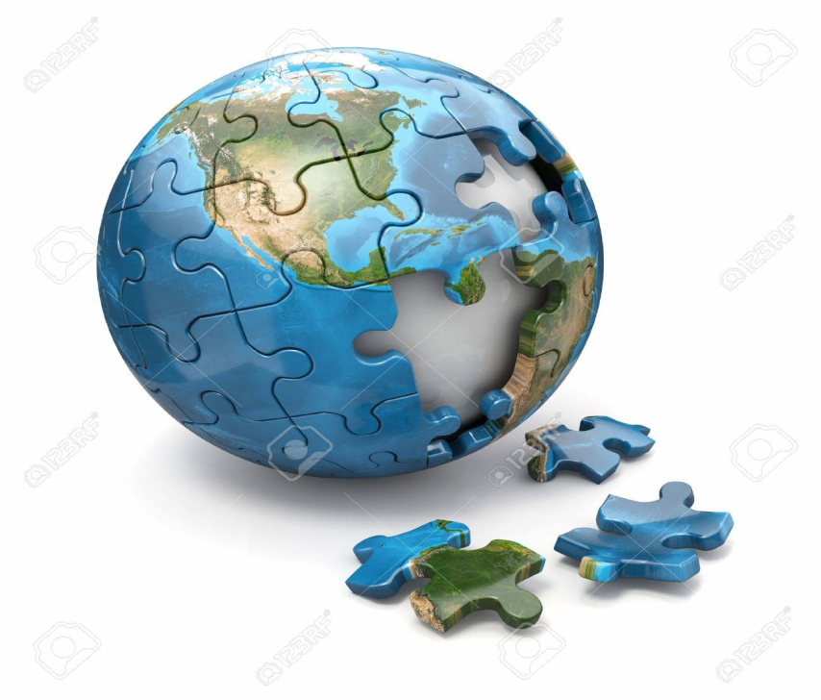
2.4 Effects of globalization
Globalization is the outsourcing of the manufacture of products to countries with cheaper workforce to later sell it in the developed countries

