Slide 1
Effects for the enviroment of fibres and fabrics production

Slide 2
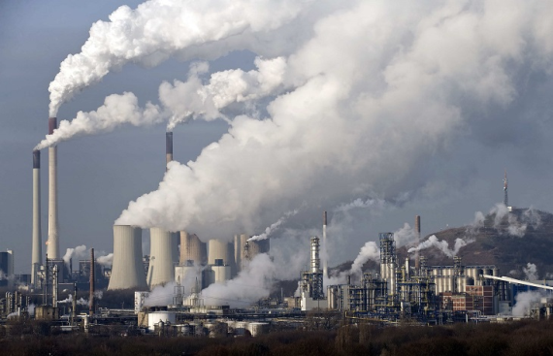
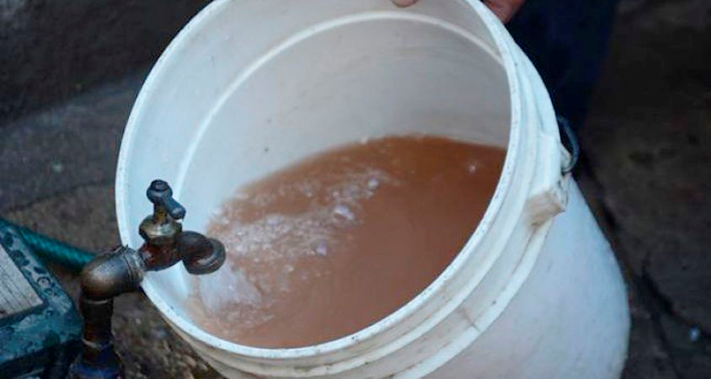
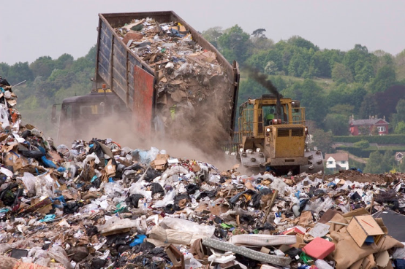
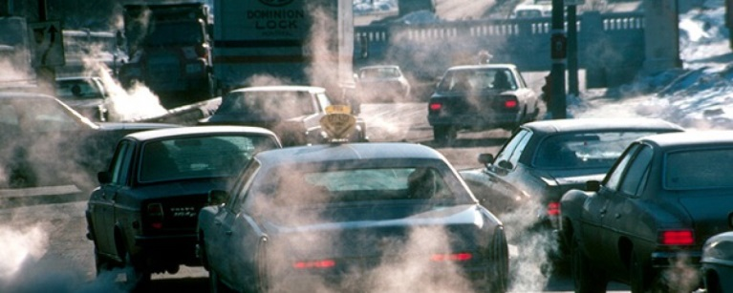
Economics /Social aspects of fibres and fabrics production
Impact gas damaging
Dumping site
Waste in water
harmful gases

Slide 3
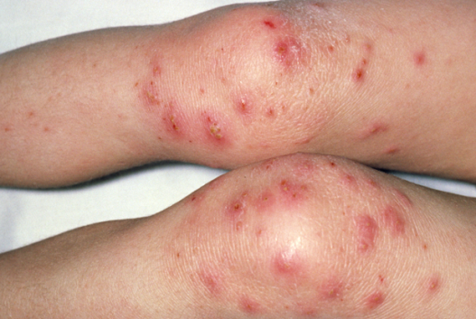
Dermatological problems
Cáncer
Stomach problems
Digestive problems

Slide 4
SOCIOECONOMIC ASPECTS OF THE MANUFACTURE OF CLOTHING
2.1- WAGES OF WORKERS
WAGES OF VERY LOW WORKERS
2 DOLLARS A DAY MORE OR LESS 1.80 A DAY
CIFRA DE NEGOCIO DE LA VENTA DE ROPA 3 MILLONES DE DOLARES

Slide 5
Labor conditions
2.4

