Slide 1
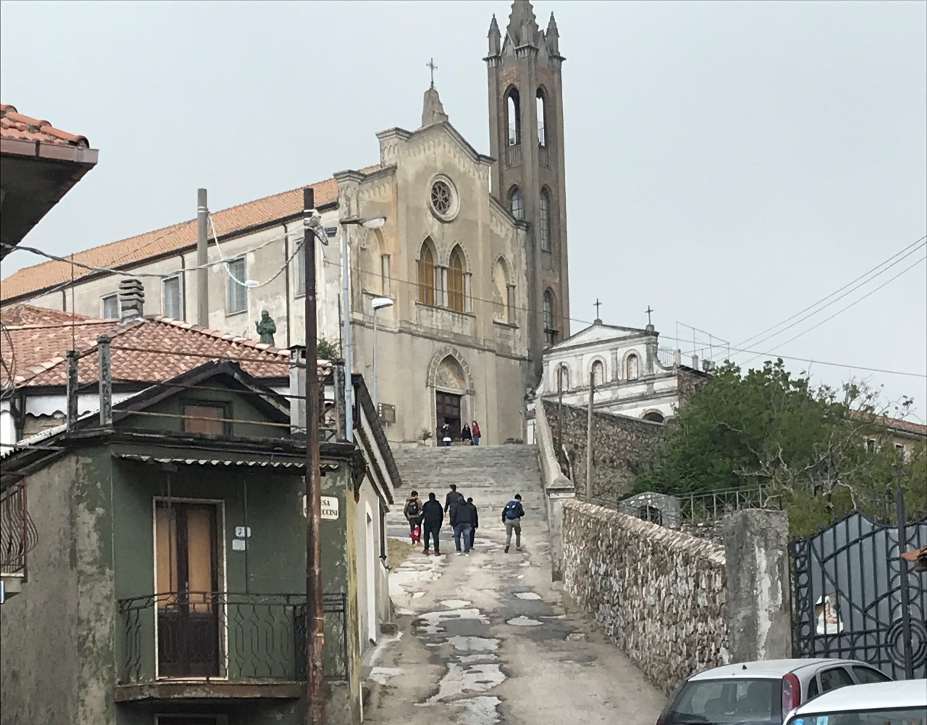
And then to Caphucin Friars Convent

Slide 2
With the museum of paesant tradition

Slide 3
…with ancient instruments

Slide 4
…and traditional fabrics

Slide 5
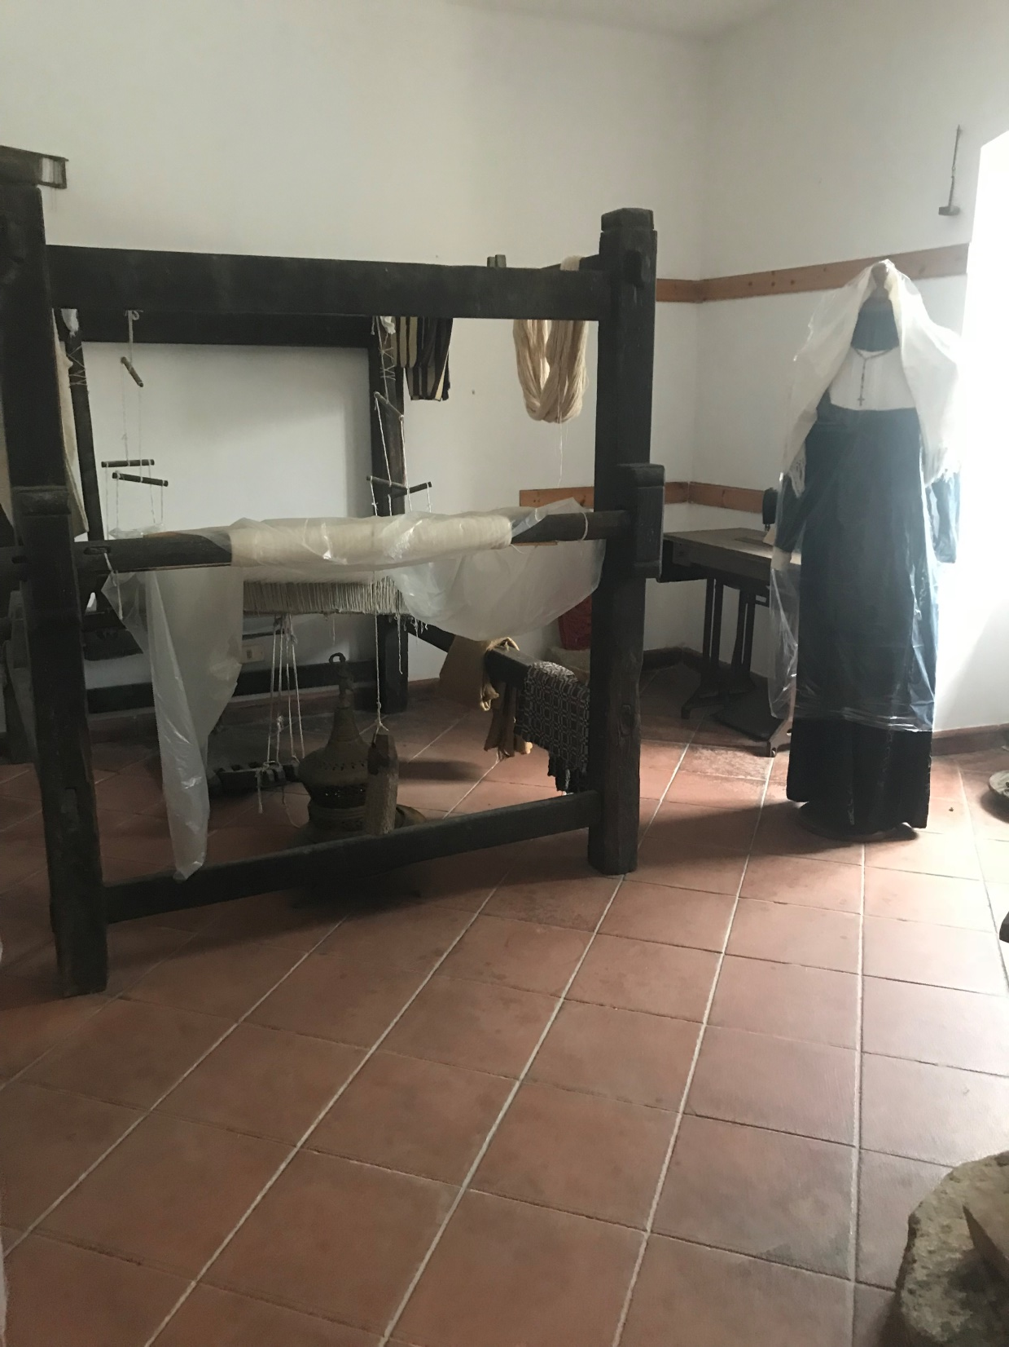
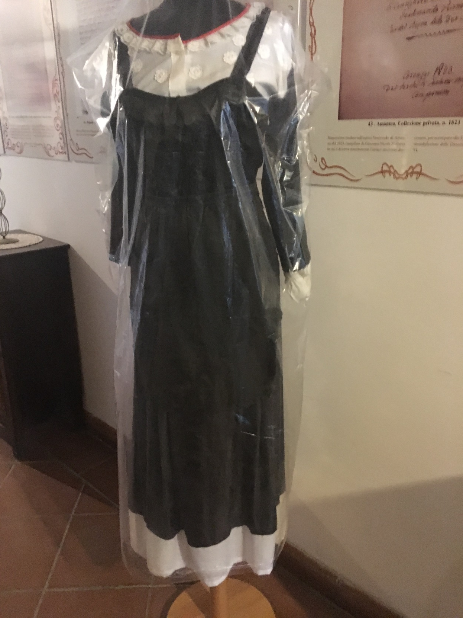
…and clothes

Slide 6
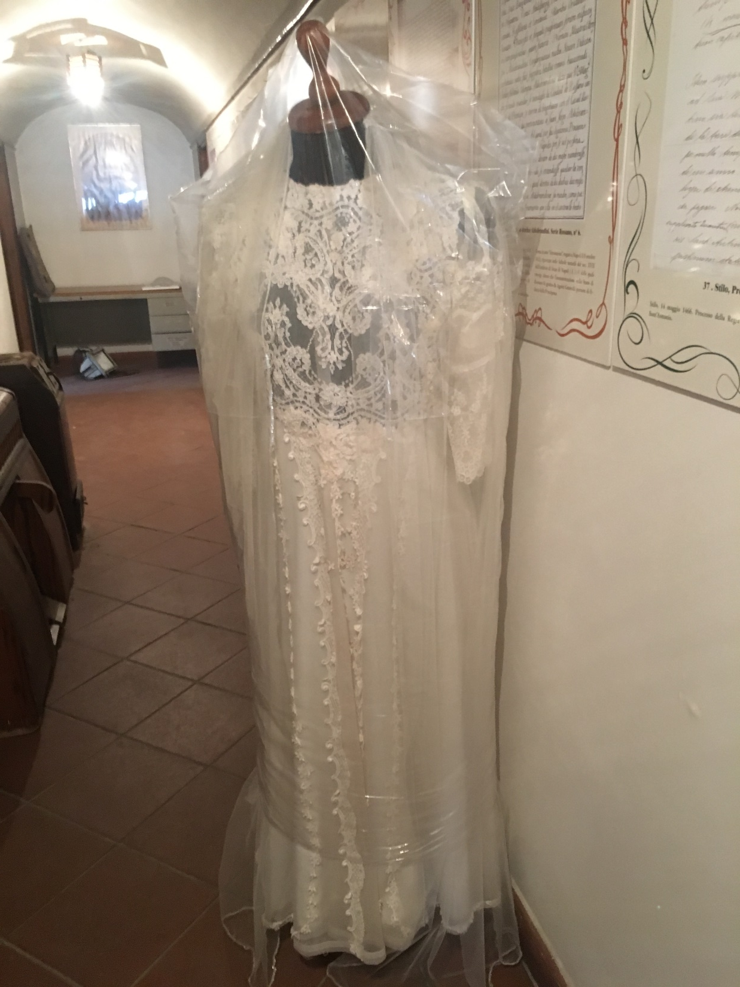
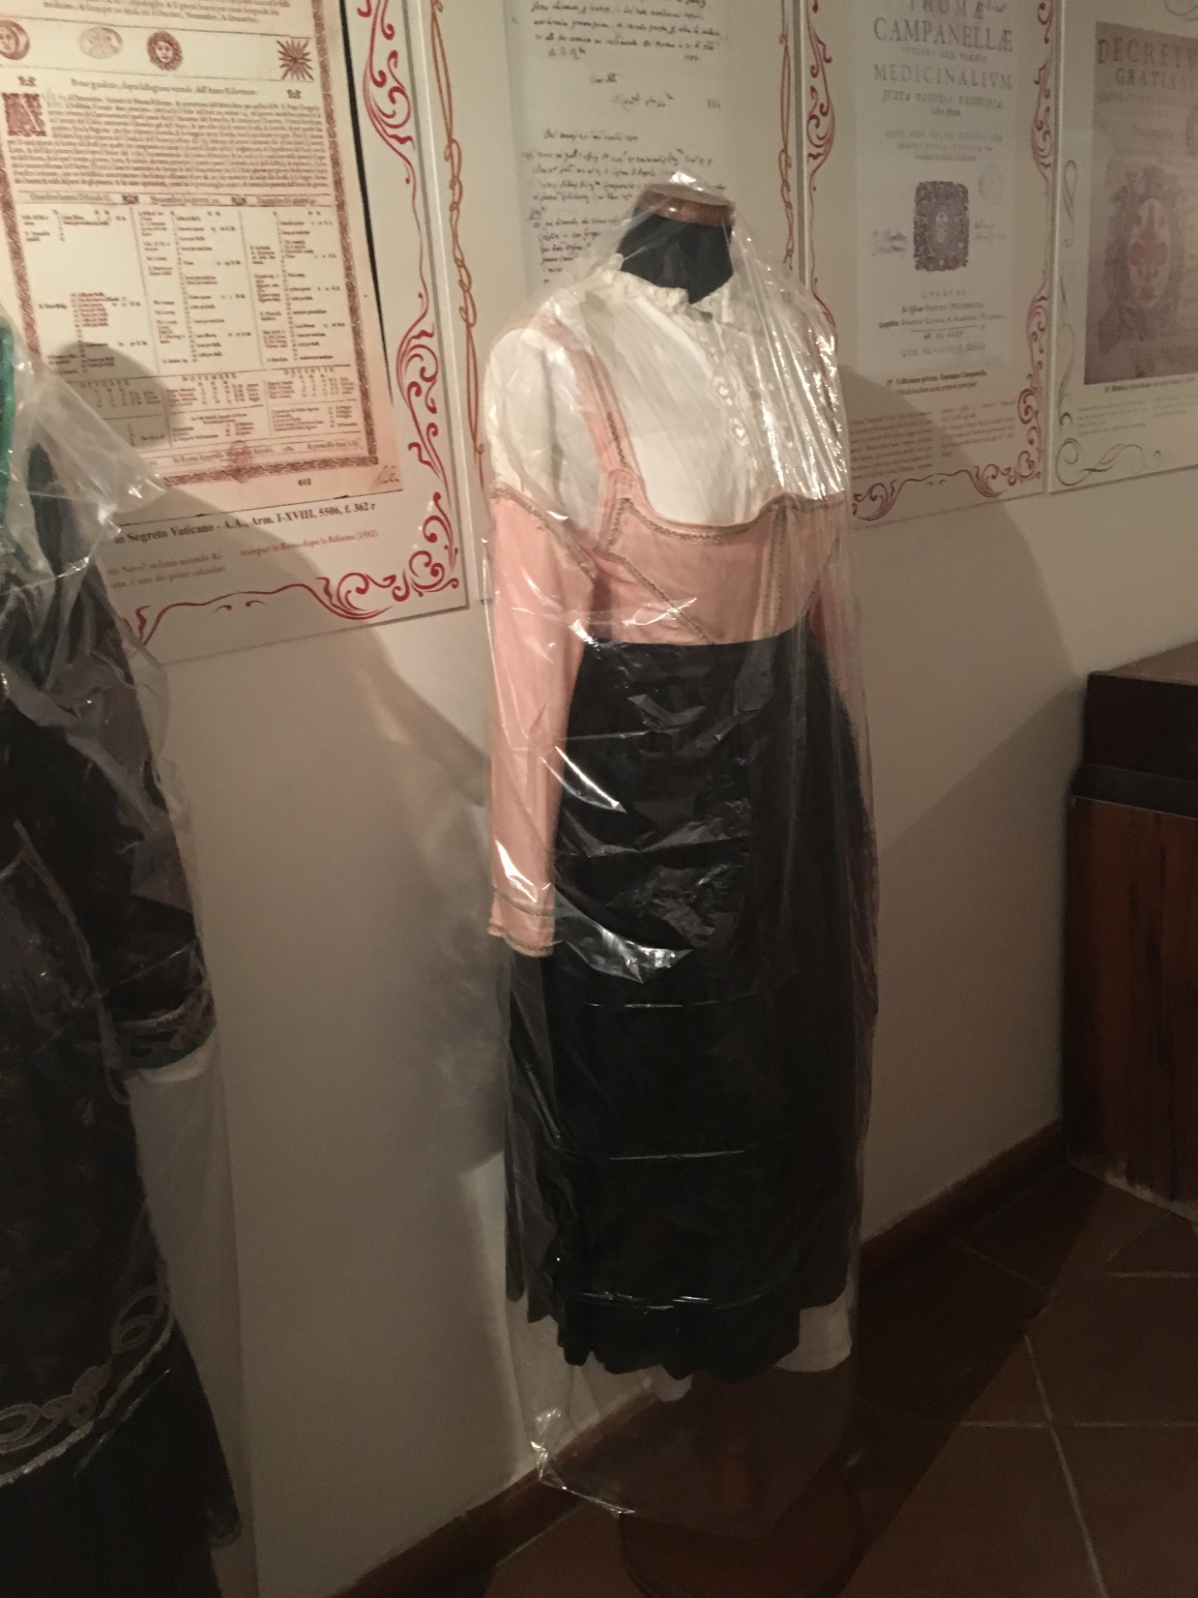

Slide 7
In «contrada Foresta», there is an old warehouse, now under renovation

Slide 8
Where ancient clothing is kept

