Slide 1
Effects for the environment of fibres and fabrics production

Slide 2
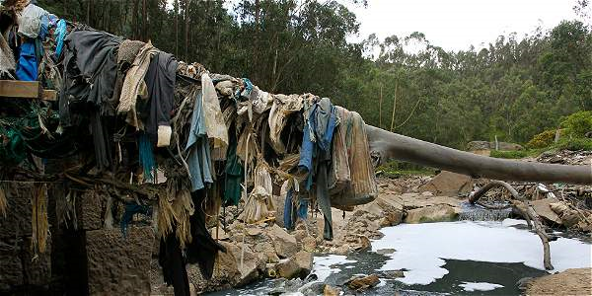
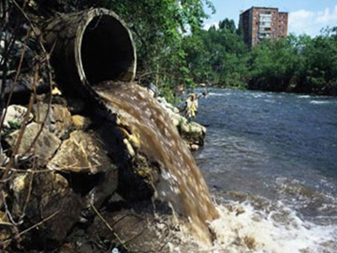
Pollution of rivers.
Massive impact in developing countries.

Slide 3
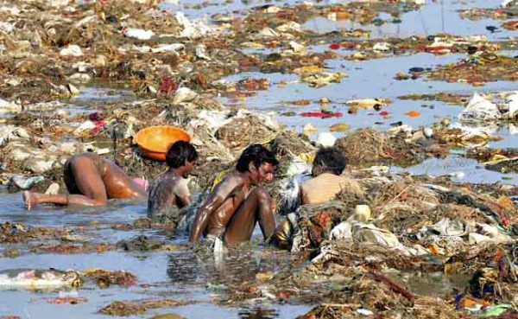
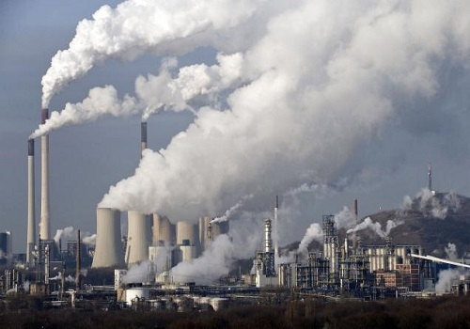
Harmful gases, dumping site.
Particles on drinking water.
The second industry more pollutant of the world.

Slide 4
Economics/Social aspects of fibres and fabrics production

Slide 5
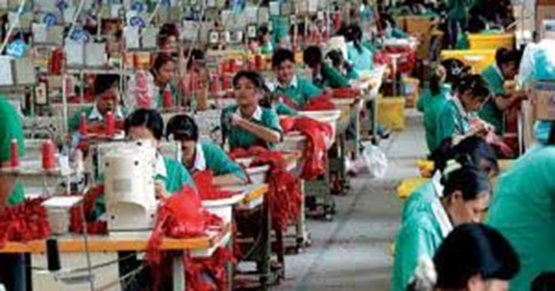
-2.1 Salary of workers:
Very low, two dollars a day.
Clothing selling: three trillion dollars business per year
-2.2 Labor conditons:
Workers clamed, suffering in third world countries.

Slide 6
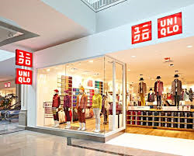
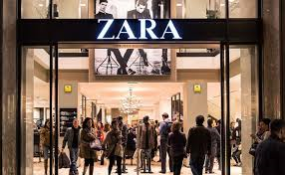
-2.3 Main brands:
Zara, H&M, uniqlo, primark, forever 21, top shop, gap, mango, Joe fresh.
-Alternative brands:
People tree, Hemper.
http://www.peopletree.co.uk/about-us/who-makes-our-products

Slide 7
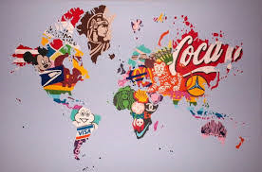
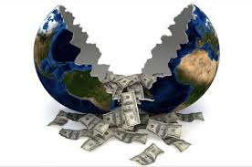
-2.4 Effects of globalization:
Globalization is the outsourcing of the manufacture of products to countries with cheaper labor for later sell them in developed countries.

