Slide 1
Fibre | Any product capable of being woven or otherwise made into fabrics; majority of fibres have a polymer structure.
Yarn | A set of textile fibres obtained by twisting or spinning.
Fabric | A structure produced by interlacing or interloping of the yarns.
Maps on classification in natural, man-made… and source made directly on GoogleDrive presentation
Table about code label made directly on GoogleDrive presentation

Slide 2
Almost all textile fibres have a polymer-based structure
protein-based
cellulose-based
synthetic polymer-based
e.g.
SILK
WOOL
e.g.
COTTON
LINEN
HEMP
JUTA
VISCOSE
ACETATE
RAYON
e.g.
POLYESTER
POLYAMIDE
(NYLON)
ACRYLIC

Slide 3
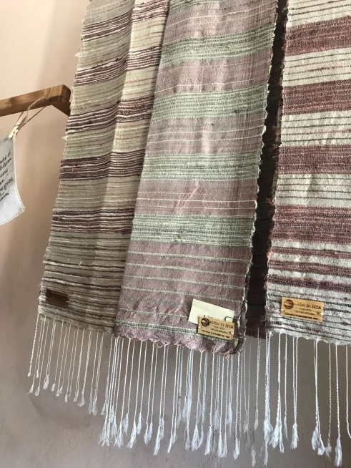
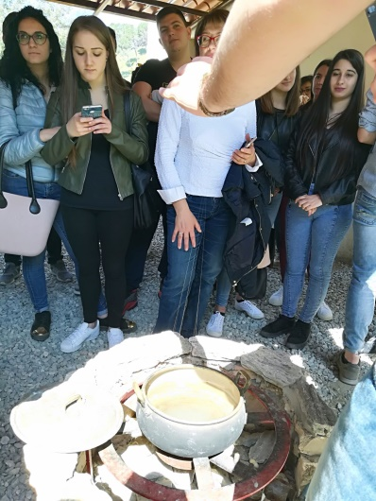
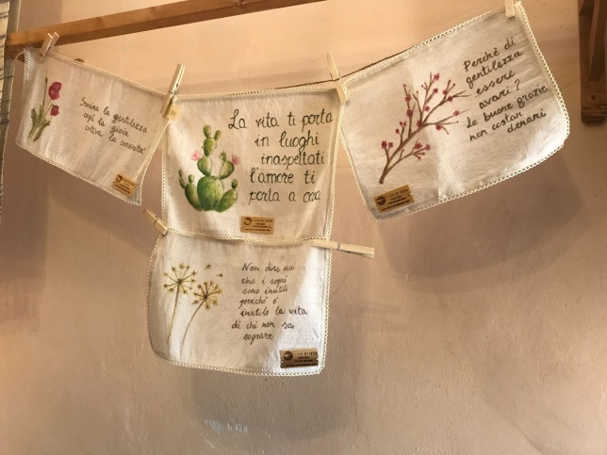
Silk filament is a double strand of fibroin, which is held together by sericin, a gummy substance, called «silk gum».
Their main role of sericin is to envelop the fibroin.
The sericin dissolves in water, but not completely, so when the filaments are pulled up, the remaining sericin dries to air and holds the threads together.
“Degumming” is the process of removing the sericin.
In presence of sericin the fibres are hard and tough and become soft and lustrous after its removal. For this reason, raw silk with the gum still on the filament is called “hard silk”; degummed silk is “soft silk”.

Slide 4
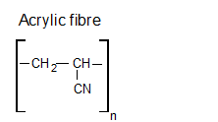
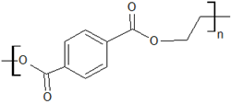
As silk, also the wool is a protein fibre: it contains the “keratin”.
Fibrous keratin molecules supercoil to form a very stable, left-handed superhelical motif.
Wool is made of :
Keratin: around 33%
Grease: around 28%
Suint: around 12%
Other: around 26 %
Synthetic fibers are obtained in the laboratory, generally derived from a condensation reaction.

Slide 5
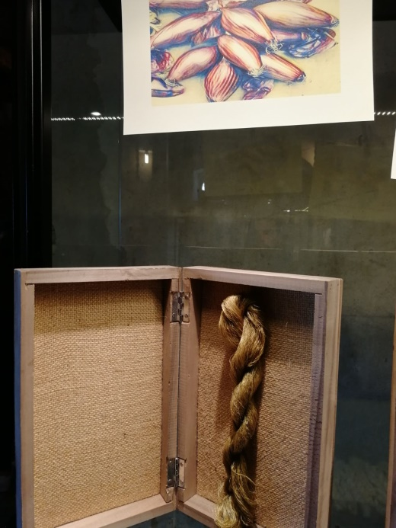
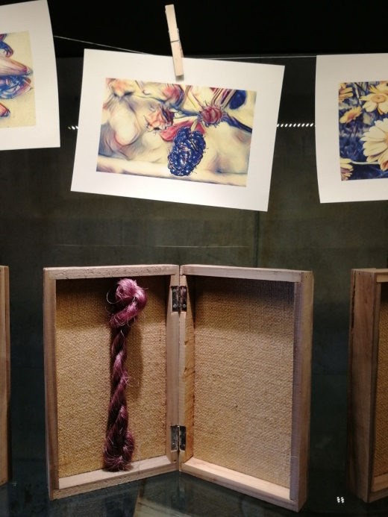
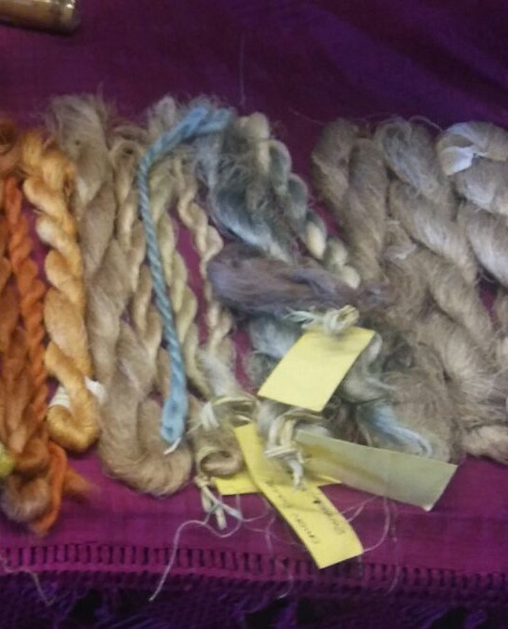
Some natural pigments

