Slide 1
FROM ESPARTO
TO CARPET

Slide 2
index
Crevillente.
A little bit of a history.
Where does it come from?
A very important industry.
Carpet evolution.
Factory of Crevillente's carpets
5 Best Crevillente carpet stores.
Carpet making.

Slide 3
From esparto

Slide 4
To carpet

Slide 5
CREVILLENTE
Crevillente is a municipality in the Valencian Community, Spain. It is located in the Sierra de Crevillente , in the province of Alicante, and its neighbour with the municipality of Elche, has 28 836 inhabitants
Crevillente has also stood out for its traditional carpet industry, which has conferred the nickname of City of the Carpet.

Slide 6
A little bit of history
At the beginning of the twentieth century, with the arrival of the first mechanical looms, in Crevillente we began to weave wool rugs. The manufacture of Esparto does not cease, but the mechanical looms and the great work of a whole people for decades allow to be able to locate Crevillente in the carpets map of the world.

Slide 7
Where does it come from?
As in the eighteenth century Crevillente was abundant the ancient mats of Esparto that were carried out manually since Arab period. In the middle of the XIX century the Esparto fillet appeared, obtaining a very high production. This is when one of the first hand looms (the grid loom) was introduced, with a large number of parts that will have the mechanical and automatic looms later.

Slide 8
A very important industry
Crevillente carpet Industry occupies the first place in domestic production and export. The industry sinks its deepest roots in the artisanal production of Esparto and Reed, products that were sold, already in the 16th century.

Slide 9
Carpet evolution
These pieces of stamens were coupled to the wooden looms and made the drawing of these through a cartonnages holes, which had already increased, so, you can talk about mixed loom, rod, double-sided and torsion bar. In the twentieth century mechanical looms were introduced, which replaced the hand looms, bringing their manufacturing process as we know it today.

Slide 10
A Factory of Crevillente's carpets: Alfombras Hispania
Carpets Roman Spain is a Spanish company with a long experience in the manufacture of carpets. In functioning from 1929. We find her in Crevillente, City of the Carpet, and modal in the sector, thanks to the experience of the whole life of dedication and love for the product.

Slide 11
The looms used by Factory of Crevillente's carpets
They use three mechanical looms, with a few characteristics of different manufacture, and that changes depending on the carpet that we are going to weave, according to height, density and size of the tapestry. The third loom, which can make up to a maximum width of 3 meters takes the same number of bodies of colors and 9.108 bobinas.son capable of supporting the step of the years and a hard load of work, supporting an excellent precision.

Slide 12
5 Best CREVILLENTE Carpet stores
Unifam Unión Fabricantes Alfombras Moquetas Revestimiento (5/5)
http://ceeielche.emprenemjunts.es/?op=36&id=13292
Alfombras Nelo (4,8 /5 )
https://www.alfombrasnelo.com/
Alfombras imperio 1979 (4,7/5)
http://www.alfombrasimperio1979.com/tienda/alfombra-crevillente-circulos-p-345.html
ALFOMBRAS Y TAPICES TADI SL (4,6/5)
http://www.infocif.es/telefono-direccion/alicante/alfombras-y-tapices-tadi-sl
RUGS BY IN LINE, S.L (4,5/5)
http://www.infocif.es/ficha-empresa/rugs-by-in-line-sl

Slide 13
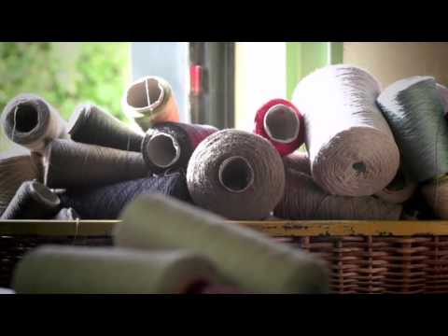
Carpet making

