Slide 1
BALIKESİR KARESİ PUBLIC TRAINING CENTER
FOTOGRAPH ALBUM

Slide 2
Our School Logo

Slide 3
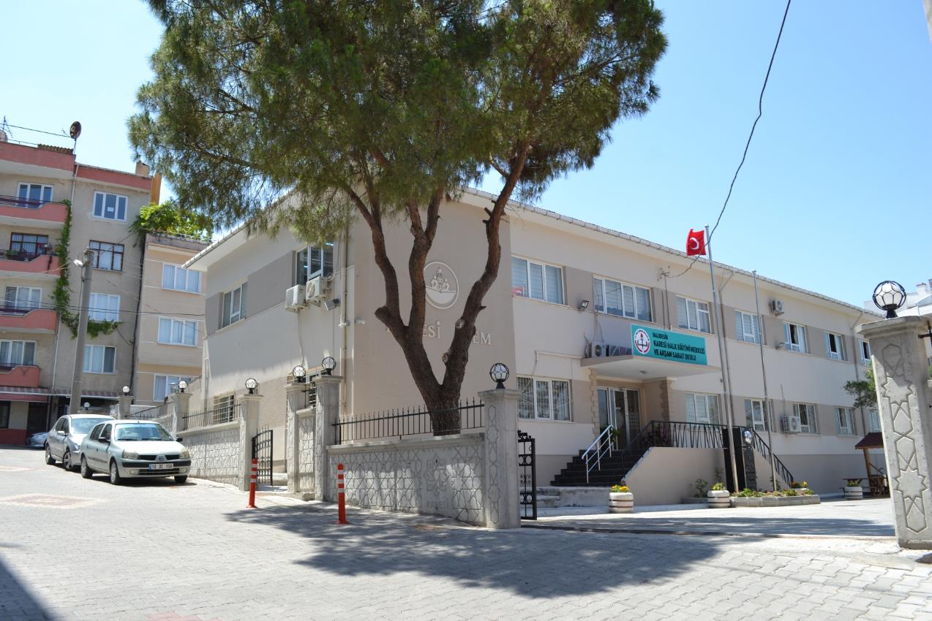
Our School

Slide 4
School Entrance

Slide 5
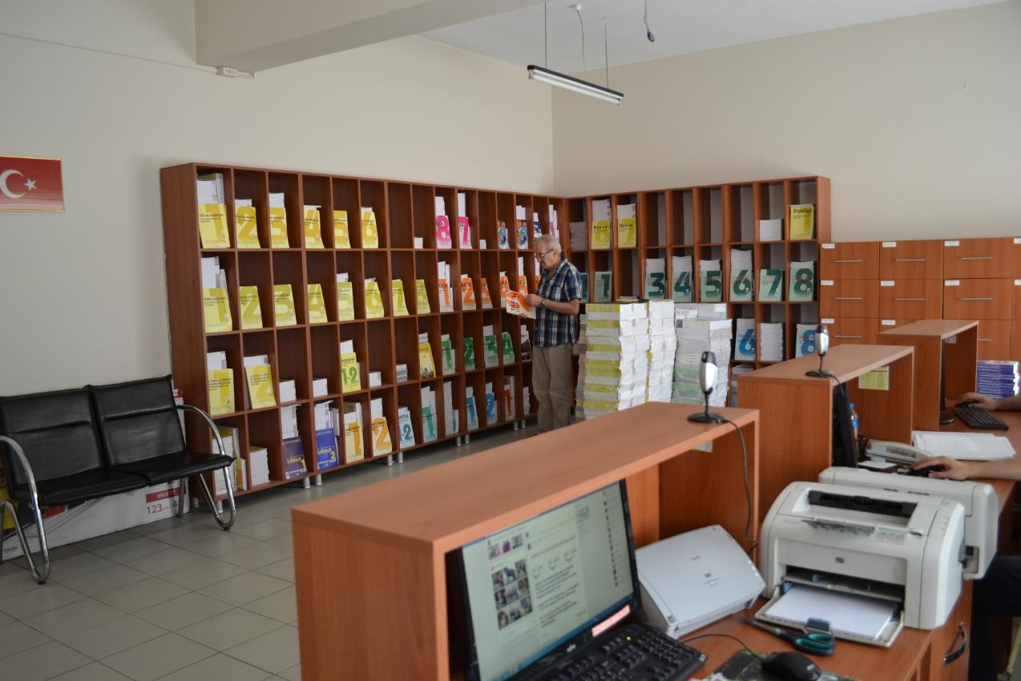
School Desk

Slide 6
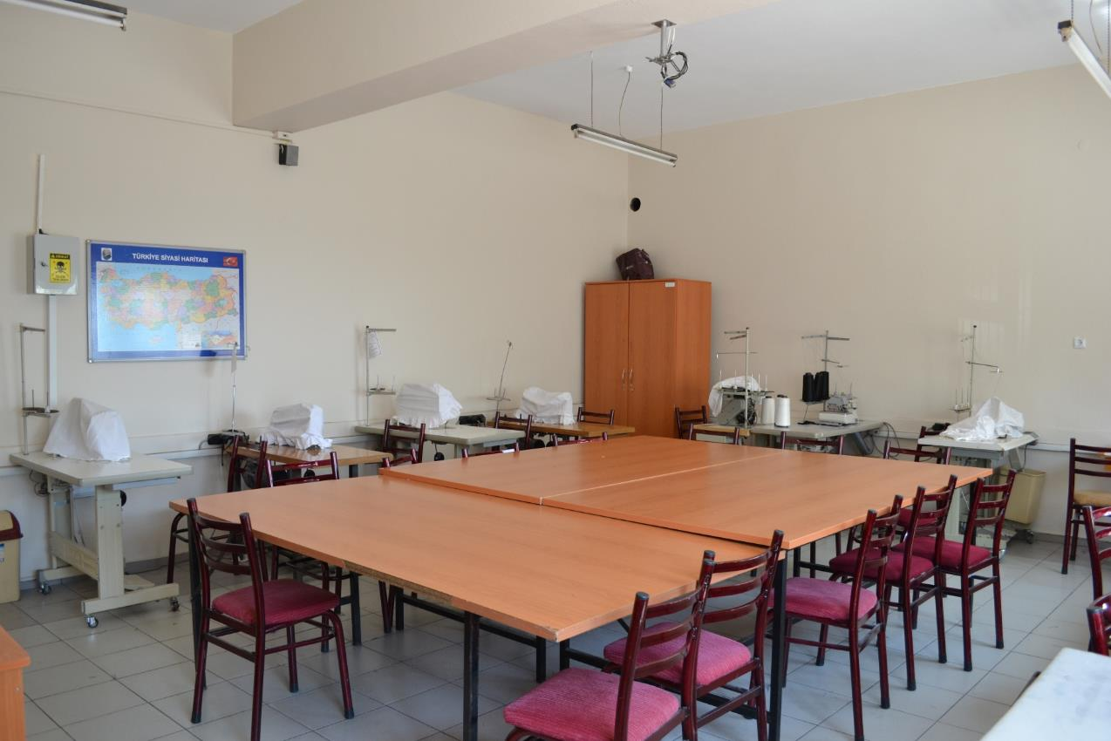
Clothing workshop

Slide 7
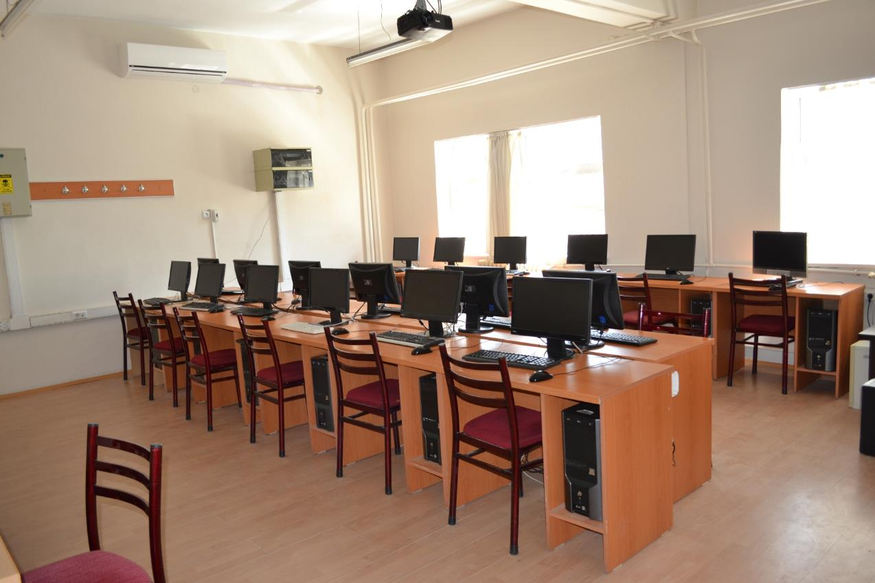
Computer classroom

Slide 8
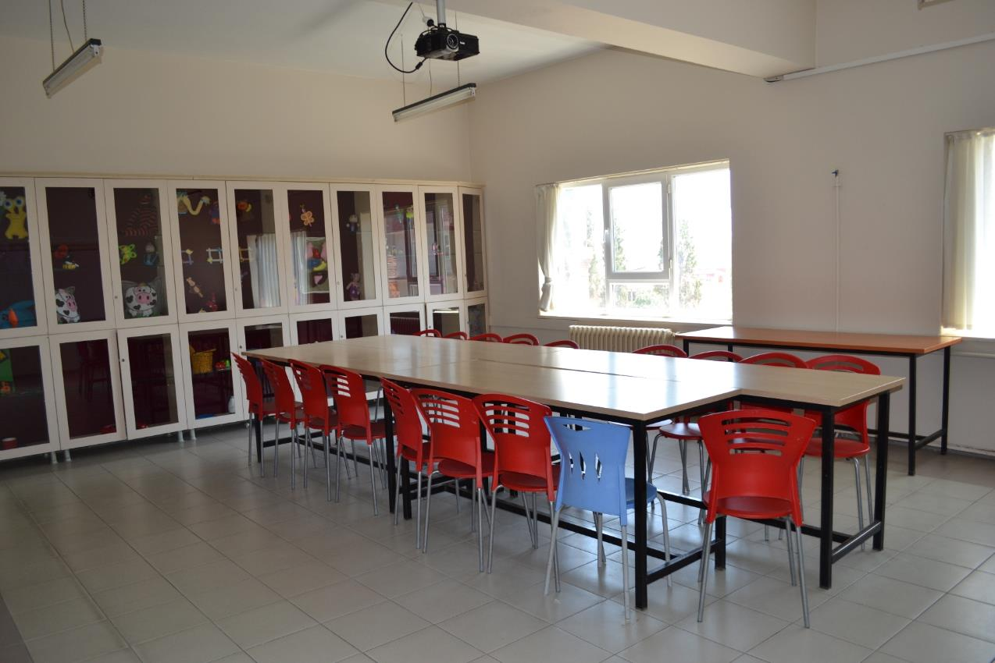
Child development and education class

Slide 9
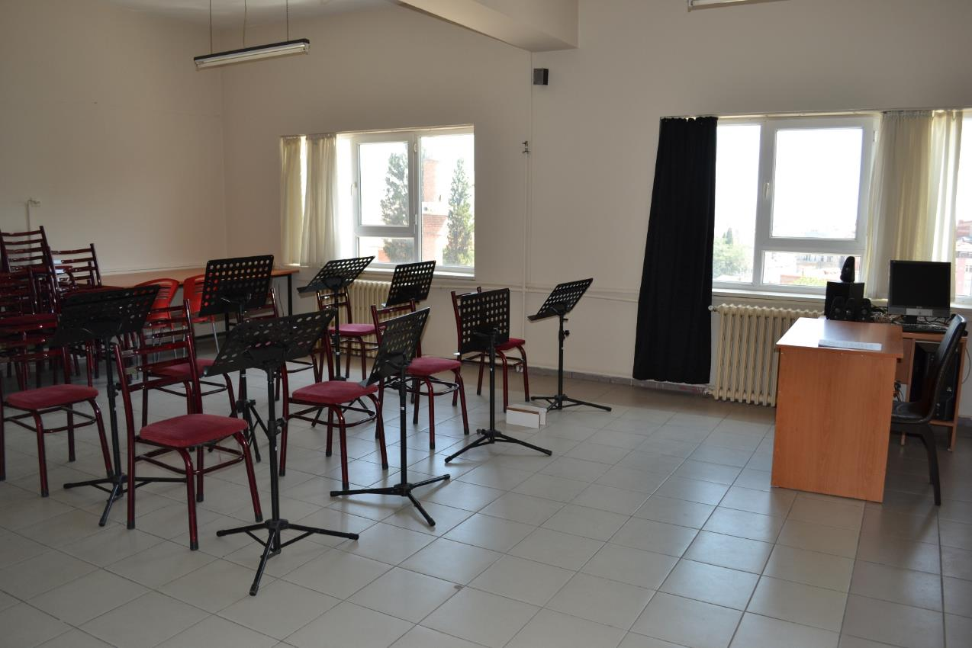
Music class

Slide 10
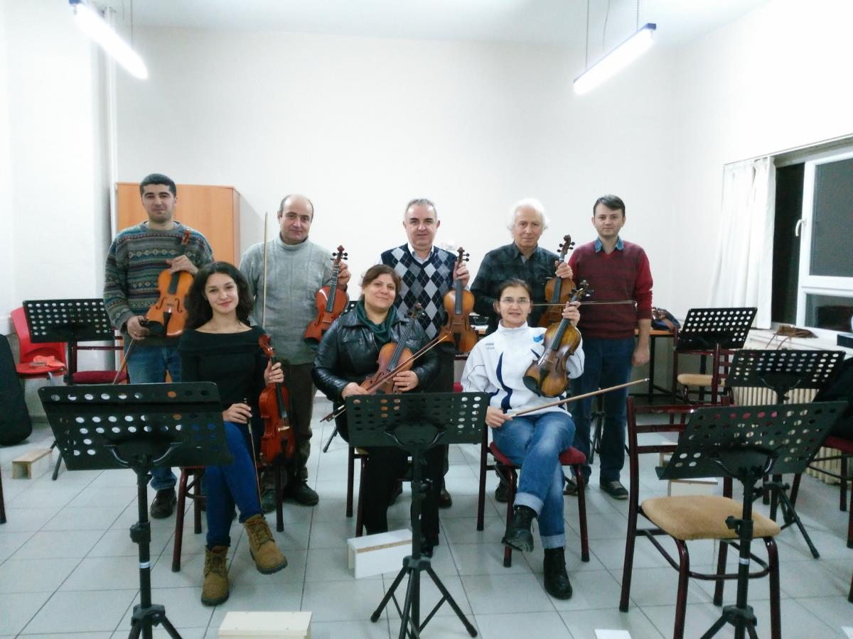
Music trainees

Slide 11
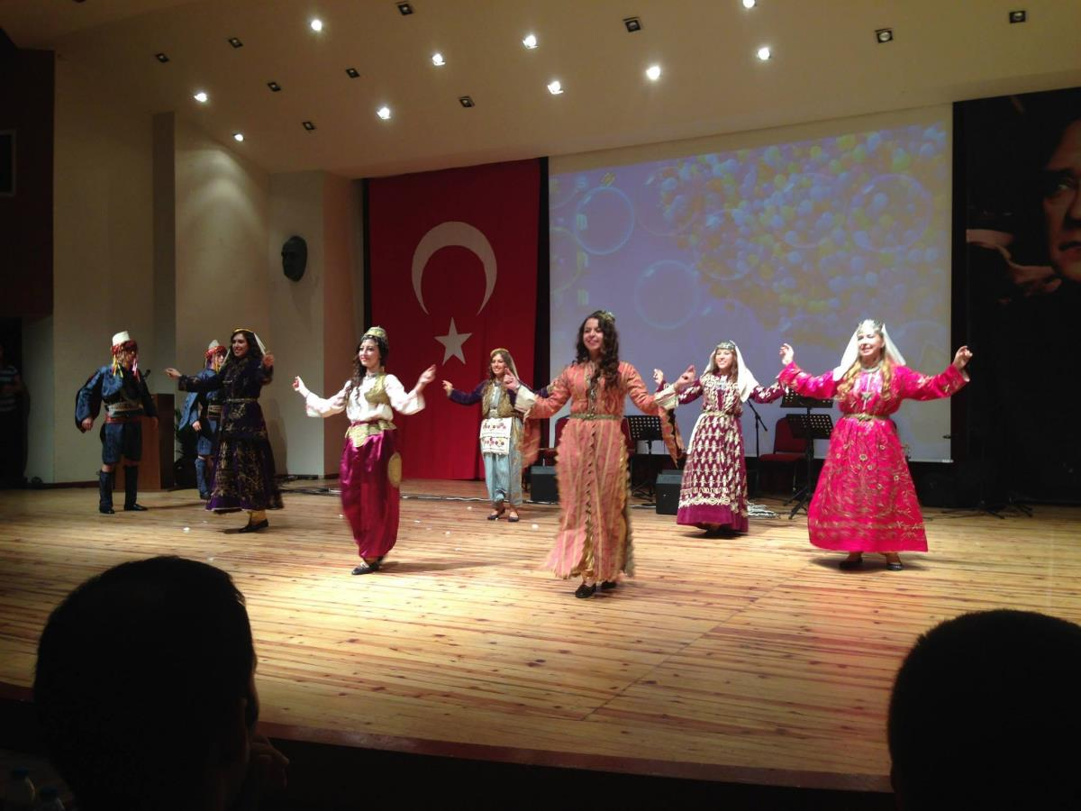
Year festival(traditional clothes)

Slide 12
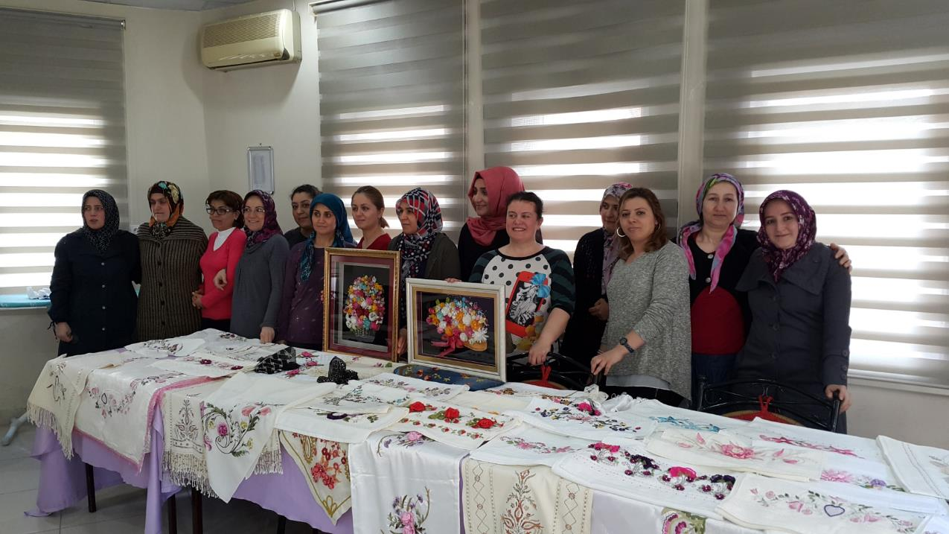
Embroidery course exhibition

Slide 13
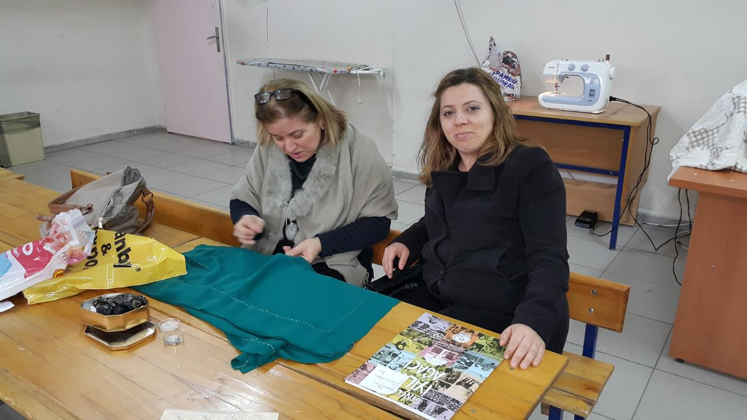
Clothing course

Slide 14
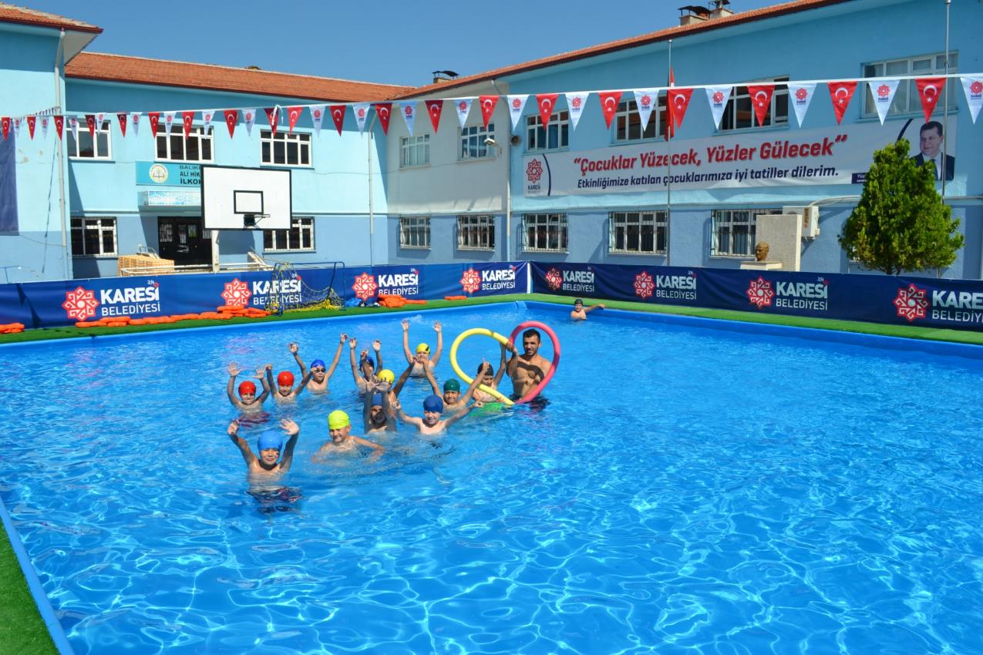
Swimming course

Slide 15
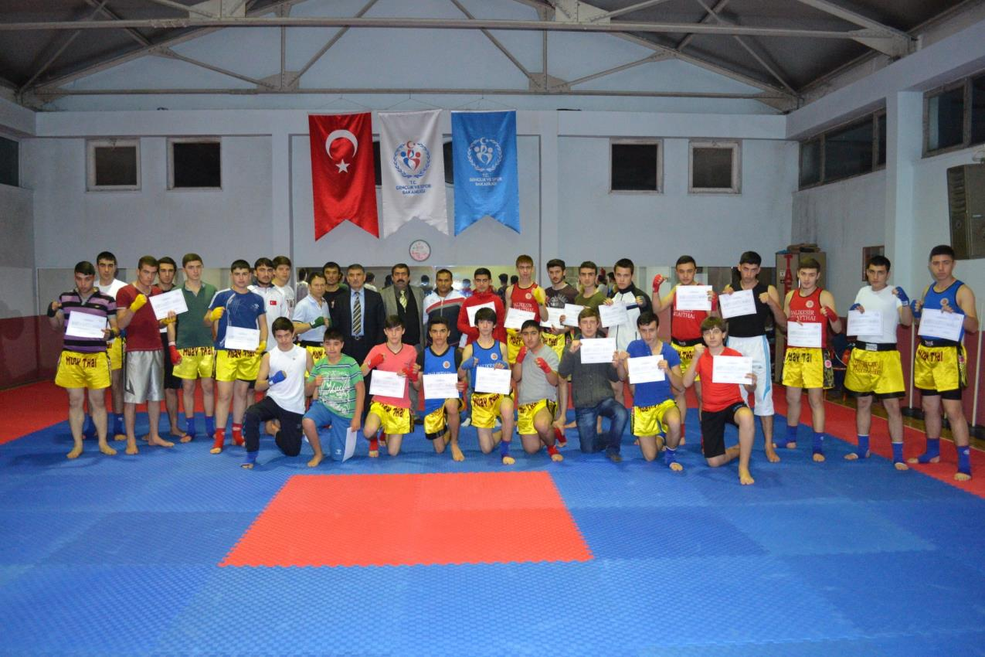
Spore course

Slide 16
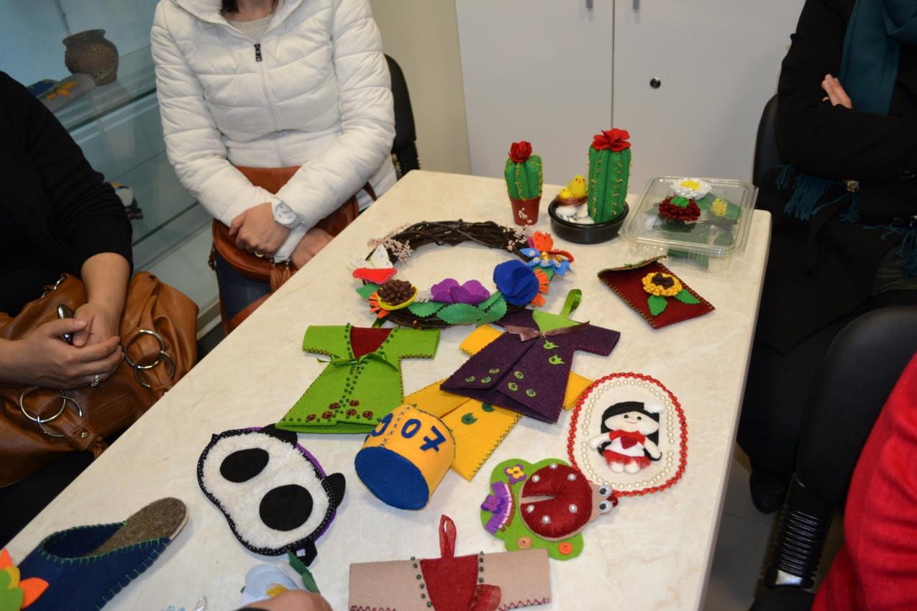
Felt accessories course

Slide 17
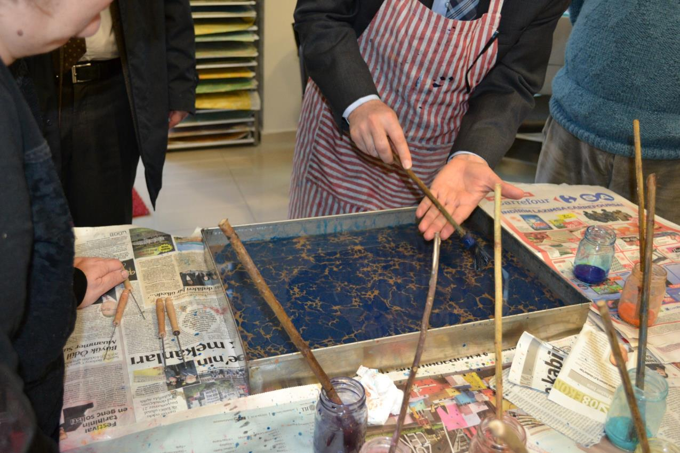
Traditional Ebru Course

Slide 18
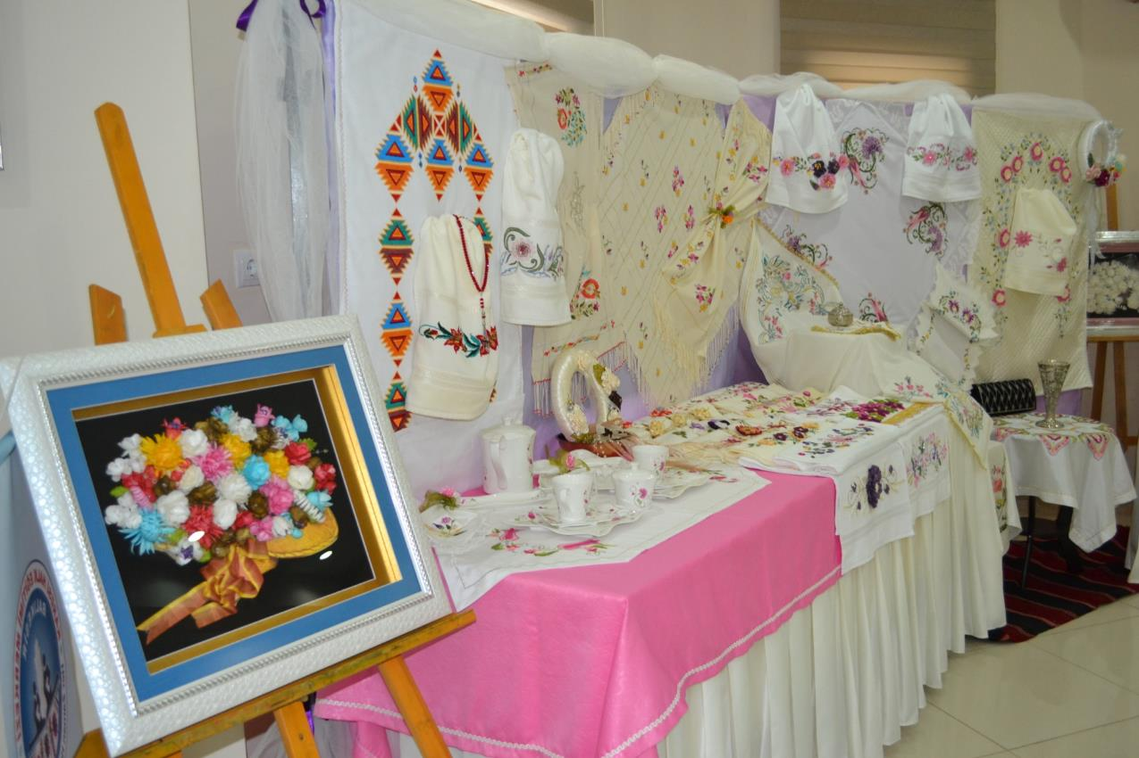
Handicrafts course

Slide 19
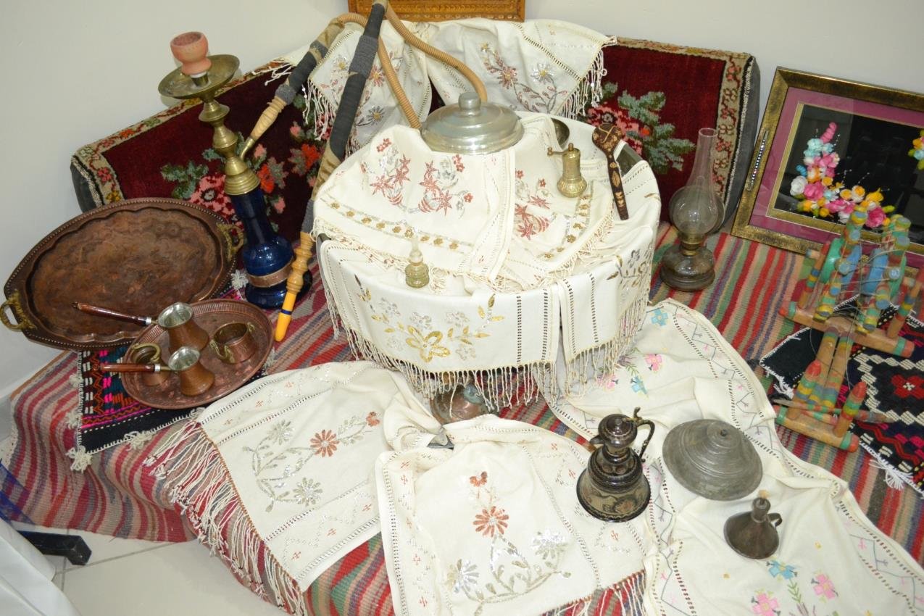
Handicrafts course

Slide 20
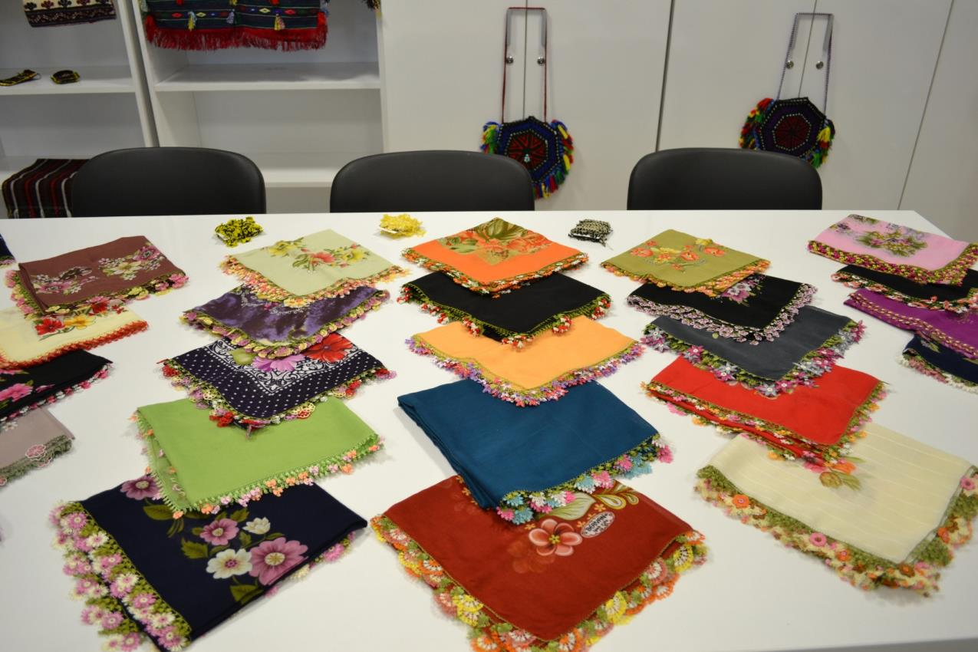
Needle lace course

Slide 21
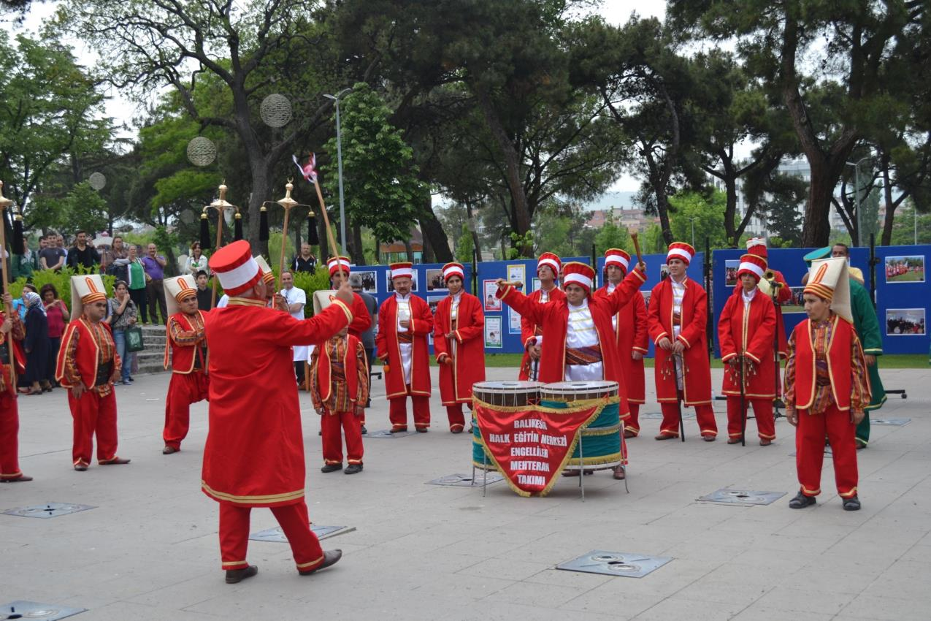
Mehteran Team

Slide 22
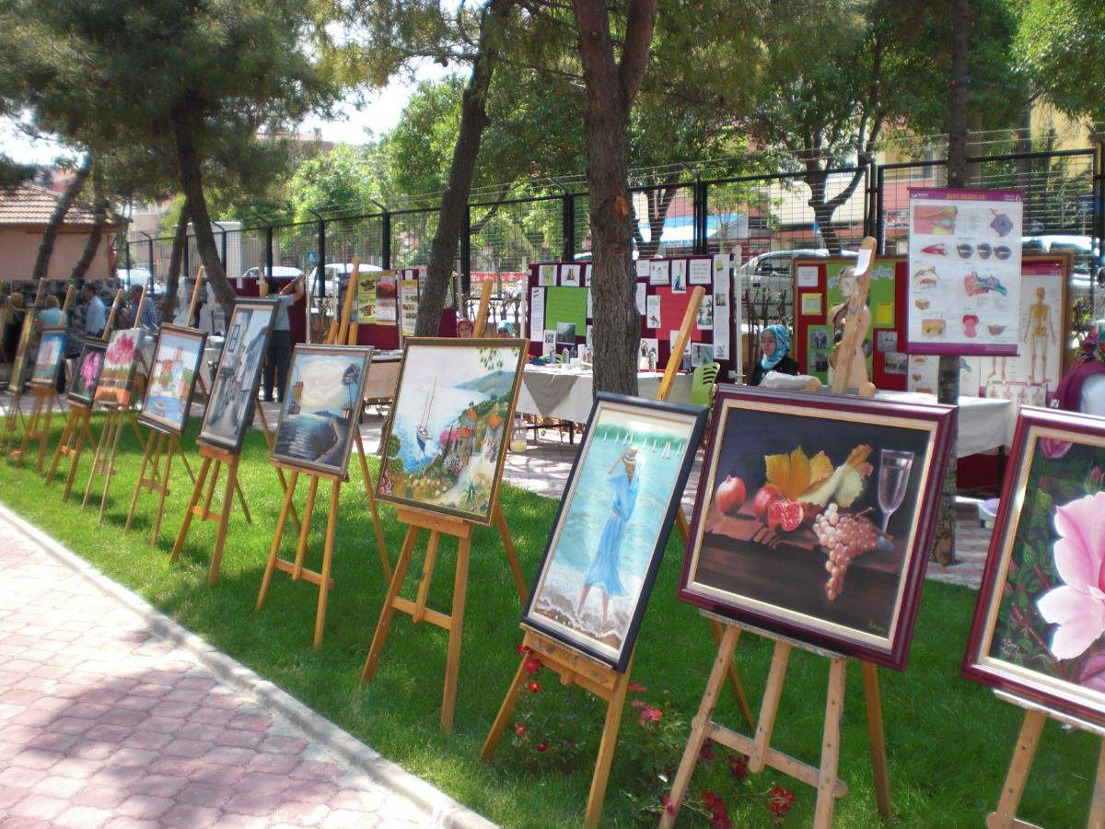
Oil painting exhibition

Slide 23
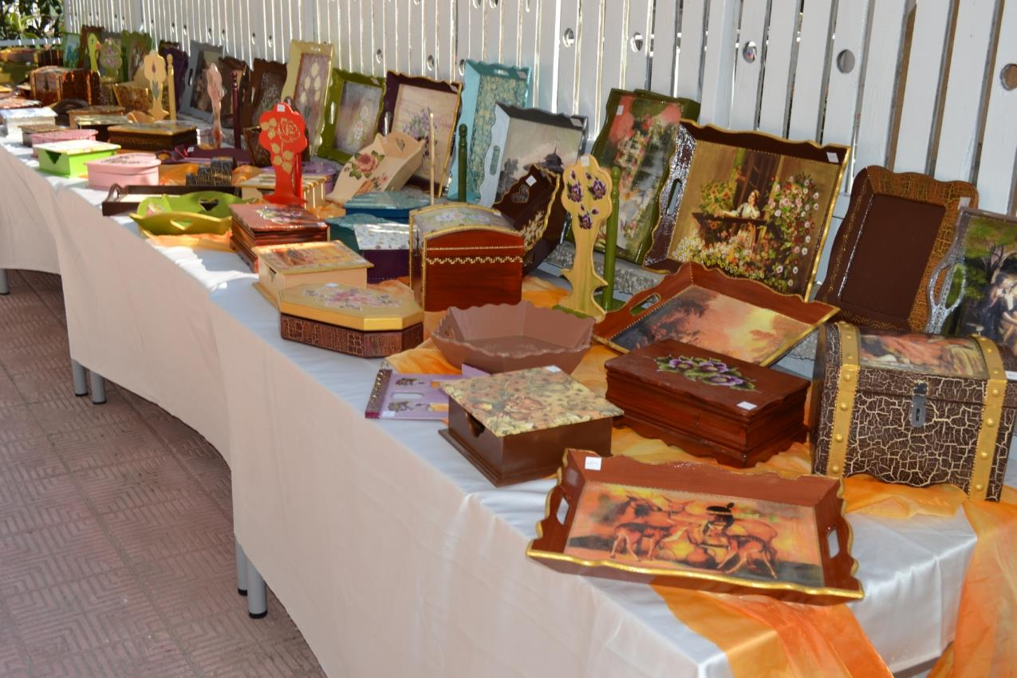
Wood painting course

Slide 24
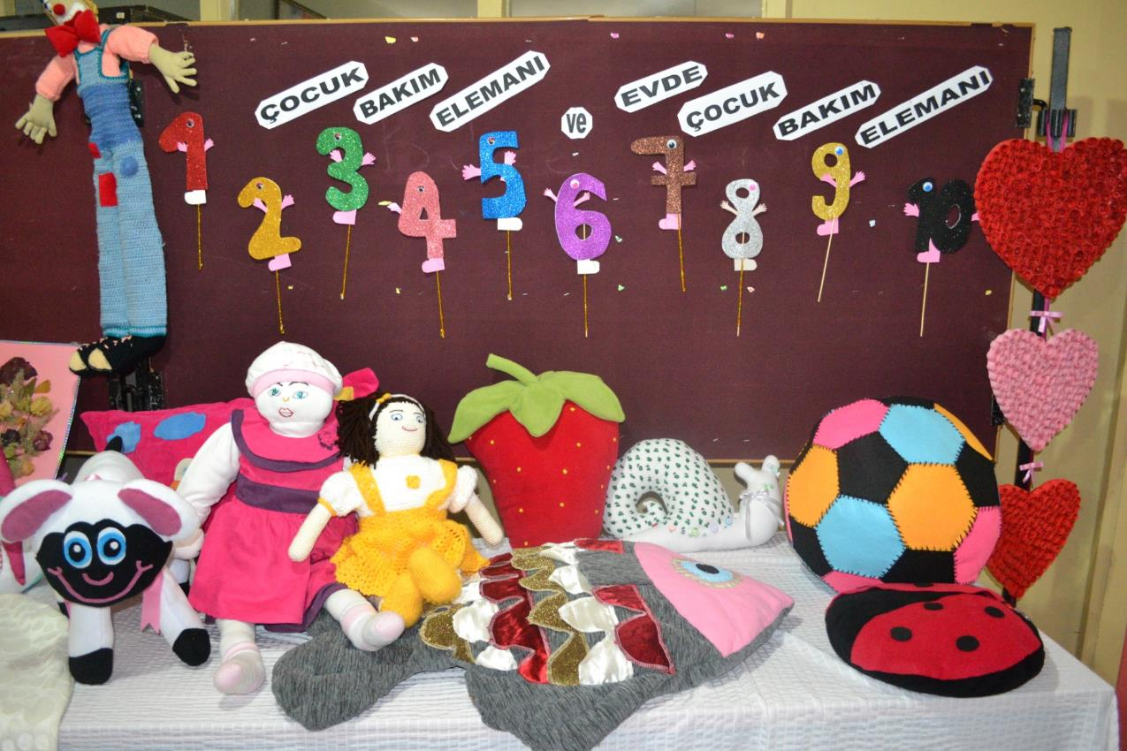
Child care staff

Slide 25
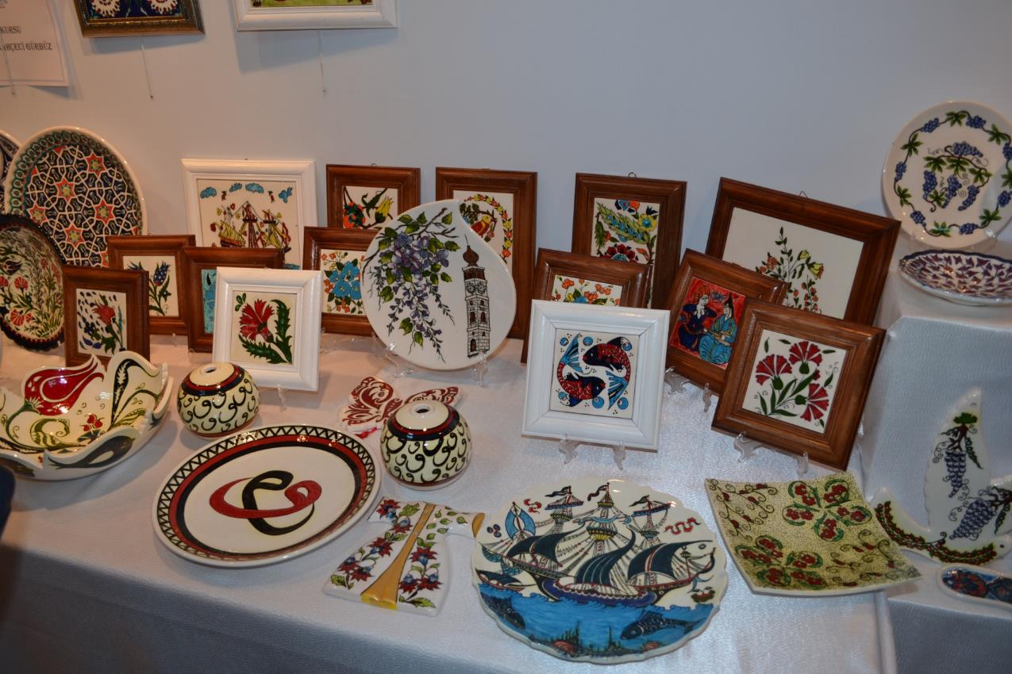
Tile,ceramik course

Slide 26
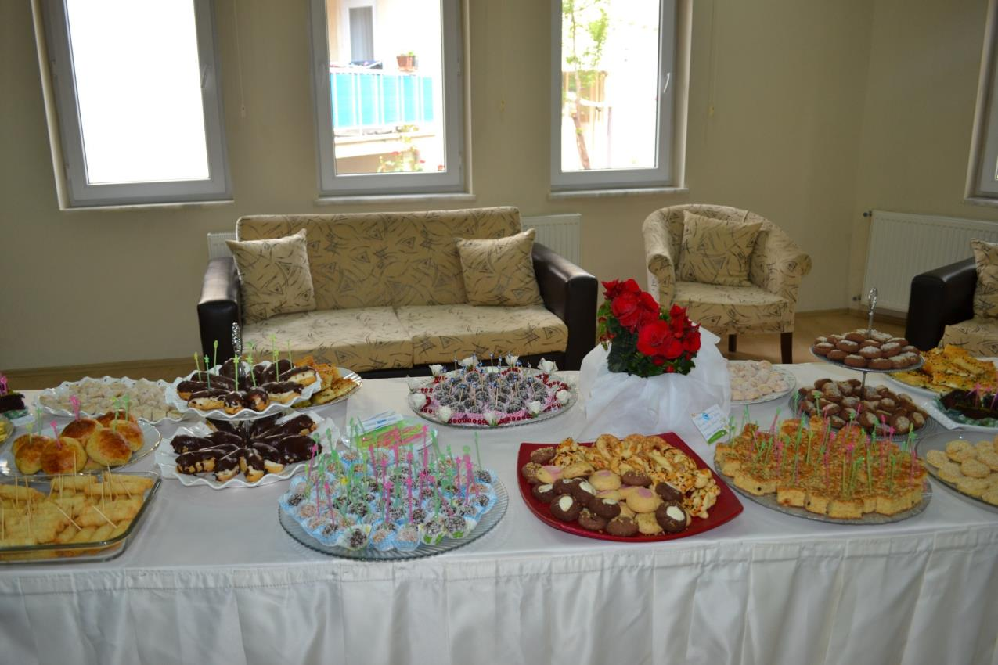
Cake course

Slide 27
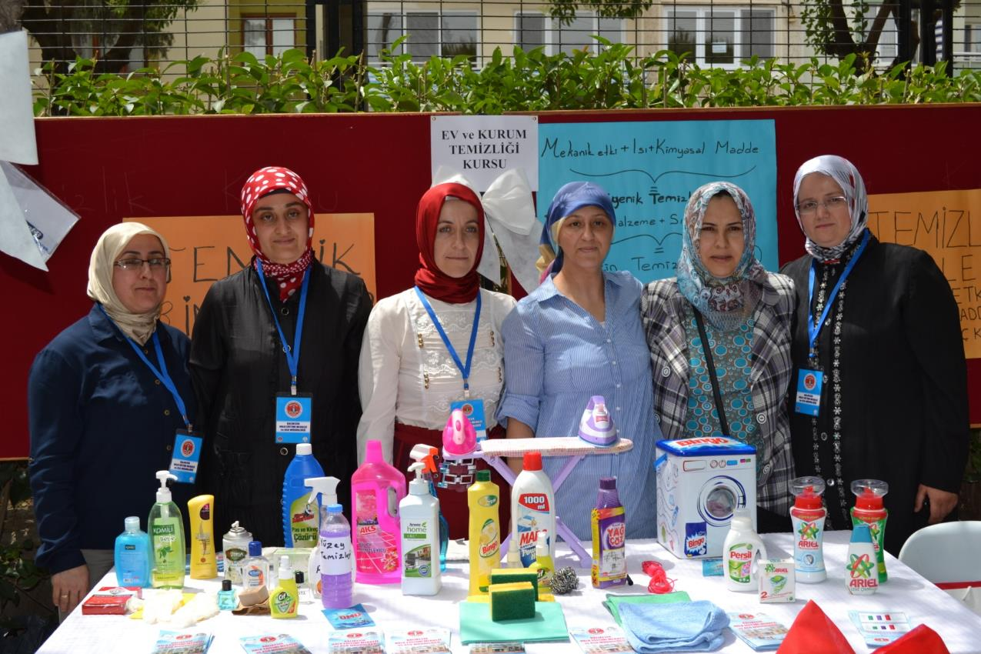
House and institutioncleaning course

Slide 28
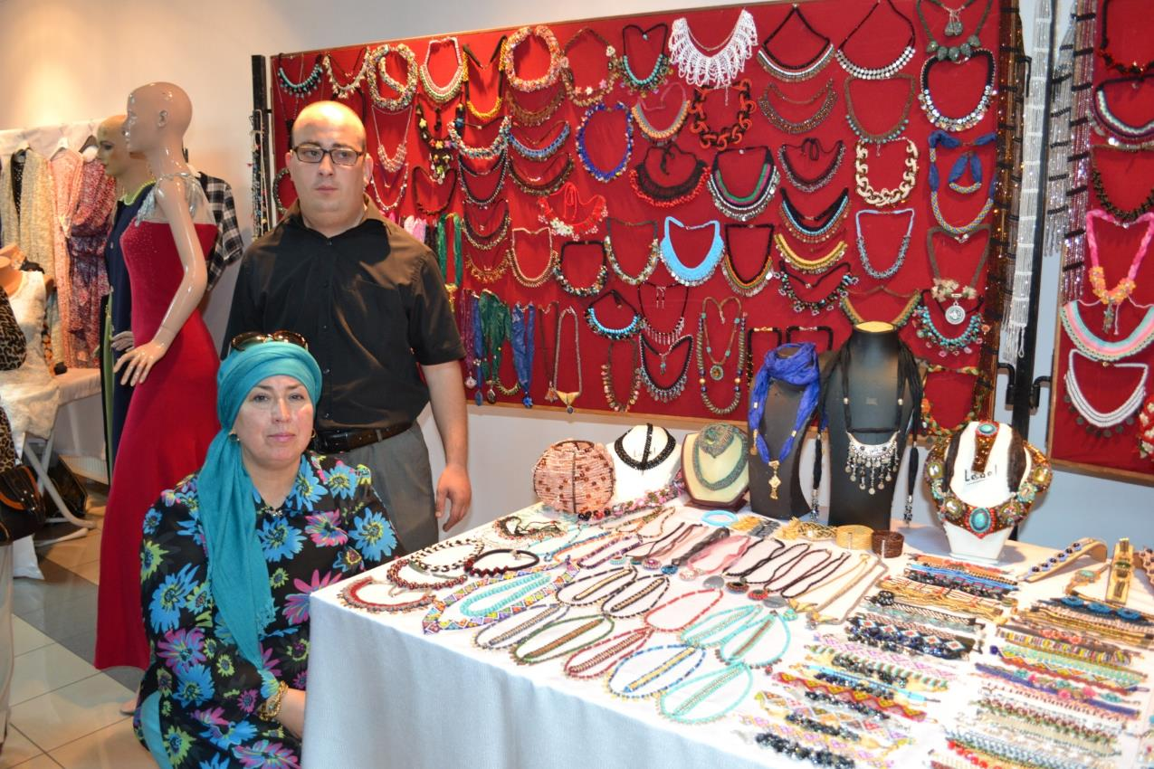
Jewelry course

Slide 29
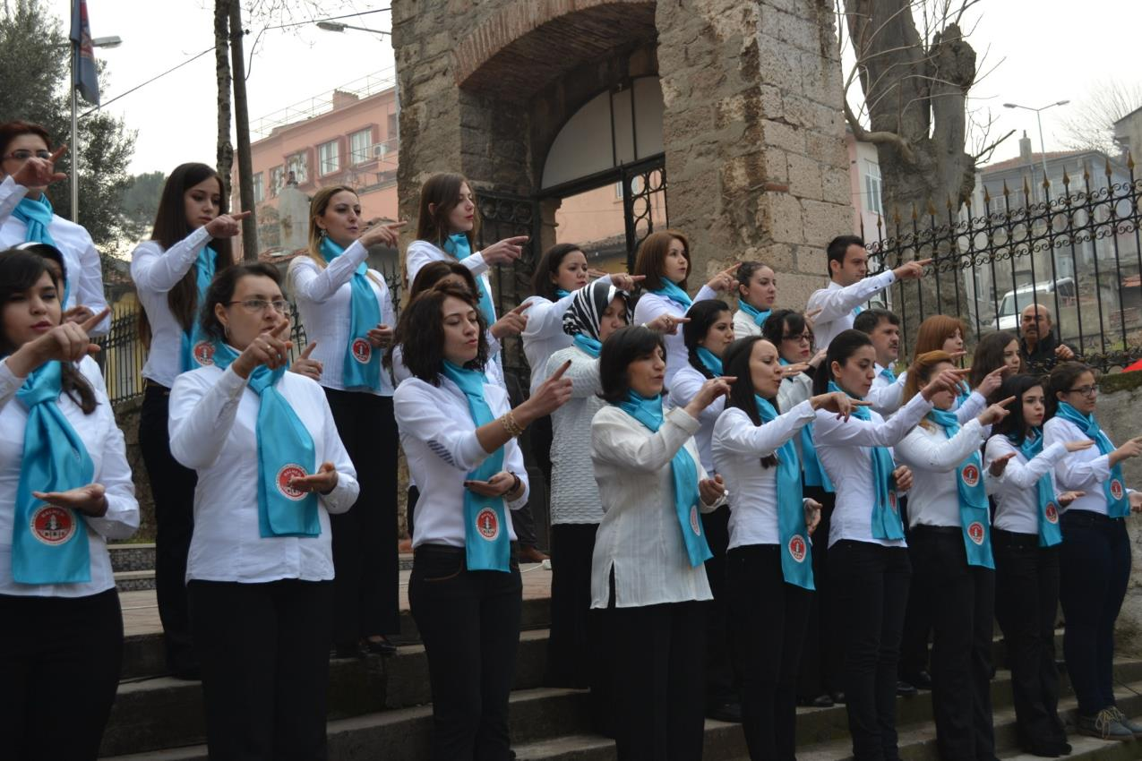
Sign language course

Slide 30
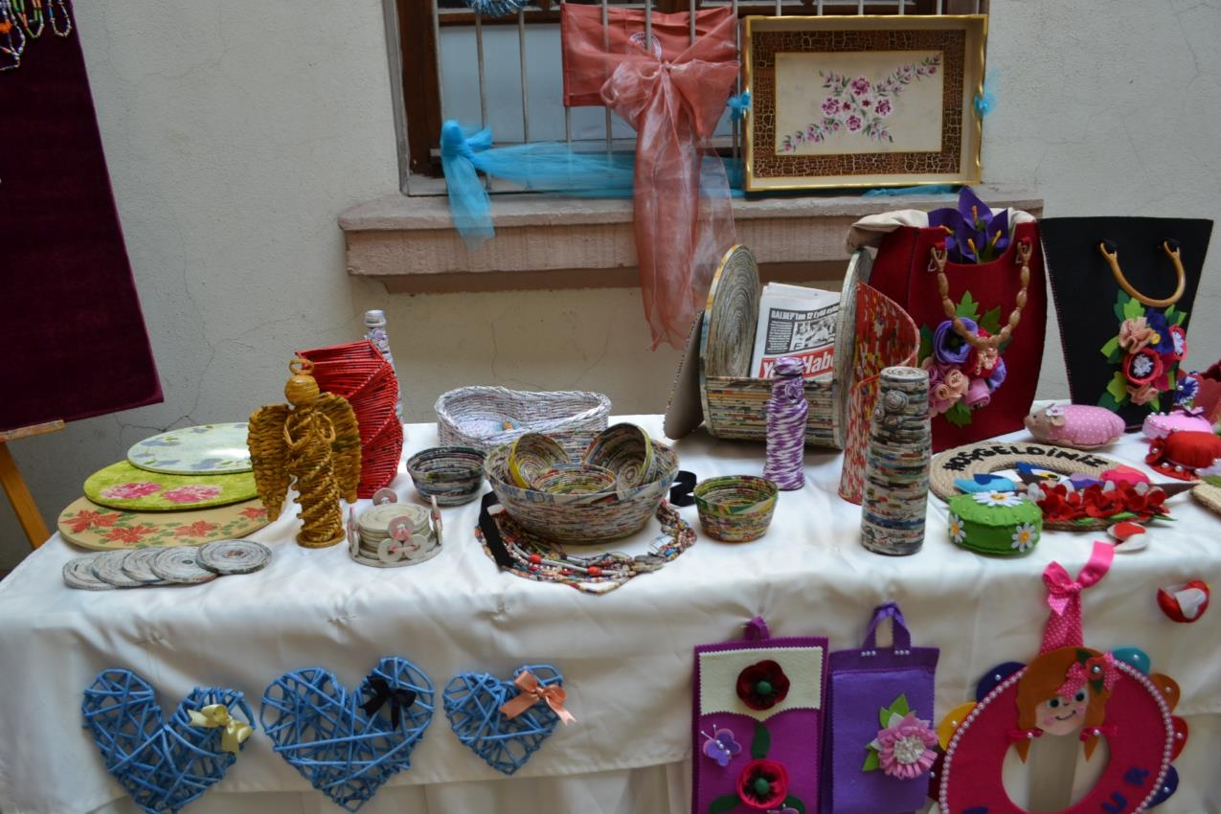
Handicrafts course

Slide 31
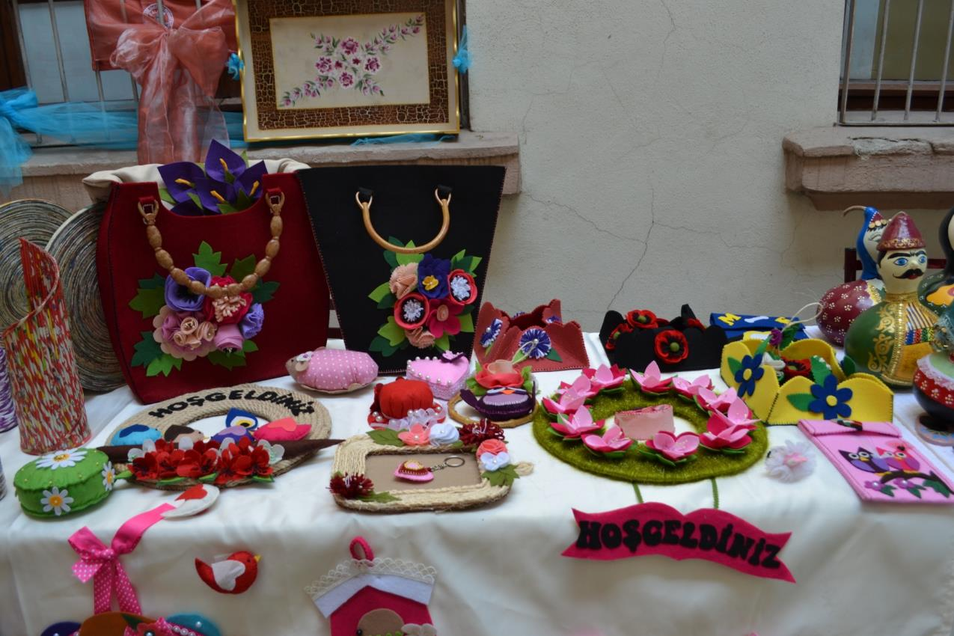
Felt accessories

Slide 32
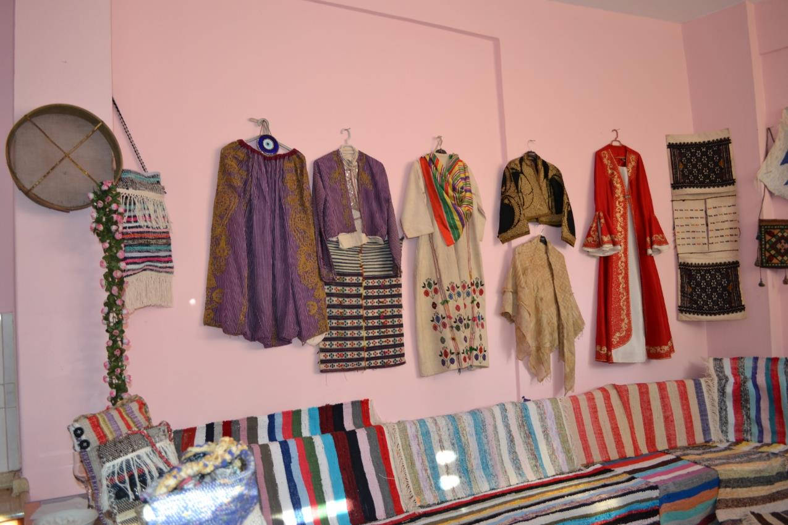
Traditional clothes

Slide 33
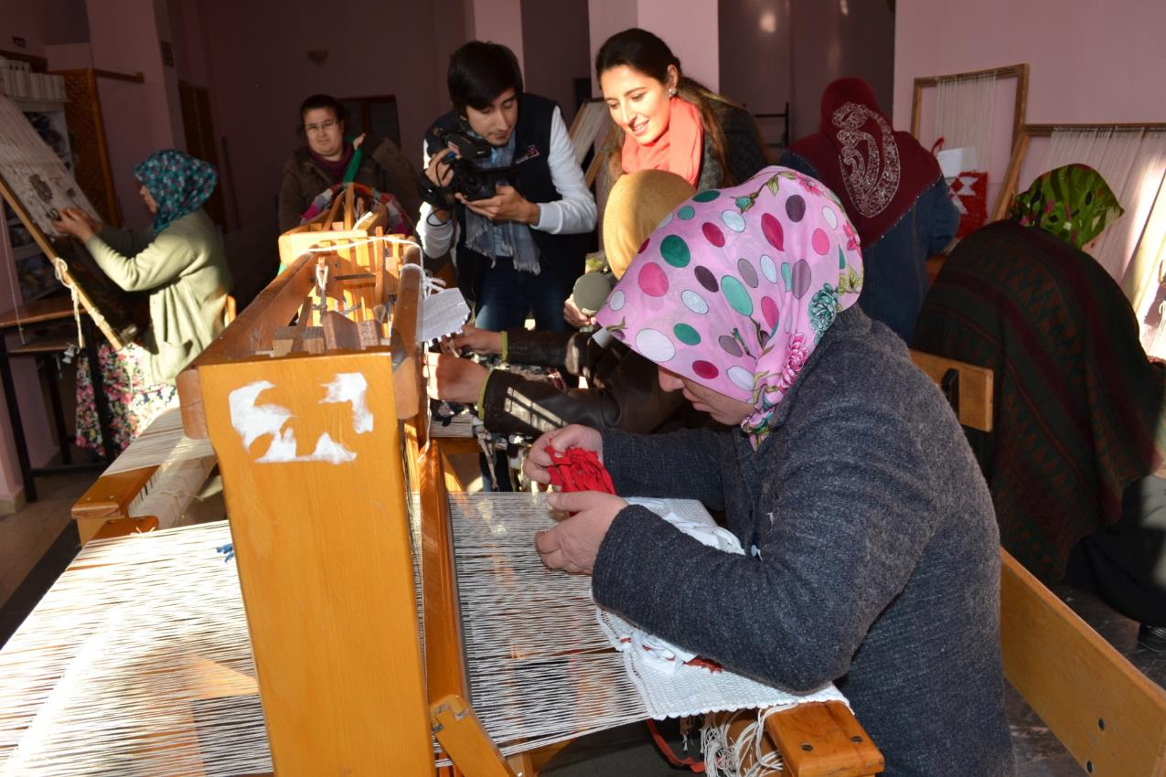
Traditional Rug and carpet weaving

Slide 34
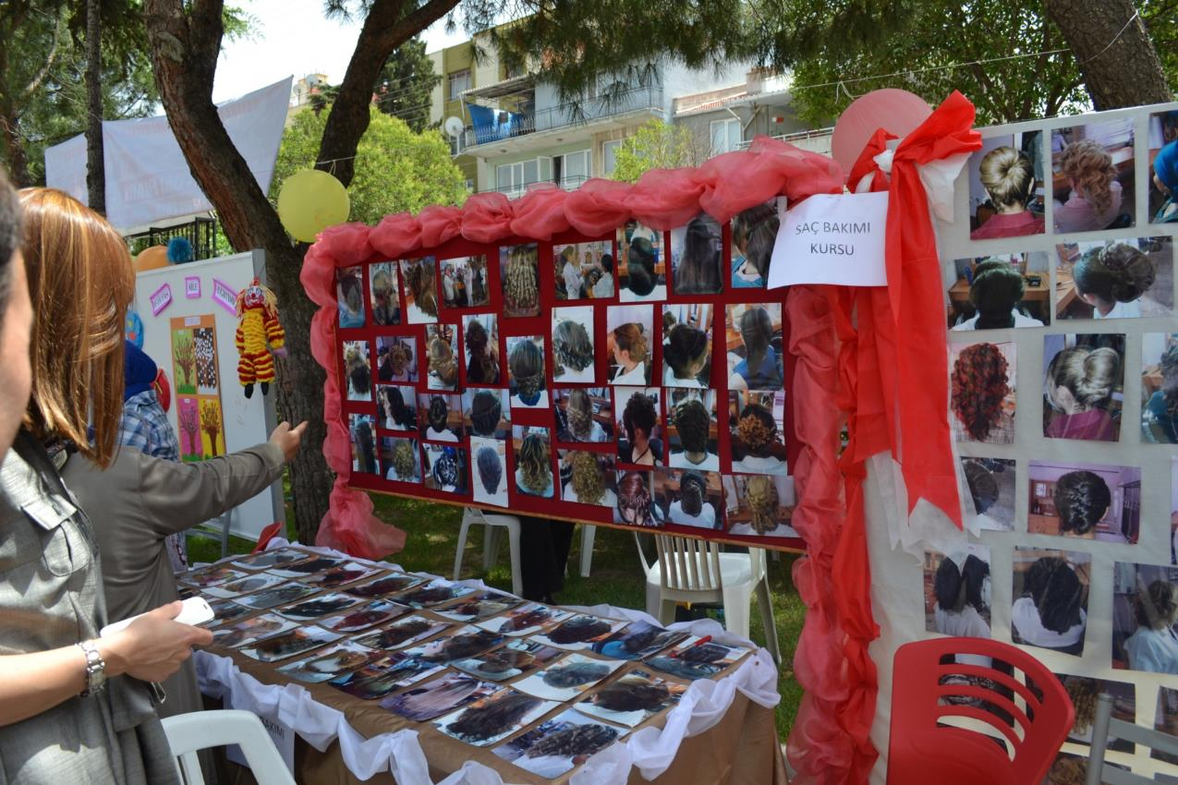
Hair care course

Slide 35
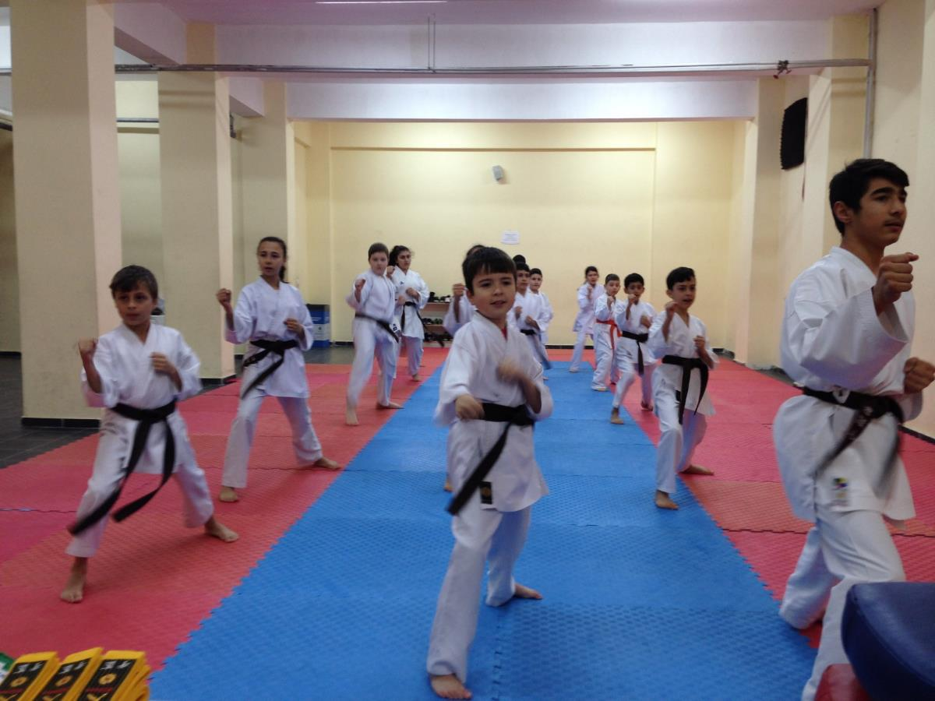
Karate course

Slide 36
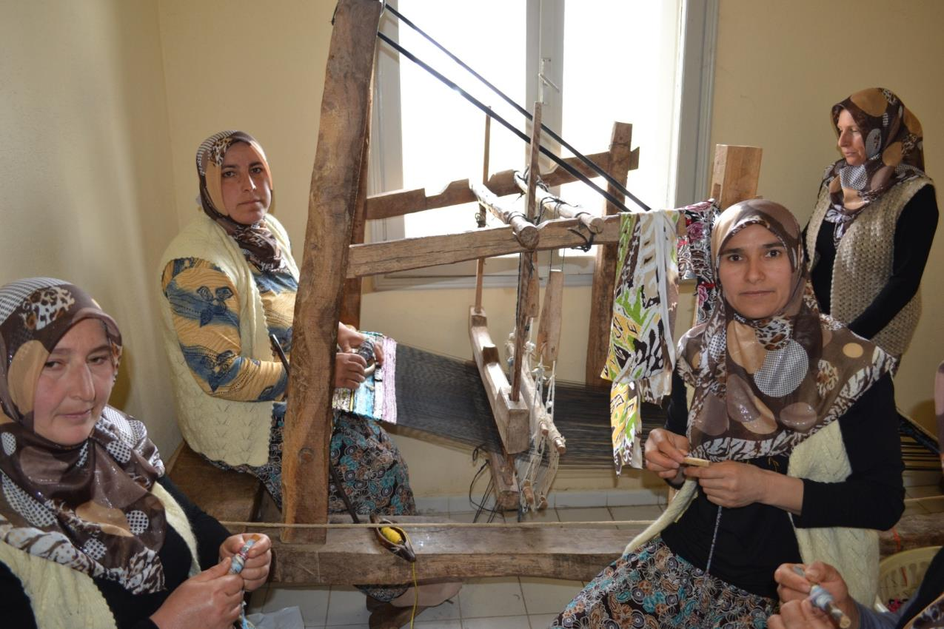
Weaving course

Slide 37
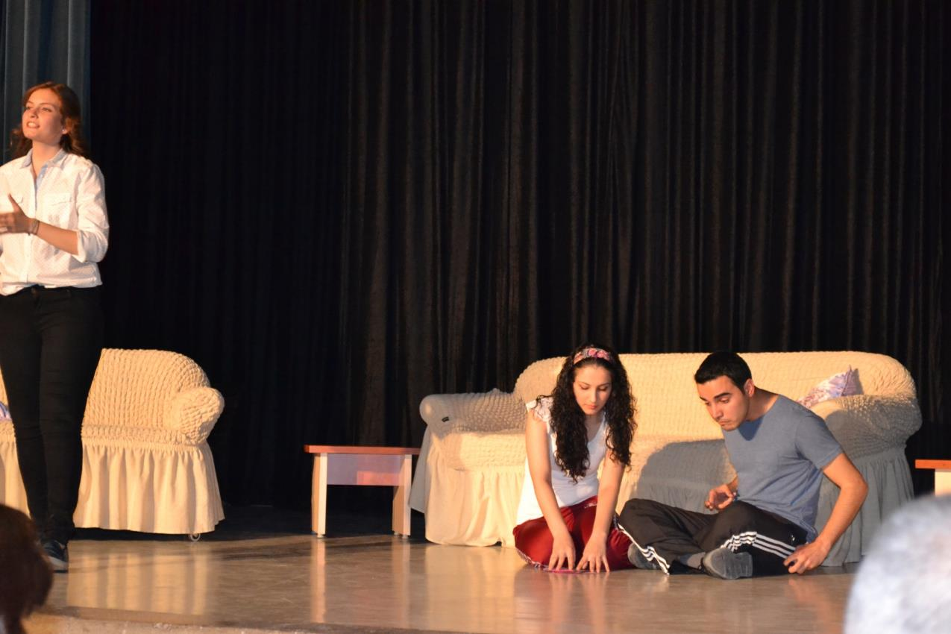
Drama course

Slide 38
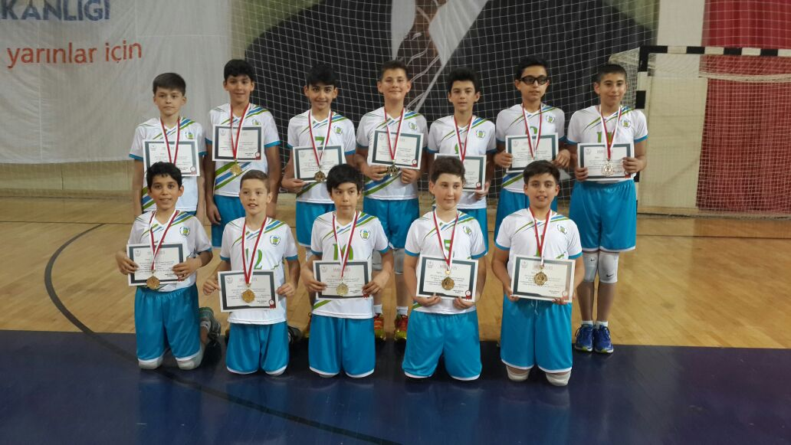
Our school volleyball team

Slide 39
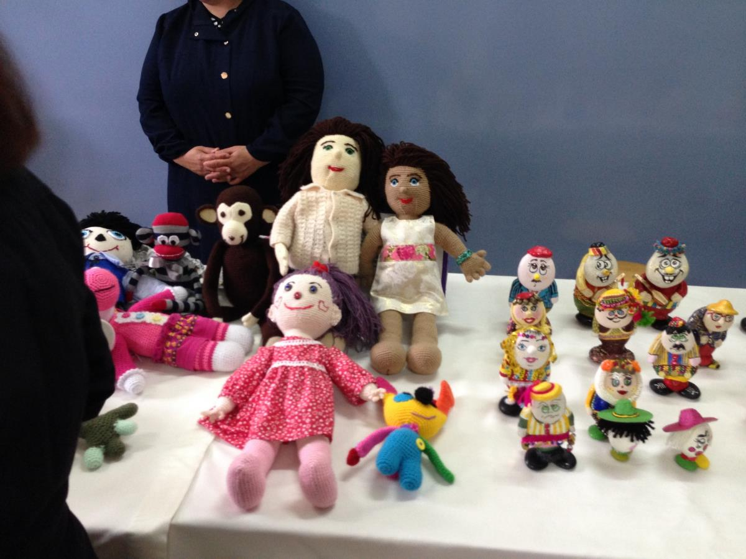
Doll made course

