Slide 1
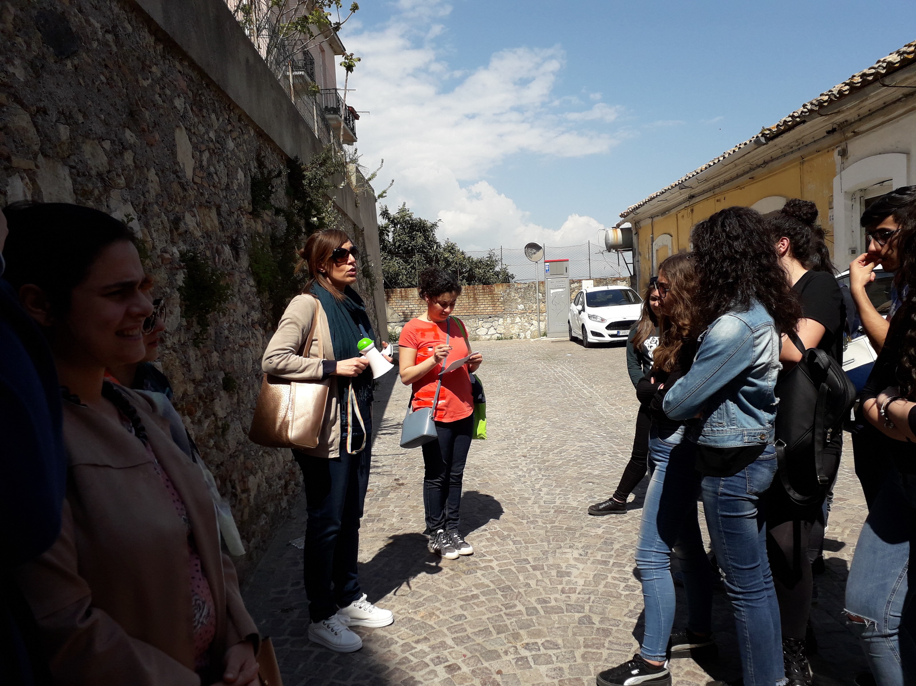
And then in Catanzaro to retrace the historical places of silk…

Slide 2
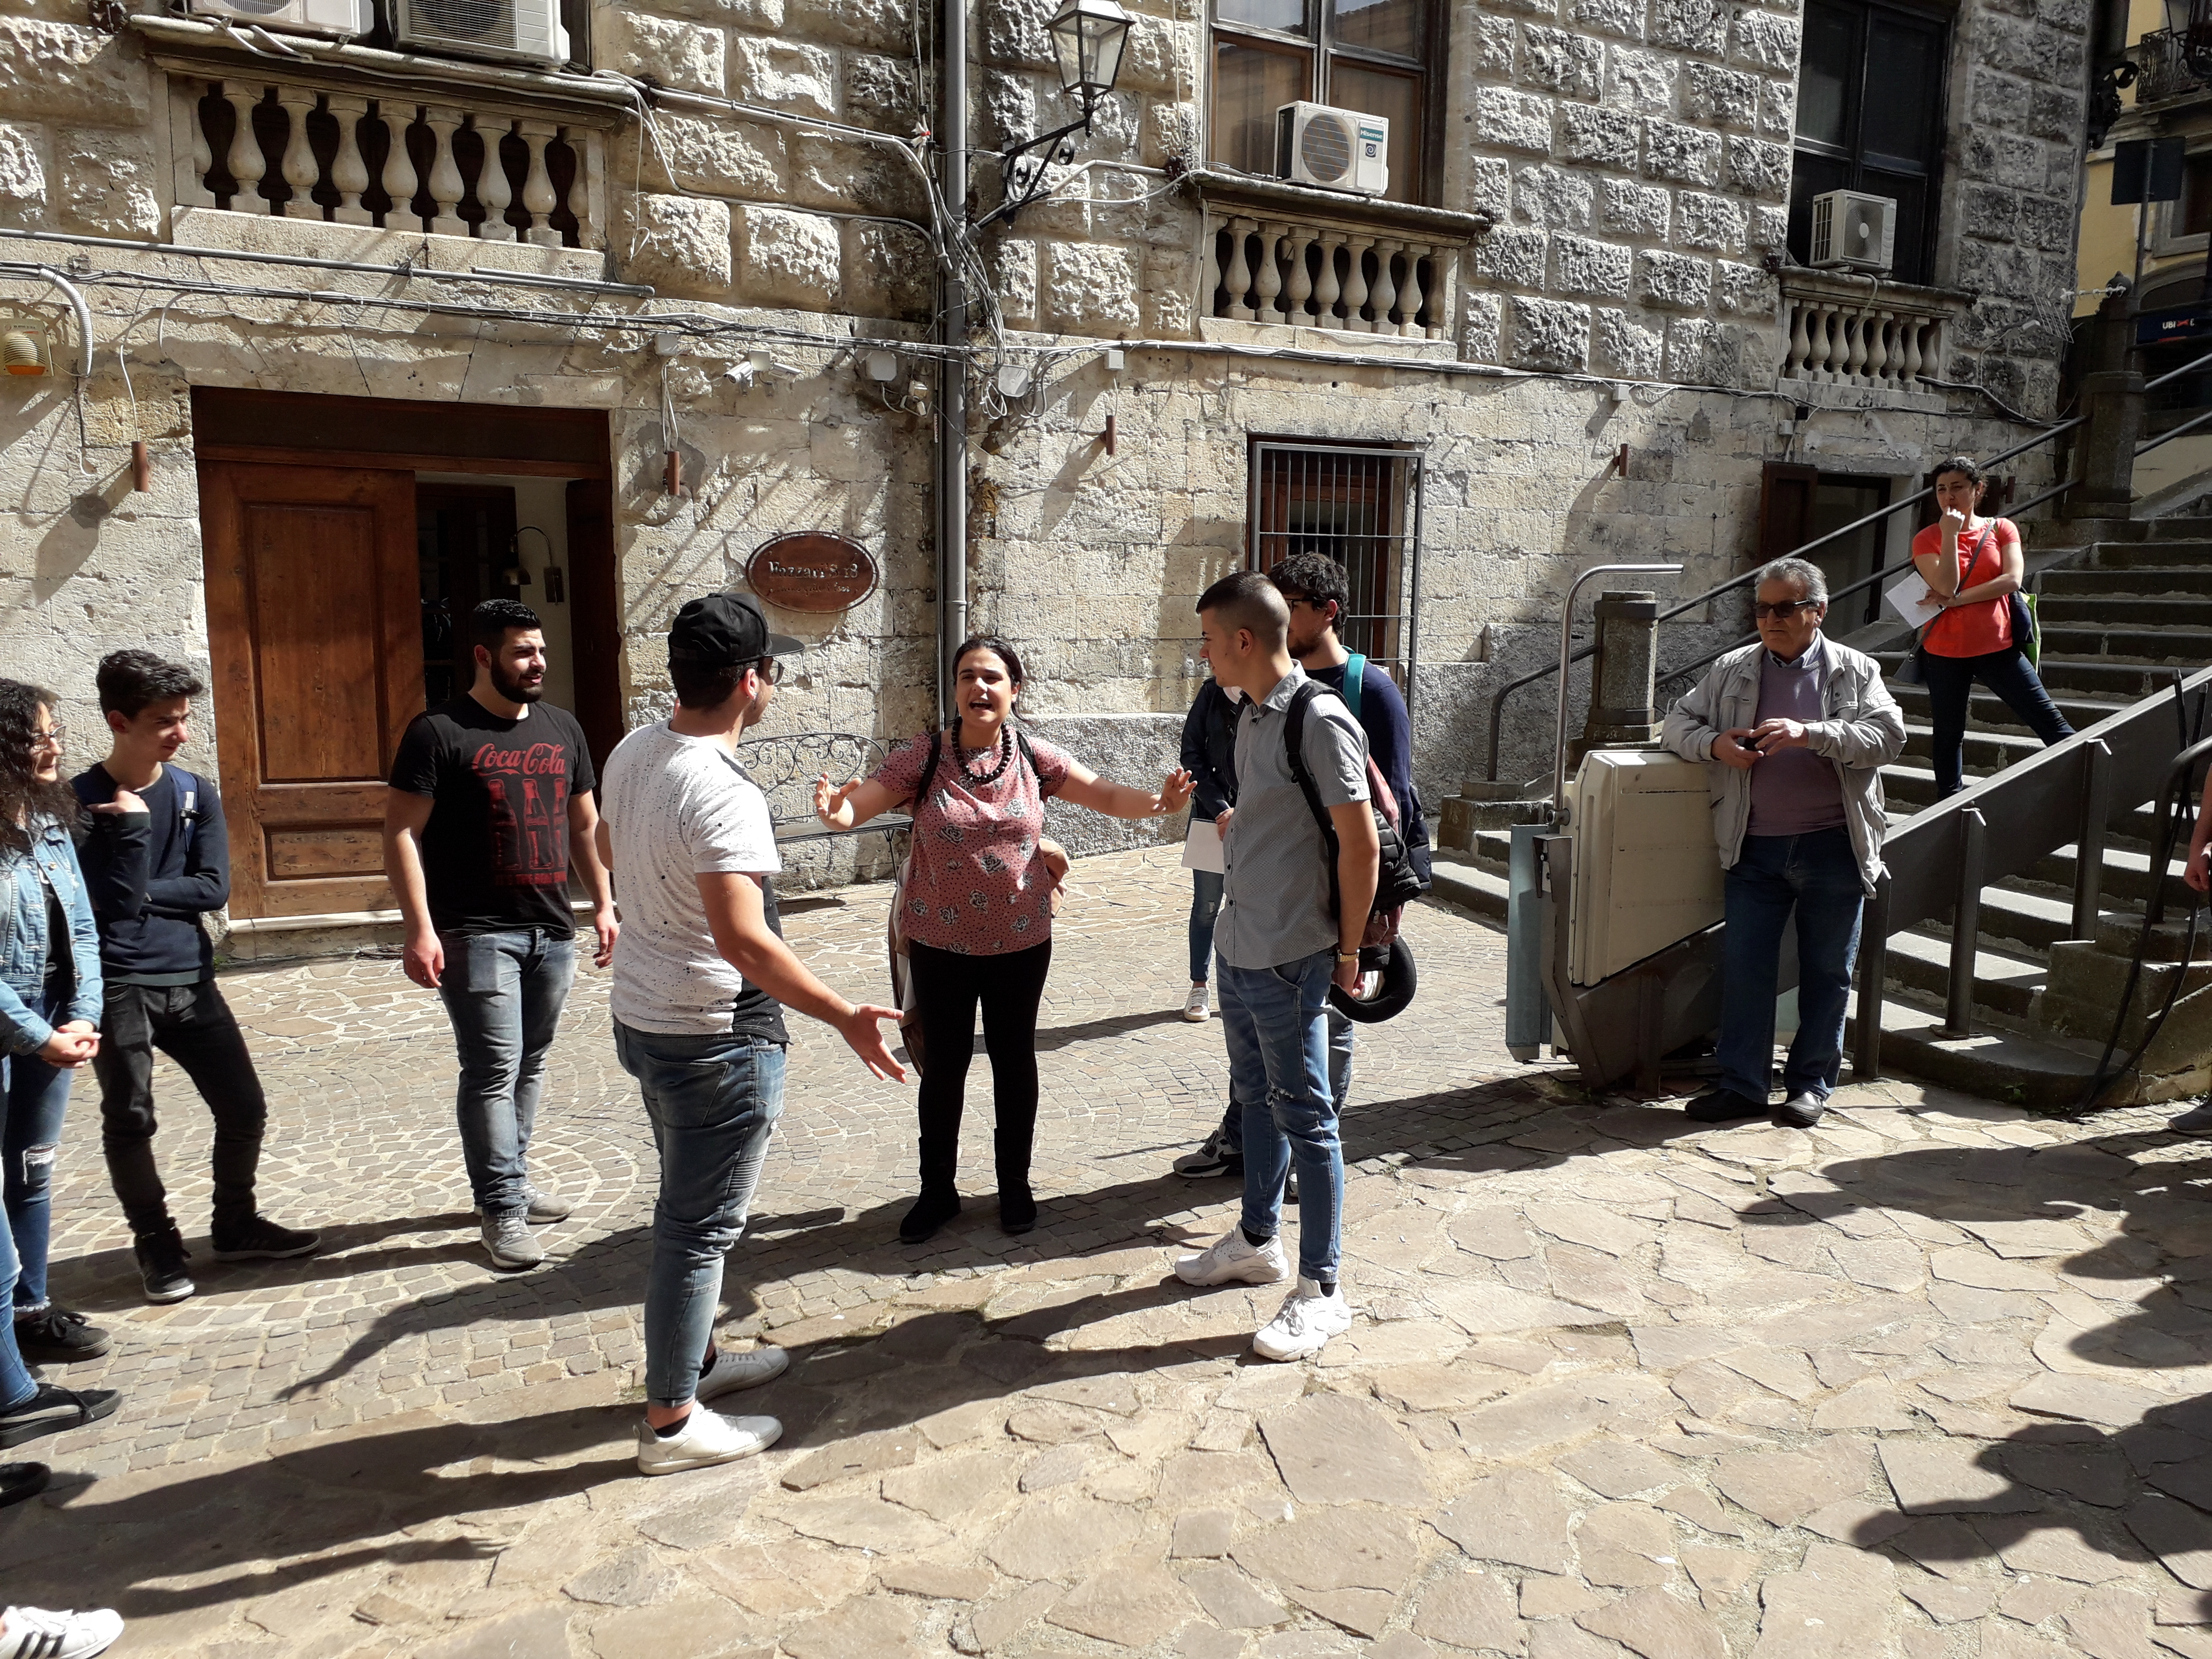

Slide 3
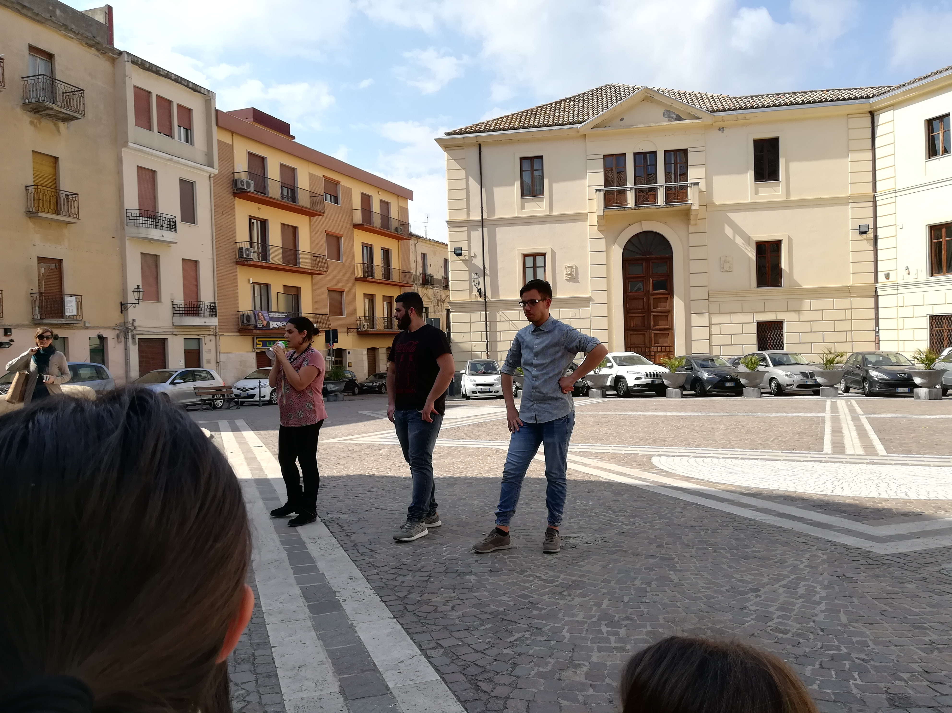

Slide 4
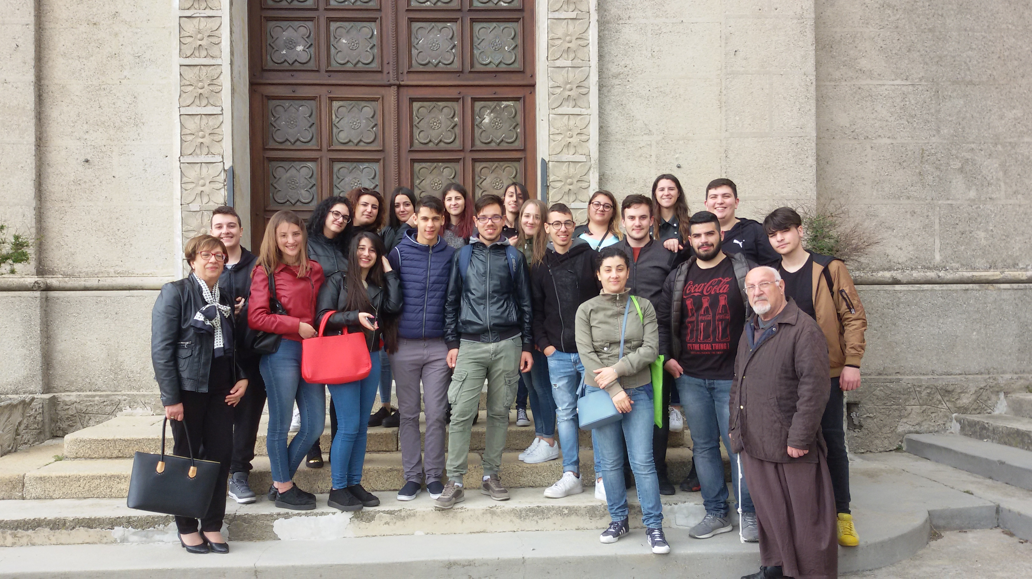
This is just a little taste, waiting to prepare an even richer and more detailed presentation!...
By Matteo, Gabriele, MariaAnna, MariaCaterina, Salvatore, Cristian, Enzo, Mattia, Giuseppe, Fabio, Luigi, Valeria, Elisabetta, Raffaele, Nicoletta, Mara, Pasqualina, RosaRita, MariaChiara, Concetta, proff Aurora calabretta & Rosalba Posca.

