Slide 1
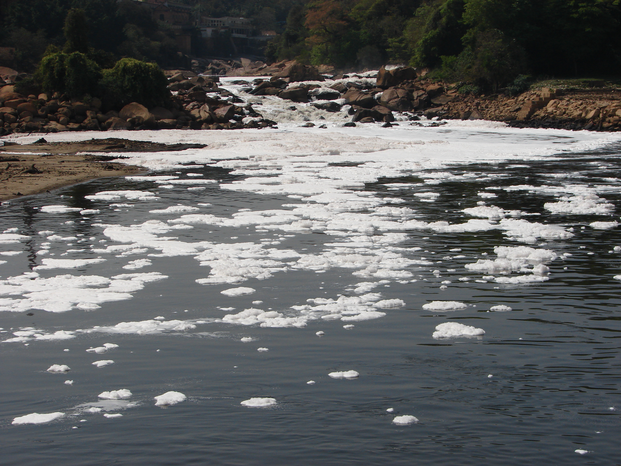
EFFECTS ON THE
ENVIRONMENT OF FIBRES
AND FABRICS PRODUCTION
Alicante, spain

Slide 2
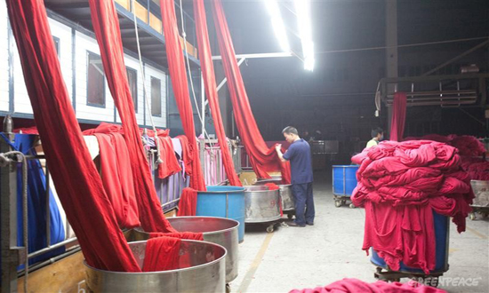
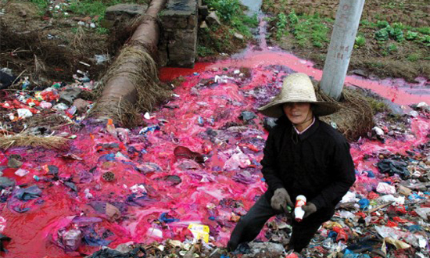
Main Environmental
The main environmental impacts related to this industry have to do with the wastewater that it generates and the chemical load they contain. Other important problems are the consumption of water and energy, odors, solid waste, noise and generation of atmospheric emissions.

Slide 3
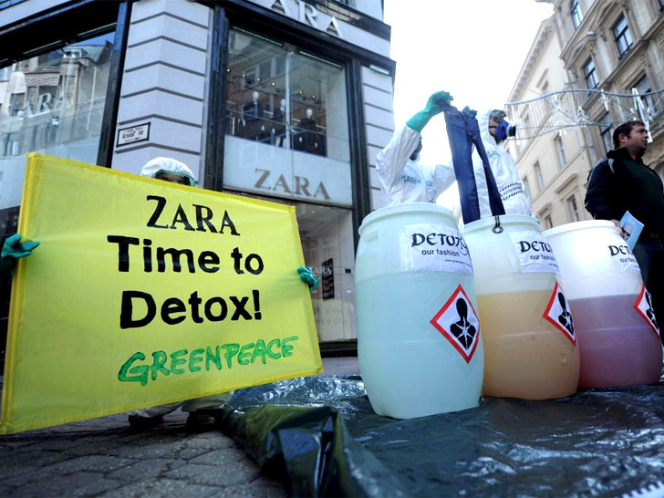
Main Environmental
Taking into account all these negative aspects, in recent years alternatives to conventional forms of production have been developed to achieve less polluting textile products. Greenpeace, through its Detox campaign, urges large textile companies to stop using its garments chemical elements that may have harmful effects on the health of humanity and the entire planet.

Slide 4
Chemical Substances
There are seven chemical substances that must be eliminated in the textile industry by 2020 according to the WHO:
·Alkylphenols -> because they are persistent, bioaccumulative and toxic (PBT)
·Phthalates -> qualified as very harmful for reproduction in mammals
·Brominated and chlorinated flame -> classified as "priority hazardous substances" according to Community legislation
·Azo dyes -> prohibited by the European Union for releasing chemical substances, tin organic compounds, for persisting in the environment and possible affectation to the immune and reproductive systems perfluorinated (PFCs)
·Chlorobenzenes -> related to liver, thyroid and central nervous system conditions
·Chlorinated solvents -> because they are considered substances that deplete the ozone layer and that can persist in l environment
·Chlorophenols -> which are highly toxic to humans and can affect many organs, and short-chain chlorinated paraffins (PCCC), which are highly toxic to aquatic organisms, do not degrade easily in the environment and have a high potential to accumulate in living organisms.

Slide 5
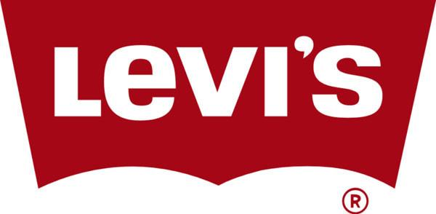
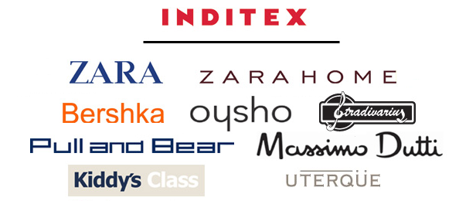
Solutions
Several textile companies have joined this initiative and are committed to eliminate these substances in their respective supply chains. This is the case of the Spanish Inditex and Mango, and other international brands such as Esprit, Levi's and Benetton.

Slide 6
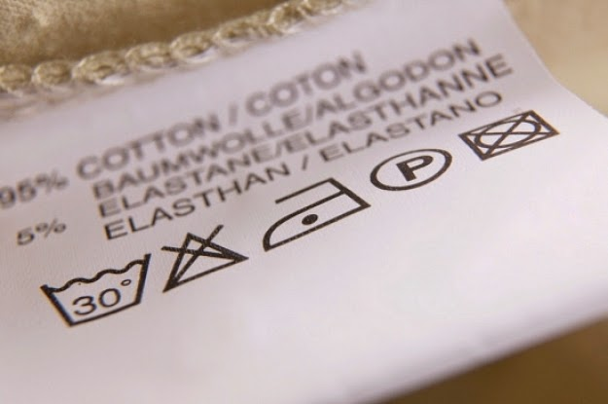
How can we contribute
to reduce pollution?
Not only do you care if the item can be washed or not by hand, but you want to know the origin of the raw material, the spinning, of the tinting and the manufacture of the fabric to know if the product is respectful with the environment and with the people who have made it. If the label does not make it easy, the citizen can also
find out if the company that has made that garment has any certification or seal of quality as "Made in Green by Oeko-Tex", the eco-label with the highest reputation worldwide to determine if textile garments contain harmful substances. Currently, it has more than 7,500 certified companies around the world.

