Slide 1

Chiaravalle C.le and surroundings, by textile tradition
eTwinning project: “Textile fibres: chemistry, fashion and tradition”, 2018

Slide 2
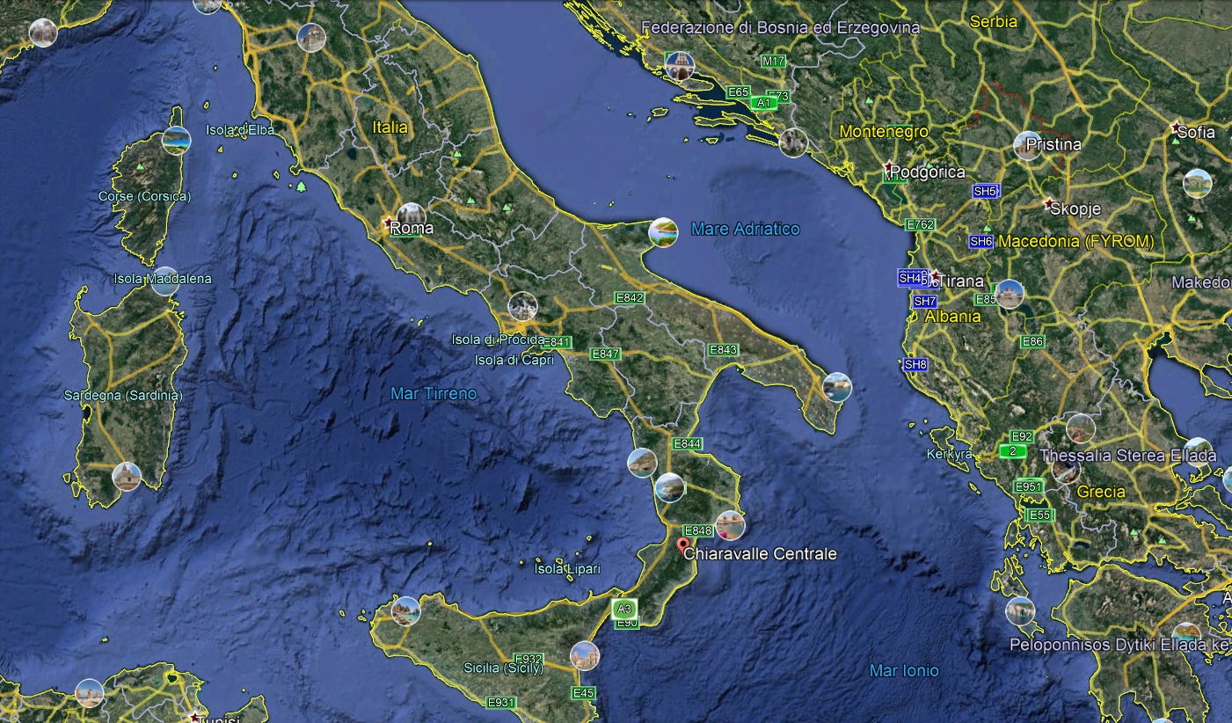
Chiaravalle C.le is located in Calabria.
Italy is boot-shaped and Calabria is its tip!

Slide 3
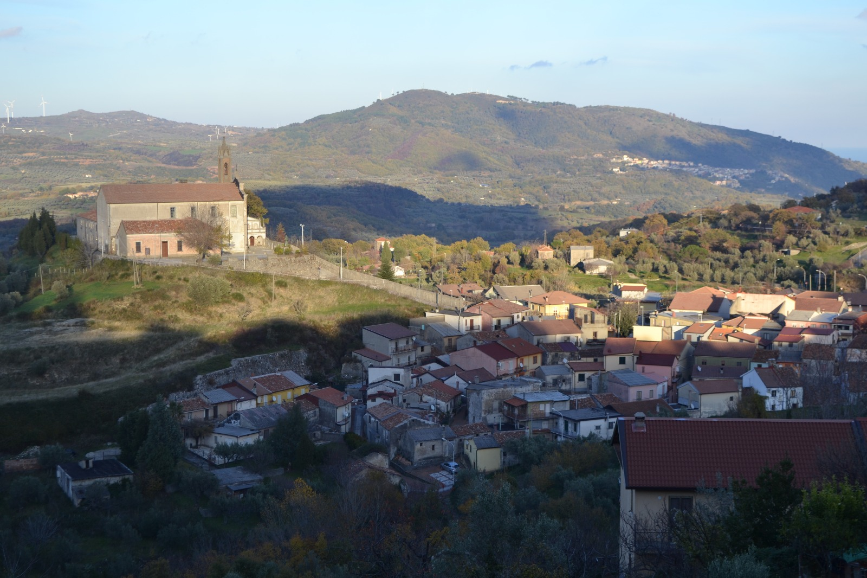
Chiaravalle C.le is a city of about 6000 inhabitants.
The altitude is 545m.

Slide 4
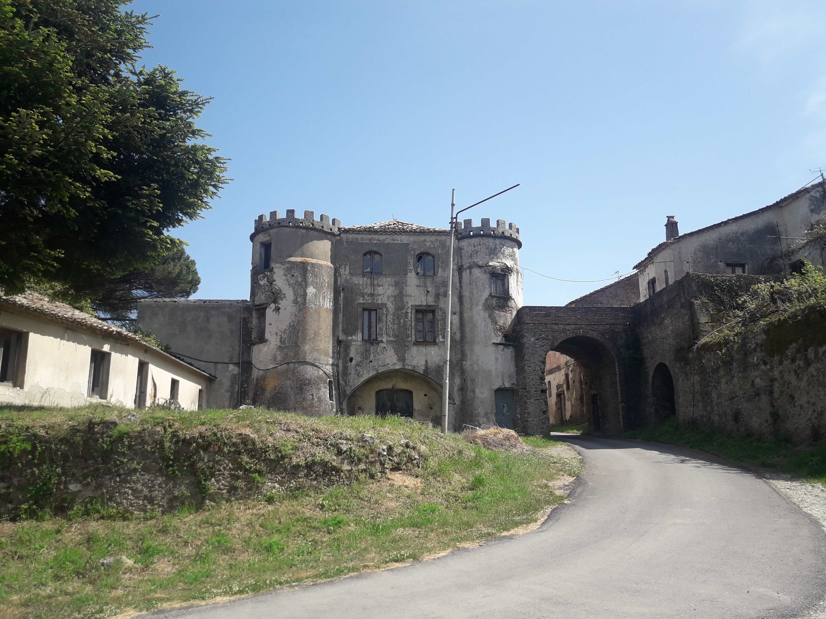
«Razzona» locality, where the paesants raised silkworms

Slide 5
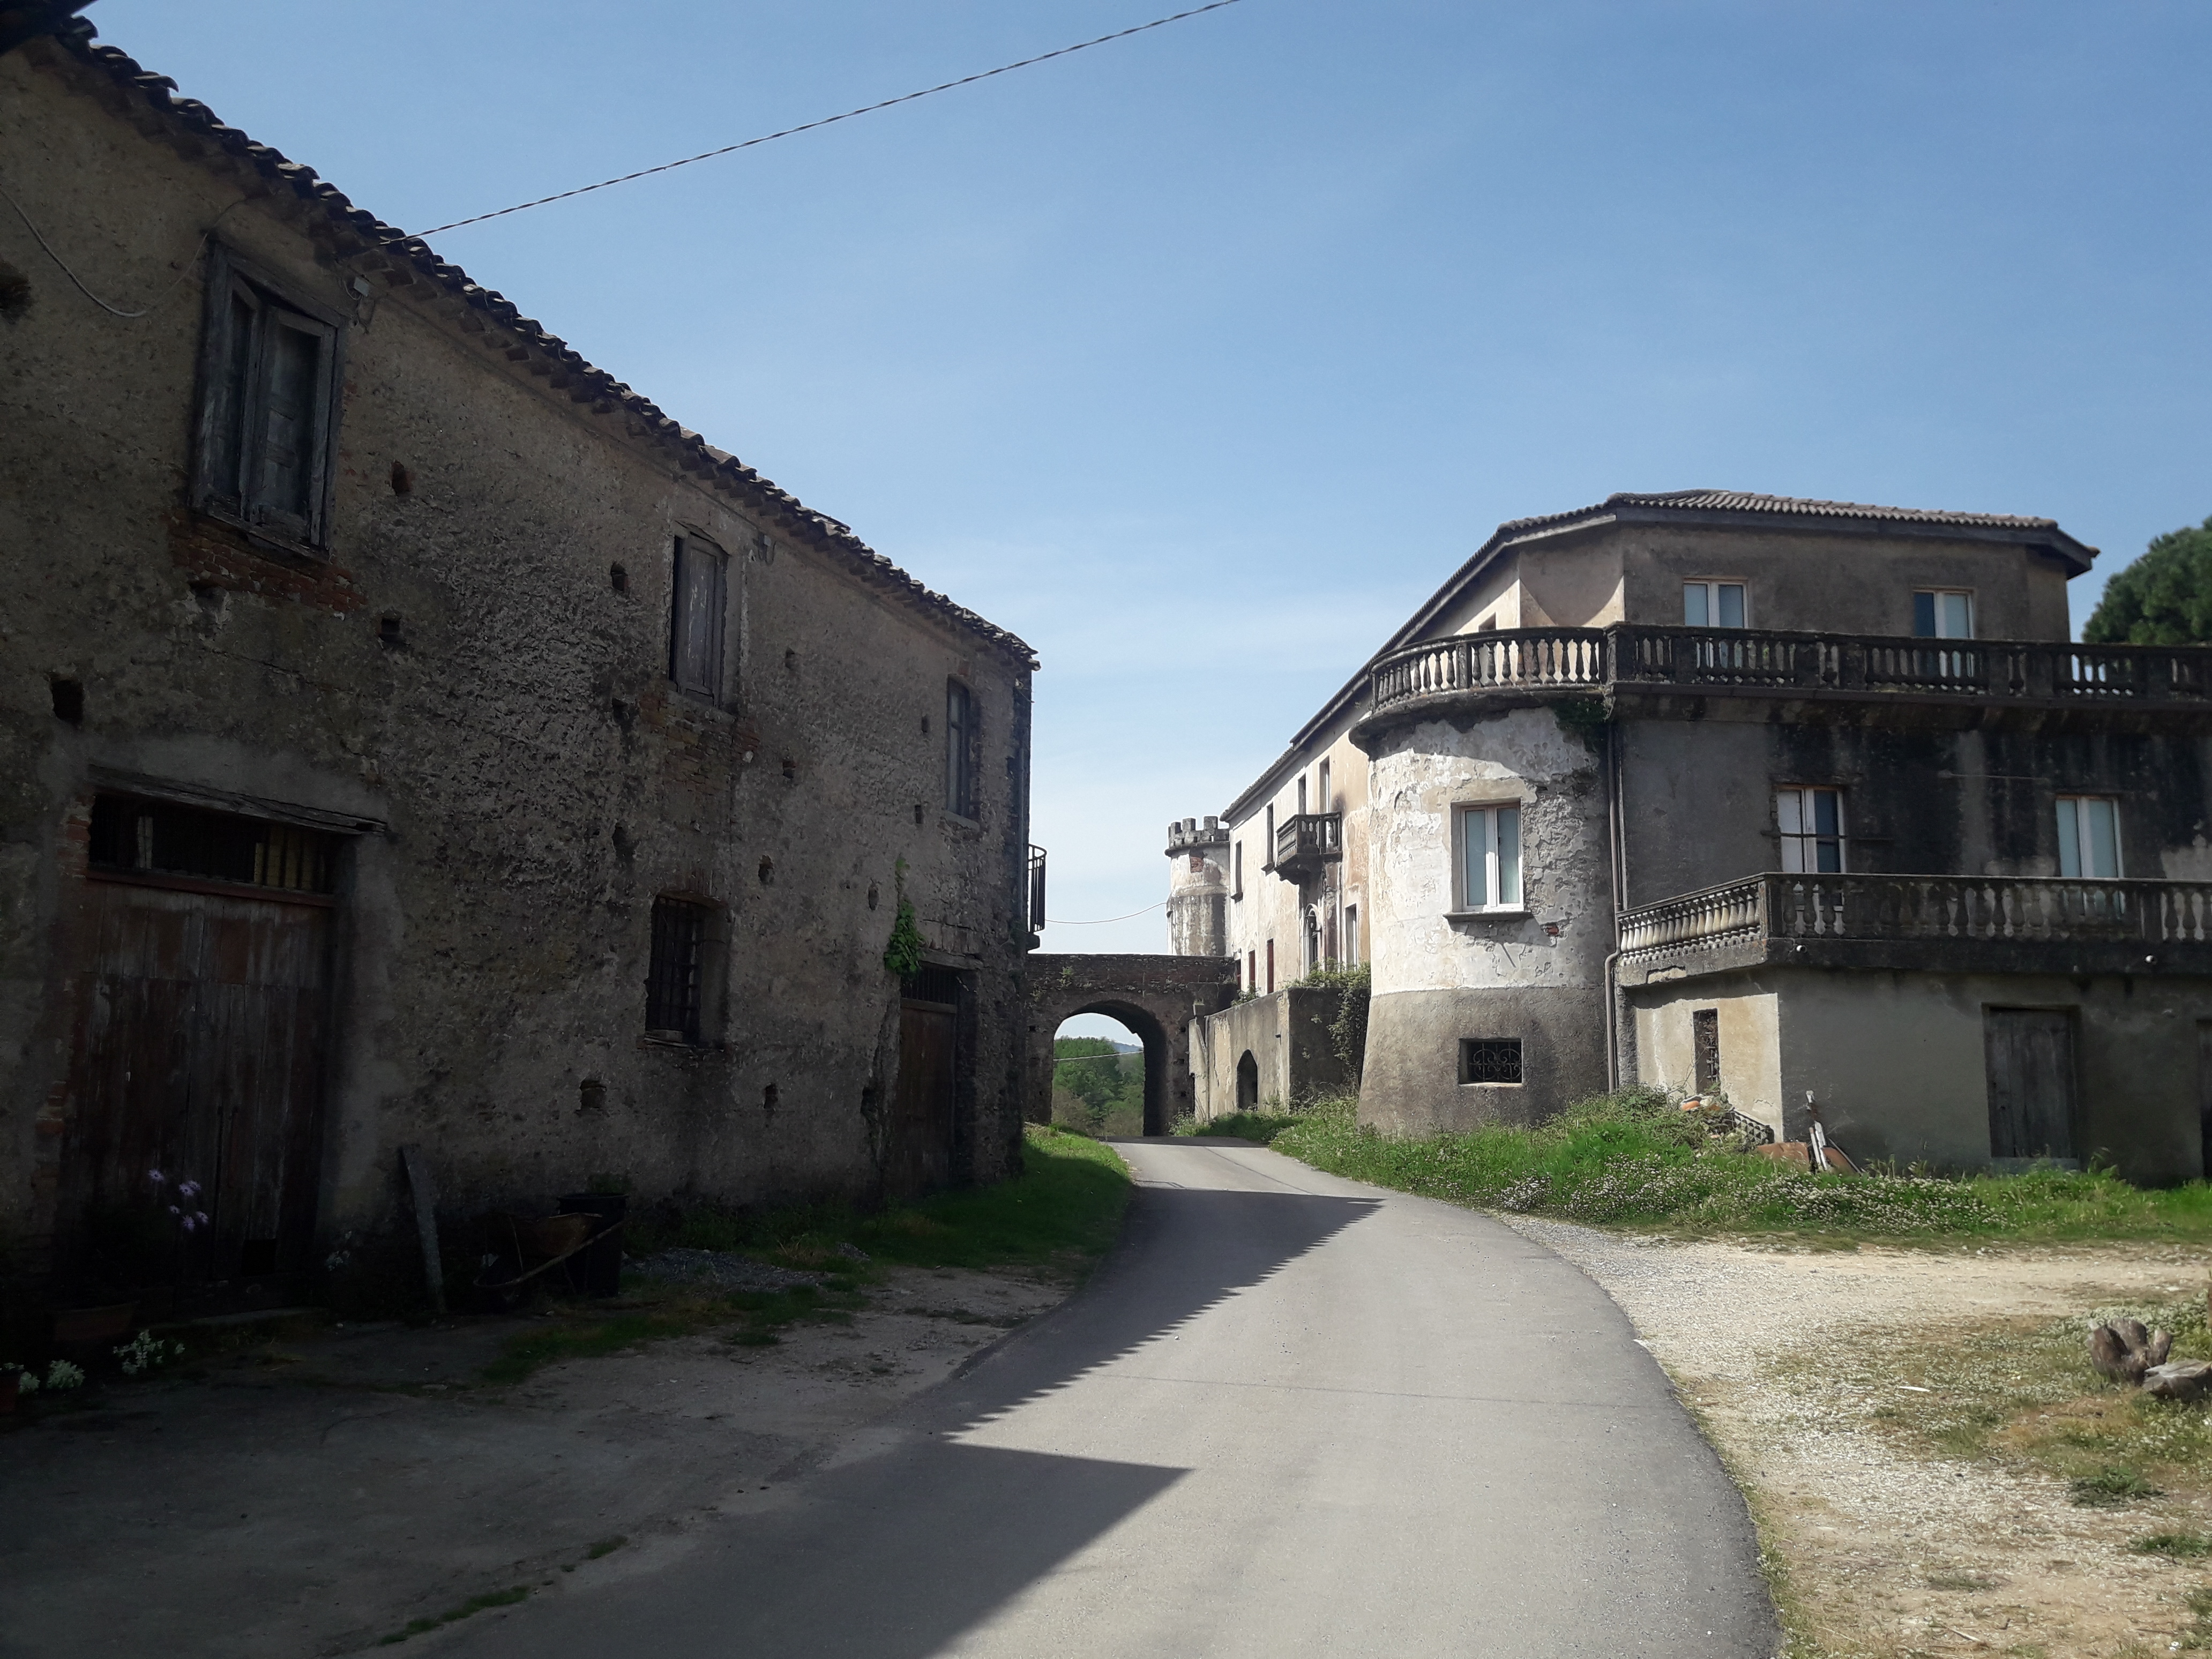
«Razzona» locality, where the paesants raised silkworms

Slide 6
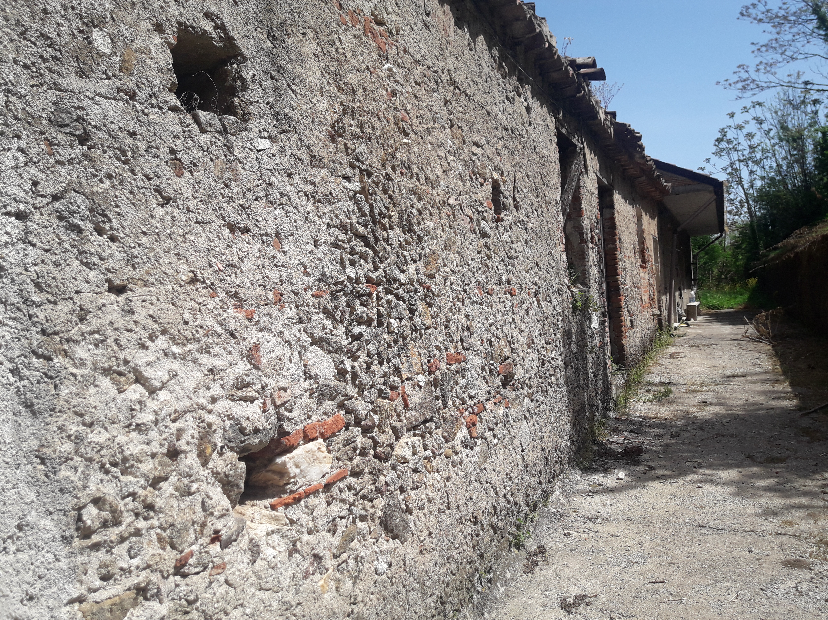
«Razzona» locality, where the paesants raised silkworms

