Slide 1
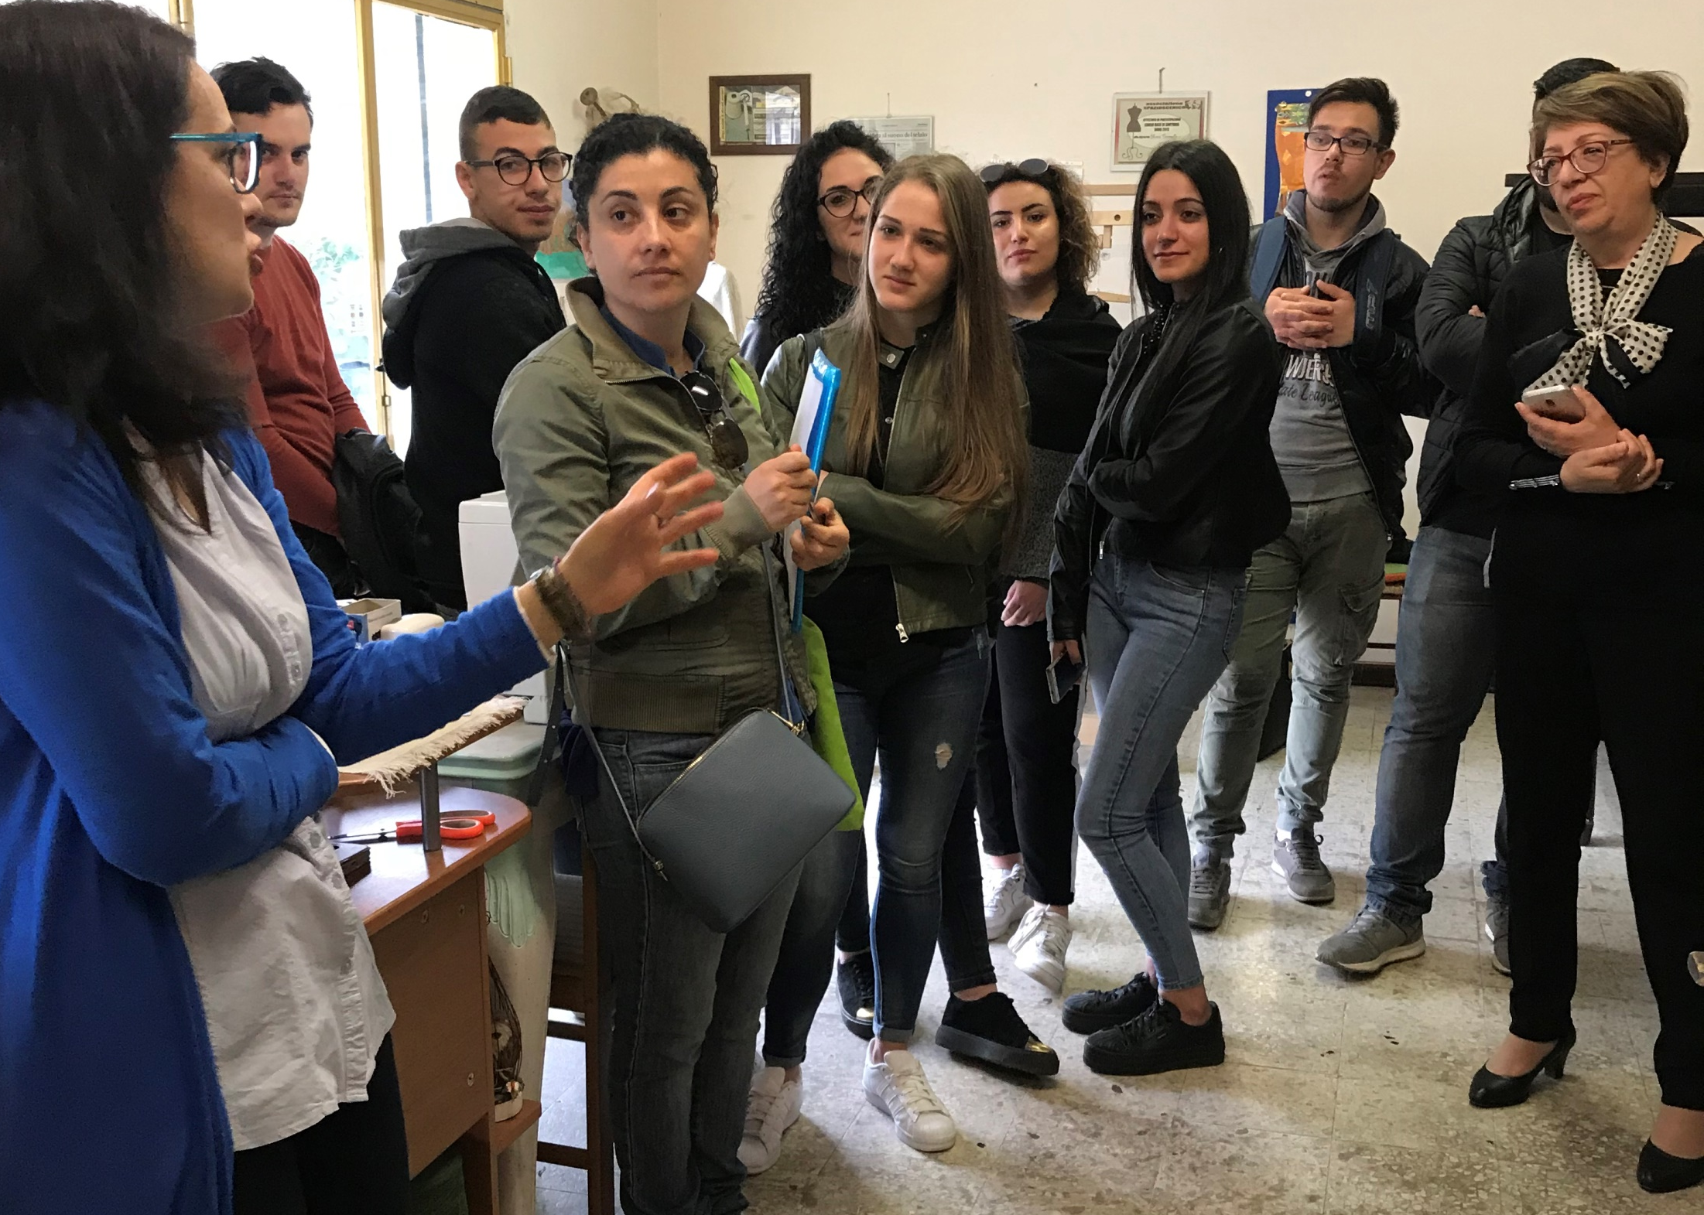
Visit to «UniversoChiara», the handcraft weaving workshop of Chiara Pirroncello, on May 3

Slide 2
Chiara and Elisabetta are preparing the interview

Slide 5
Chiara weaves according to traditional methods

Slide 6
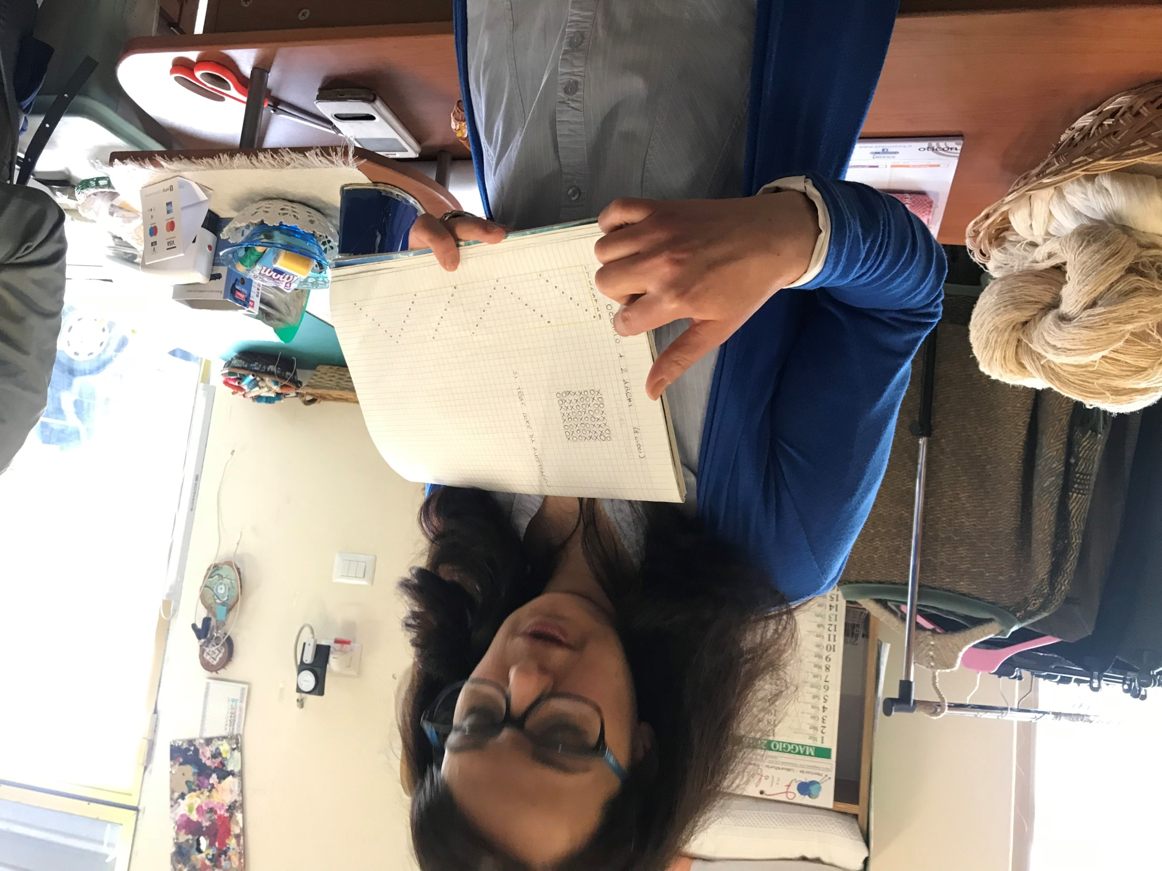

Slide 7
