Slide 1
In «contrada Foresta», there is an old warehouse, now under renovation

Slide 2
Where ancient clothing is kept

Slide 4
Ancient spinning mill, in San Vito

Slide 5
Where once the carding of wool took place, in Cardinale

Slide 7
Along the road between Argusto and Satriano: the broom

Slide 8
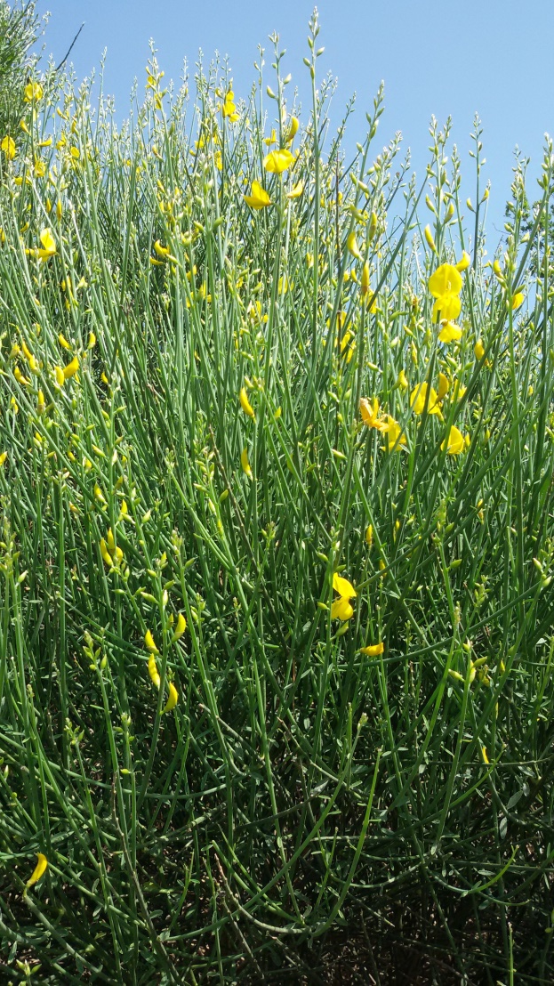
FABRICS FROM THE BROOM:
·The broom is collected
· It is done in bunches for how long it is
·It bends and with the broom itself attacks
·It is soaked in the river for three/four days
· After drying it drains and with the remaining threads the bags are made. PROCEEDINGS:
In late spring the Calabrian mountains are filled with flowering brooms, robust and vigorous plants that, above all at one time, were used for the production of cheap textile fibers that were worked on the loom according to the ancient textile art of the Calabrian tradition. First it is collected, then it is done in bunches for how long it is, bends it with the broom itself. In order to transform the broom into yarn it is necessary to subject it to a long and complex treatment which consists in placing the broom soaked in the river for three / four days. After that, it is dried and then defaced and beating, then the carding and finally is spun with the help of a spindle and collected in skeins through the passage to the spinning wheel.
This is how we obtained the yarn to be woven with the loom. Bags were made with the remains of the broom.
This is the story told to MariaChiara by her grandmother Maria and
the neighbor Mrs Teresa

Slide 9
Broom blanket, Argusto

Slide 10
Broom blanket, Argusto

