Slide 1
Effects for the environment of fibres and fabrics production.

Slide 2
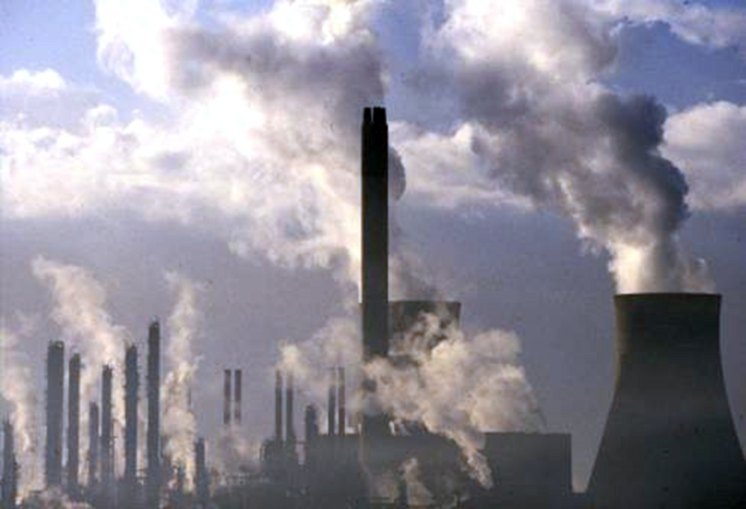
Massive impact
Harmful gass
Wastes in the water
People’s health

Slide 3
Dermatological problems Digestive problems The second most industry Polluting of rivers
,

Slide 4
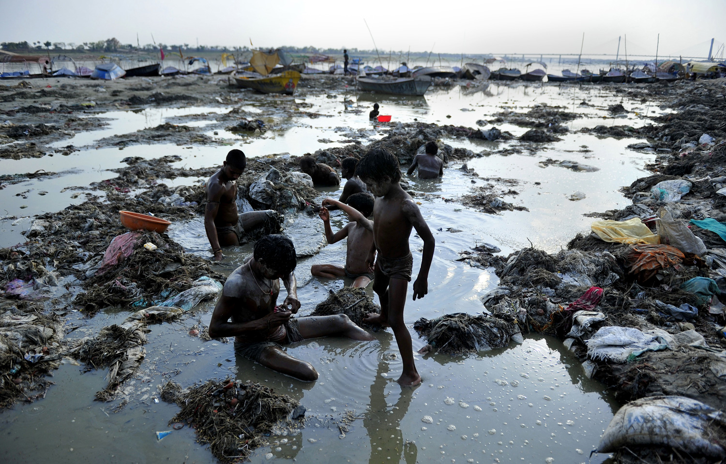
CONTAMINATION OF RIVERS:

Slide 5
2.Socio economic aspects of the manufacure of clothing:
2.1 WORKERS’ WAGES
Very low salaries
Two dollars a day.

Slide 6
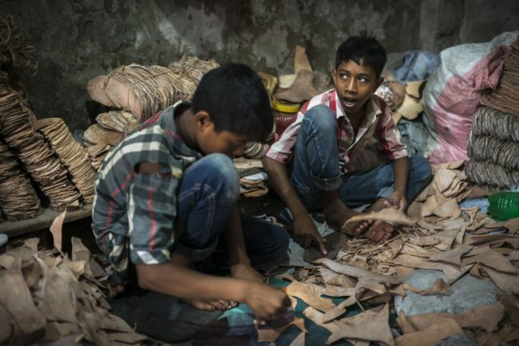
2.2 Labor conditions
Horribly enslaved

Slide 7
2.3 MAIN BRANDS
ZARA,H&M,UNIQLO, PRIMARK, FOREVER21, TOTSHOP, GAP, MANGO, JOEFRESH.

Slide 8
2.4 EFECTS OF GLOBALIZATION
Globalization is the outsourcing of the manufacture of products to countries with the cheapest labor to later sell them in the developed countries.
Efects it is an economic, technological, political, social, business and cultural process on a world scale that consists in the growing communication and interdependence between the different countries of the world uniting their markets, societies and cultures

