Slide 1
Alcoy’s
Textil Industry

Slide 2
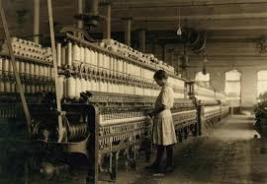
What is Alcoy and Where is it.
Alcoy or Alcoi is an industrial and university city, region and municipality located in the province of Alicante, Spain. It had an important industry related to textile, paper and manufacture that made Alcoy the financial, commercial and cultural center in the surrounding area.

Slide 3
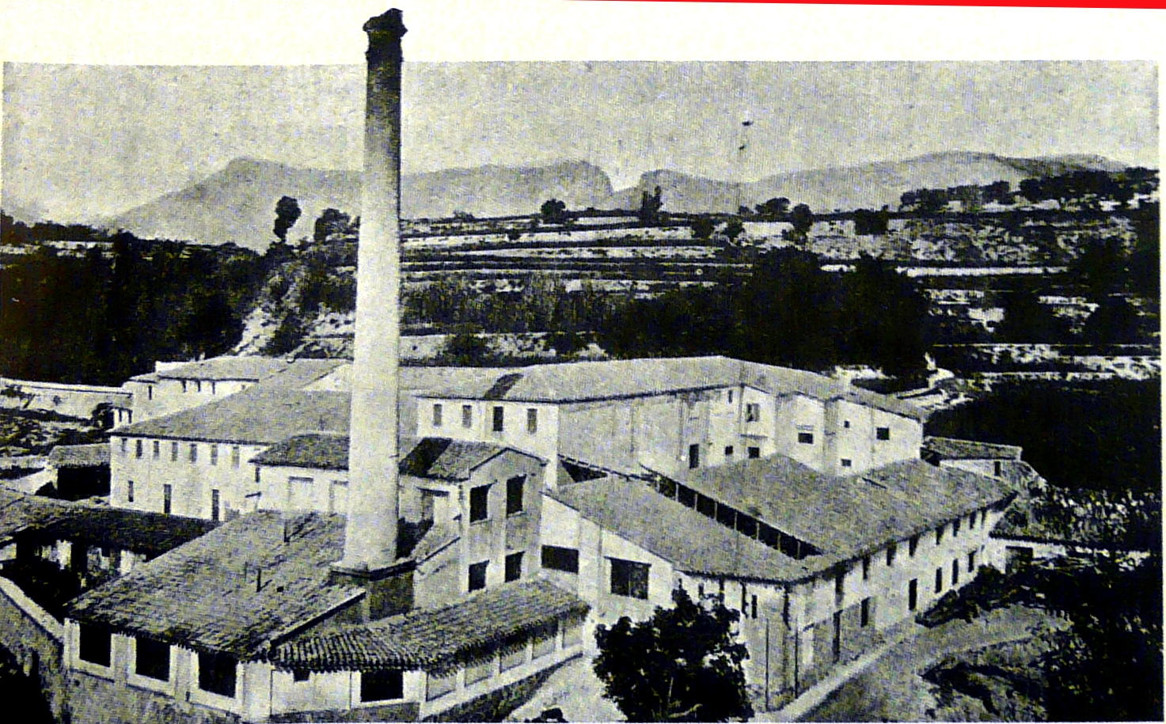
Royal Cloth Factory of Alcoy
The Royal Cloth Factory of Alcoy was an eighteenth-century organization of textile manufacturers in Alcoy that produced clothes for the royal armies of the King and was popularly known as “Casa de la Bolla”. In this place, textile samples of all the production were subjected to a quality control and if they are adequate, were tagged with a quality seal.

Slide 4
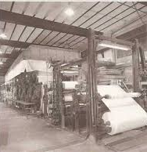
A school to fight the textile machines
The Royal Cloth Factory of Alcoy, caused by different anti-machinist riots, founded in 1829 the first textile school of technical education: the School of Bolla.
And in 1931, the Royal Cloth Factory changed its name in Textil Alcoyana.

Slide 5
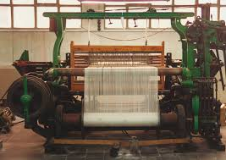
The economy increased
Around the half of the nineteenth century there was a big investment in textile machines and these exceeded the number of employees. During the nexts 50 years, the mechanization increased and the economy with it. More routes to trade were built, favoring globalization and lowering transportation taxes.

Slide 6
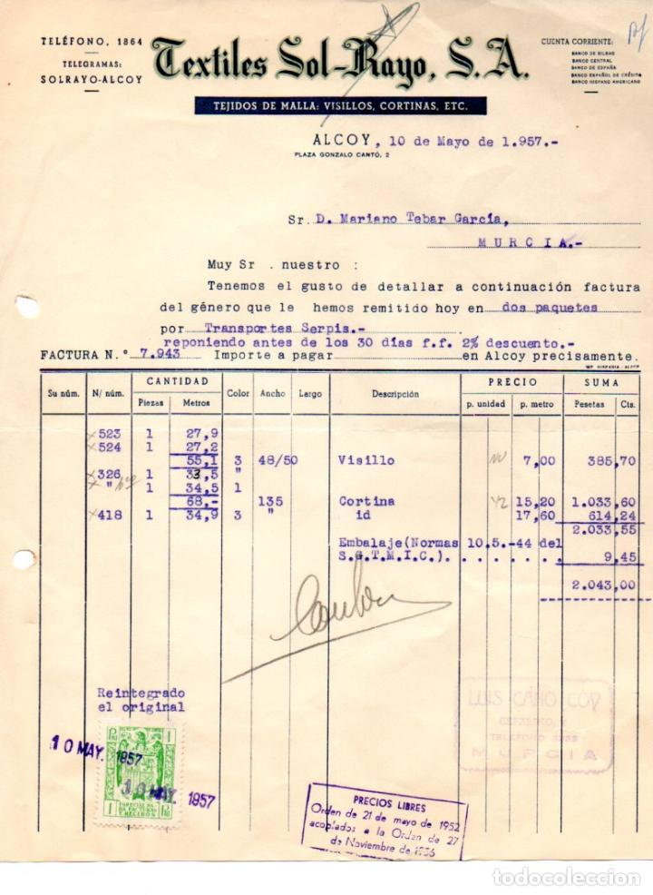
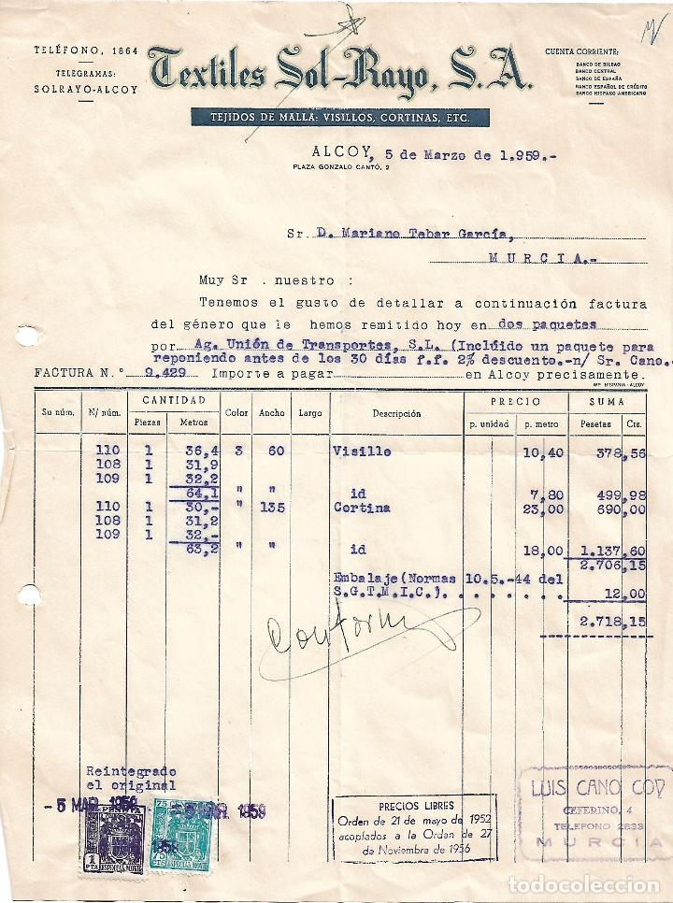
The crisis (1975 – 1985)
At the end of the twentieth century, after the Spanish Civil War, close and disappear practically all the significant industries in Alcoy. The main causes were:

Slide 7
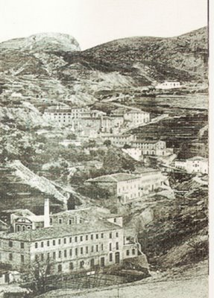
1) The huge increase in wage costs can no longer be brought to the sale prices.
2) The opening of international trade. And the competition of imported manufactured products made with advanced technologies.
3) The economic difference between a family industry of Alcoy and a multinational.

Slide 8
Bibliography
https://legadoalcoy.wordpress.com/2016/12/06/alcoy-en-la-historia-industrial-de-espana/
http://www.lasprovincias.es/20110814/comunitatvalenciana/alicante/retales-pasado-fabril-201108140754.html
https://es.wikipedia.org/wiki/Real_F%C3%A1brica_de_Pa%C3%B1os_de_Alcoy

