Slide 1
Textile Yarns
Definition, Types, Classification

Slide 2
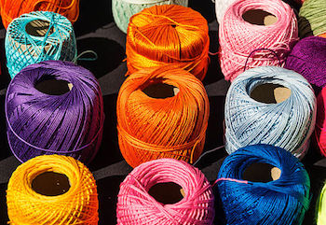
How is the yarn made?

Slide 3
What is Textile Yarn?
Have you ever looked closely at your favorite shirt? It's made of fabric with many woven textile yarns. But how is the yarn made? In this lesson, you will learn about types and classifications of yarns used to make textiles.
Every day, we use things made with textile yarn. Think about the shirt you wear and the carpet you walk on. Have you ever thought about how that yarn is made?
Textile yarn is a strand of natural or synthetic fibers or filaments.

Slide 4
What is a fiber? What is a filament?
A fiber is a small short piece of hair.
A filament is a long strand of a single substance. In textile yarn, individual fibers or filaments are wound together to make threads.
Textile yarn can be made with natural fibers from substances such as wool from sheep, silk from silkworms, or cotton and linen from plants. It can also be made with synthetic or man-made fibers created from a variety of substances like nylon, acrylic, and polyester.

Slide 5
spinning
The process of making yarn is called spinning. Yarn can be spun by machine or by hand. Yarn used for weaving tend to have a tight twist, smooth surface, and lots of lengthwise strength. Yarn for knitting has a looser twist.
Many specific production methods result in an endless variety of yarn. Textile yarn is made in a global industry that involves many specialized technical terms. We can't cover them all here, but for now, let's explore basic classifications and a few types of yarn.

Slide 6
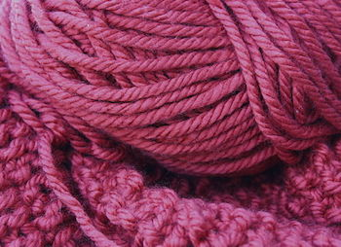
Classifications of Textile Yarn

Slide 7
Classifications of Textile Yarn
All textile yarn is classified according to structure, or how they are made.
In general, there are three basic classifications.
Let's look at each of them:
Staple fiber yarns
Ply yarns
Filament yarn

Slide 8
Staple fibre / ply / filament yarns
Staple fiber yarns are made of many short staple fibers that are wound together to make yarn. This is the most basic classification of yarn. Most staple fiber yarns are made of natural materials.
Ply yarns are made of one or more strands of staple fiber yarns. A single ply yarn is a single strand of staple fibers held together by twisting. Two and three ply yarns are made of two or three single yarns twisted together. Multiple ply yarns are used for fabrics that might require more strength or fabrics that need a desired surface effect.
Filament yarn is made of one or more continuous strands that run the entire length of the yarn. These are much longer than staple fibers. Silk is the only natural filament yarn. Most filament yarns tend to be made from synthetic materials created by mechanical or chemical processes.

Slide 9
Types of Textile Yarn
Under these three qualifications, there are many types of textile yarn. Some yarns are a mixture of natural and synthetic threads.
For example, blended yarns combine threads of different fibers such as wool and polyester.
Yarns are also distinguished by how many times the threads are twisted or how tightly they are wound. Each variation impacts the qualities of the yarn and its use.
For example, corn yarn involves twisting two or more multiple ply yarns together to create a cord. When two more corn yarns are twisted together they make a rope.

Slide 10
quiz
1. What is the name of process used to make textile yarn? (Carding/Weaving/Spinning/Sewing)
2. What is the main difference between a fiber and a filament?
(All fibers are natural and all filaments are synthetic/Fibers are long and strong and filaments are short and weak/Fibers are used to make filaments/A fiber is a short piece of hair and a filament is a long continuous strand)
3. Which classification of textile yarns includes those that are created by twisting one or more strands of yarn to make a single yarn?
(Specialty yarns/Staple fiber yarn/Ply yarns/Filament yarns)

