Slide 1
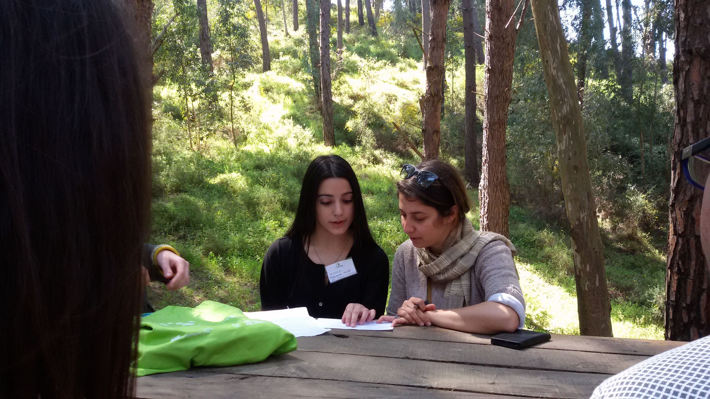
Here Pasqualina is preparing the interview with Miriam, one of the members of the cooperative…

Slide 2
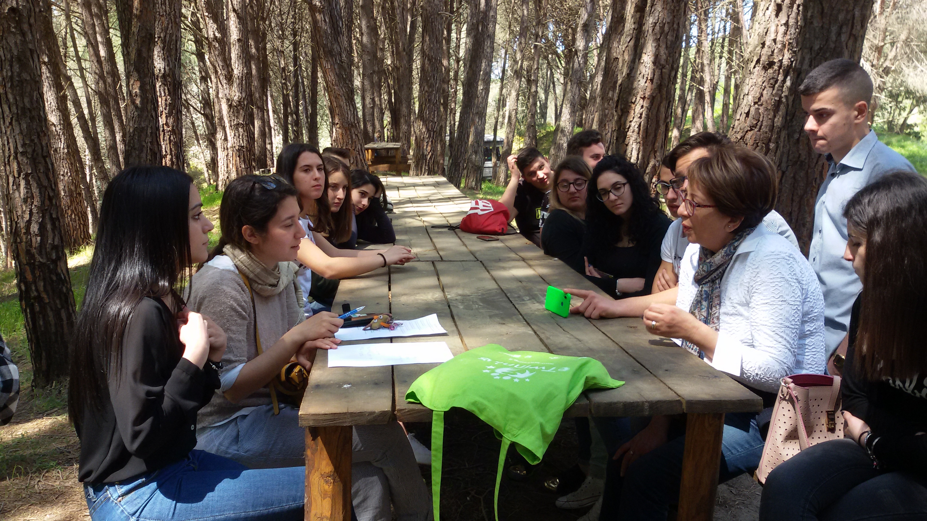

Slide 3
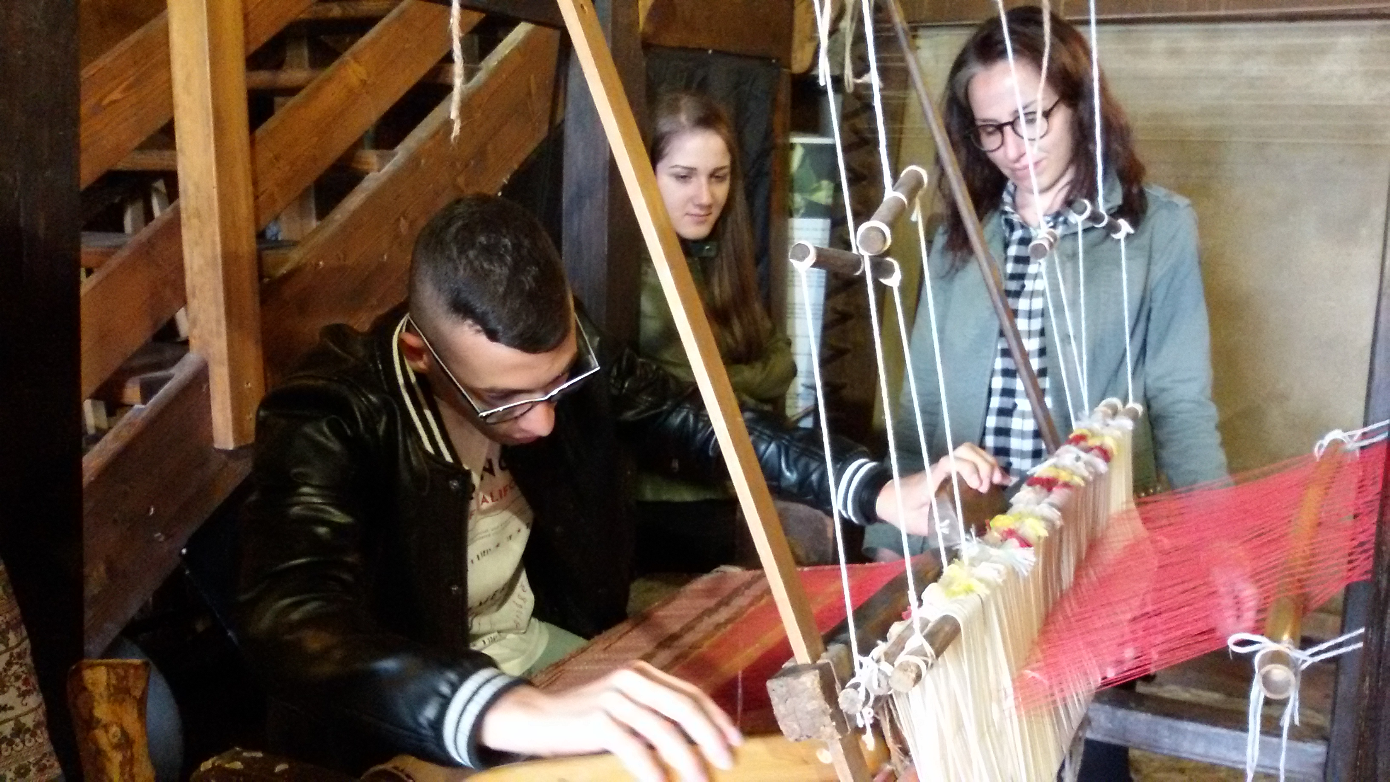
Matteo…

