Slide 1
Textile fibres, fabrics and dyes
Collaborative writing
eTwinning project: “Textile fibres: chemistry, fashion and tradition”, 2018

Slide 2
Schools Partners
ITT “Ferrari”, Chiaravalle C.le, Italy.
IES Les Foies, Beniganim, Spain.
IES Radio Exterior, Alicante, Spain.
Kauno Stepono Dariaus ir Stasio Gireno Gimnazija, Kaunas, Lithuania.
Karesi public training center, Balikesir, Turkey.
Licee La Martiniere-Diderot, Lyon, France.
Paul Hazard High School, Armentieres, France.
Technical college Elisa Zamfirescu, Satu Mare, Romania.
1° Epal Lamias, Lamia, Greece.
eTwinning project “Textile fibres: chemistry, fashion, tradition” , 2018

Slide 3
Summary
Definition of fibre, yarn, fabric
Abbreviation on labels for clothing
Classification in natural, man-made… and source
Chemical composition of natural and man-made fibres
How to recognize different fabrics
Fabric Dyes: Natural and Synthetic - Relationships between fabric and dyes
Effects of globalized fibre and fabric production on the environment
Economic/Social aspects of globalized fibre and fabric production
eTwinning project “Textile fibres: chemistry, fashion, tradition” , 2018

Slide 4
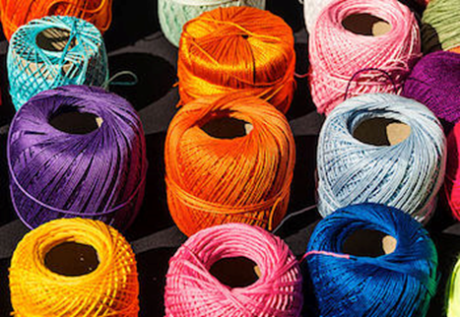
1. Definition of fibre, yarn, fabric
Fibre | Any product capable of being woven or otherwise made into fabrics; majority of fibres have a polymer structure.
Yarn | A set of textile fibres obtained by twisting or spinning.
Fabric | A structure produced by interlacing or interloping of the yarns.
Click on video
What is Textile Yarn?
Have you ever looked closely at your favorite shirt? It's made of fabric with many woven textile yarns. But how is the yarn made? In this lesson, you will learn about types and classifications of yarns used to make textiles.
Every day, we use things made with textile yarn. Think about the shirt you wear and the carpet you walk on. Have you ever thought about how that yarn is made?
Textile yarn is a strand of natural or synthetic fibers or filaments.
eTwinning project “Textile fibres: chemistry, fashion, tradition” , 2018

Slide 5
1. Definition of fibre, yarn, fabric
What is a fiber? What is a filament?
A fiber is the basic unit of raw material having suitable length, pliability, and strength for conversion into yarns and fabrics. Fibres can occur naturally or can be produced artificially.
A filament is a long strand of a single substance. In textile yarn, individual fibers or filaments are wound together to make threads.
Textile yarn can be made with natural fibers from substances such as wool from sheep, silk from silkworms, or cotton and linen from plants. It can also be made with synthetic or man-made fibers created from a variety of substances like nylon, acrylic, and polyester.
Spinning
The process of making yarn is called spinning. Yarn can be spun by machine or by hand. Yarn used for weaving tend to have a tight twist, smooth surface, and lots of lengthwise strength. Yarn for knitting has a looser twist.
Many specific production methods result in an endless variety of yarn. Textile yarn is made in a global industry that involves many specialized technical terms. We can't cover them all here, but for now, let's explore basic classifications and a few types of yarn.
eTwinning project “Textile fibres: chemistry, fashion, tradition” , 2018

Slide 6
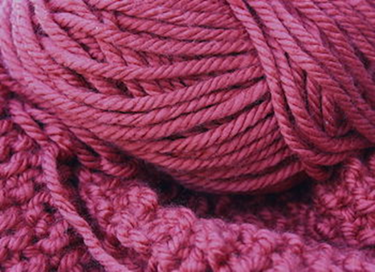
1. Definition of fibre, yarn, fabric
Classification of textile yarn
All textile yarn is classified according to structure, or how they are made.
In general, there are three basic classifications.
Let's look at each of them:
Staple fiber yarns
Ply yarns
Filament yarn
eTwinning project “Textile fibres: chemistry, fashion, tradition” , 2018

Slide 7
1. Definition of fibre, yarn, fabric
Stable fiber / Ply / Filament yarn
Staple fiber yarns are made of many short staple fibers that are wound together to make yarn. This is the most basic classification of yarn. Most staple fiber yarns are made of natural materials.
Ply yarns are made of one or more strands of staple fiber yarns. A single ply yarn is a single strand of staple fibers held together by twisting. Two and three ply yarns are made of two or three single yarns twisted together. Multiple ply yarns are used for fabrics that might require more strength or fabrics that need a desired surface effect.
Filament yarn is made of one or more continuous strands that run the entire length of the yarn. These are much longer than staple fibers. Silk is the only natural filament yarn. Most filament yarns tend to be made from synthetic materials created by mechanical or chemical processes.
Types of textile yarn
Under these three qualifications, there are many types of textile yarn. Some yarns are a mixture of natural and synthetic threads. For example, blended yarns combine threads of different fibers such as wool and polyester.
Yarns are also distinguished by how many times the threads are twisted or how tightly they are wound. Each variation impacts the qualities of the yarn and its use. For example, corn yarn involves twisting two or more multiple ply yarns together to create a cord. When two more corn yarns are twisted together they make a rope.

Slide 8
2. Abbreviation on labels for clothing
Code | English | Italian | French | Spanish
CO | Cotton | Cotone | Coton | Algodon
LI | Linen | Lino | Lin | Lino
WO | Wool | Lana | Laine | Lana
SE | Silk | Seta | Soie | Seda
WS | Cashmere | Cashmere | Cachemire | Cachemira
CA | Acetate | Acetato | Acétate | Acetato
VI | Viscose | Viscosa | Viscose | Viscosa
PL | Polyester | Poliestere | Polyester | Poliéster
EA | Elastane | Elastano | Elasthane | Elastano
PA | Polyamide | Poliammide | Polyamide | Polyamide
Some European code abbreviation
eTwinning project “Textile fibres: chemistry, fashion, tradition” , 2018
Notes:
Could you use a logo proposal as background and then put this as image?

Slide 9
2. Abbreviation on labels for clothing
Code | Lithuanian | Greek | Romanian | Turkish
CO | Medvilnė | Βαμβάκι | Bumbac | Pamuk
LI | Linas | Λινό | In | Keten
WO | Vilna | Μαλλί | Lâna | Yün
SE | Šilkas | Μετάξι | Mătase | İpek
WS | Kašmyrui | Κασμίρ | Cașmir | Kaşmir
CA | Acetatas | Ασετάτ | Acetat | Asetat
VI | Viskozė | Βισκόζη | Vâscoză | Viskoz
PL | Poliesteris | Πολυεστέρας | Poliester | Polyester
EA | Elastanas | Ελαστάν | Elastan | Elastan
PA | Poliamidas | Πολυαμίδη | Poliamidă | Poliamid
Some European code abbreviation
eTwinning project “Textile fibres: chemistry, fashion, tradition” , 2018
Notes:
Could you use a logo proposal as background and then put this as image?

Slide 10
2. Abbreviation on labels for clothing
Click on video
eTwinning project “Textile fibres: chemistry, fashion, tradition” , 2018
Notes:
Could you use a logo proposal as background and then put this as image?

Slide 11
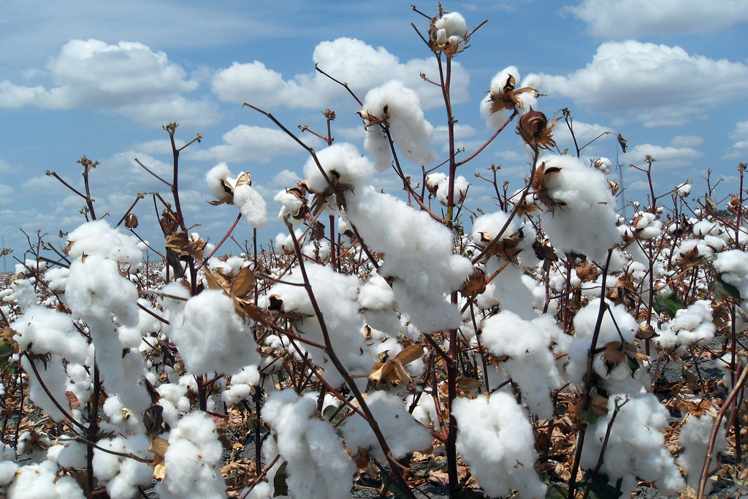
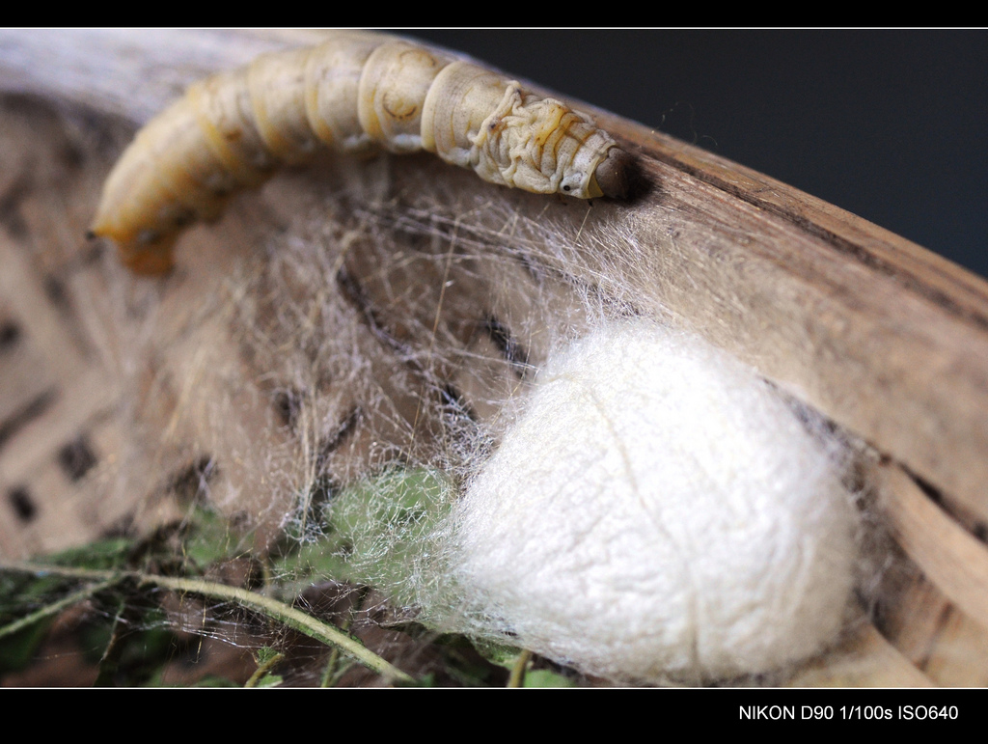
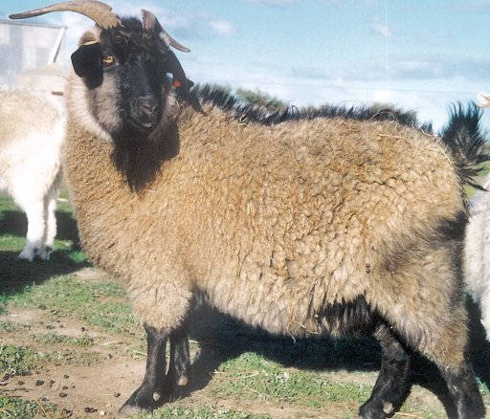
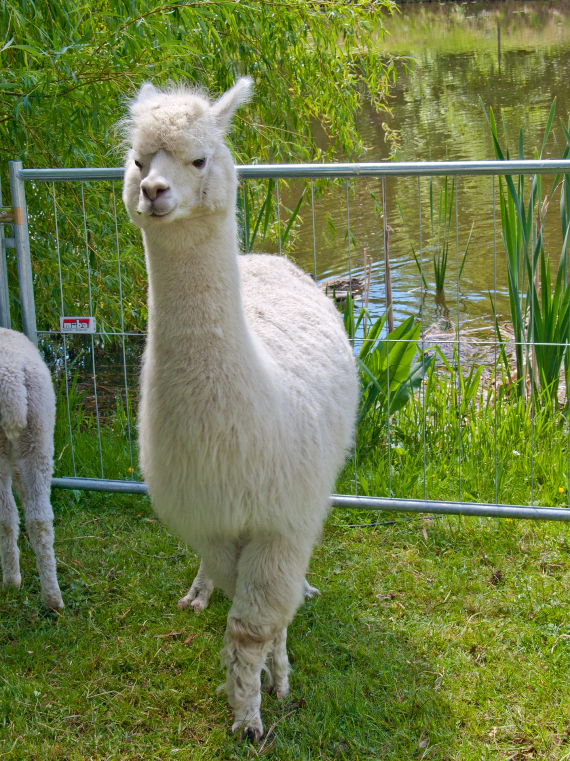
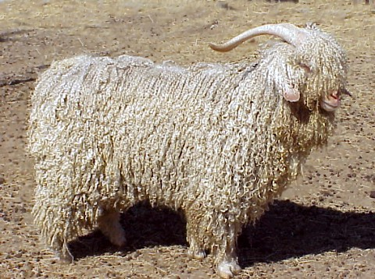
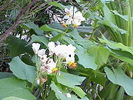
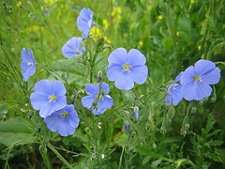
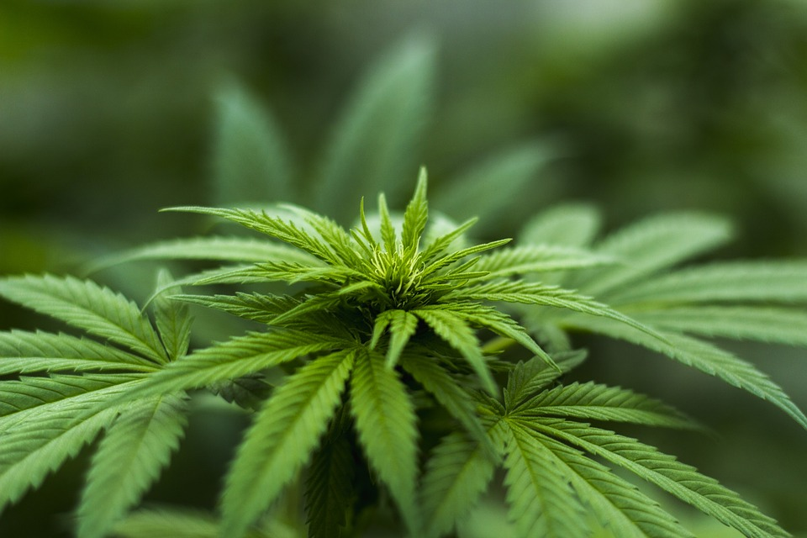
3. Classification in natural, man-made… and source
NATURAL TEXTILE FIBRES
(present in nature as filaments)
WOOL
ANIMAL FIBRES
(obtained from animals)
SILK
VEGETABLE FIBRES
(derived from plants)
CACHEMIRE
ALPACA
MOHAIR
JUTA
COTTON
LINEN
HEMP
eTwinning project “Textile fibres: chemistry, fashion, tradition” , 2018

Slide 12
3. Classification in natural, man-made… and source
MAN MADE FIBRES
fibres that are not naturally present in nature
ARTIFICIAL FIBRES
SYNTHETICS FIBRES
MODIFIED NATURAL POLYMERS (e.g. cellulose)
OFTEN OBTAINED FROM PETROLEUM DERIVATES
ACETATE
VISCOSE
POLYESTER
POLYAMIDE
(nylon)
RAYON
ACRYLIC
eTwinning project “Textile fibres: chemistry, fashion, tradition” , 2018

Slide 13
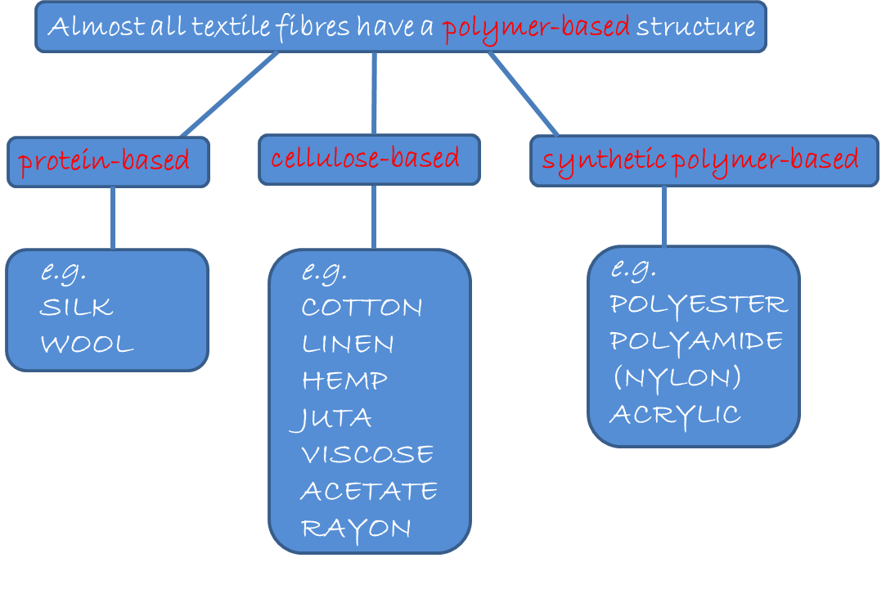
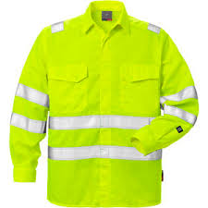
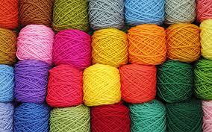
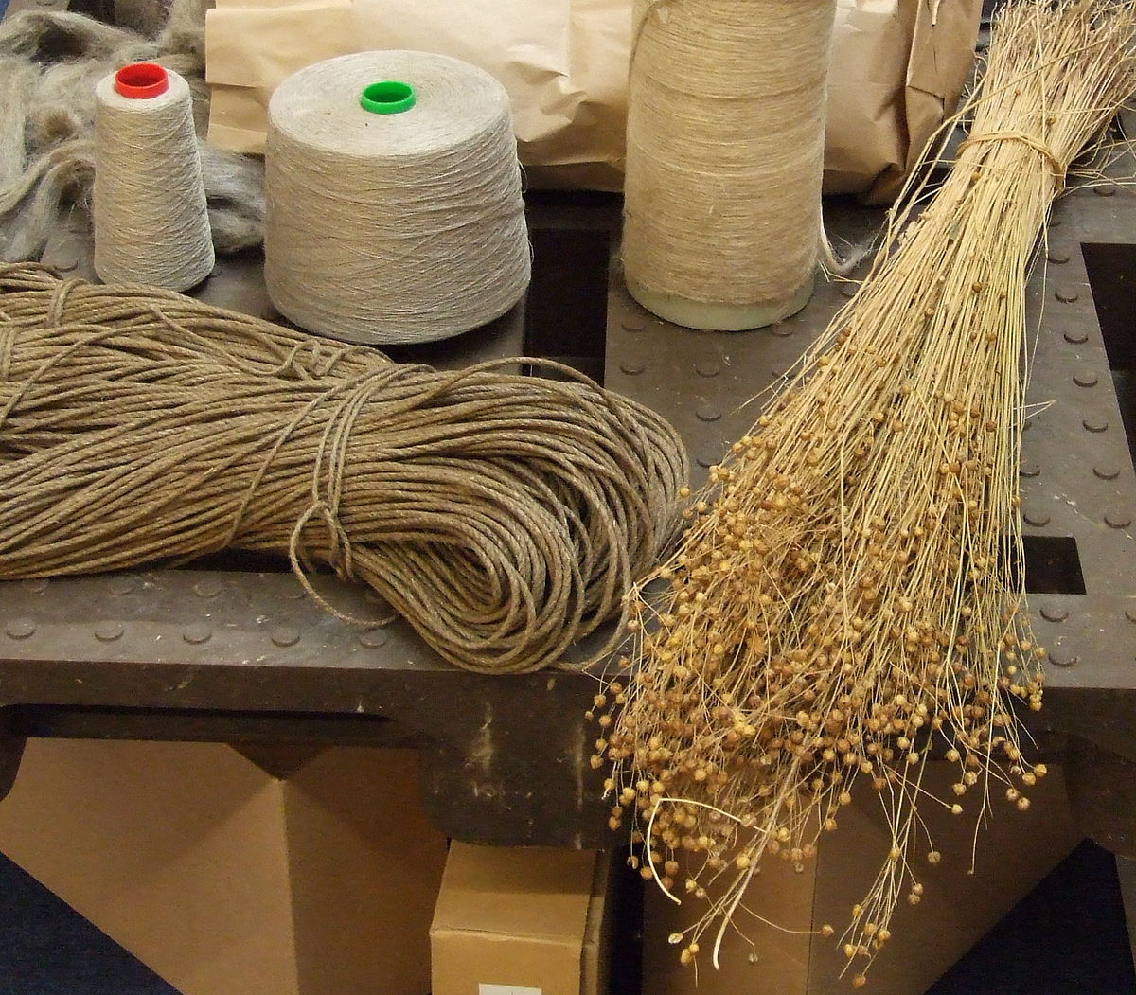
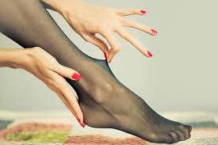
4. Chemical composition of natural fibres and man-made fibres
eTwinning project “Textile fibres: chemistry, fashion, tradition” , 2018

Slide 14
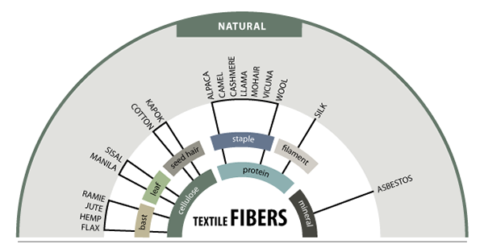
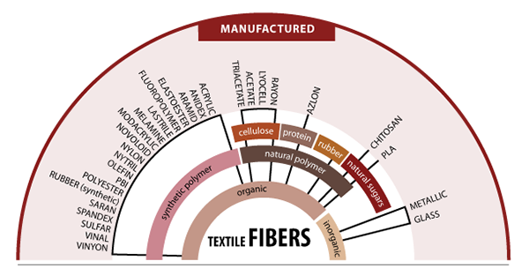
4. Chemical composition of natural fibres and man-made fibres
A SUMMARY SCHEME
eTwinning project “Textile fibres: chemistry, fashion, tradition” , 2018

Slide 15
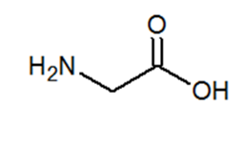
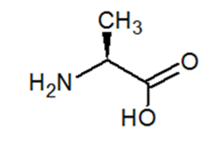
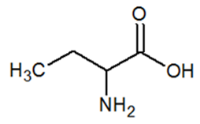
4. Chemical composition of natural fibres and man-made fibres
SILK
The silk is a natural protein fiber of animal origin.
Animal is the silkworm and is the larva or caterpillar of the domestic silkmoth, Bombyx mori.
The silk is composed of two proteins: fibroin and sericin.
Fibroin:
Sericin:
Main aminoacids:
Glycine
Alanine
Serine
eTwinning project “Textile fibres: chemistry, fashion, tradition” , 2018

Slide 16
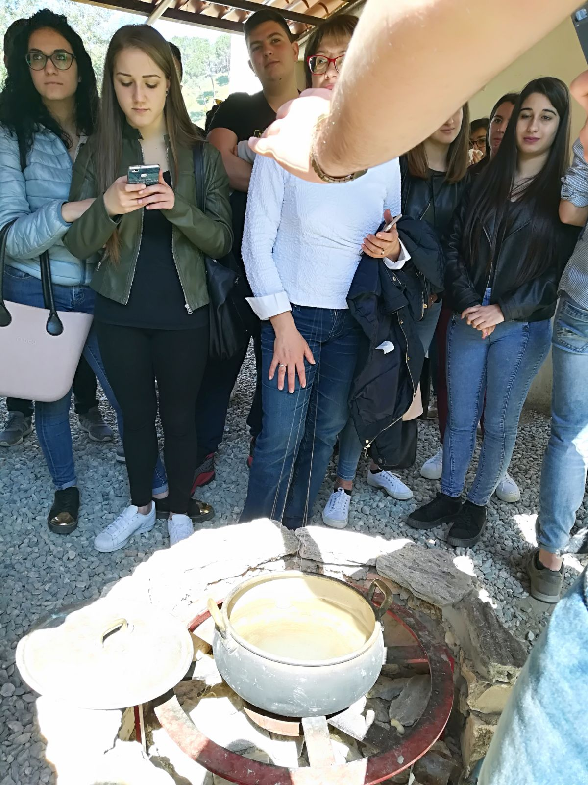
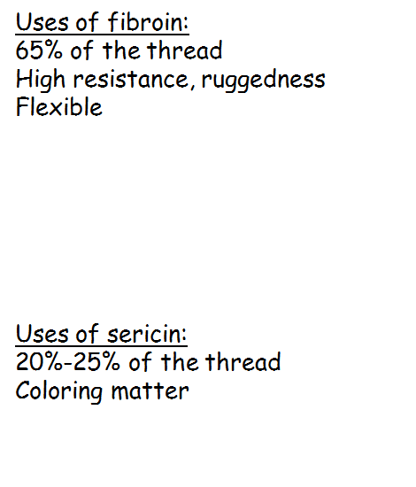
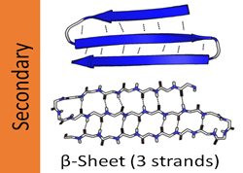
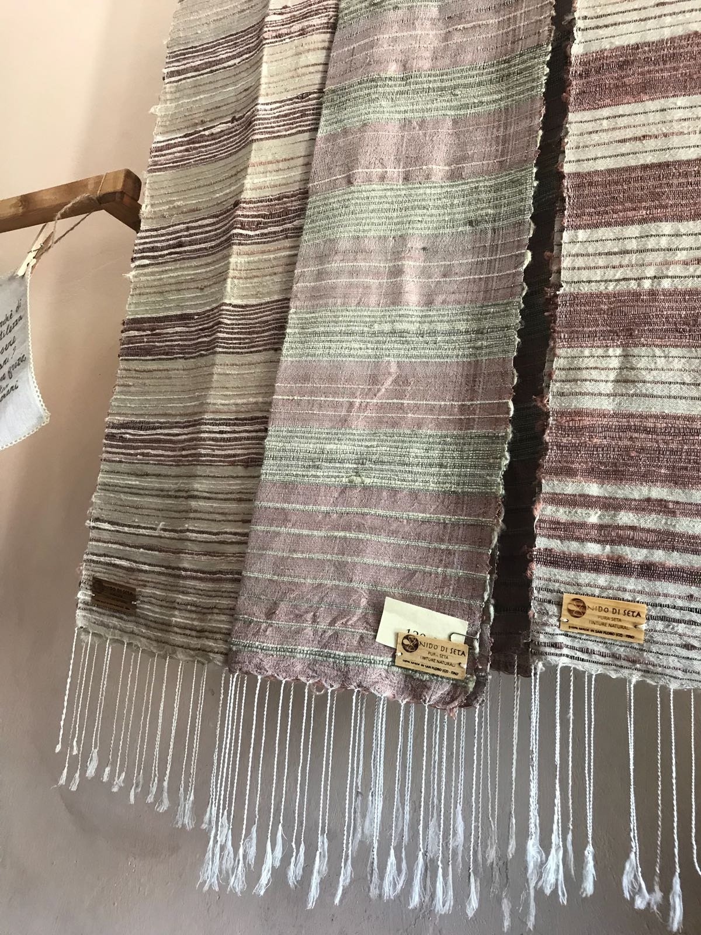
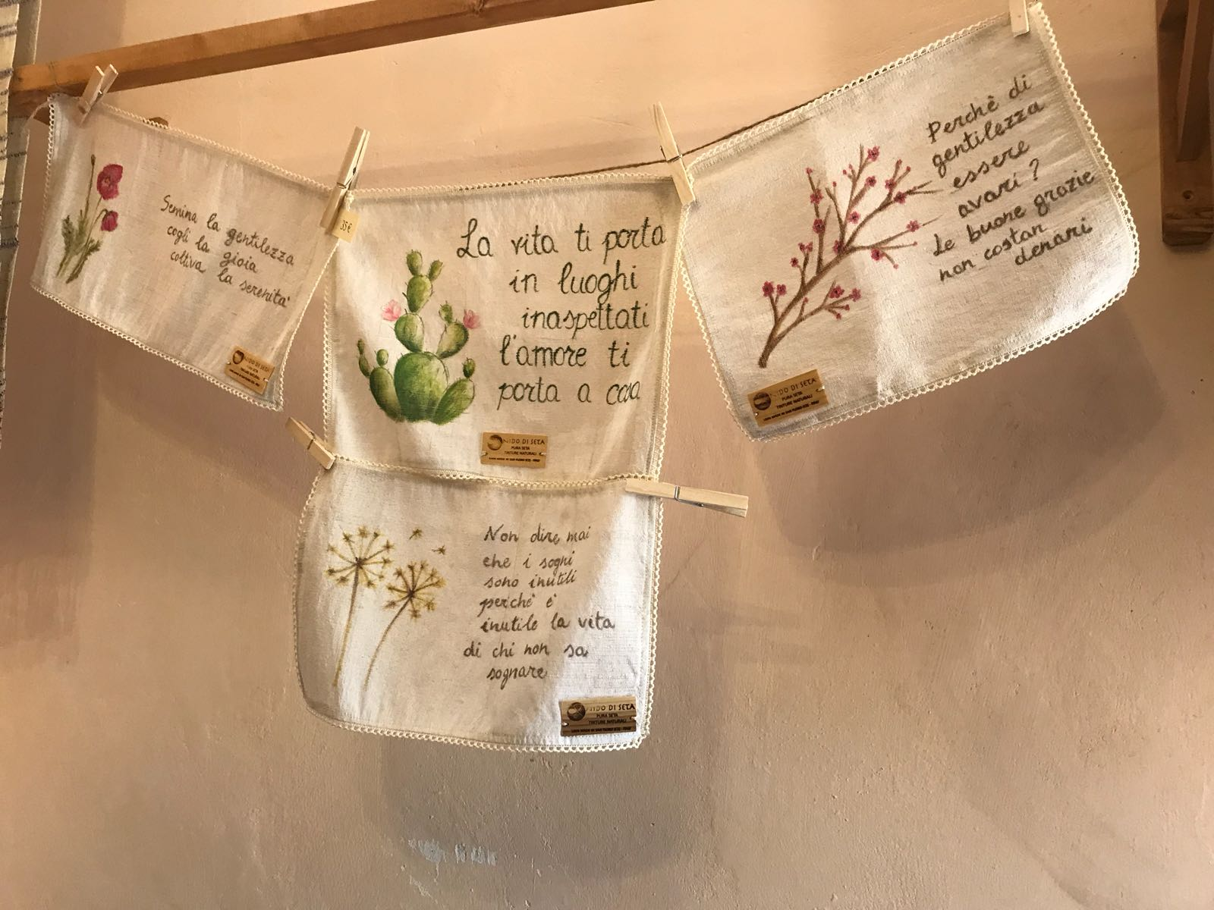
4. Chemical composition of natural fibres and man-made fibres
Silk filament is a double strand of fibroin, which is held together by sericin, a gummy substance, called «silk gum».
The main role of sericin is to envelop the fibroin.
The sericin dissolves in water, but not completely, so when the filaments are pulled up, the remaining sericin dries to air and holds the threads together.
“Degumming” is the process of removing the sericin.
In presence of sericin the fibres are hard and tough and become soft and lustrous after its removal. For this reason, raw silk with the gum still on the filament is called “hard silk”; degummed silk is “soft silk”.
eTwinning project “Textile fibres: chemistry, fashion, tradition” , 2018

Slide 17
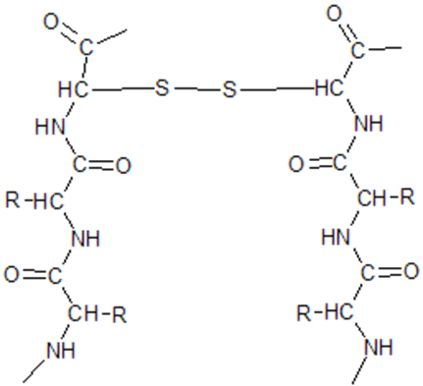
4. Chemical composition of natural fibres and man-made fibres
WOOL
As the silk, also the wool is a protein fibre: it contains the “keratin”.
Fibrous keratin molecules supercoil to form a very stable, left-handed superhelical motif.
Wool is made of :
Keratin: around 33%
Grease: around 28%
Suint: around 12%
Other: around 26 %
eTwinning project “Textile fibres: chemistry, fashion, tradition” , 2018

Slide 18
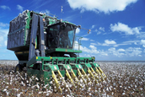
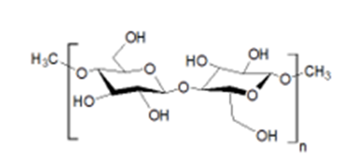
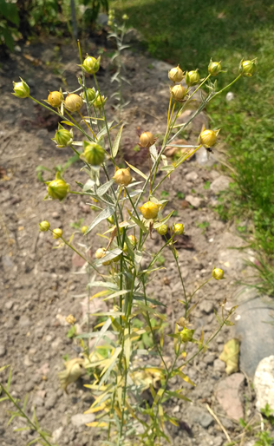
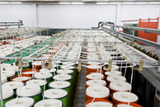
4. Chemical composition of natural fibres and man-made fibres
Linen is mainly made of cellulose
Molecular weight : 337.35 g/mol
Empirical formula : (C₆H₁₀O₅)_{n}
LINEN
(a natural fibre)
COTTON
(a natural fibre)
In clothing : Clothing is very much in the forefront of the use of linen in textiles. Linen stay fresh in the summer, is intrinsically antibacterial and hypoallergenic.
In upholstery textile: (dedicated to interior decoration), linen represents the natural that soothes us and which we like to surround ourselves with.
Cellulose
In technical fabrics: called flax composites, they are used in automotive, boats, sports equipment. Linen composites are a future alternative to the use of carbon and fiberglass.
Cotton is made of :
Cellulose : around 95 %
Protein : around 1,6 %
Waxes : around 1 %
Other : around 2,4 %
eTwinning project “Textile fibres: chemistry, fashion, tradition” , 2018

Slide 19
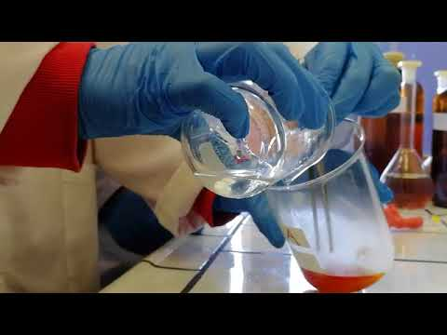
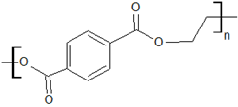
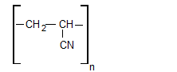
4. Chemical composition of natural fibres and man-made fibres
Synthetic fibers are obtained in the laboratory, generally derived from a condensation reaction.
Click on video
Nylon 6,6
Synthesis of nylon 6,6
Polyesters are a class of polymers obtained by condensation-stage polymerization containing the functional group of esters along the main carbon chain.
Acrylic fibre
Polyester
eTwinning project “Textile fibres: chemistry, fashion, tradition” , 2018

Slide 20
5. How to recognize different fabrics
Click on video
Click on video
eTwinning project “Textile fibres: chemistry, fashion, tradition” , 2018

Slide 21
5. How to recognize different fabrics
Organoleptic analysis consists in determining the characteristics of raw materials/products by means of senses (seeing, smell, etc.) and touch sensations (soft, harsh).
Among the characteristics of textile fibers that can be analyzed with the help of the sense of sight and touch, we mention:
color;
gloss (mat, weak, full, strong, very strong);
length (short, medium, long fibers, filaments);
fineness (small, medium, high);
corrugations (no corrugations, slightly curled, normally curled, with frequent curls);
the impurity content (contains / contains no impurities)
the touch sensations (soft, harsh, etc)
Knowing the properties of textile fibers, you can identify their nature / type by organoleptic analysis of fiber samples.
eTwinning project “Textile fibres: chemistry, fashion, tradition” , 2018

Slide 22
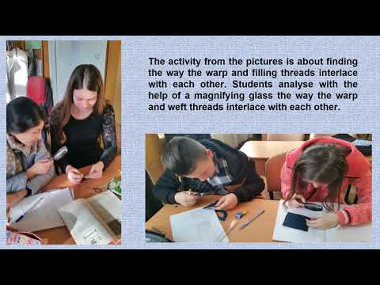
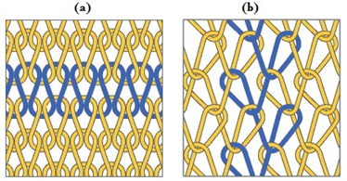
5. How to recognize different fabrics
Analysing yarns and knitted fabrics
The knitted fabrics are produced by interconnected loops of yarn. These loops are easily stretched in different directions when subjected to external force, offering more elasticity than woven fabrics. Owing to this fact, the knitted fabrics are more form-fitting than woven fabrics and believed to be better suitable for garments that must be elastic or stretchable in response to the wearer’s motions, such as socks and hosiery. The yarns used for knitting have normally low twist level, which gives them more bulk and less drape than a woven fabric.
Click on video
(a) Weft- and
(b) warp-knitted structures
eTwinning project “Textile fibres: chemistry, fashion, tradition” , 2018

Slide 23
5. How to recognize different fabrics
Weaving-Structure and design analyse
Weaving is a method of fabric production in which two distinct sets of yarns or threads are interlaced at right angles to form a fabric or cloth. The longitudinal threads are called the warp and the lateral threads are the weft or filling. The method in which these threads are interwoven affects the characteristics of the cloth. The way the warp and filling threads interlace with each other is called the weave.
The majority of woven products are created with one of three basic weaves: plain weave, satin weave, or twill.
Plain weave (also called tabby weave, linen weave or taffeta weave) is the most basic of three fundamental types of textile weaves. It is strong and hard-wearing, used for fashion and furnishing fabrics. In plain weave, the warp and weft are aligned so they form a simple criss-cross pattern. Each weft thread crosses the warp threads by going over one, then under the next, and so on.
The satin weave is distinguished by its lustrous, or 'silky', appearance. Satin describes the way the threads are combined, and the yarn used may be silk or polyester, among others, giving different fabrics.The satin weave is characterized by four or more cool fill or weft yarns floating over a warp yarn or vice versa, four warp yarns floating over a single weft yarn.
Twill is done by passing the weft thread over one or more warp threads and then under two or more warp threads and so on, with a "step" or offset between rows to create the characteristic diagonal pattern. Because of this structure, twills generally drape well. Examples of twill fabric are chino, drill, denim, gabardine, tweed and serge.
eTwinning project “Textile fibres: chemistry, fashion, tradition” , 2018

Slide 24
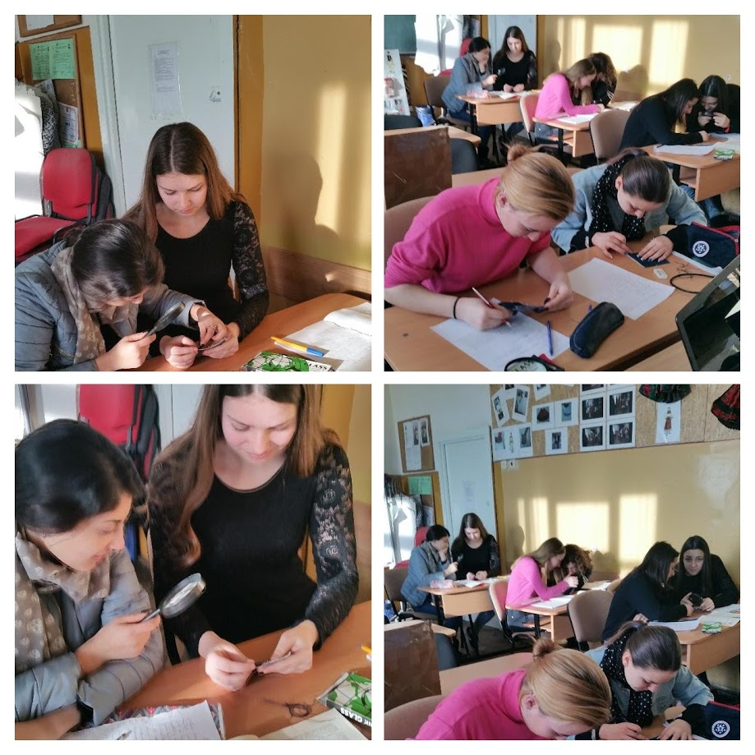
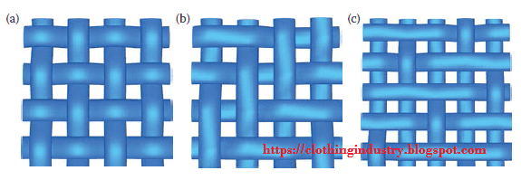
5. How to recognize different fabrics
The activity from the pictures is about finding the way the warp and filling threads interlace with each other. Students are studying the way the threads are interlacing and draw on a sheet of paper with squares – full squares when the warp thread pass over the weft thread and empty squares when the warp thread pass underneath the weft thread. Students will use the magnifying glass to this laboratory activity, in order to a better seeing of the fabric’s threads.
(a) Plain, (b) twill, and (c) satin fabric structures
eTwinning project “Textile fibres: chemistry, fashion, tradition” , 2018

Slide 25
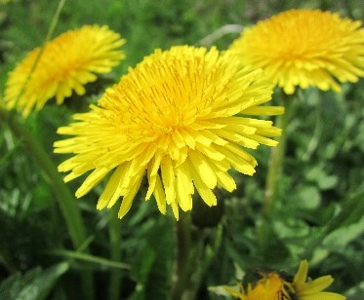
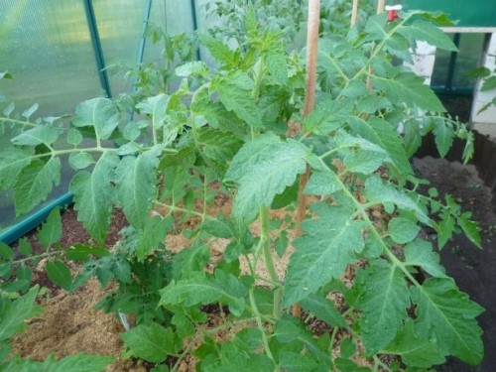
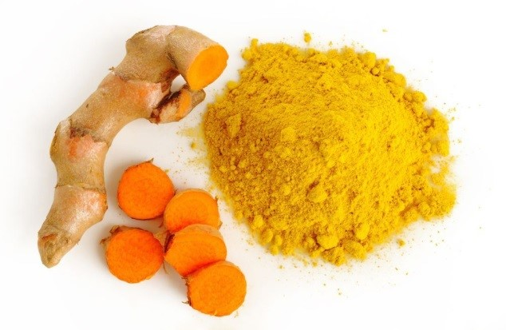
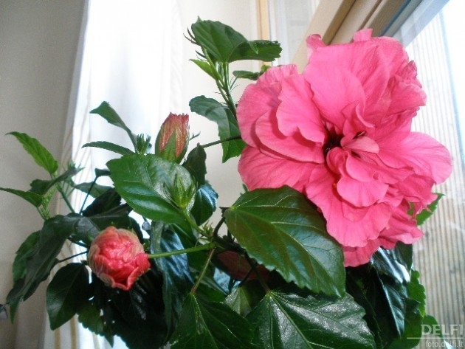
6. Fabric Dyes: Natural and Synthetic - Relationships between fabric and dyes
Some natural pigments for fabrics
Dandelion (gray, green)
Tomato leaves (light green)
Turmeric (bright yellow)
Kinote rings (light pink)
eTwinning project “Textile fibres: chemistry, fashion, tradition” , 2018

Slide 26
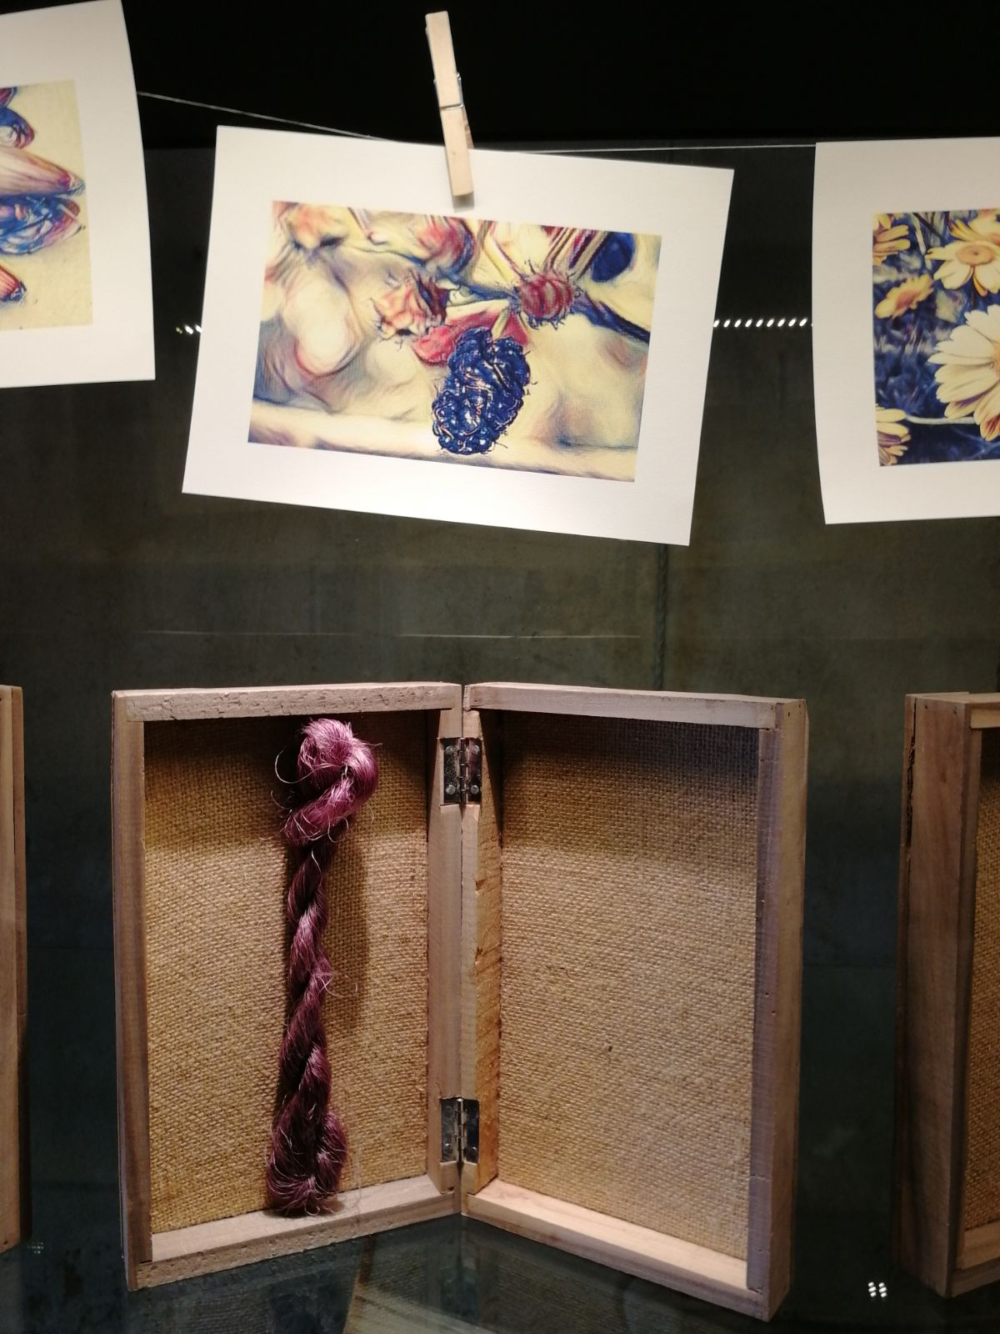
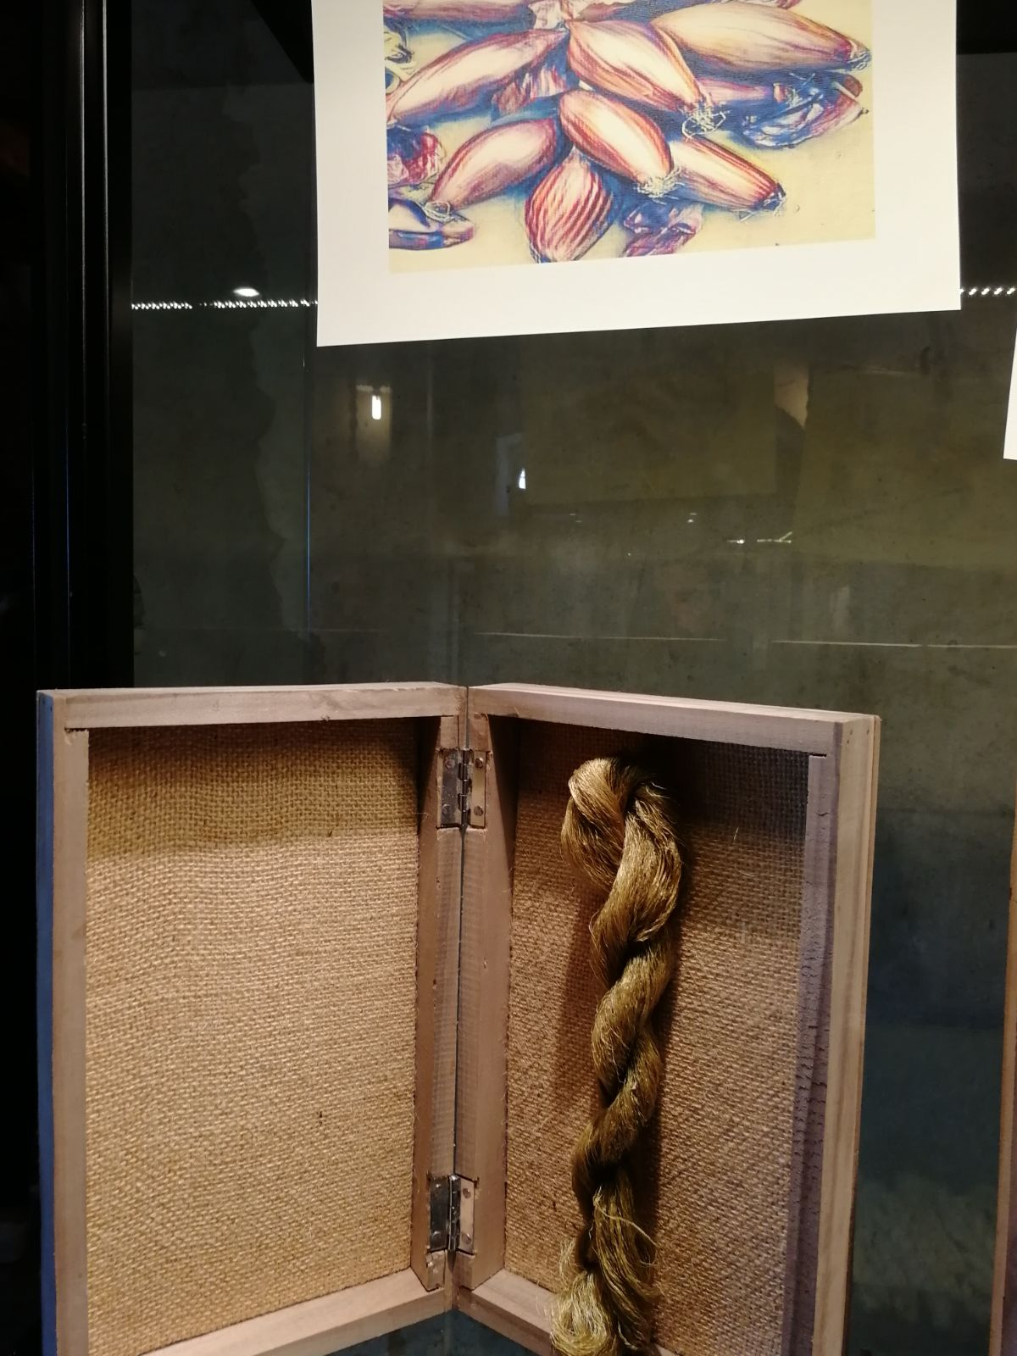
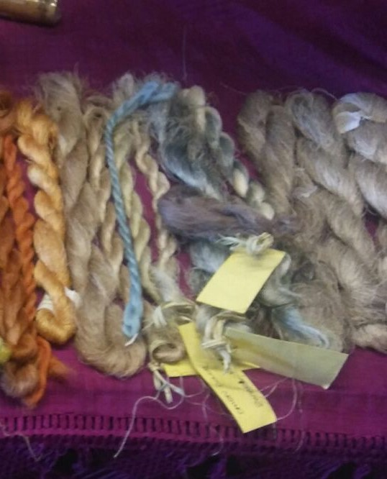
6. Fabric Dyes: Natural and Synthetic - Relationships between fabric and dyes
Cirò’s Grapes (light blue, gray)
Mulberry blackberry (violet)
Tropea red onion (green)
eTwinning project “Textile fibres: chemistry, fashion, tradition” , 2018

Slide 27
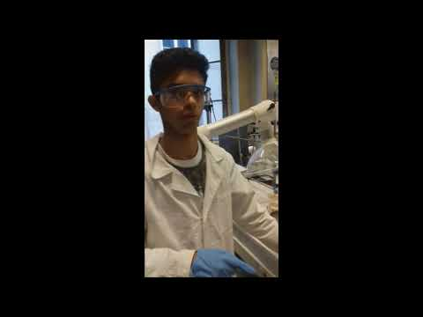
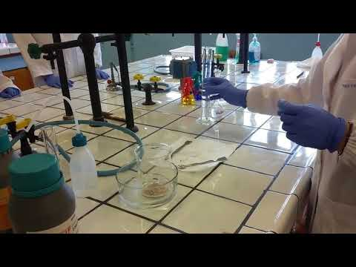
6. Fabric Dyes: Natural and Synthetic - Relationships between fabric and dyes
Lab experiments synthetizing dyes
Click on video
Making 2-Naphthol aniline
Red dyes
Click on video
eTwinning project “Textile fibres: chemistry, fashion, tradition” , 2018

Slide 28
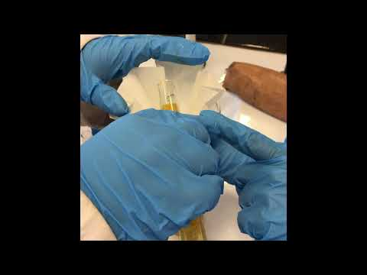
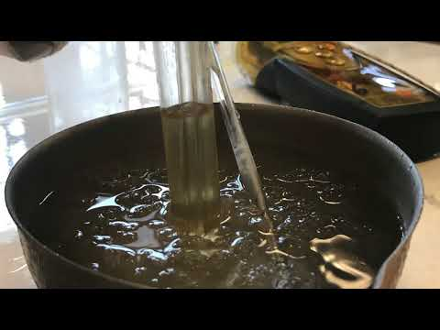
6. Fabric Dyes: Natural and Synthetic - Relationships between fabric and dyes
Click on video
Dye with aniline and salicylic acid
A red dye made of aniline and 1-naphtol
Click on video
eTwinning project “Textile fibres: chemistry, fashion, tradition” , 2018

Slide 29
6. Fabric Dyes: Natural and Synthetic - Relationships between fabric and dyes
Tye dye and Shibori
Click on video
eTwinning project “Textile fibres: chemistry, fashion, tradition” , 2018

Slide 30
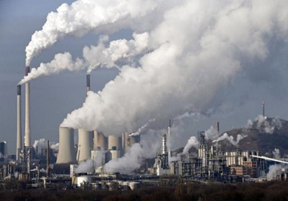
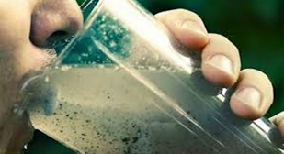
7. Effects of globalized fibre and fabric production on the environment
Pollution of rivers
Harmful gases, dumping site
Particles on drinking water
The second industry more pollutant of the world
eTwinning project “Textile fibres: chemistry, fashion, tradition” , 2018

Slide 31
8. Economic/Social aspect of globalized fibre and fabric production
Clothing selling: three trillion dollars business per year
Very low salaries: Two dollars a day
Workers enslaved, suffering in third world countries
eTwinning project “Textile fibres: chemistry, fashion, tradition” , 2018

Slide 32
8. Economic/Social aspect of globalized fibre and fabric production
Multinational brands vs Alternative brands
Main brands:
Zara, H&M, Uniqlo, Primark, Forever 21, Top Shop, GAP, Mango, Joe Fresh
Alternative brands:
People tree, Hemper
http://www.peopletree.co.uk/
http://www.hemper.es/
eTwinning project “Textile fibres: chemistry, fashion, tradition” , 2018

Slide 33
THANKS FOR THE ATTENTION!
eTwinning project “Textile fibres: chemistry, fashion, tradition” , 2018

