Slide 1
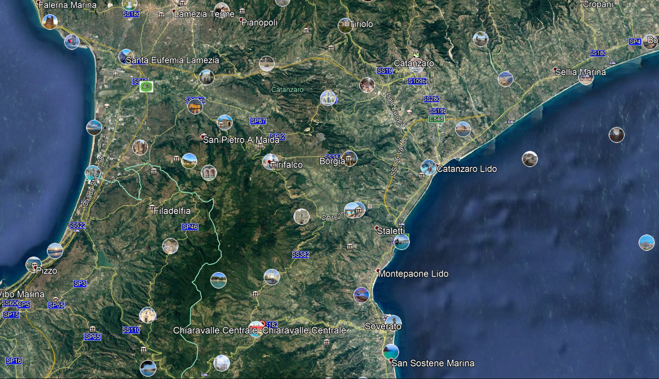
San Floro

Slide 2
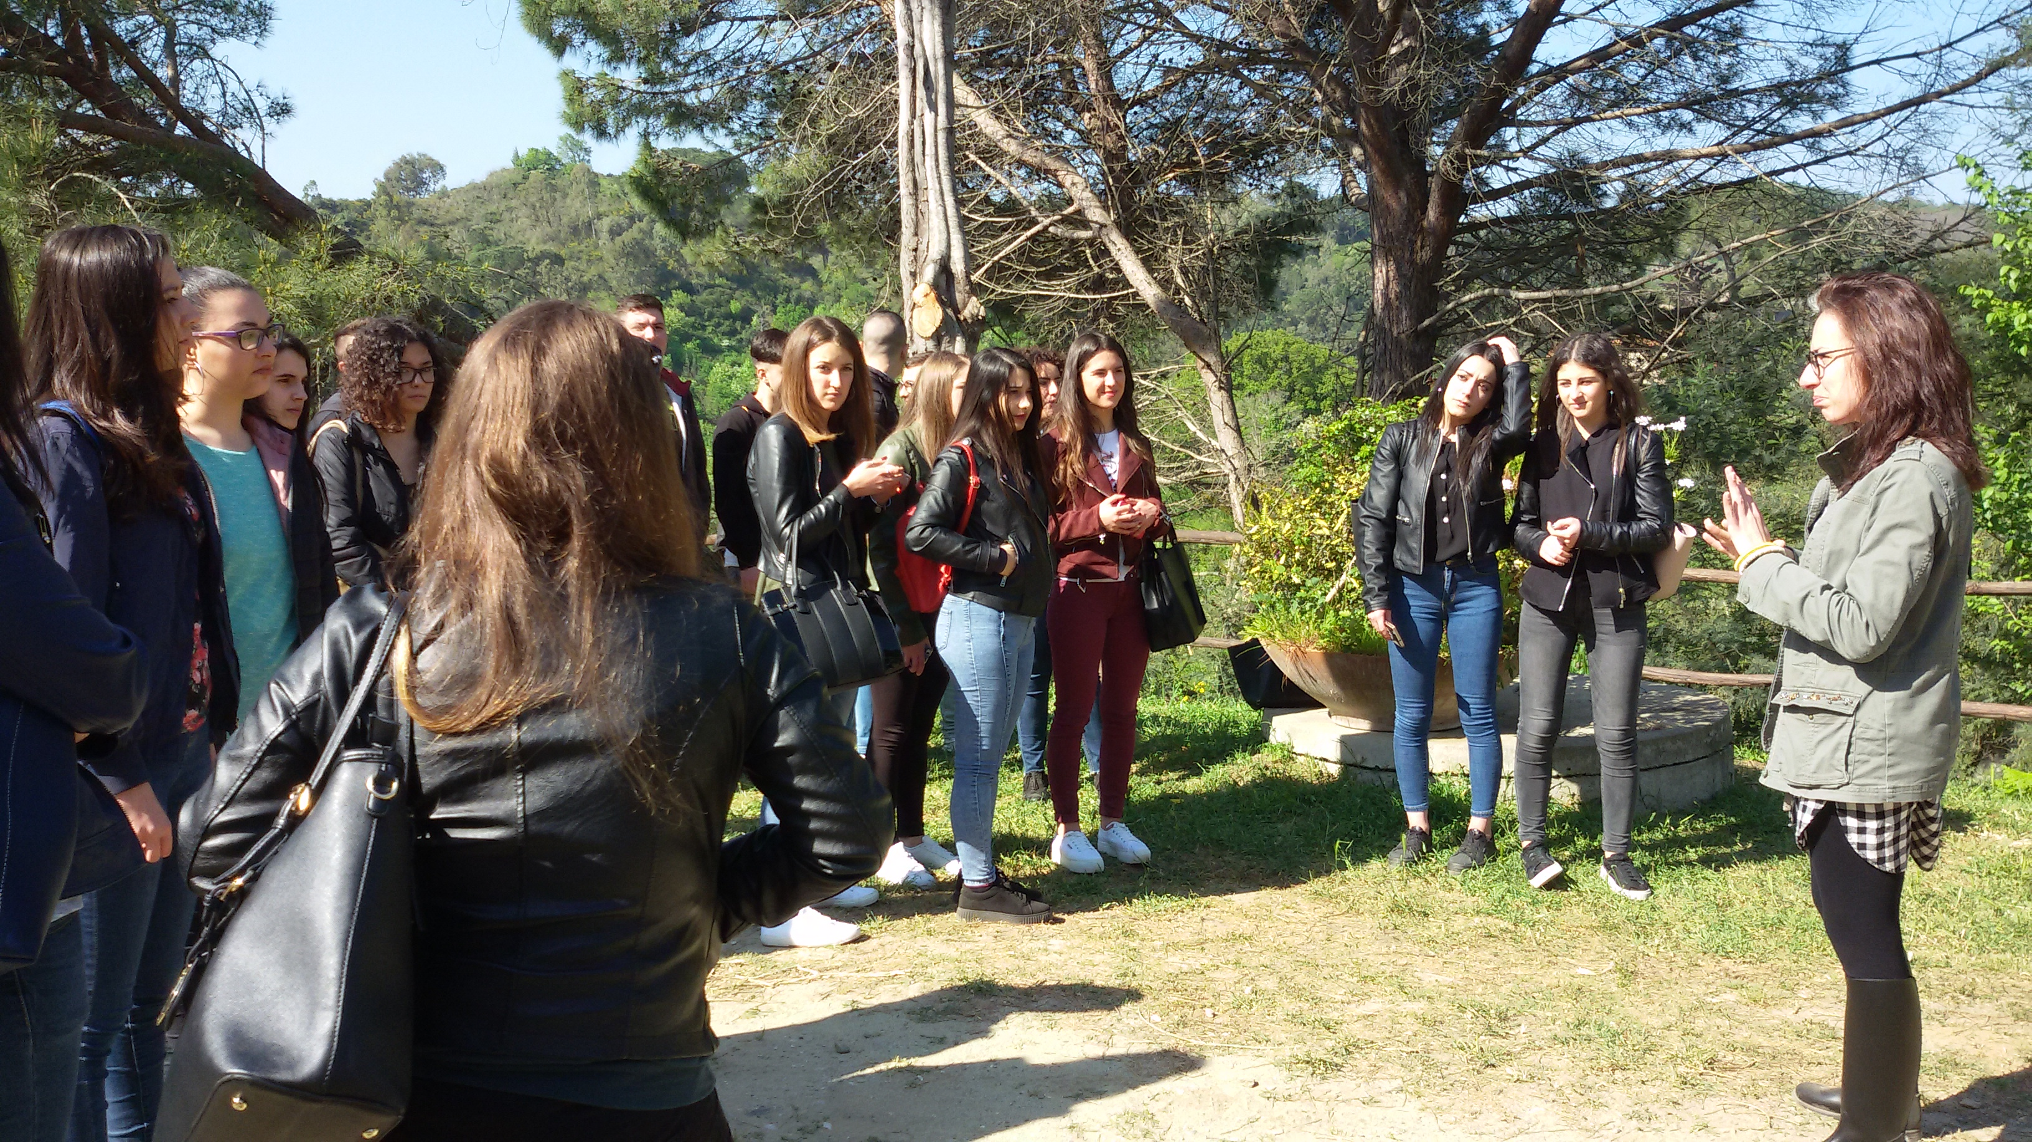
Visit of the «Nido di seta» cooperative, in San Floro (CZ), on April 21.
The cooperative has revived the ancient silk tradition …

Slide 3
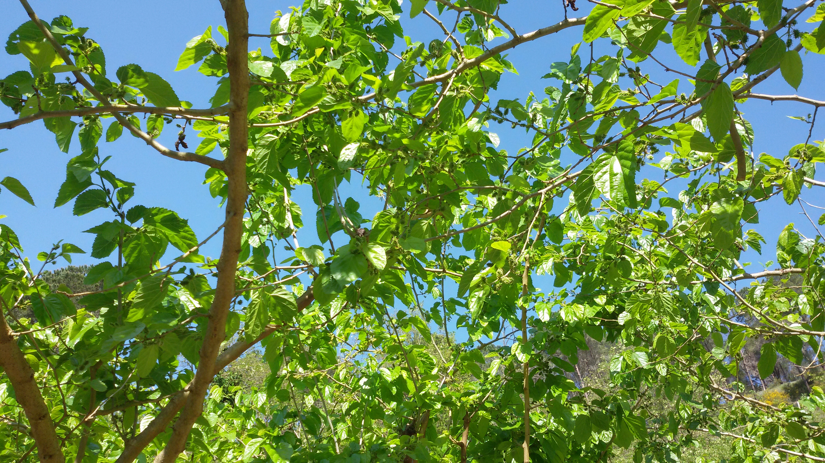
From mulberry…

Slide 4
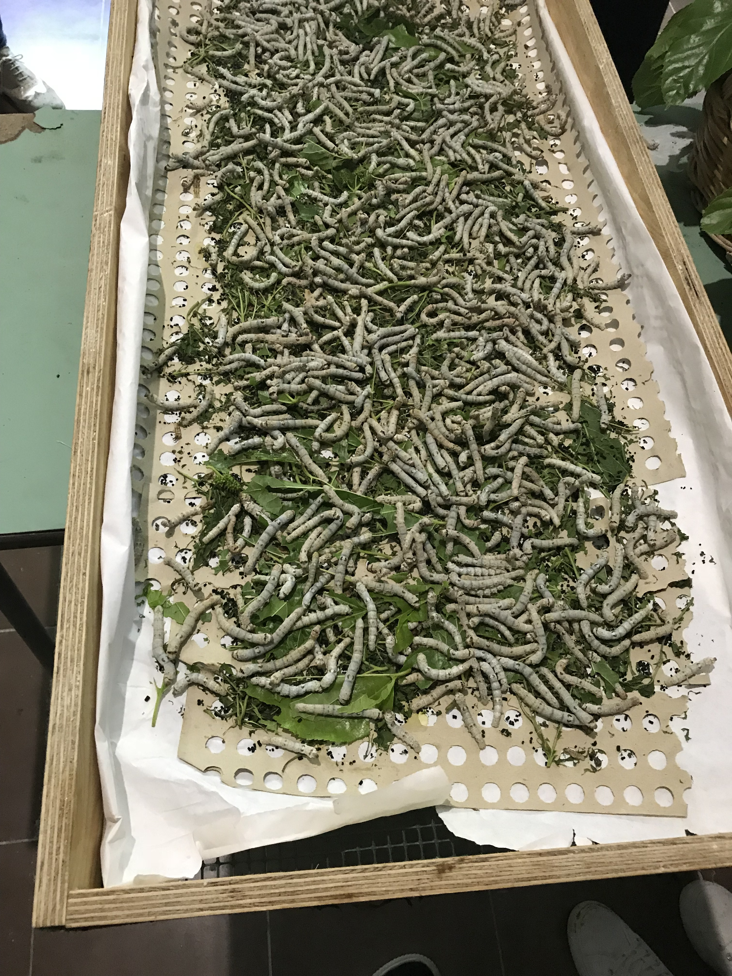
To silk worms…

Slide 5
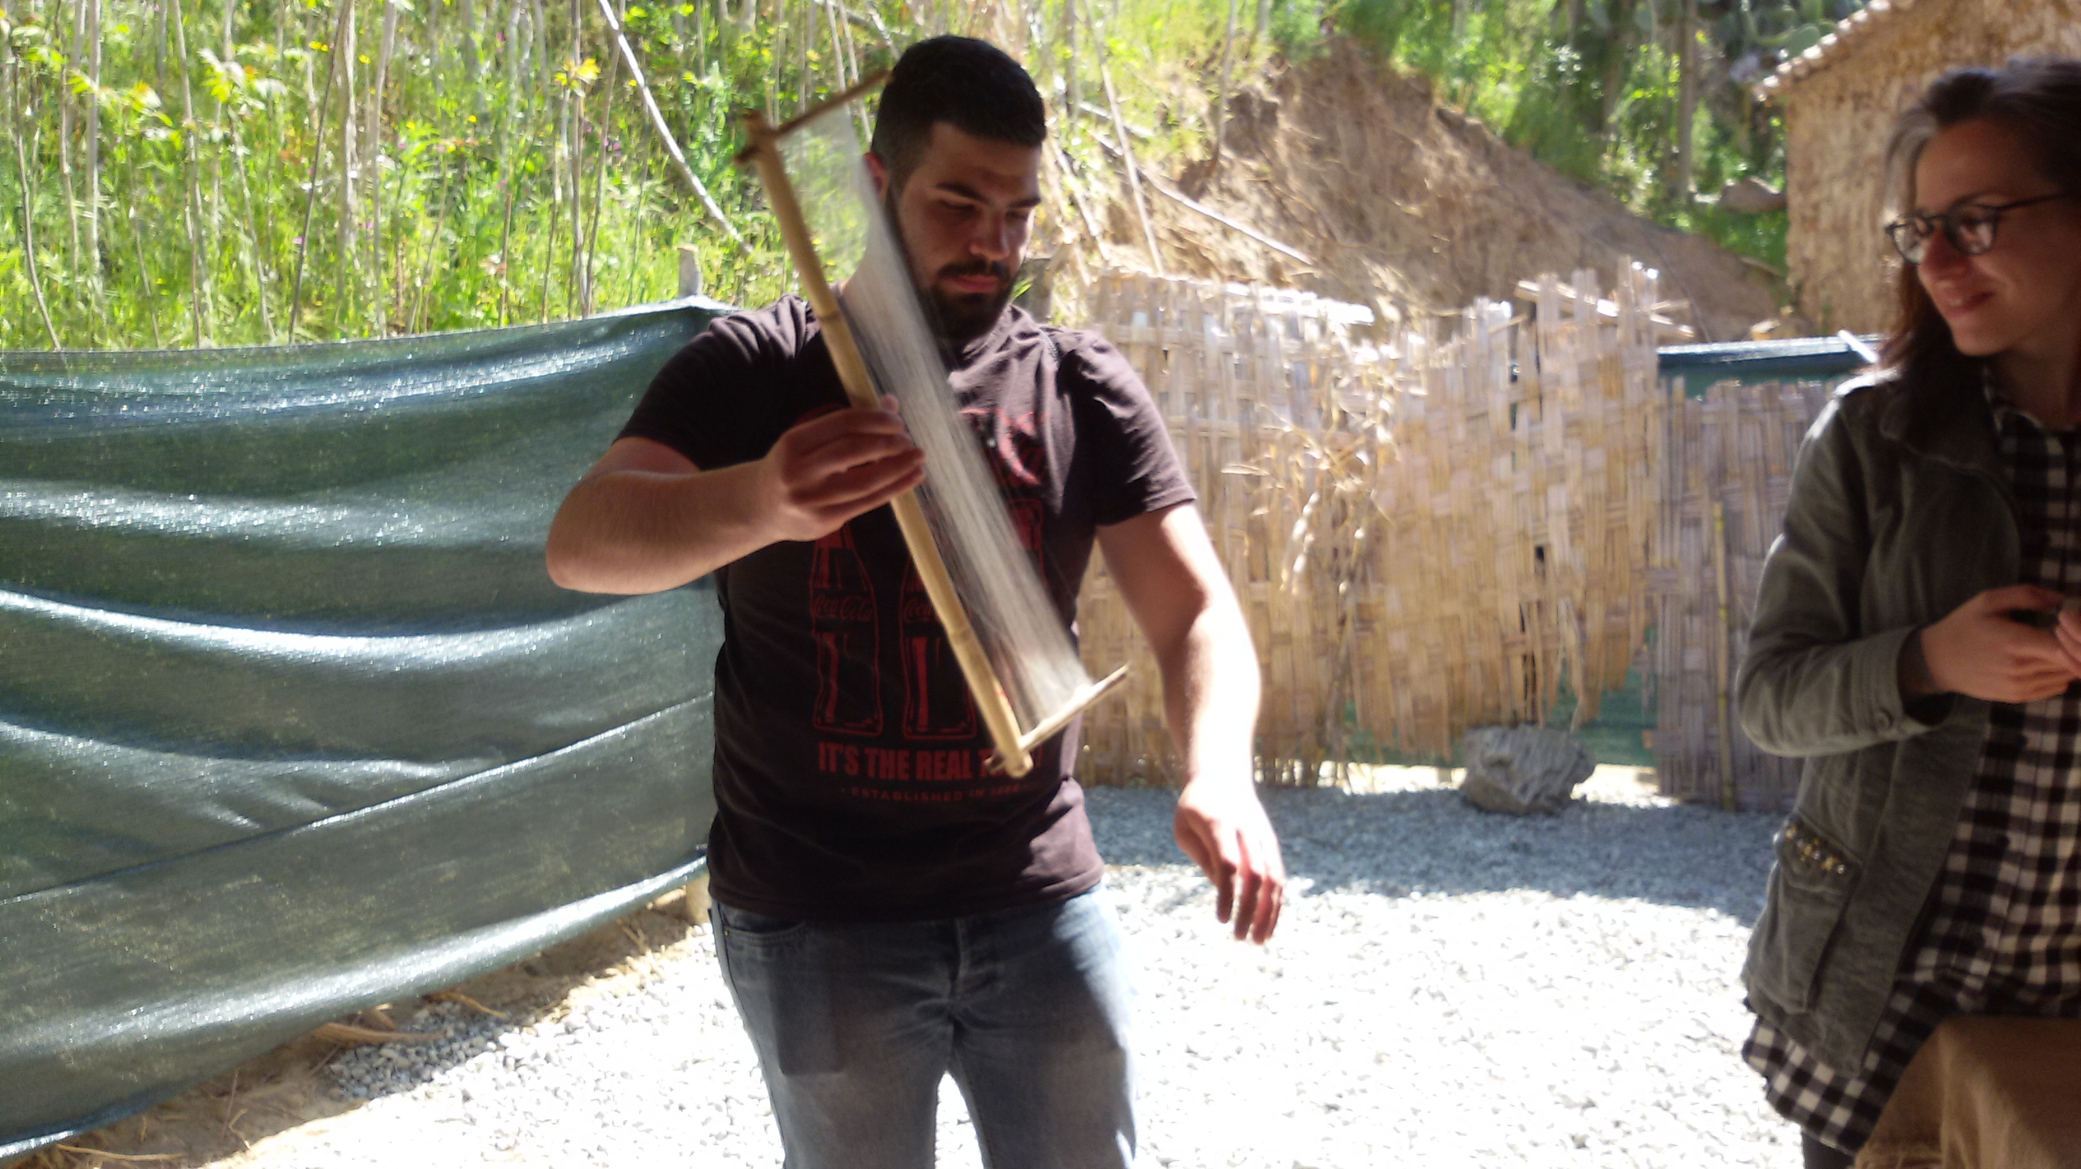
Giuseppe…

Slide 6
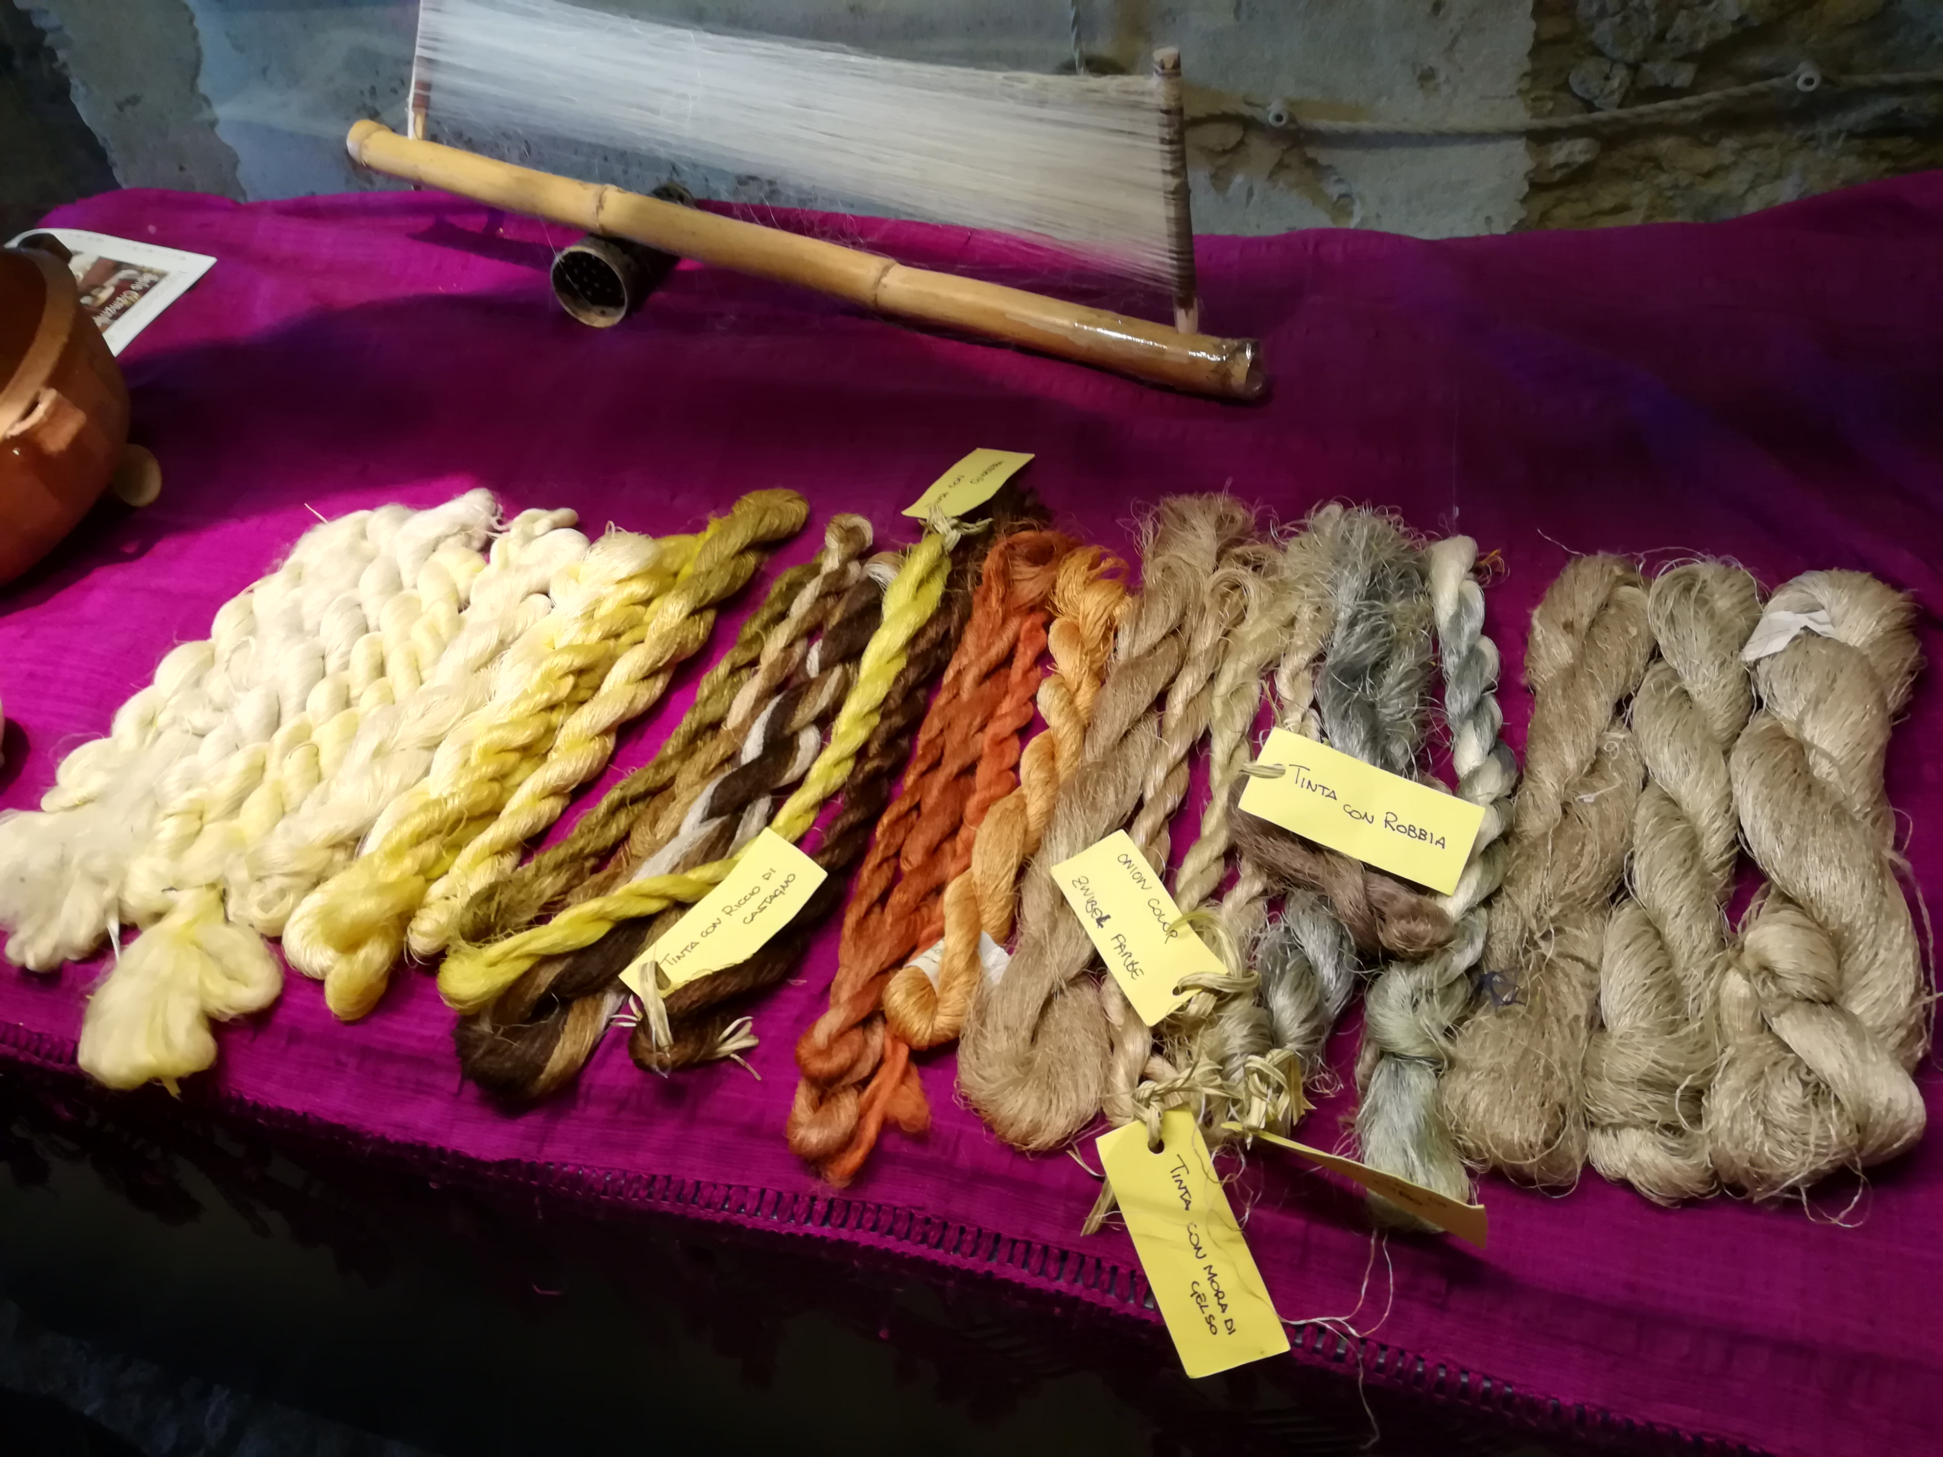

Slide 7
