Slide 1
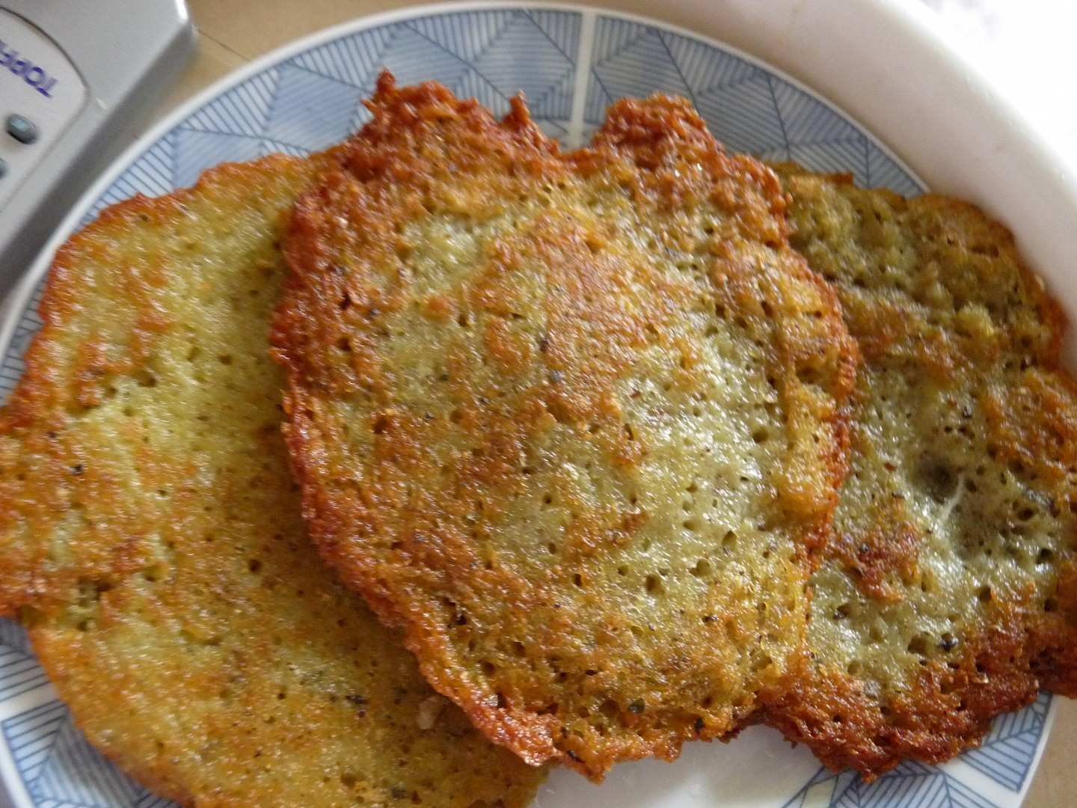
POTATO PANCAKE „BRAMBORÁK“

Slide 2
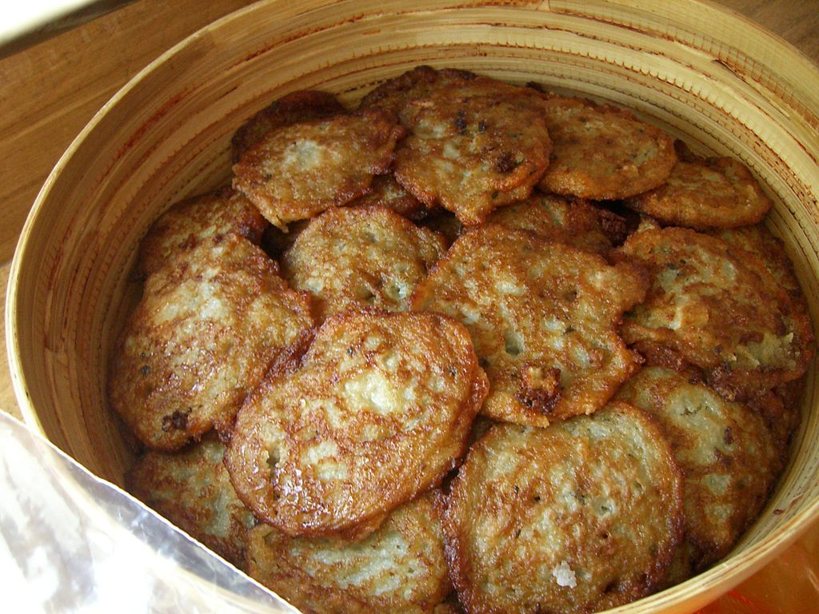
Traditional meal of Slavonic and German nations and of Hungarian people
National dish in Belarus
Can be found in cuisines of most countries in different variations
Czech „bramborák“ was earlier
a dish of poor people
It can be eaten e.g. with
sauerkraut or
smoked meat

Slide 3
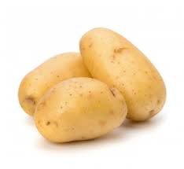
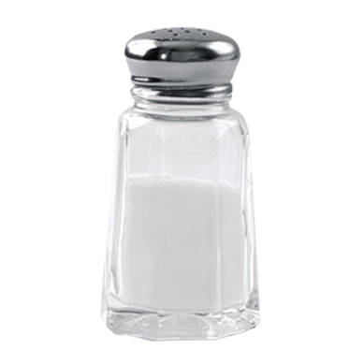
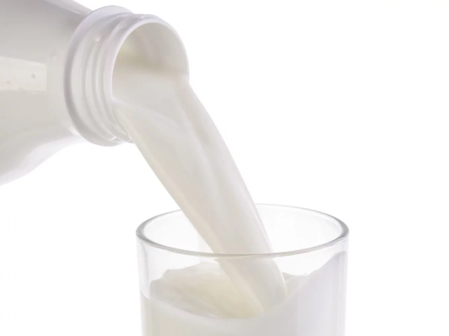
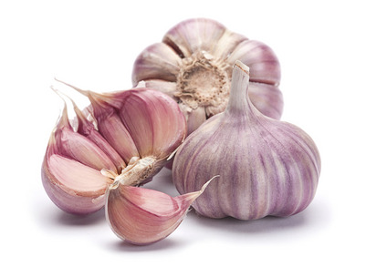
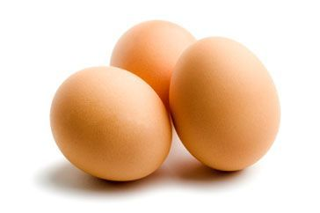
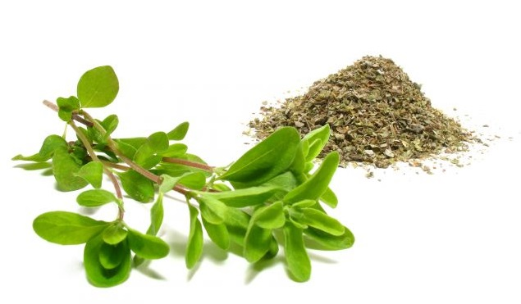
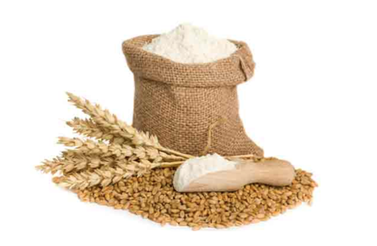
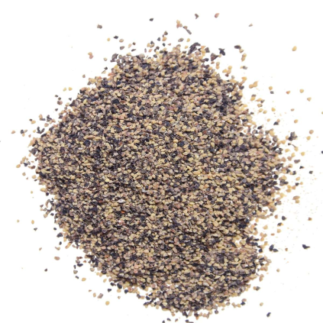
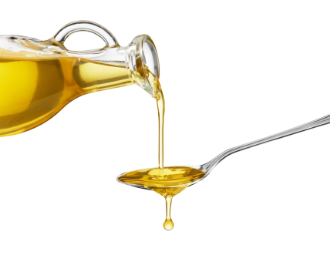
INGREDIENCES
Potatoes (1 kg)
Milk (10 ml)
Pepper
Salt
Oil
Flour (120 g)
Garlic (2 -3 cloves)
Eggs (2 pcs)
Marjoram

Slide 4
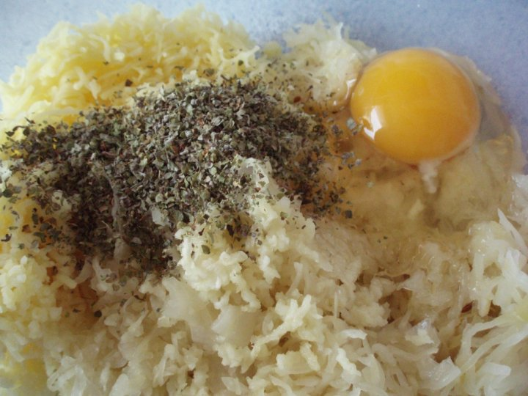
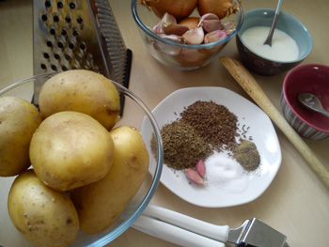
COOKING
Grated raw potatoes are
salted and seasoned with pepper
We add eggs and marjoram
We add flour and milk
(to have the dough
of proper consostency)

Slide 5
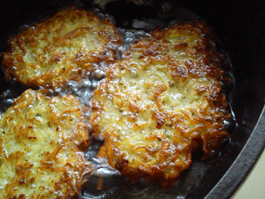
Finally, we make flat cakes and fry them on oil…..

Slide 6
ENJOY ☺

