Slide 2
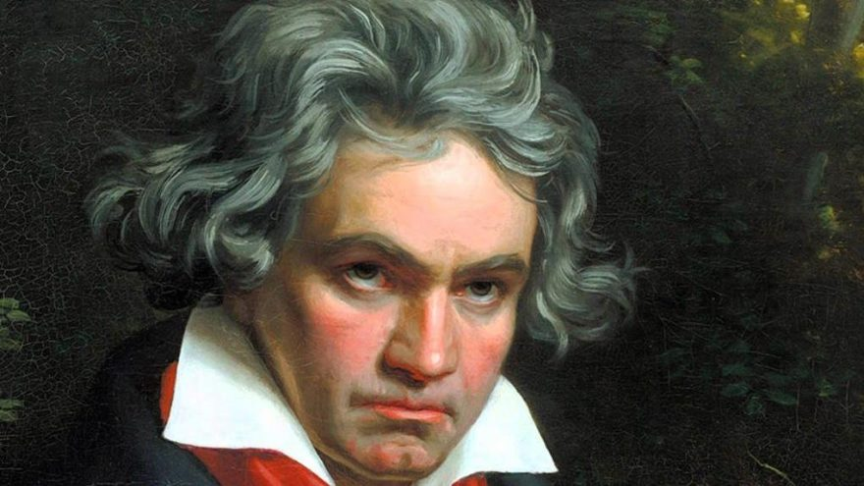

Slide 3
Ludwig Van Beethoven
Birth Date | 17 December 1770 Bonn - Germany
Death | 26 March 1827 (56 years old) Vienna - Austria
Cause Of Death | Cirrhosis
Ocupation | Pianist, Composer

Slide 4
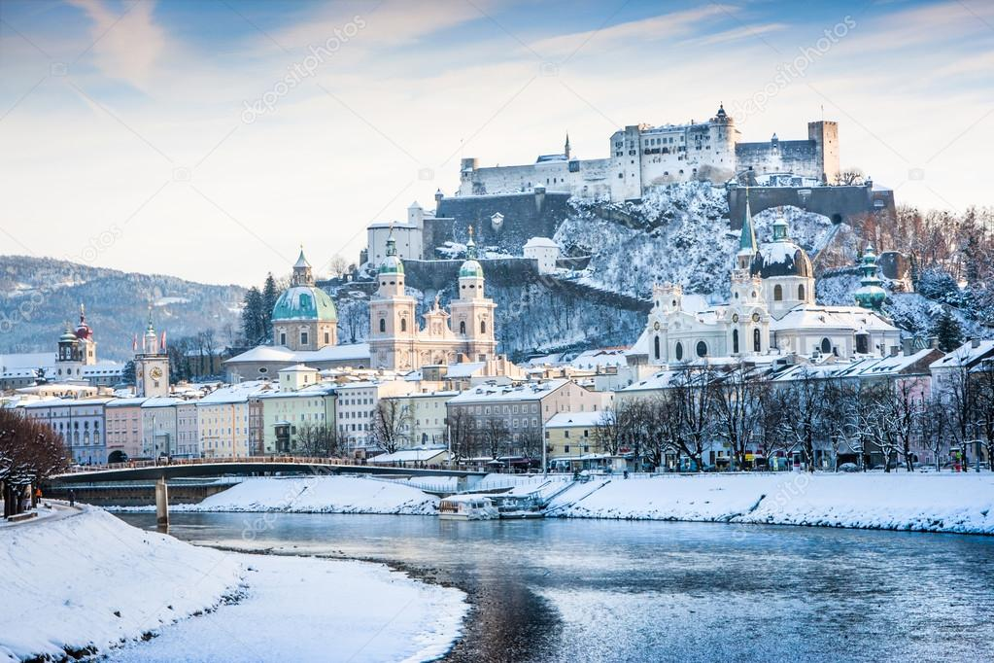
Salzburg is in the central-northern part of Austria. It is a state of Austria at the foot of the Alps. It is the fourth largest city in Austria with a population of 150,000.

Slide 5
THE SOUND OF MUSIC
is a 1965 USA musical film. His original name is The Sound of Music. It is about a governess taking care of seven kids of a captain.
Awards: Best Film Oscar, Best Film Music Oscar

Slide 6


Slide 7
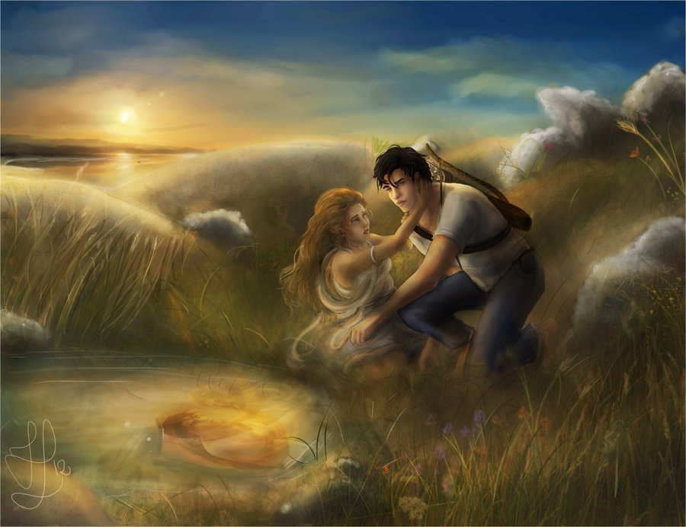

Slide 8
Ekho And Narkissos
The fairy's daughter Ekho desperately falls in love with the hunter Narcissus and cannot get any response. Ekho melts and dies. Their bones turn into rocks and their sounds turn into echoes that we call “echo. The gods get very angry and want to punish Narcissus. Narcissus falls in love with himself while bending onto the river to drink water. He cannot leave the river. He just melts there and turns into daffodil flowers. The word narcissism comes from here.

Slide 9
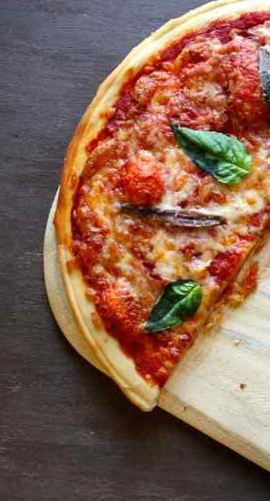
You can make anyone happy. You are pizza .

Slide 10
PIZZA
The history of pizza begins with various ancient cultures’ producing basic flatbreads with several toppings. ... The word pizza was first documented in A.D. 997 in Gaeta and successively in different parts of Central and Southern Italy.

Slide 11
WHAT ARE THESE ?
Mandabatmaz
Mehmet Efendi
Orhan Efendi
Hacı Şerafettin Gümülcine

Slide 12
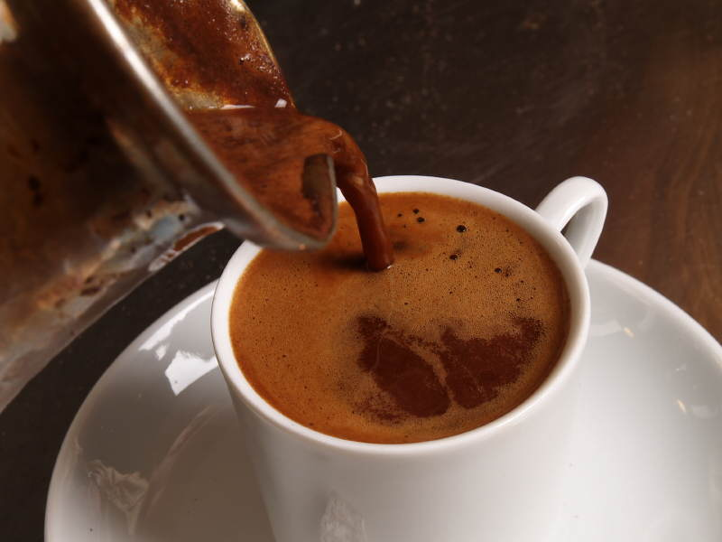
Turkish coffee is one of the oldest methods of coffee preparation and cooking since the Ottoman Empire which has an important place in Turkish culture. It has a unique identity and tradition with its unique taste, foam, smell, presentation style. It is the only type of coffee served with grounds

Slide 13
Yes Dear Kids;
Today there may not be anyone who do not know German Bethoven, Austrian Salzburg, Italian pizza, Greek mithology, and Turkish coffee . Although all those cultural significances were born within their own nations , they are now being internationally shared.
That’s we are sharing people, places, food and drinks, stories, films, songs ; our significant cultural items and in fact transmitting a shared cultural heritage to the next generations.
We hope you will think about our recent cultural heritage and finding out similarities ,we hope you will establish stronger bounds. Meanwhile you will also discover too many differences but comprehending that they are our richness we hope you will build a culture of respect and tolerance.

