Slide 1
Manisa Social Sciences High School
BARBER MUSEUM

Slide 2
What’s that?
Manisa Social Sciences High School will be creating a
‘’Turkish Barbering History and Culture Museum’’ as a part of www.aMUSE(U)Ment.eu youth thinking about their recent cultural heritage project.

Slide 3
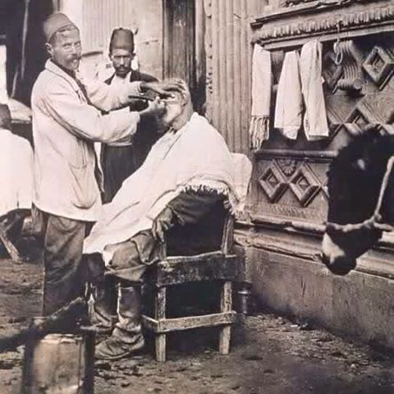
Why?
1- Our school is a Social Sciences High School. Barbering is a productive and a fitting subject because:
Barbering has a deep history and while a lot of other jobs were coming to an end, it improved and changed.

Slide 4
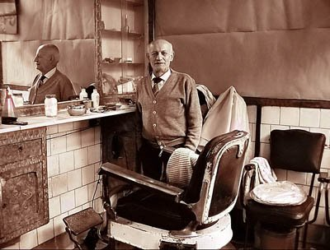
Why?
In the past, it also had functions like dentist, doctor, circumciser; but they do not do them anymore.
Barbers have been a symbol of culture from past to present.
Following their historical development will give us the opportunity of analyzing the cultural change of our country.

Slide 5
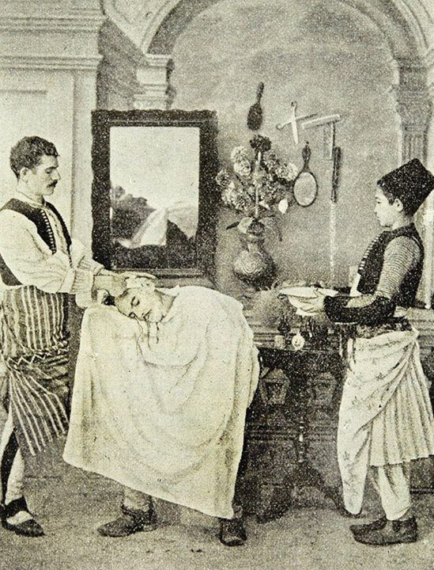
Why?
In our culture, barbering has an important position. It even has a place at the beginning of our childhood stories as riddles.
“Deve tellal iken pire berber iken” – while a camel was a crier and a flea was a barber-

Slide 6
WHY?
Again in Turkish culture, we can see traditional songs, riddles and tongue twisters. Researching these had been simply enjoyable and instructive.

Slide 7
WHY?
2- The researches made in the past about this topic were limited and insufficient. Additionally, there isn’t an exact barber museum at present. They only take place in career museums. Ours will be the first in this category.

Slide 8
3- We think the museum created in our school’s project room will be productive.
4- Picking photos, books and data about the barbering is easy because it is an active occupation.

Slide 9
HOW?
We’re designing our museum to clarify our history and culture. For that purpose there will be;
1- Old barber equipments on the shelves.
2- A barber seat, mirror and table in the museum.
3- Photos, documents and posters about barbering on the walls.
4- Books about barbering on tables or shelves.
5- Playing songs about barbering in audio system.
6- A documentary reflecting onto the wall from the projection. Visitors will follow the documentary by subtitles.
We want our project partners to see and evaluate our museum. So we will share the museum on social platforms.

Slide 10
Where,When,Who?
Where;
The museum will be in our school’s project room.
When;
The museum is now available on 14 January 2020.
Who;
The project responsible teacher Hanife KARAKAYA, her colleague friends and students’ team have created the museum. Also we got help from govermental and non-governmental organizations.
We hope we will do a good job.

Slide 11
THANK YOU

