Slide 1
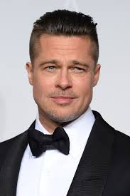
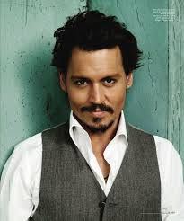
Films & Stars.
Films
&
Stars
Movie reviews, recommendations and expectations.

Slide 2
What about movies?
Let’s start with…

Slide 3
Continuing the global exploits in the unstoppable franchise built on speed, Vin Diesel, Paul Walker and Dwayne Johnson lead the returning cast of Fast & Furious 7. James Wan directs this chapter of the hugely successful series that also welcomes back favorites Michelle Rodriguez, Jordana Brewster, Tyrese Gibson, Chris "Ludacris" Bridges, Elsa Pataky and Lucas Black. They are joined by international action stars new to the franchise including Jason Statham, Djimon Hounsou, Tony Jaa, Ronda Rousey and Kurt Russell.

Slide 4
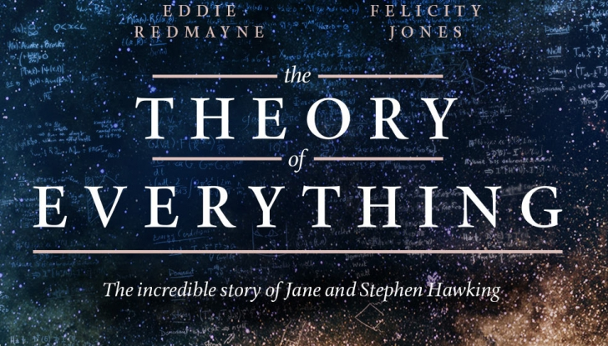

Slide 5
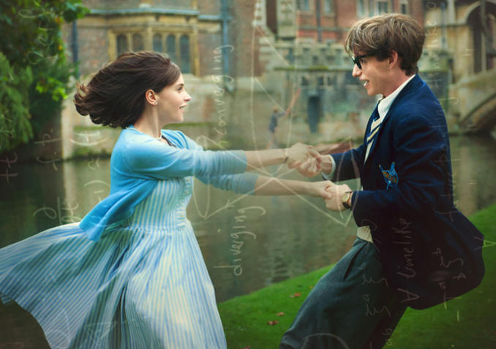
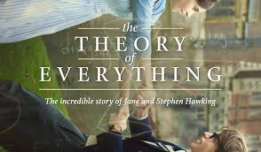
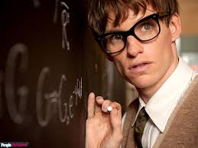
Starring Eddie Redmayne and Felicity Jones, this is the extraordinary story of one of the world's greatest living minds, the renowned astrophysicist Stephen Hawking, who falls deeply in love with fellow Cambridge student Jane Wilde. Once a healthy, active young man, Hawking received an earth-shattering diagnosis at 21 years of age. With Jane fighting tirelessly by his side, Stephen embarks on his most ambitious scientific work, studying the very thing he now has precious little of - time. Together, they defy impossible odds, breaking new ground in medicine and science, and achieving more than they could ever have dreamed. The film is based on the memoir Travelling to Infinity: My Life with Stephen, by Jane Hawking, and is directed by Academy Award winner James Marsh. WE can ensure you that you are going to love this film no matter of your age!!

Slide 6
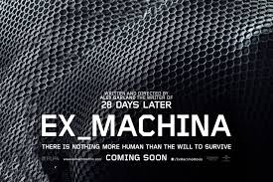
Alex Garland, writer of 28 Days Later and Sunshine, makes his directorial debut with the stylish and cerebral thriller, EX MACHINA. Caleb Smith (Domhnall Gleeson), a programmer at an internet-search giant, wins a competition to spend a week at the private mountain estate of the company's brilliant and reclusive CEO, Nathan Bateman (Oscar Isaac). Upon his arrival, Caleb learns that Nathan has chosen him to be the human component in a Turing Test-charging him with evaluating the capabilities, and ultimately the consciousness, of Nathan's latest experiment in artificial intelligence. That experiment is Ava (Alicia Vikander), a breathtaking A.I. whose emotional intelligence proves more sophisticated--and more deceptive--than the two men could have imagined. COMING SOON…

Slide 7
Thank you,
Antigoni & Helen!

