Slide 1
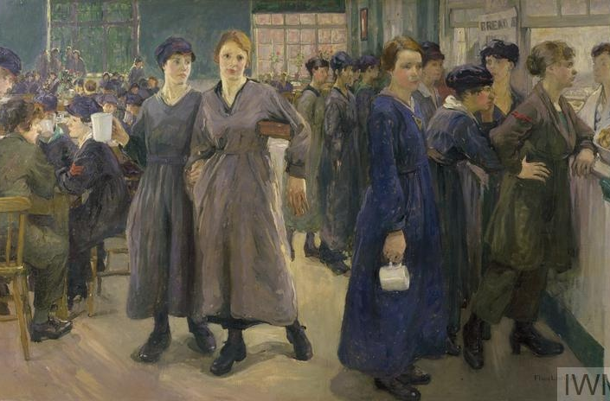
WOMEN ARTISTS BETWEEN 2 WARS
Tea, 8.a

Slide 2
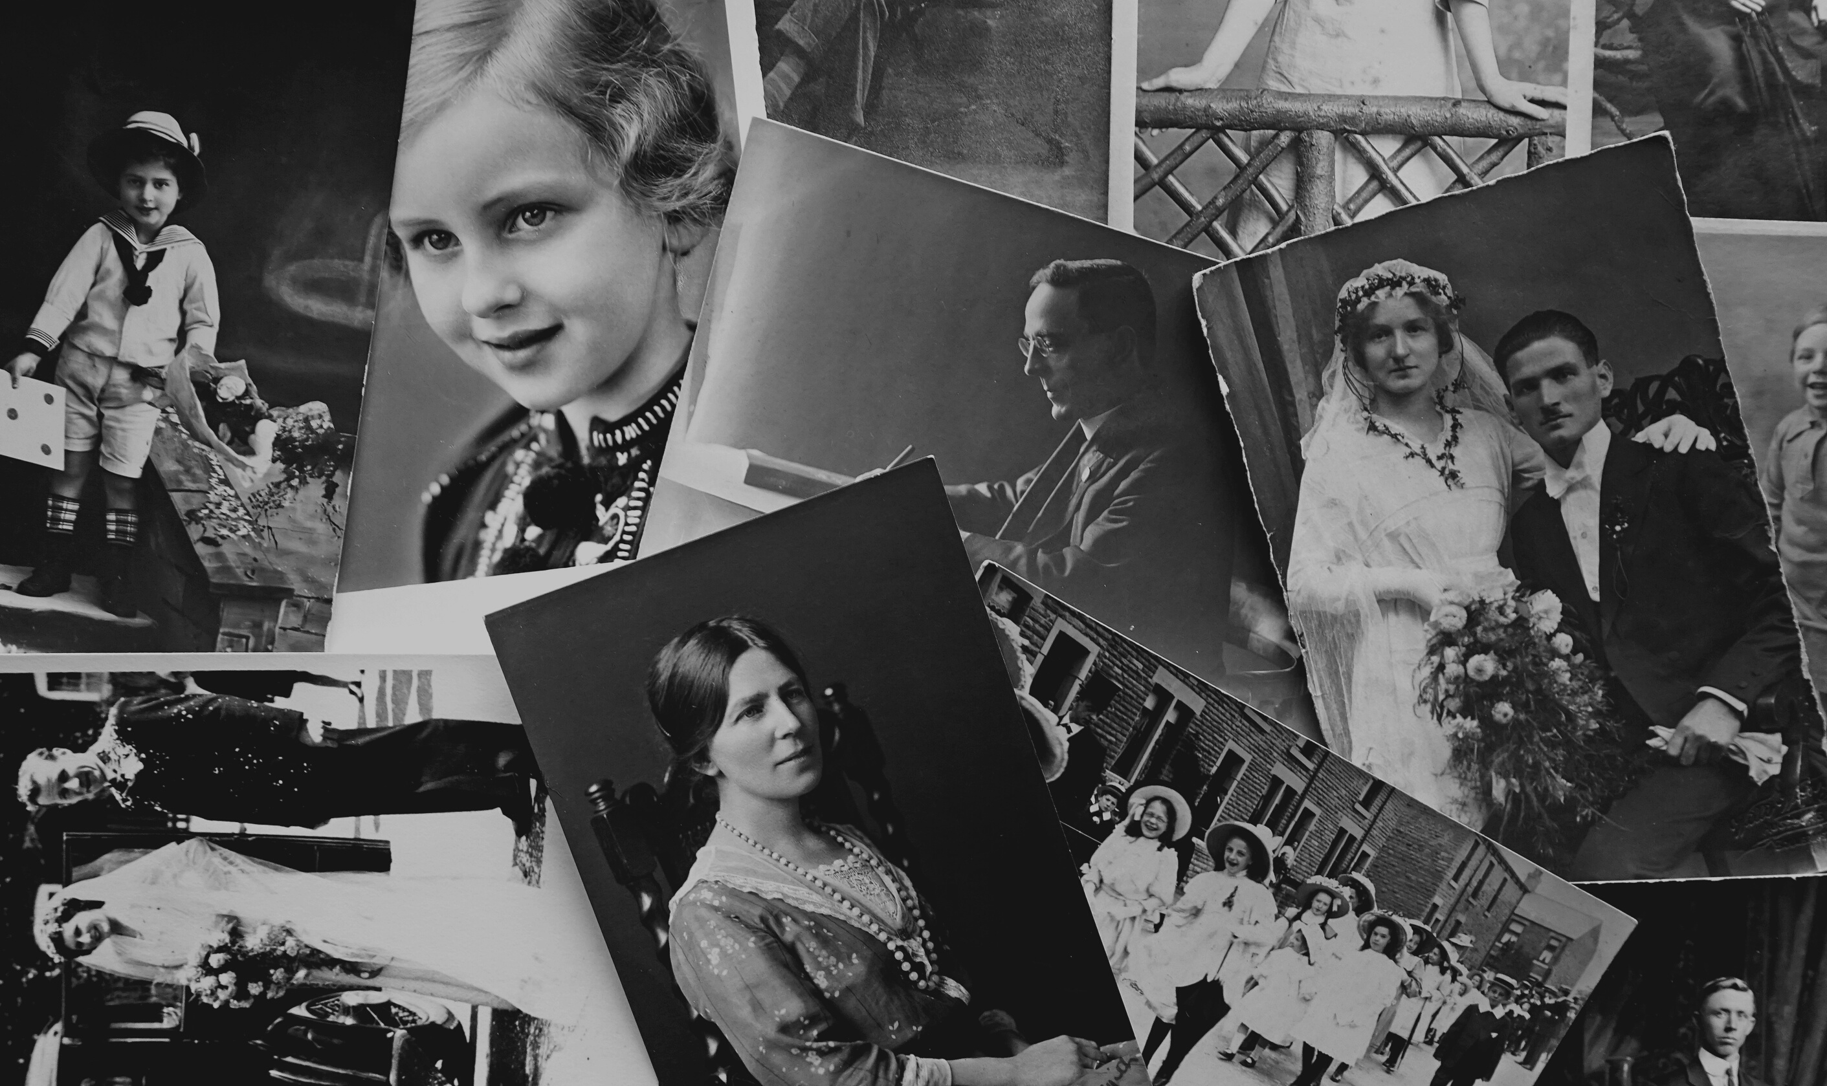
1.EDITH PIAF
2.VIRGINIA WOOLF
3.AGHATA CHRISTIE
4.FRIDA KAHLO
5.MARRY CASSATTO
6.CONCLUSION
CONTENT:

Slide 3
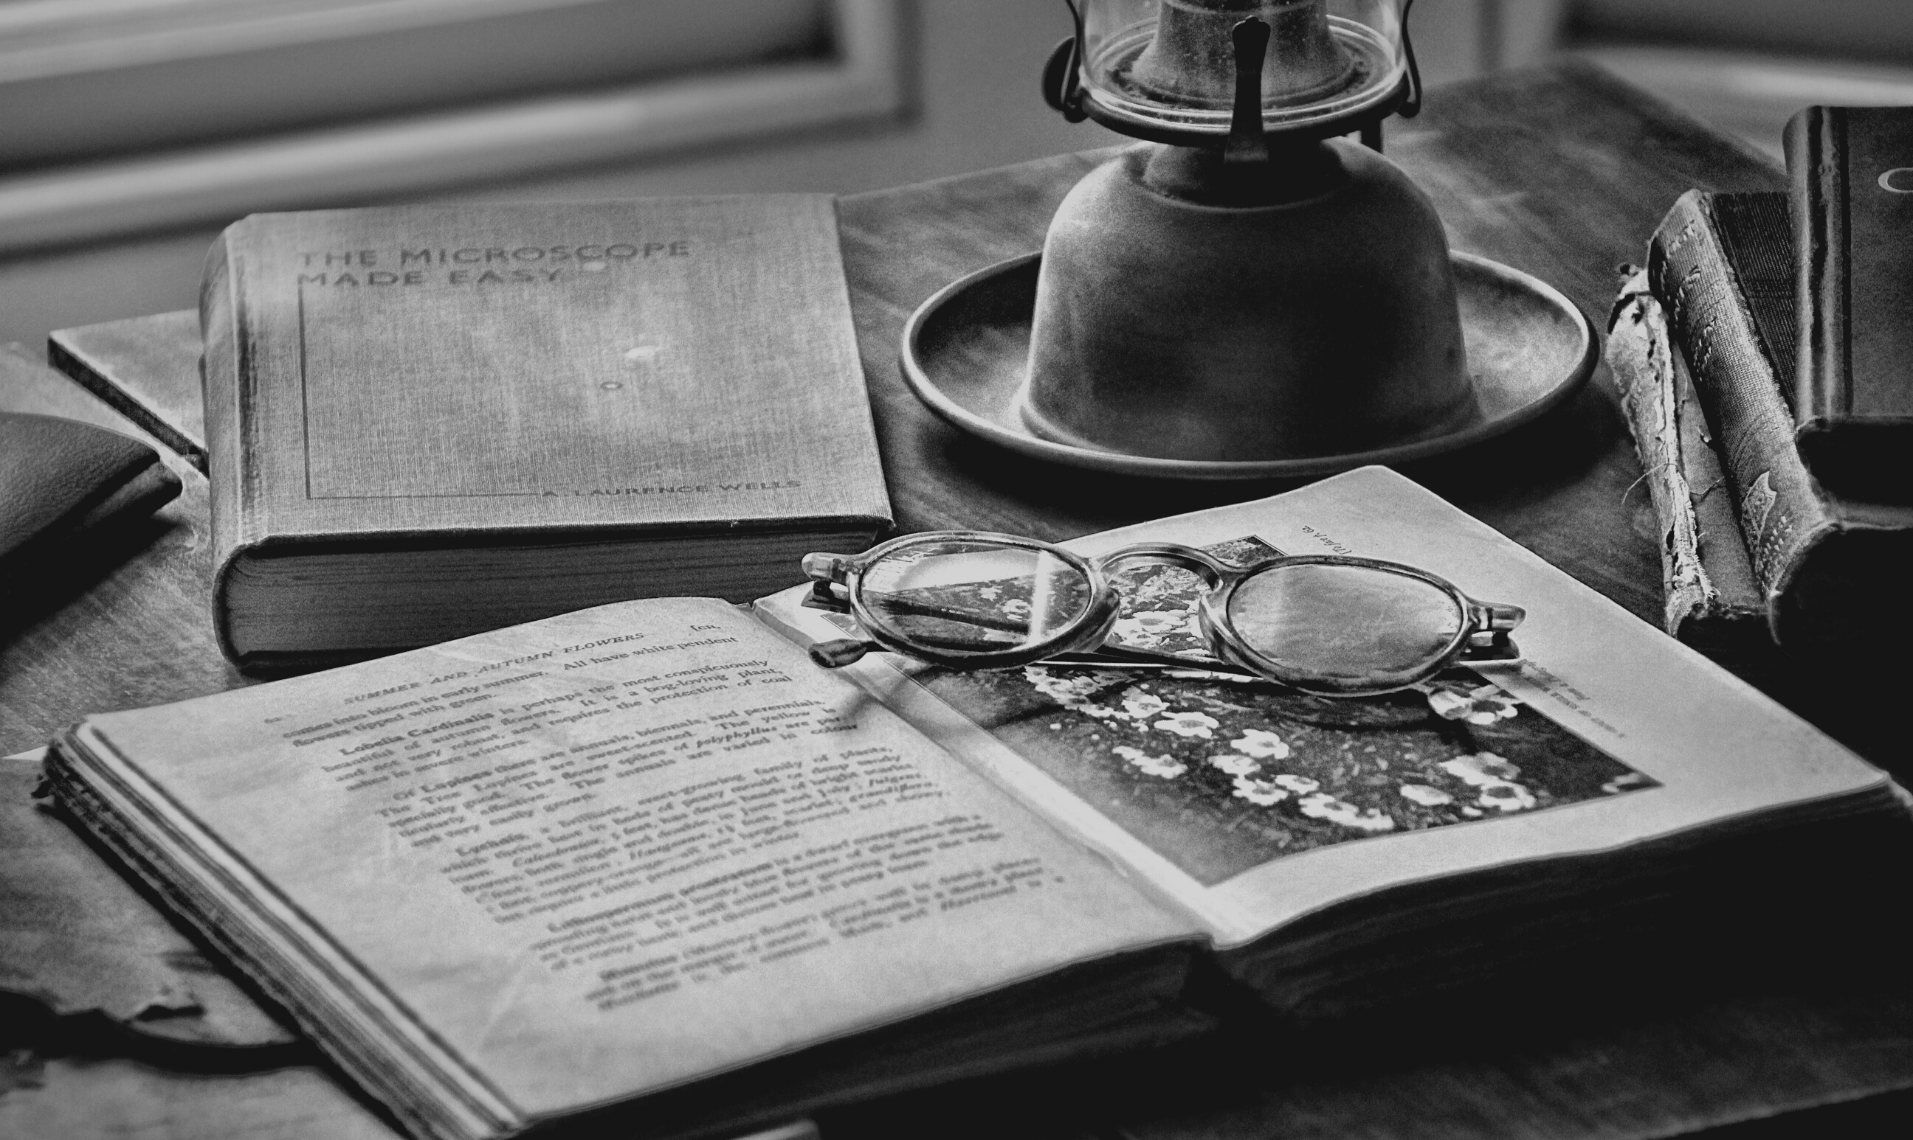
KEYWORDS:
women in art
French chanson
modern literature
feminist literary and cultural critique
the queen of crime
realism, cubism
and surrealism
impressionism

Slide 4
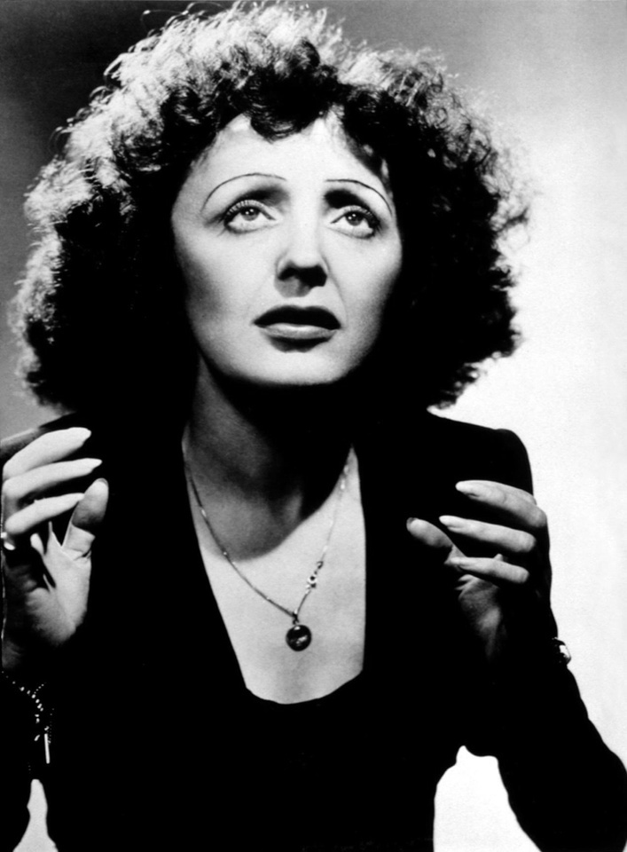
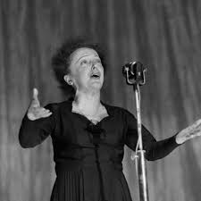
born December 19, 1915, in Paris
died October 10, 1963
At the age of 15, she began as a street singer - in 1937 she sang on Parisian stages and became a famous name in French chanson
She wrote memoirs "At the Ball of Chance" and "My Life"
because of her height of only 142 centimeters, her stage name was La Mome Piaf or Sparrow
EDITH PIAF

Slide 5
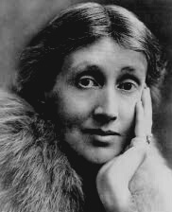
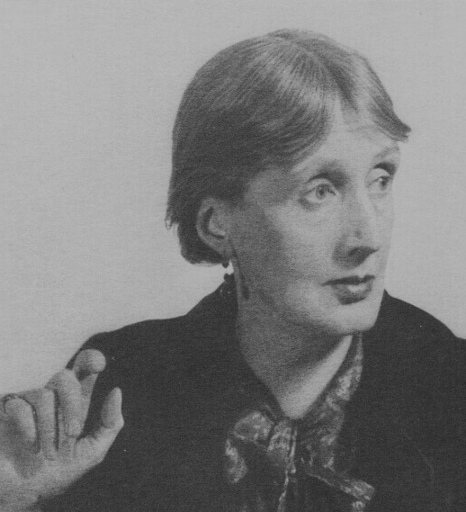
VIRGINIA WOOLF
born 25. I. 1882 - near Rodmell in Sussex
died March 28, 1941
Mrs. Dalloway’s novels, Towards the Lighthouse and The Waves are top chievements of modern and modernist literature
essays Own Room and Three Guineas are fundamental works of feminist literary and cultural criticism
ONE OF HER QUOTES:
" As long as you write what you want to write, that’s the only thing that matters; whether it will matter for centuries or just for hours, no one can say. “

Slide 6
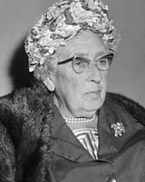
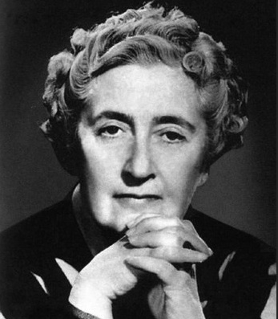
AGHATA CHRISTIE
born September 15, 1890
died January 12, 1976
writer of crime and love novels
She was also called the "queen of crime" - the Agatha Award - the Award for a crime novel
best-selling author alongside Shakespeare

Slide 7
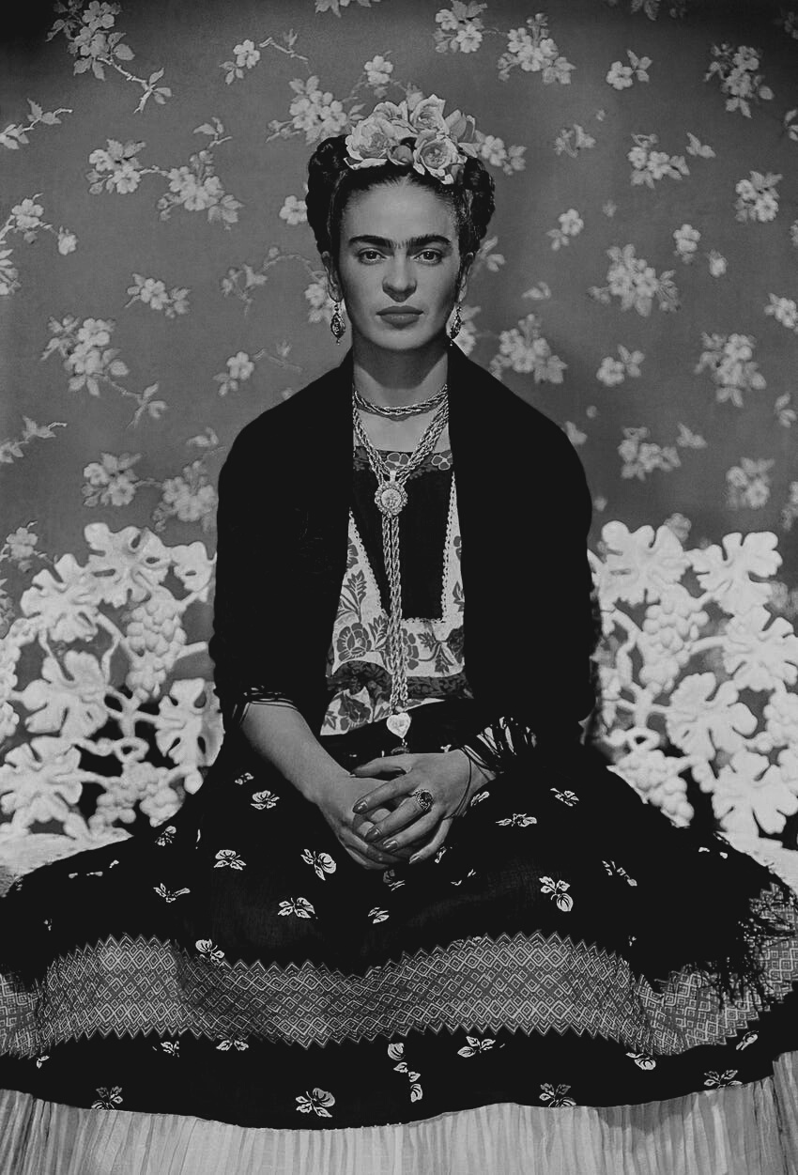
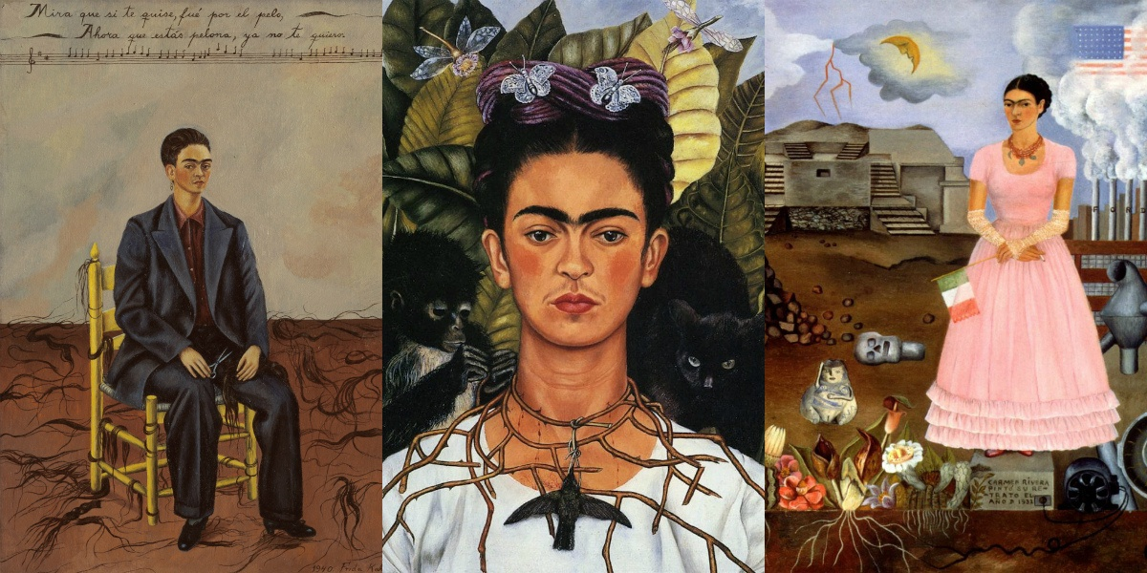
FRIDA KAHLO
born July 6, 1907, in Mexico
died July 13, 1954
Mexican painter of realism, cubism
and surrealism
1939 held an exhibition in Paris — the exhibition was praised by Picasso and Kandinsky

Slide 8
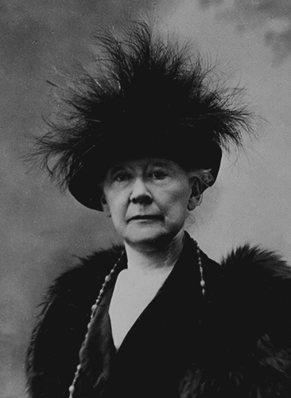
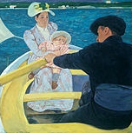
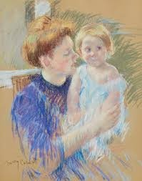
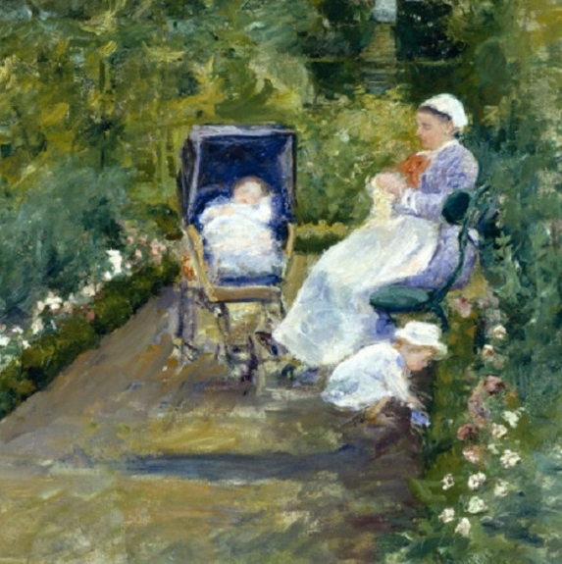
MARY CASSATT
born May 22, 1845.
died June 14, 1926
she is credited with spreading impressionism in the United States = encouraging her relatives and friends to redeem the works of the Impressionists at a time when they were unpopular
famous works: Rowing group, Mother and child, Woman in the garden over the cradle

Slide 9
CONCLUSION
Thanks to female artists, for the first time we get a fresh look at the world of 19th century women. A woman begins to portray herself as a woman who performs an action, who thinks, who is not frivolous and who is independent of a man. They lived and worked in unenviable positions,
burdened with social conventions and rigid rules, but that did not stop them from fighting for their deeds and talent.

Slide 10
LITERATURE
https://prezi.com/p/zlsg8fc9yhym/emancipacija-i-polozaj-zena-izmeu-dva-rata/
https://hr.eferrit.com/mary-cassatt/
https://www.biografija.org/slikarstvo/frida-kalo/
https://hr.odkurzacze.info/521-edith-piaf-biography-news-photo.html
https://enciklopedija.hr/Natuknica.aspx?ID=66348
https://www.biografija.org/knjizevnost/agata-kristi-agatha-christie/
"TRAGOM PROŠLOSTI 8"- Krešimir Erdelja i Igor Stojaković

