Slide 1
Women artists in Croatia

Slide 2
WOMEN ARTISTS IN CROATIA
women have not always been represented in art as men so in Croatia were an eternal inspiration but rarely did they create various works of art things improved slightly between the two wars and the

Slide 3
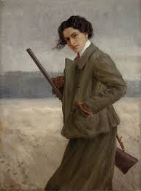
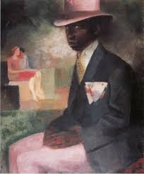
SOME OF THEM...
Ivana Brlić Mažuranić
Marija Jurić Zagorka
Nasta Rojc
Sonja Kovačić- Tajčević
Nina Vavra
Dora Pejačević

Slide 4
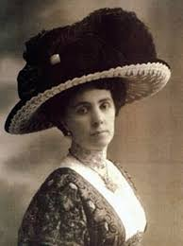
IVANA BRLIĆ MAŽURANIĆ
Croatian writer born in Ogulin in 1874. she gained fame by writing for children she is often referred to as the Croatian Andersen in 1937 she became the first female member of the Yugoslav Academy of Sciences and Arts

Slide 5
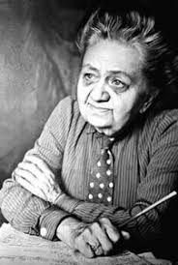
MARIJA JURIĆ ZAGORKA
from 1999 to 1993 she was a successful writer and journalist politically engaged in the field of women's first has written a large number of novels Women's leaf, Croat

Slide 6
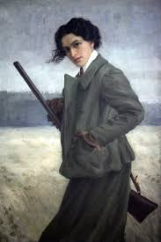
NASTA ROJC
painter born in Bjelovar she is the author of the illustrations for the first edition of the novel Oddly Things by the Apprentice Hlapić- Ivana Brlić Mažuranić

Slide 7
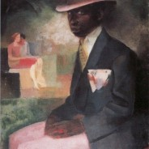
SONJA KOVAČIĆ- TAJČEVIĆ
Croatian painter was born in Bosniaks near Županja she studied painting in Zagreb her famous works are: Black man in pink hat, mother and child
CRNAC S RUŽIČASTIM ŠEŠIROM

Slide 8
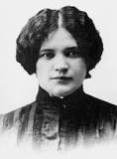
NINA VAVRA
Croatian actress, writer and translator born in Križevci the films she made are: Devilish and Matija Gubec

Slide 9
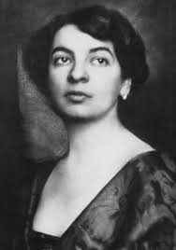
DORA PEJAČEVIĆ
Croatian composer born in Budapest

Slide 10
THANK YOU FOR YOUR ATTENTION!
IZRADILA:LEONARDA BREŽNJAK

Slide 11
IZVORI I LITERATURA
K Erdelja, I Stojaković , Tragom prošlosti 8 , školska knjiga, Zagreb ,2014. Znanost i kultura u prvoj polovici XX. , str. 100.
https://www.moderna-galerija.hr/sonja-kovacic-tajcevic/ž (16.1.2021)
https://www.enciklopedija.hr/natuknica.aspx?id=64021(16.1.2021)
https://www.enciklopedija.hr/natuknica.aspx?ID=47324ž(16.1.2021)
https://libela.org/sa-stavom/10591-hrvatske-umjetnice-od-kraja-19-do-21-stoljeca-1-dio/(16.1.2021)
https://kuca.senoa.eu/obitelj-senoa/nasta-rojc(16.1.2021)

