Slide 1
ADVENT
Centar za odgoj i obrazovanje Čakovec, Croatia
November 2015
Created for the eTwinning project Advent and Christmas in our lives by Jarmila Naranđa

Slide 2
Teacher: Jelena Lakuš
Pupils: Special Class PO17
Activity: creating decorations

Slide 3
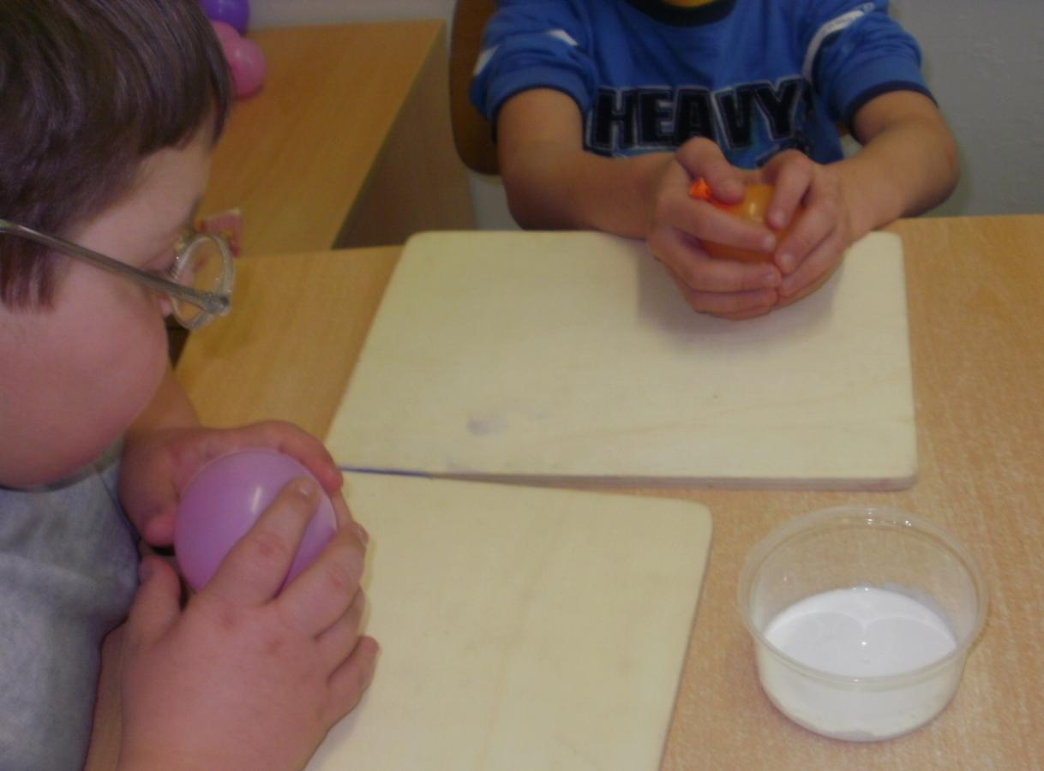

Slide 4
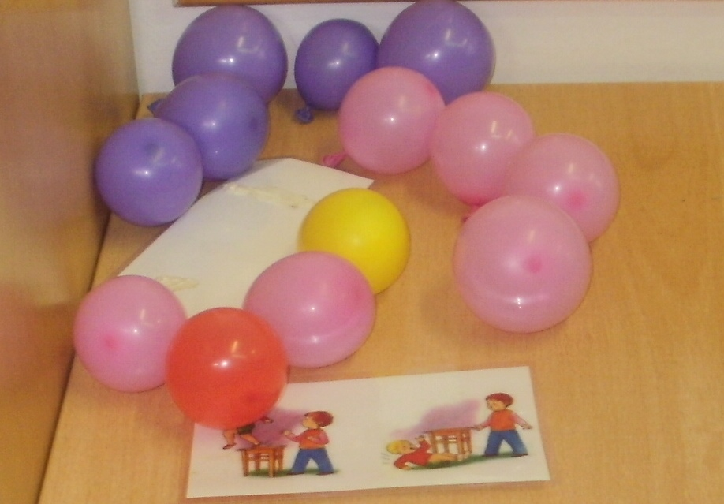

Slide 5
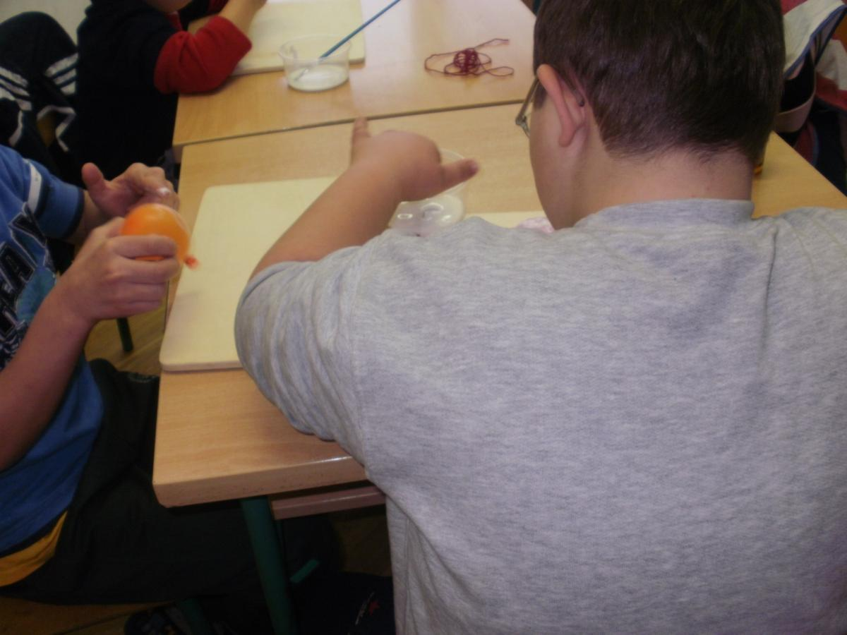

Slide 6
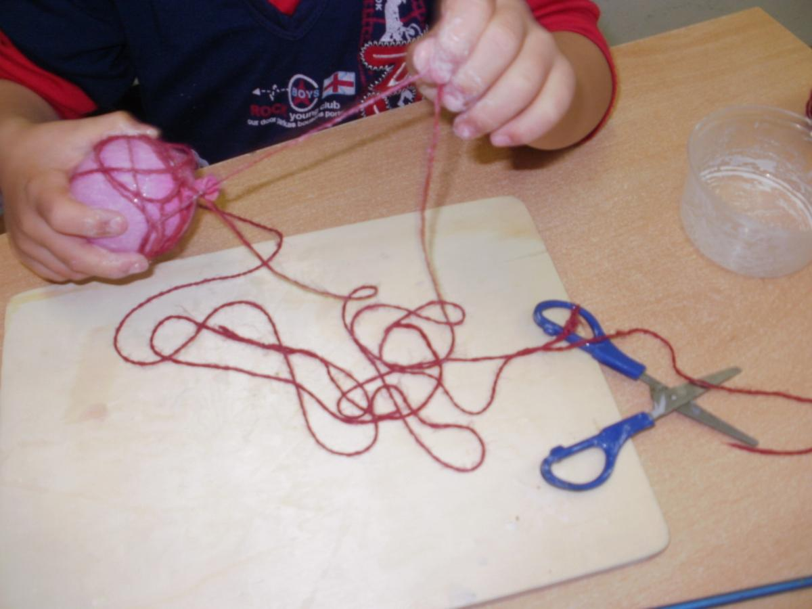

Slide 7
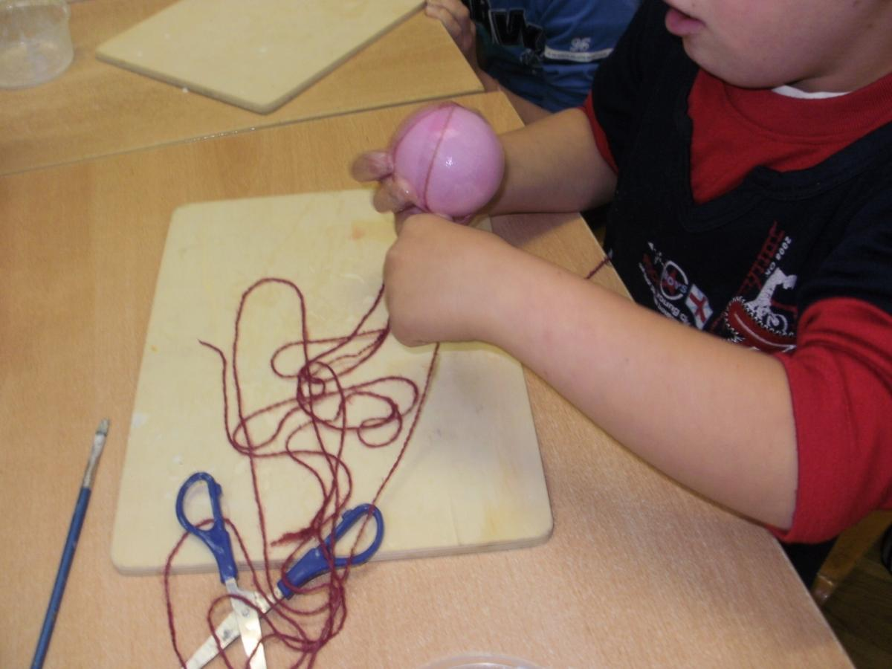

Slide 8
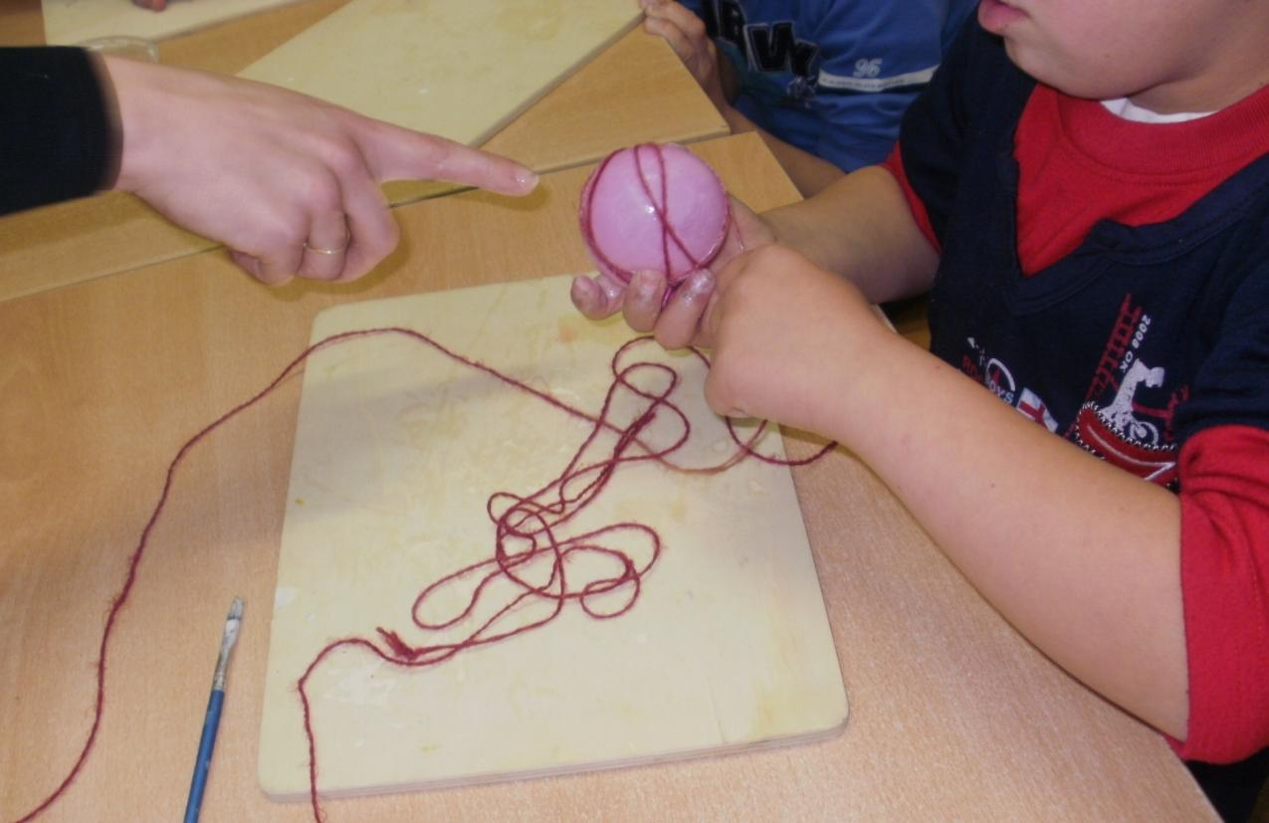

Slide 9
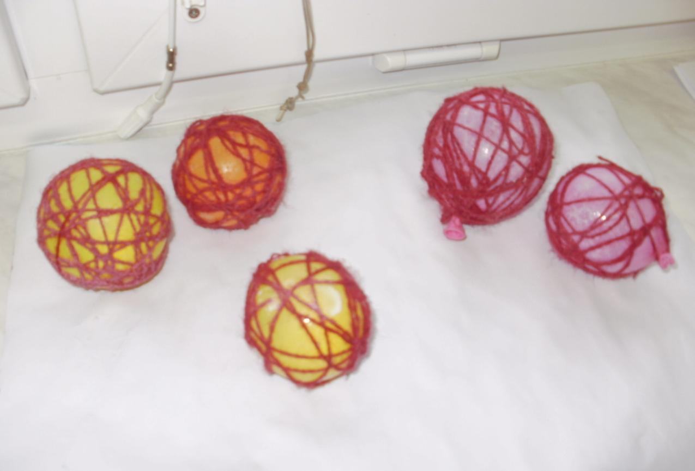

Slide 10
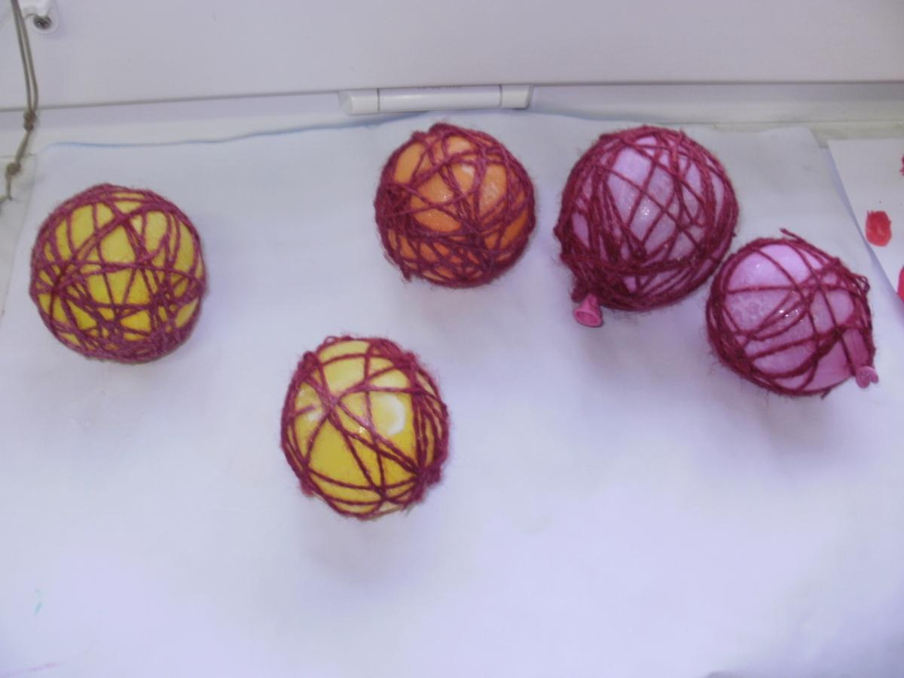

Slide 11
Teacher: Josip Geček Pupils: Special Class PO1 Activity: Advent decoration

Slide 12
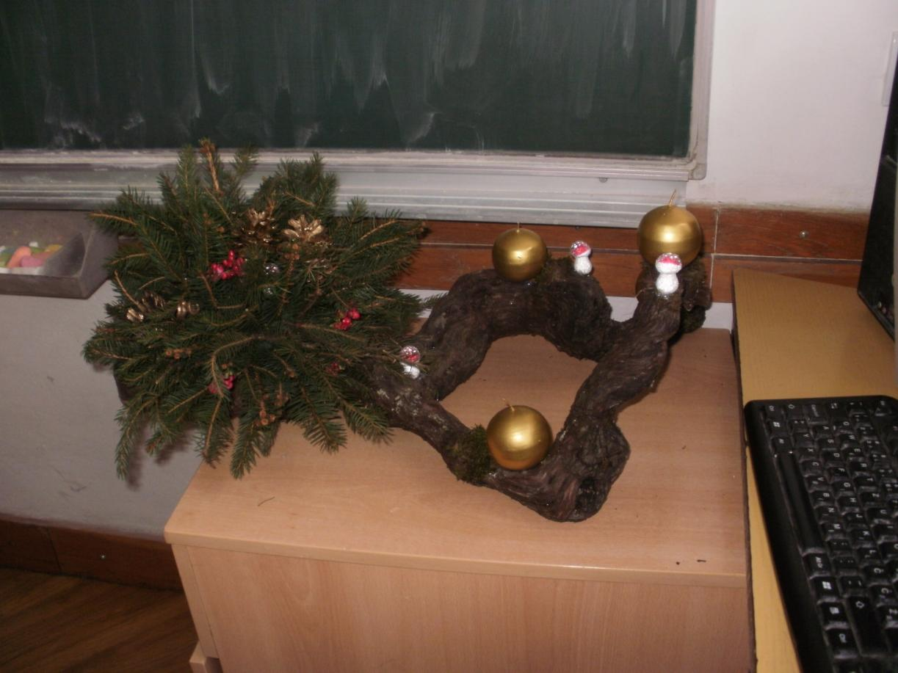

Slide 13
