Slide 1
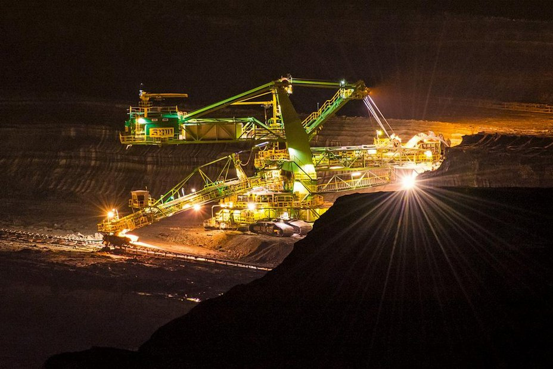
Mine Turow

Slide 2
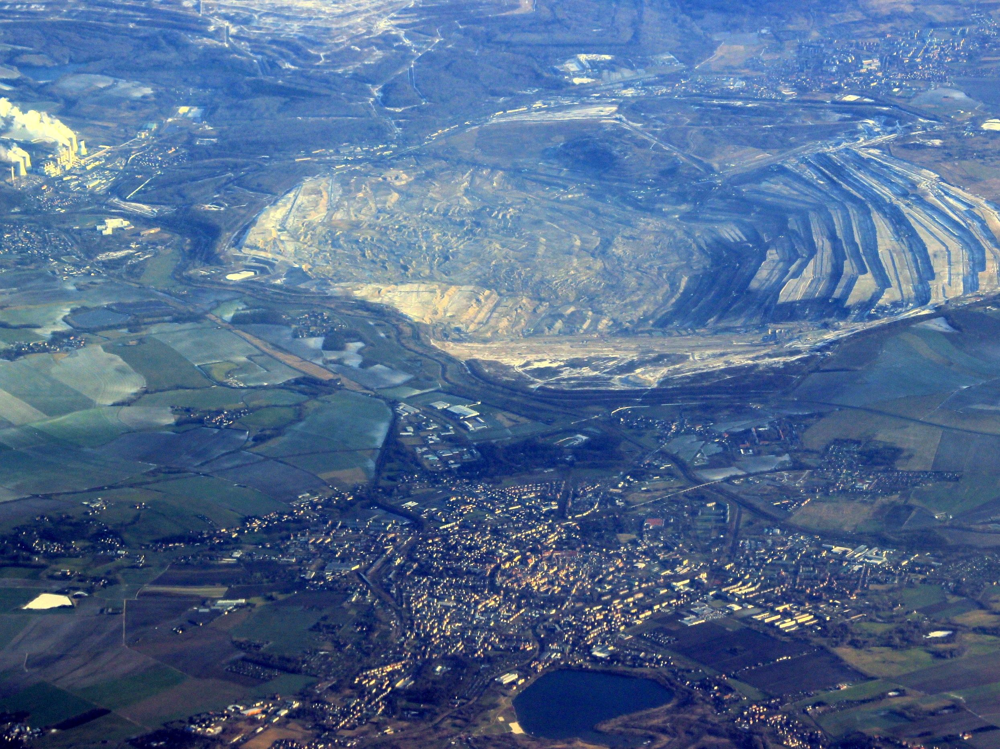

Slide 3
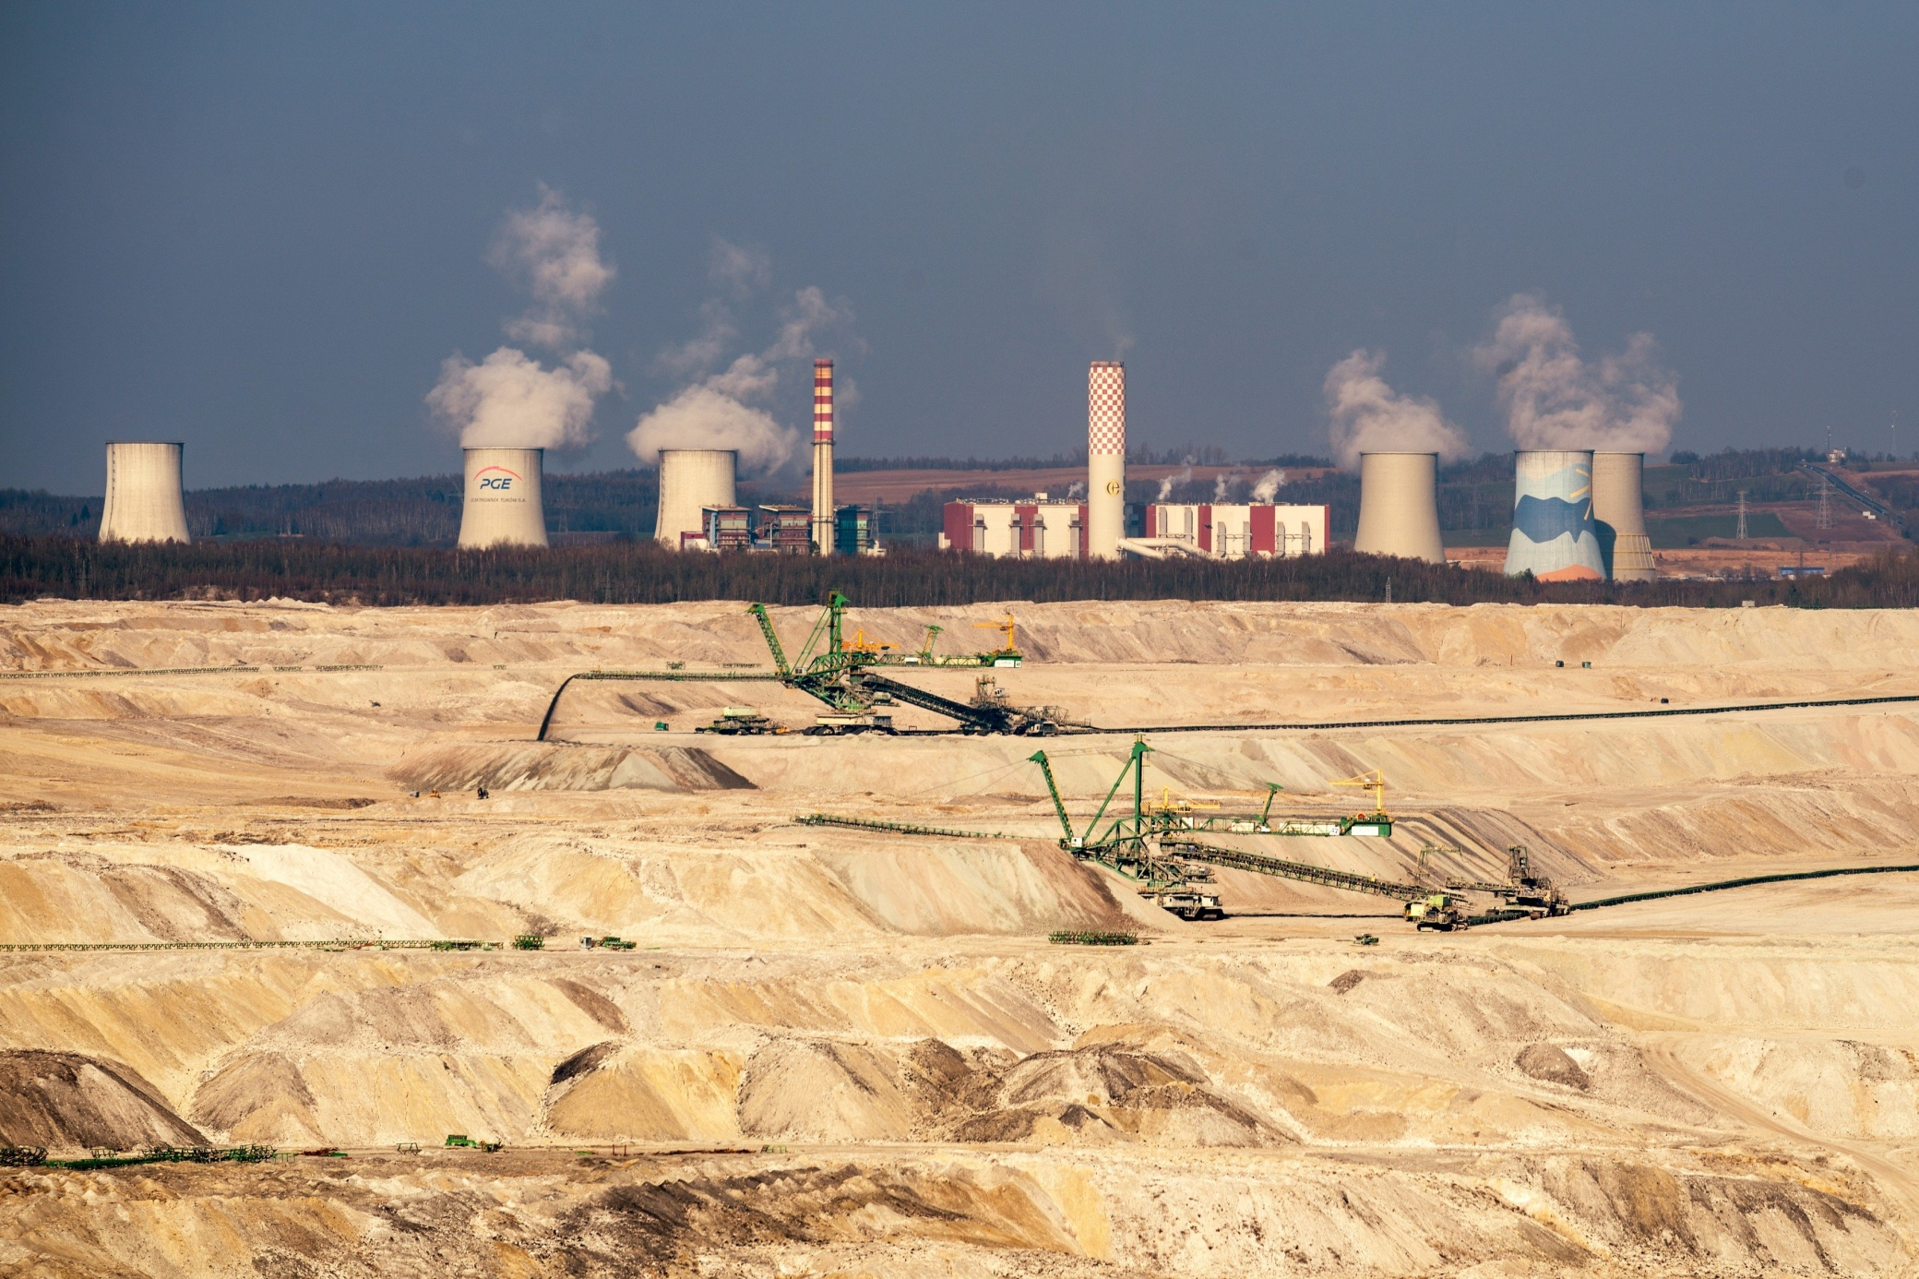

Slide 4
Basic information
It is a lignite quarry – It means brown coal is mined here.
It lies in the southwest of Poland. It borders with the German city of Zittau. It is15 kilometers far from Liberec.
In the mine there are these sorts of materials mined: brown coal
stones
clay for chemic and ceramic industry

Slide 5
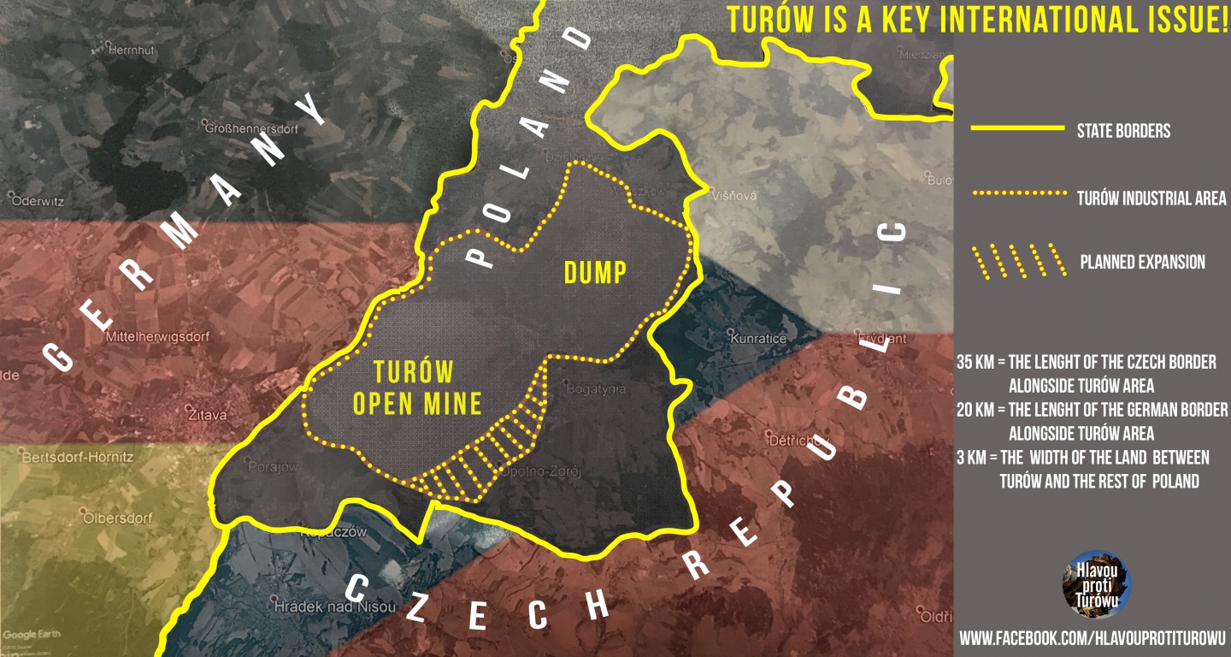

Slide 6
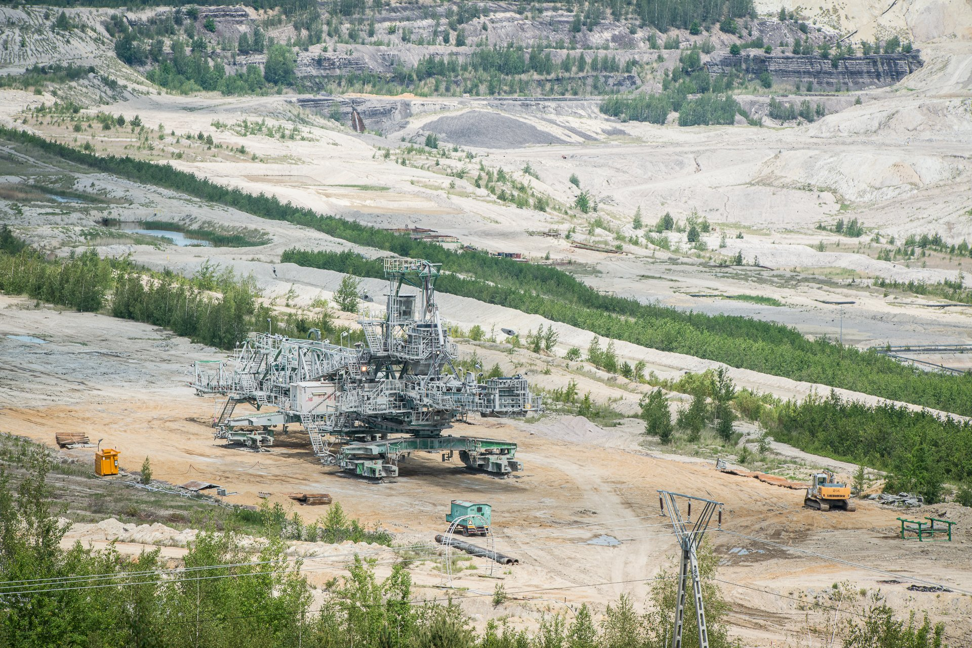

Slide 7
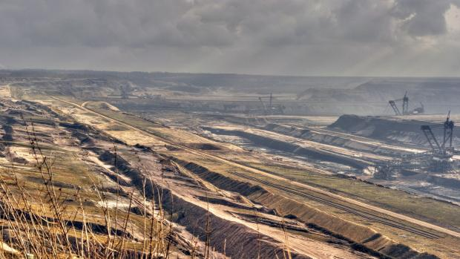

Slide 8
Why is it an ecological problem ?
Some villages were destroyed because of the mine.
Area between Liberec and Turow suffers from a lack of underground water!!!
Mining should take place until 2044.
Greenhouses near the mine that draw energy from the power plant are a source of a big light pollution.
In 2016, greenhouses illuminated the sky more than Liberec.

Slide 9
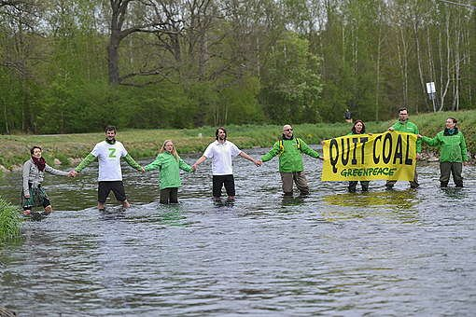
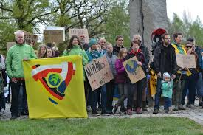
There have been a lot of protests against the mine expansion. People have been protesting, signing petitions and media have been repeatedly reporting this problem. The other side of the problem is that people who work in Turow are worried to lose their jobs in case that the mine closes.

Slide 10
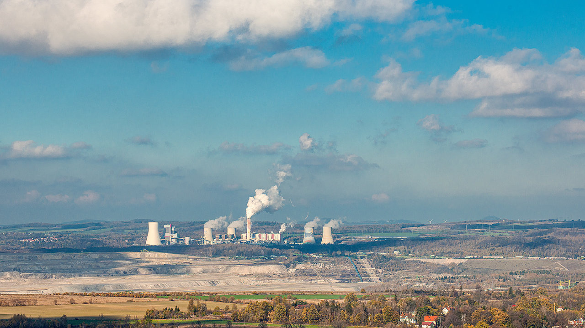

Slide 11
Are there any benefits ?
Thanks to the owner of Citronex (factory), the problem with sky illumination is being solved.
After mining, an artificial lake is to be created on the site.

Slide 12
THANKS FOR YOUR ATTENTION

