Slide 1
Health and fitness

Slide 2
Food plates
The healthy food plate is a brief outline of what your daily nutrition should look like.
It shows how much of each type of food you should eat, fruit and veg being the largest amount then sugar being the smallest.
There are five sections to the food plate; fruit and vegetables, carbohydrates, dairy products, proteins and sugar. They come with suggestions on how much you should have of each part of the plate

Slide 3
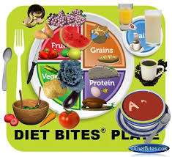
Examples

Slide 4
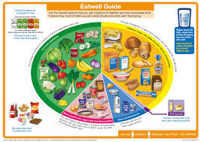

Slide 5
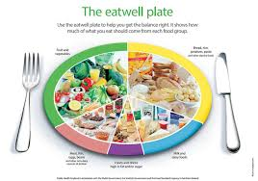

Slide 6
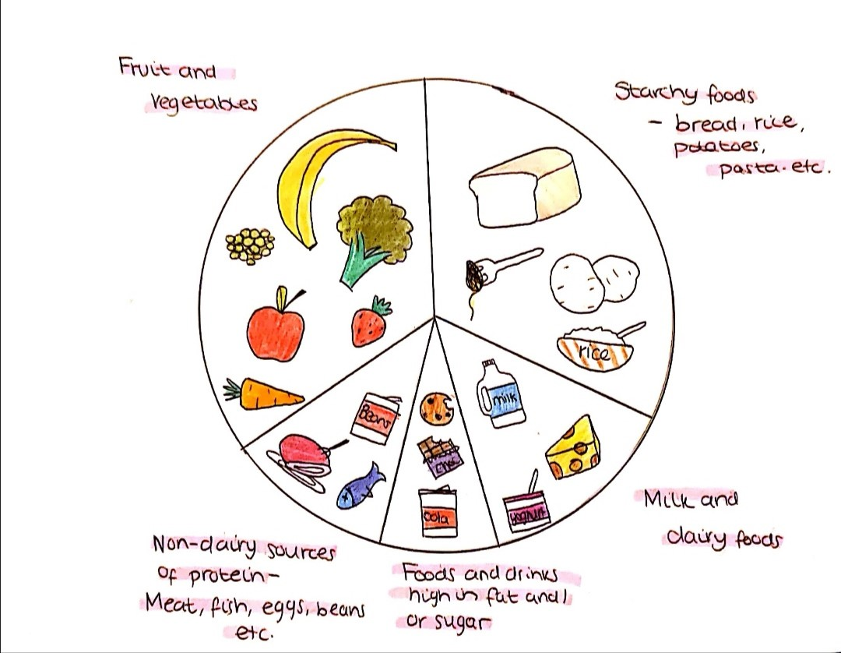

Slide 7
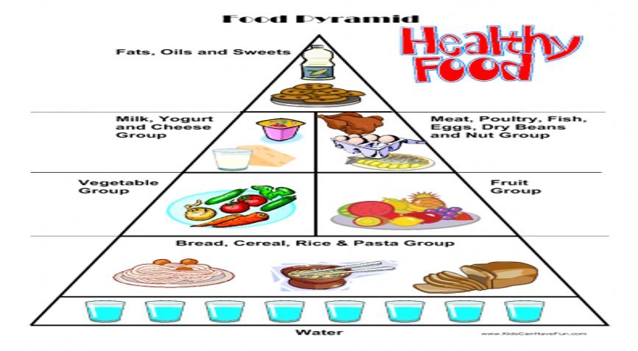

Slide 8
Exercise pyramids
Exercise pyramids show you what you should be doing to stay healthy
The top shows what you what to cut back on
The next level shows what you should do every now and then
The next what you should do very often
Then the bottom layer is what you should do daily
These pyramids help you to know how to stay fit and healthy and how far you should be pushing yourself

Slide 9
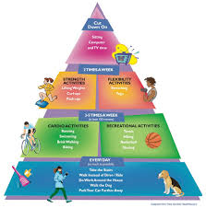
Examples

Slide 10
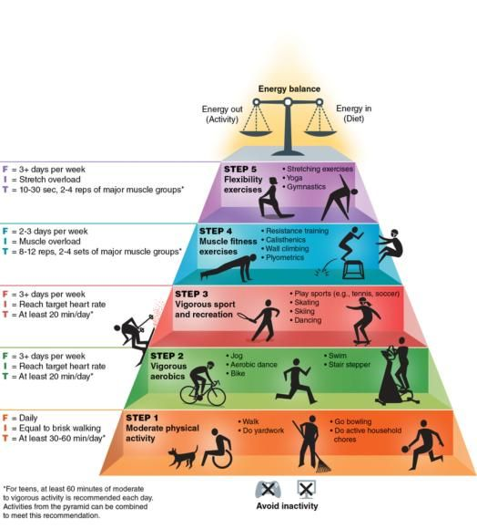

Slide 11
Sports at our school
Here at bower park we take pride in our sports. Kids here take part in sports in and outside of school.
Our most biggest recent success came with handball. This was when our u15 girls became national champions. No. 1 in the whole of England
There are also many individual achievements too, some for the school and some outside of school with clubs

Slide 12
When the girls became national champions

