Slide 1
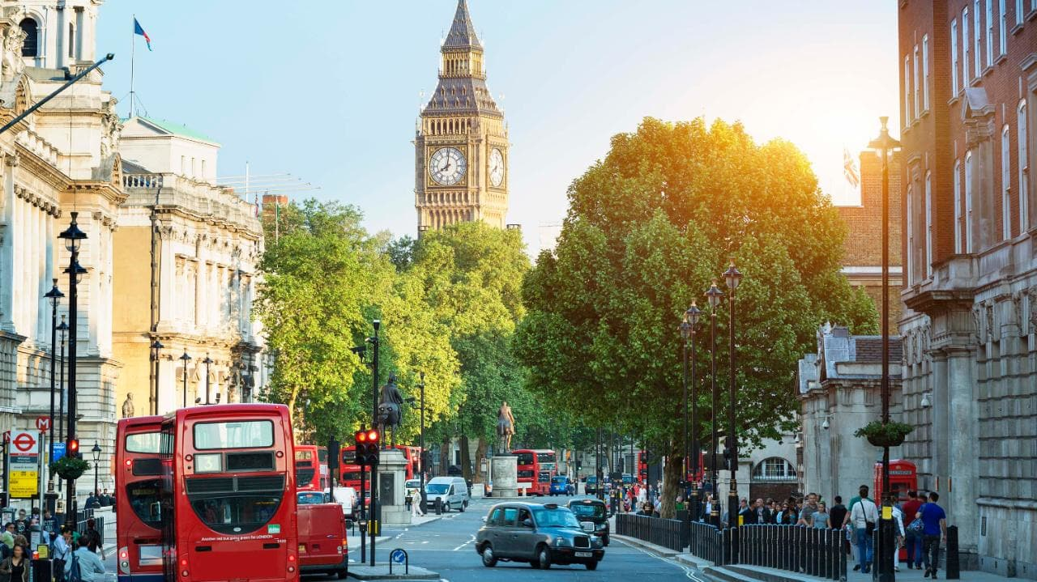
London

Slide 2
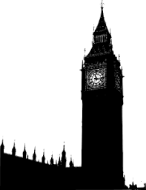
Main Attractions
London Eye
Buckingham Palace
Trafalgar Square
Big Ben (Elizabeth Tower)
Tower of London
River Thames
Hyde Park
St. Pauls Cathedral

Slide 3
Fun Facts About London
We drive on the left!
Over 300 languages are spoken in London.
There were only six deaths in the great fire of London.
The Millennium Dome is the biggest structure of its kind in the world.
You cant feed pigeons in Trafalgar Square because it is banned.
London has over 170 Museums

Slide 4
Our Language:
How to pronounce words in an English Accent:

Slide 5
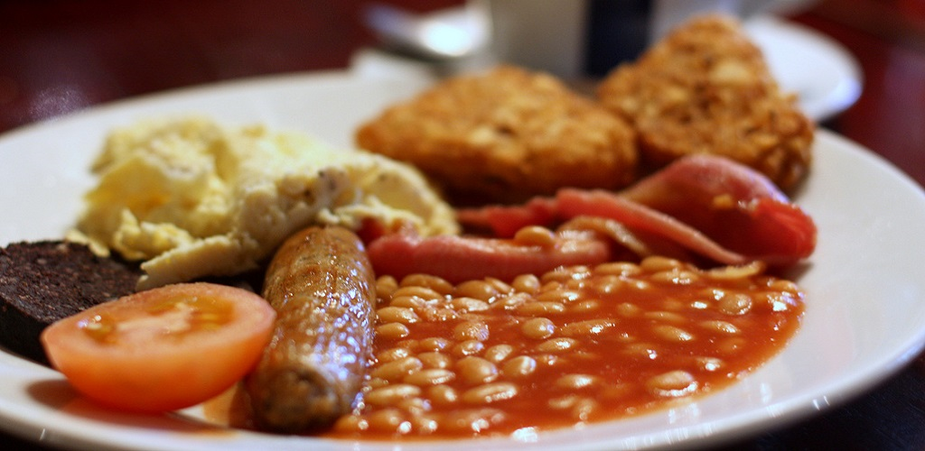
Food
Fish and Chips
Full English breakfast
Bangers and Mash
Pie and Mash
Roast Beef
Yorkshire Pudding
Shepherds Pie
Cottage Pie

