Slide 1
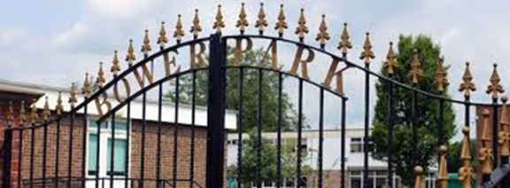
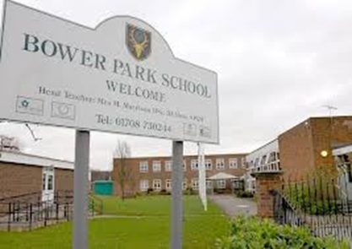
Bower Park Academy
Havering Road,
Romford,
Essex
RM1 4YY
Email:
office@bowerpark.havering.sch.uk

Slide 2
Short history of our school.
Our school opened in 1949 as chase cross secondary modern. In 1989 it was amalgamated with forest lodge school and it was renamed to its current name, bower park.
Our school is divided into four houses of Mandela, nightingale, Wilberforce, Shakespeare.

Slide 3
Extracurricular activities
Digital leadership
Badminton
Craft club
Drama club
Glee club
Dance club

Slide 4
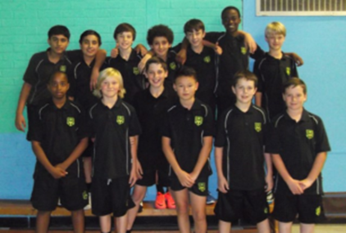
Our football and cricket team

Slide 5
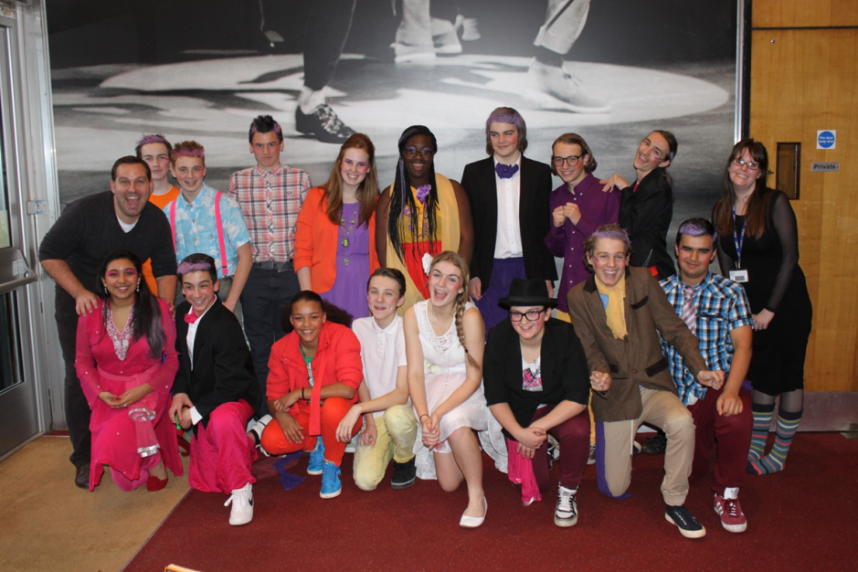
The school
It is made up of five years from year seven
It specialises in performing arts such as drama, dance and music.
We also have a fast track drama group this is where they take their gcse early.
Each class varies from 29-31 people in a class
The school also does construction and hair dressing for selected students.

Slide 6
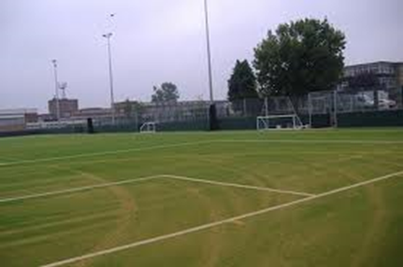
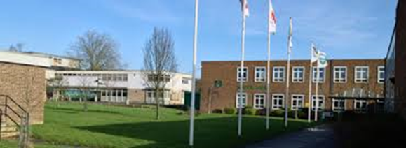
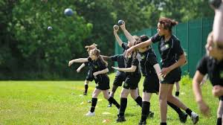
Our school

Slide 7
Other world wide trips
We have another trip to south Africa

