Slide 1
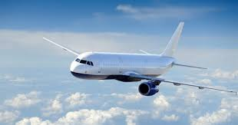
LONDON "UK"
PREPAREd by all teams : team I, TEAM II, TEAM III, TEAM IV

Slide 2
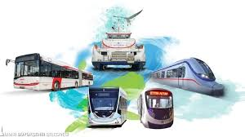
TRANSPORTATION
DISTANCE;
This distance will take approximately 1 day and 14 hours by car. If you are planning to travel by plane, you can complete the 3066 Km journey in approximately 4 hours and 35 minutes.

Slide 3
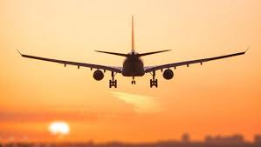
TRANSPORTATION 2
Airplane : ISTANBUL/TURKEY ---- LONDON/UNITED KINGDOM
Price : 474 Turkısh lira USD : 77,66

Slide 4
ACCOMODATION
Holiday Inn Express London Chingford
OYO Royal Park
Westminster Borough, Londra

Slide 5
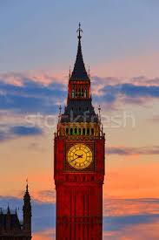
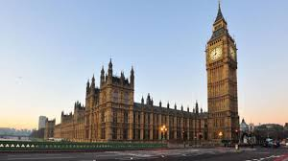
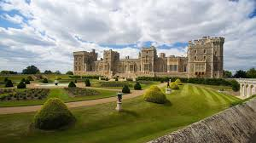
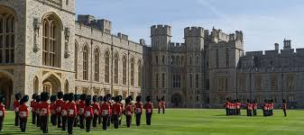
PLACES TO VISIT
BİG BEN
LONDON CASTLE

Slide 6
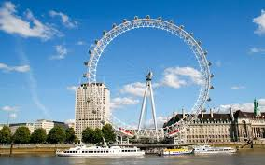
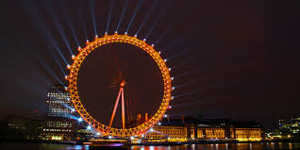
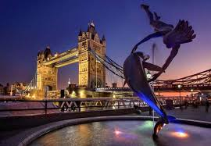
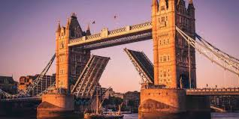
PLACES TO VISIT 2
LONDON EYE
Tower Bridge

Slide 7
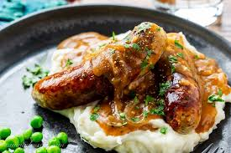
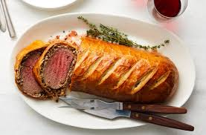
WHAT TO EAT?
BANGERS & MASH
BEEF WELLINGTON

Slide 8
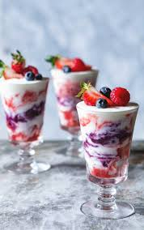
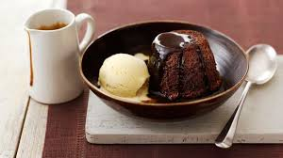
WHAT TO EAT? 2
ETON MESS
STİCKY TOFFEE

Slide 9
Thank you!

