Slide 1
Buxtehude
Our hometown

Slide 2
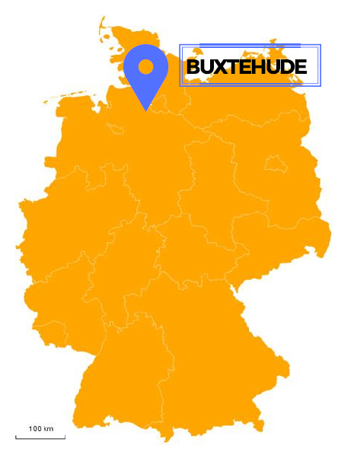
General facts
Population: 40.000 people
Near Hamburg
Known as a „fairy tale city“
(Hase & Igel = Hare & Hedgehog))

Slide 3
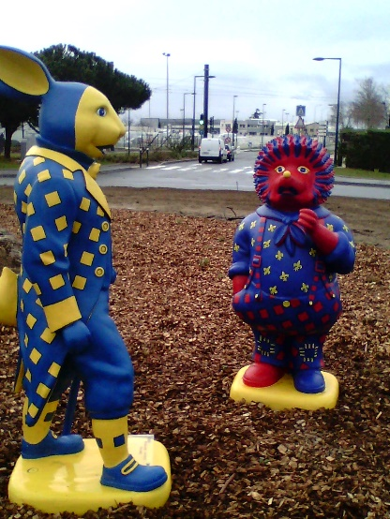
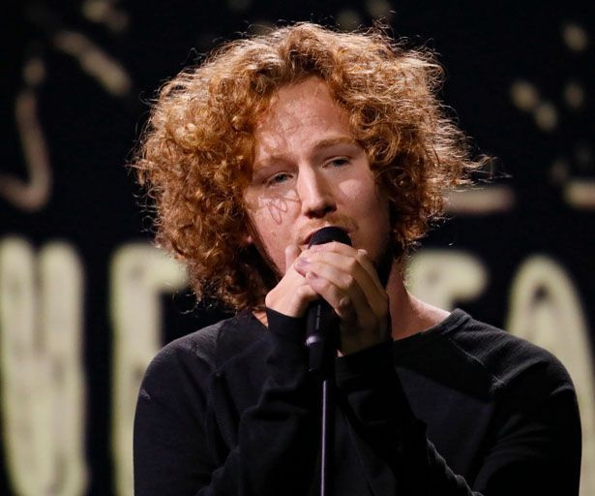
Specialities
Buxtehuder Bulle
Hanseatic town
Twin towns: Blagnac in France and Ribnitz-Damgarten in Germany
Michael Schulte, singer living in Buxtehude

Slide 4
A short guided city tour

Slide 5
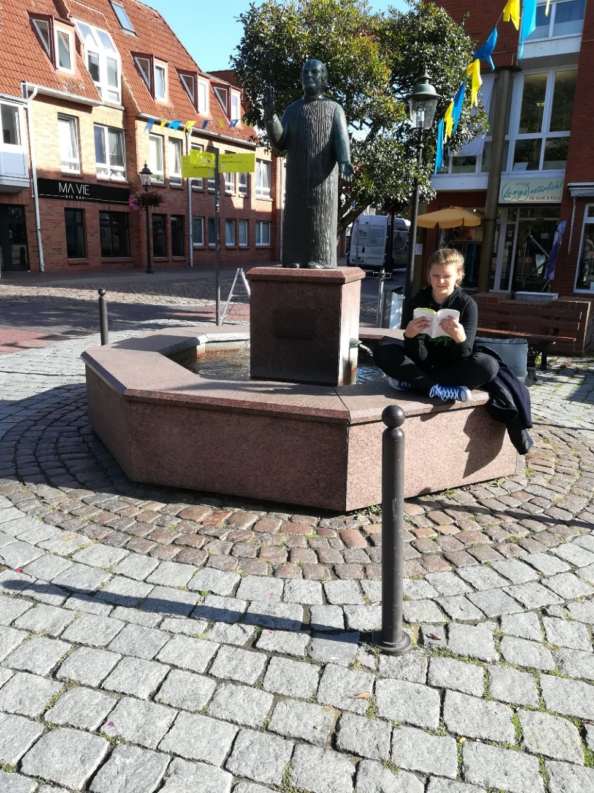
Halepaghen-Brunnen / Halepaghen-well

Slide 6
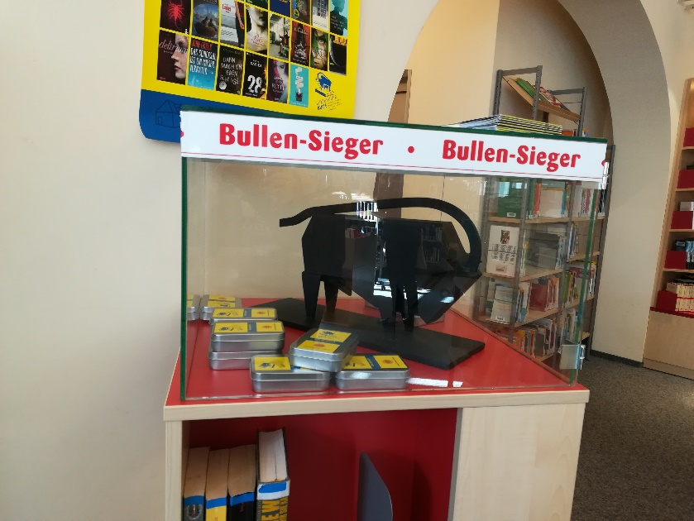
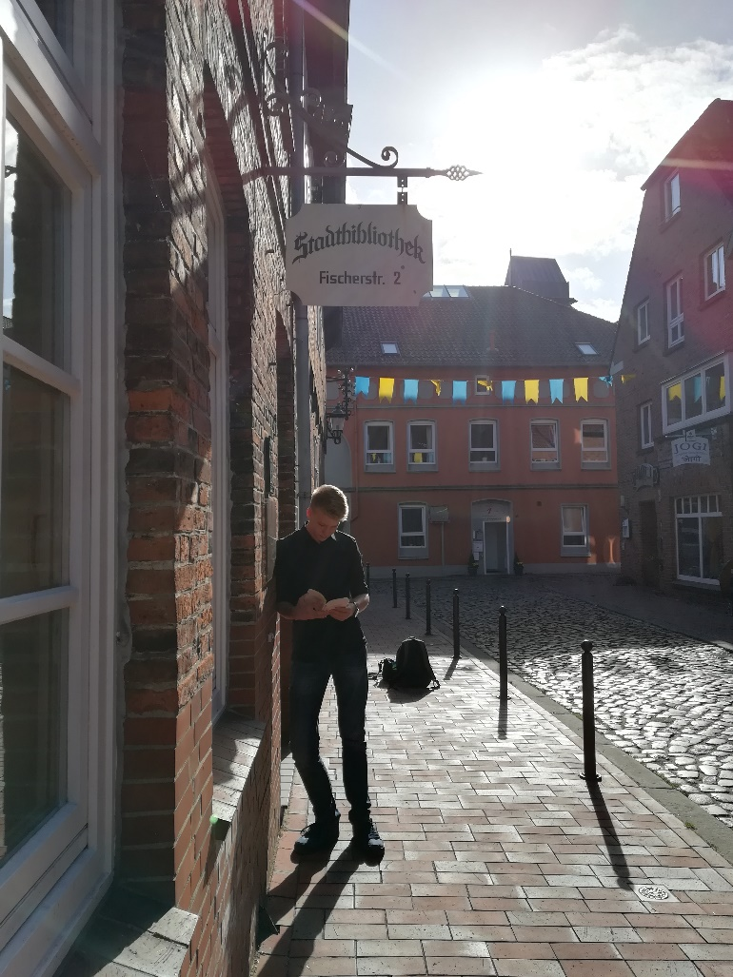
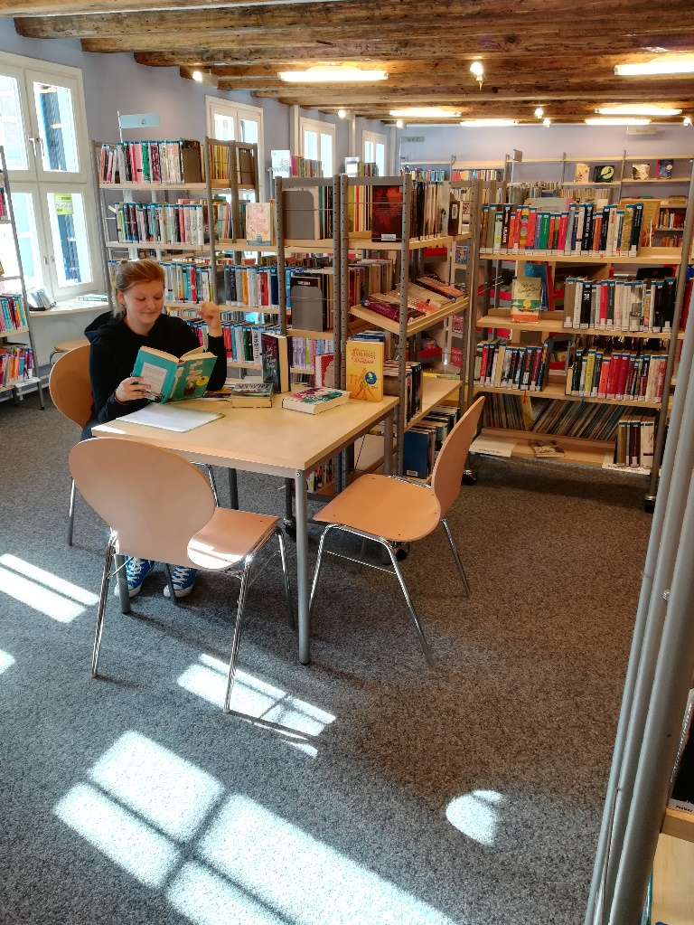
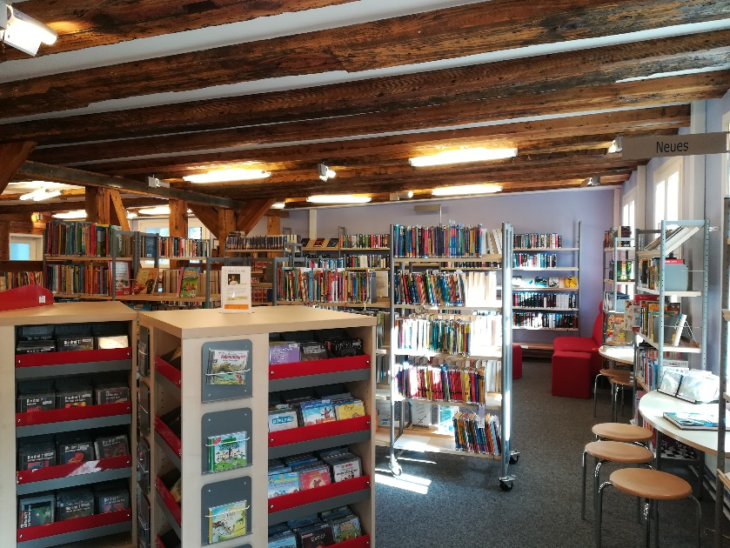
Town Library

Slide 7
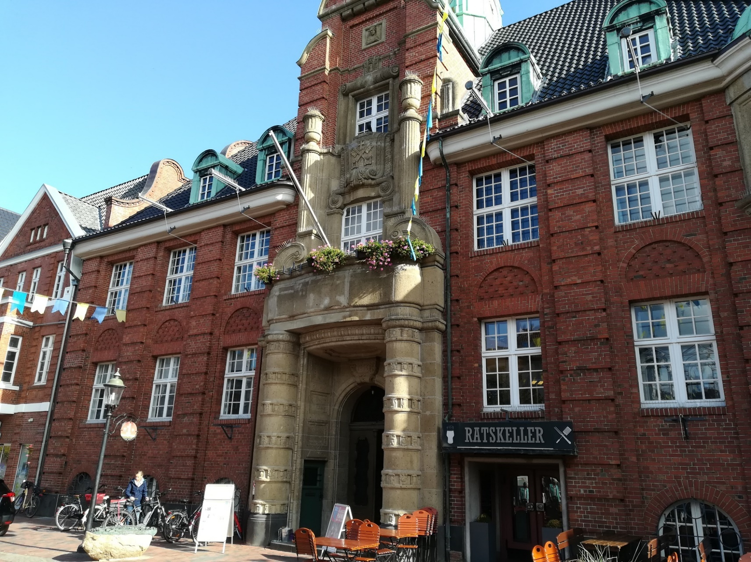
Old townhall (Rathaus)

Slide 8
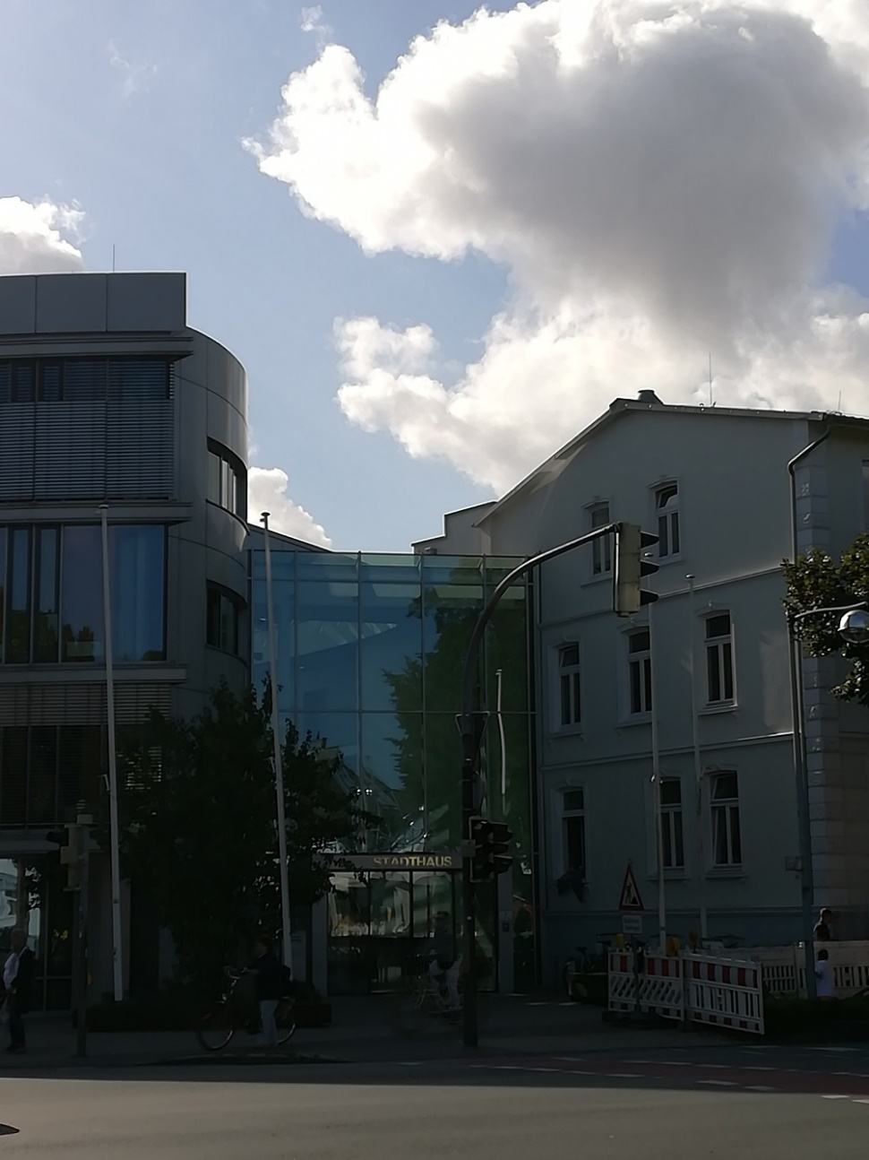
New townhall (Stadthaus)

Slide 9
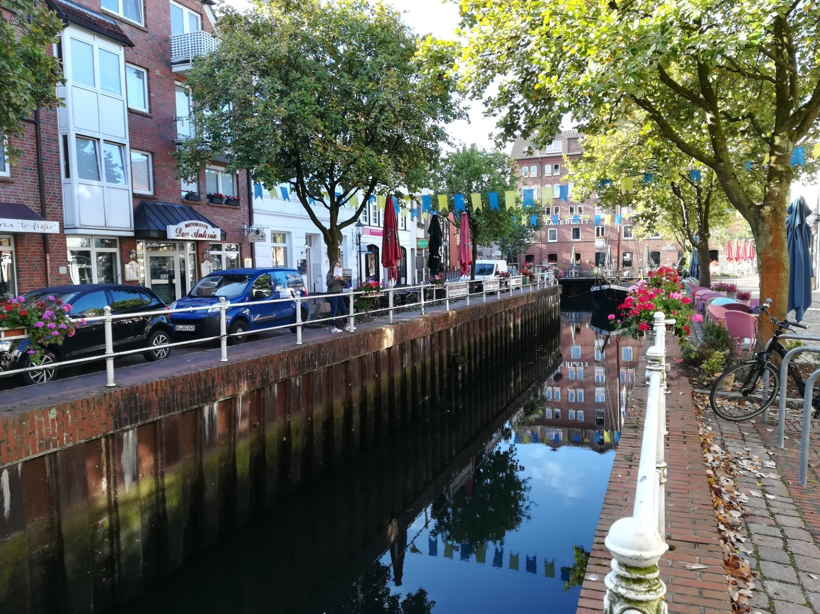
Fleth

Slide 10
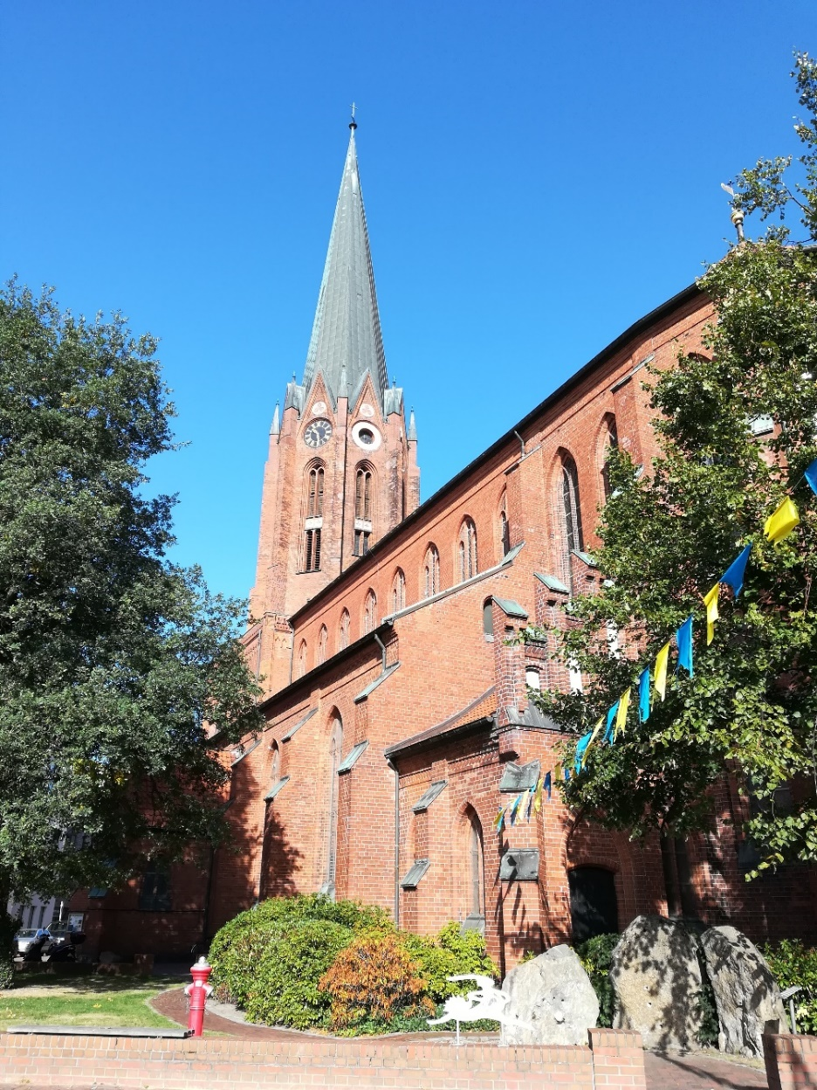
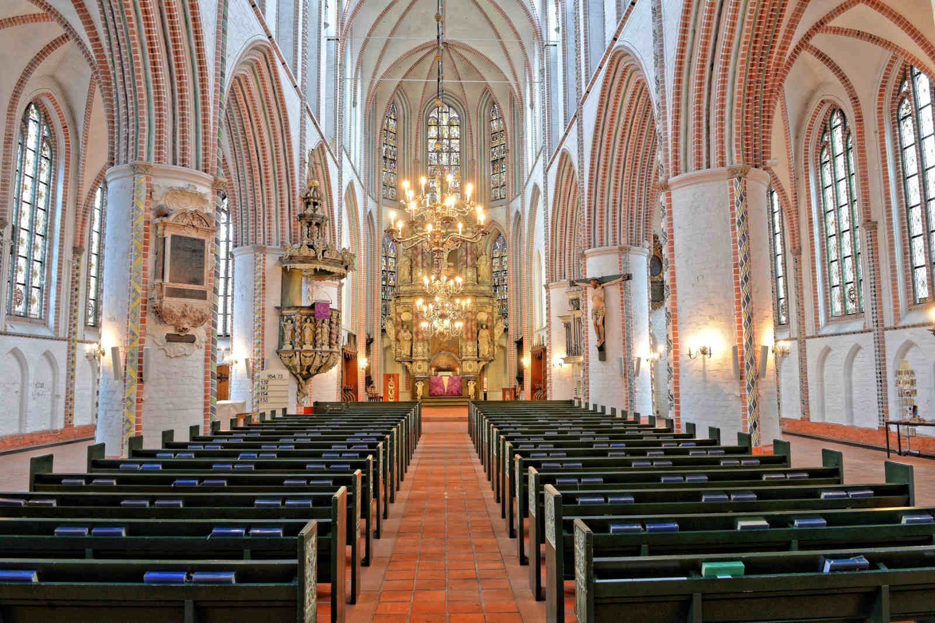
St.-Petri-Church

Slide 11
We are happy to work with you in the next days!

