Slide 1
Brave New World

Slide 2
Introduction
Do you think you live in a perfect world?
What would make a world perfect to you?
Do you think feelings control the world?

Slide 4
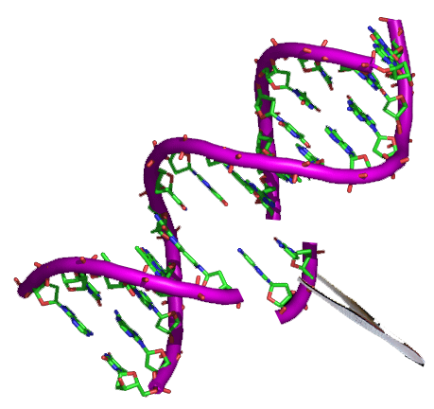
Discussion
Do you think it’s possible to genetically modify people for a certain job?
Is it morally right?

Slide 5
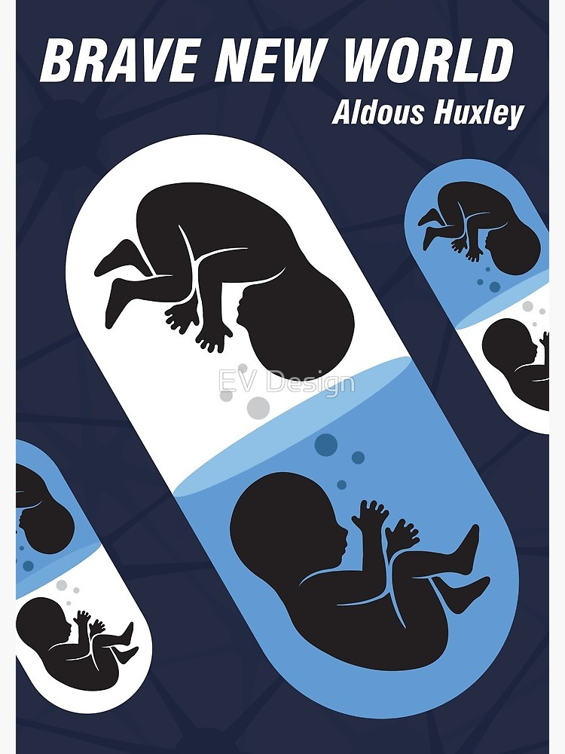

Slide 6
Quote from the book
‘And that,’ put in the Director sententiously , ‘that is the secret of happiness and virtue - liking what you’ve got to do. All conditioning aims at that: making people like their unescapable social destiny.’
What are the positive aspects of living in a controlled society

Slide 7
Trailer and discussion
https://www.youtube.com/watch?v=N5BKctcZxrM
Are there any books or movies that remind you of such a society?
Are there any countries in our world that could be compared to such a society?

Slide 8
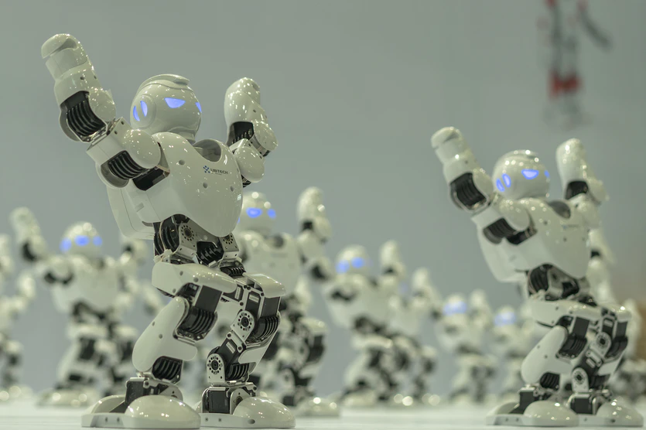
What if…
Example: What if you woke up tomorrow in an artificial world?

Slide 9
Why do we recommend this book?

