Slide 1
Der Mensch und seine Welt Man and his world
Zusammenfassung desTeilprojekt 2/ Summary of Subproject 2

Slide 2
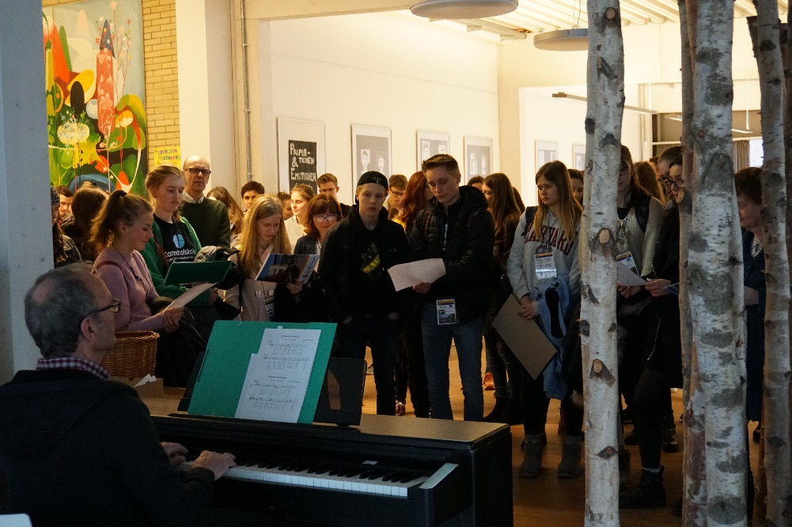
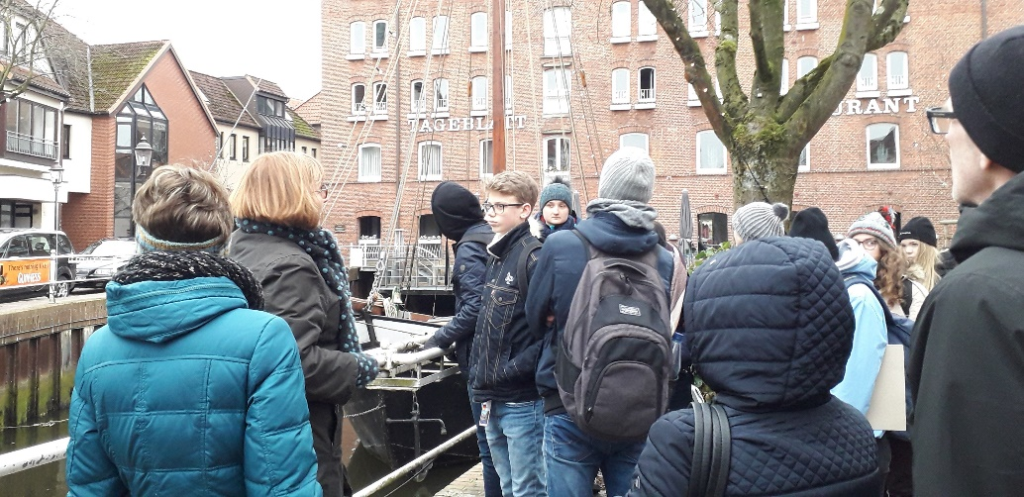
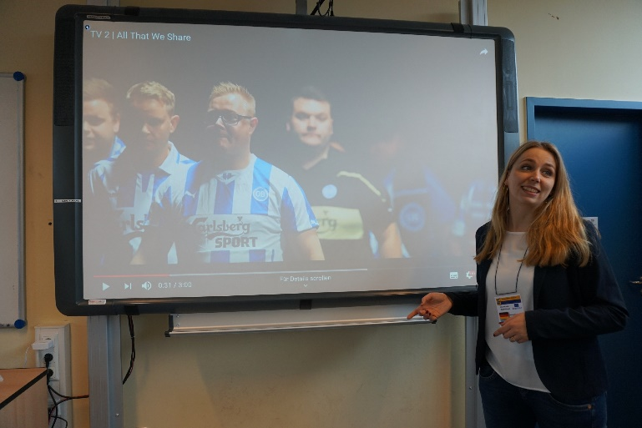
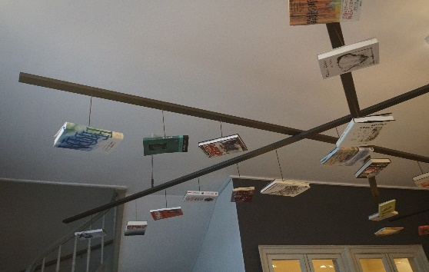
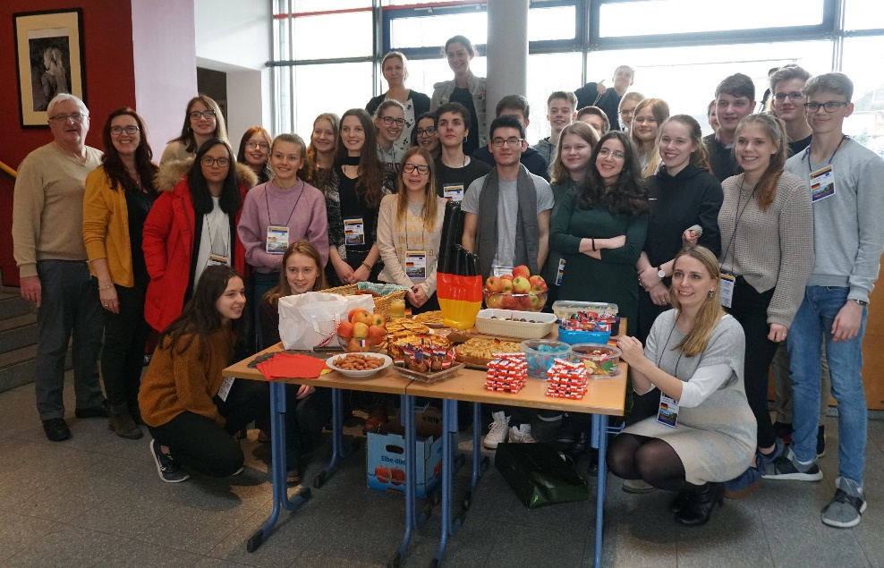
Projekttreffen in Buxtehude
Project meeting in Buxtehude
That's how we got to know Halepaghen School, Buxtehude and its surroundings

Slide 3
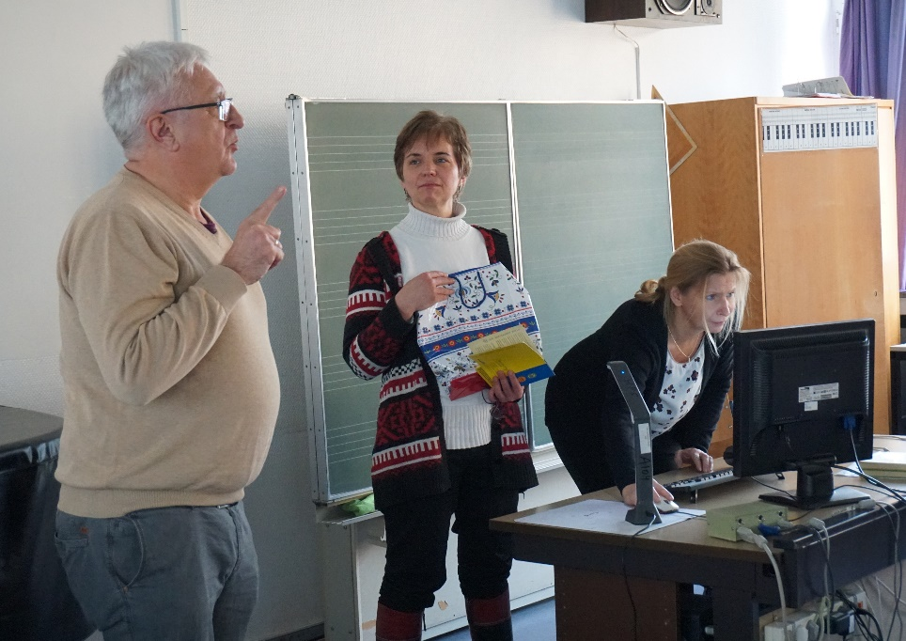
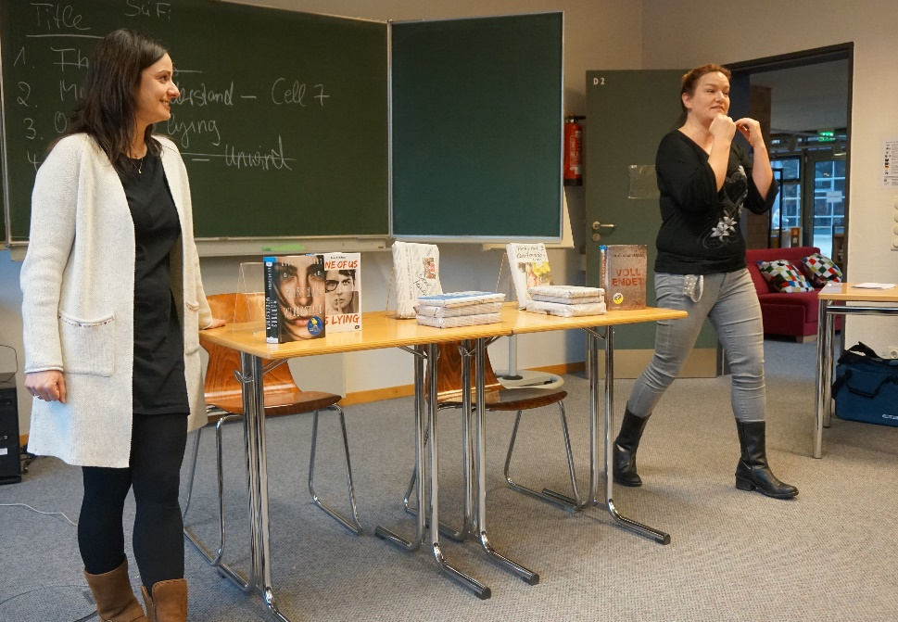
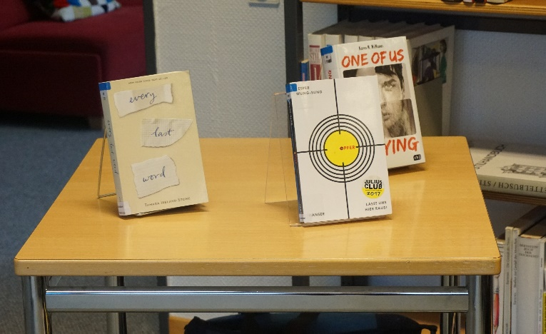
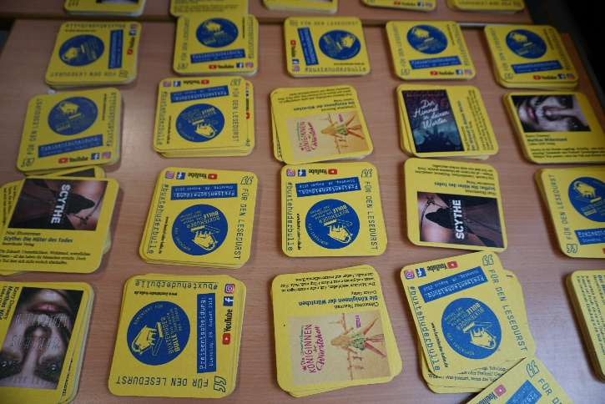
Projekttreffen in Buxtehude
Project meeting in Buxtehude
Book Casting and Buxtehuder Bulle are
the reading actions that are regularly conducted at Halepaghen School.

Slide 4
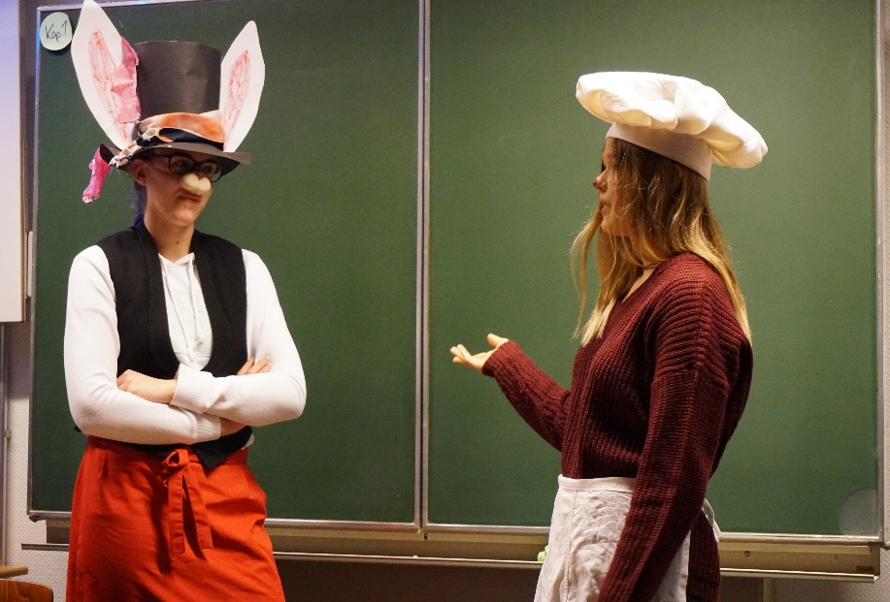
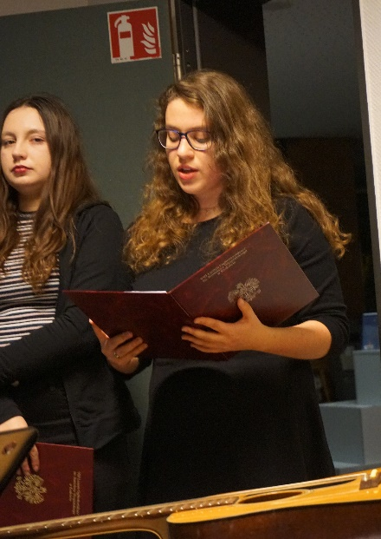
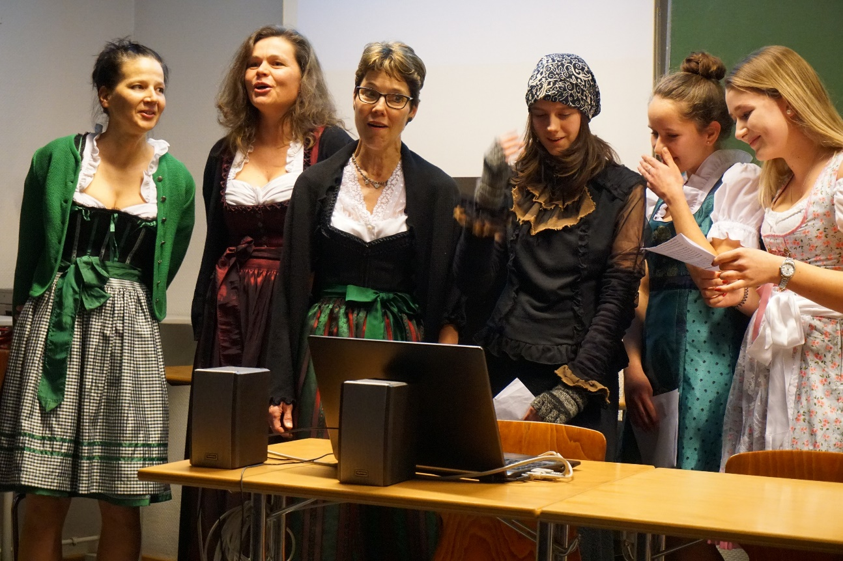
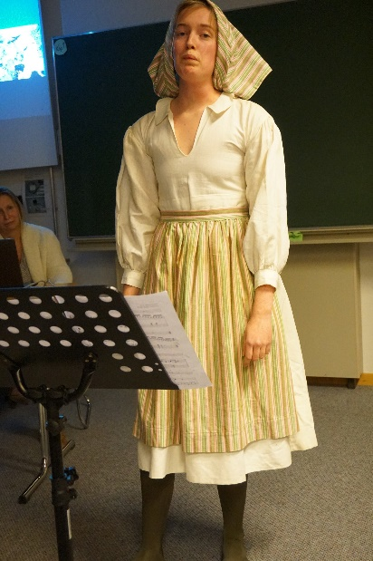
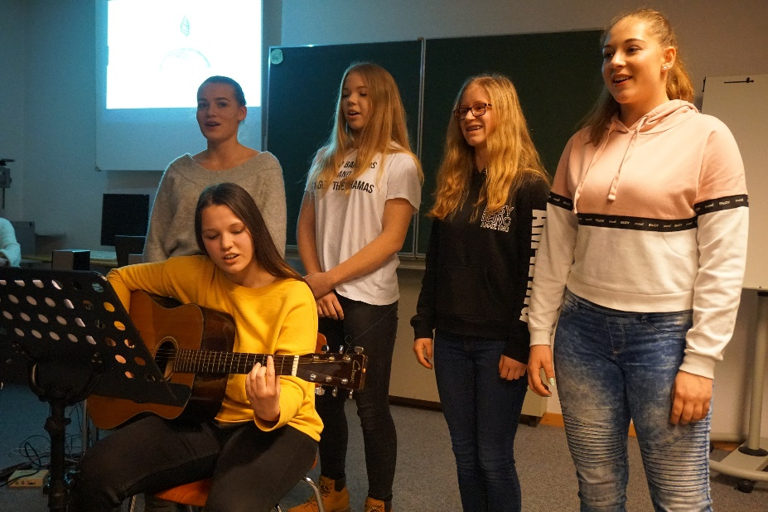
Projekttreffen in Buxtehude
Project meeting in Buxtehude
At the reading soirée we enjoyed literature in different ways.

Slide 5
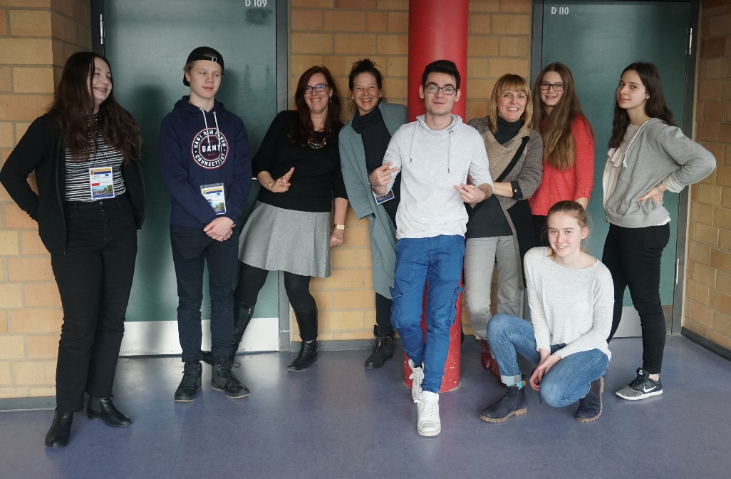
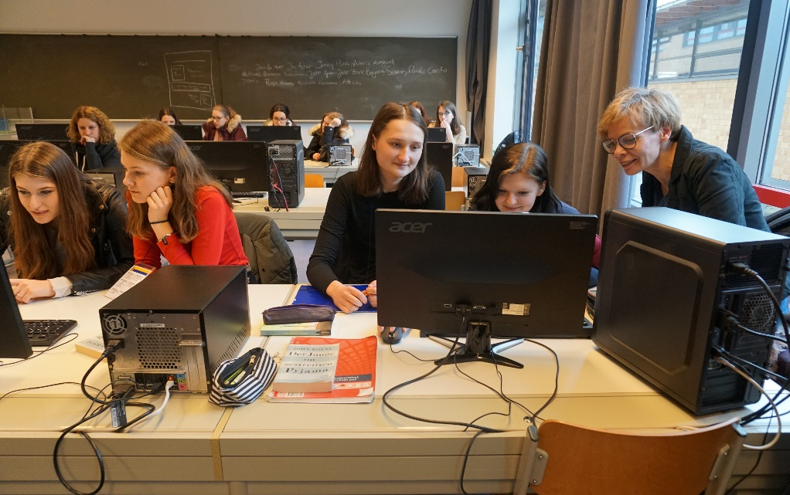
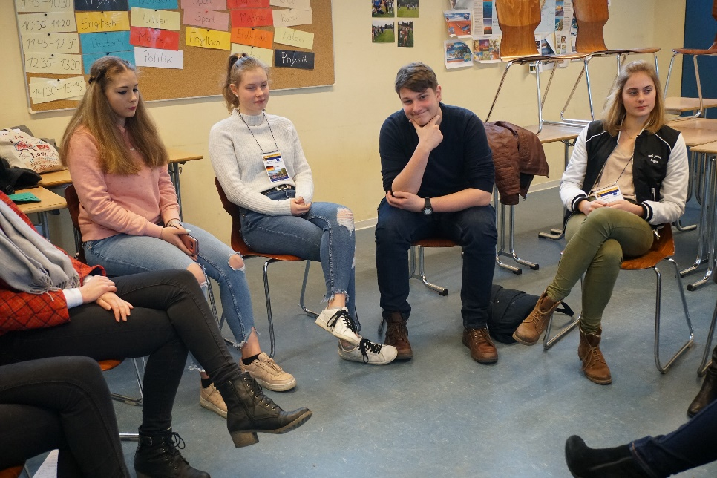
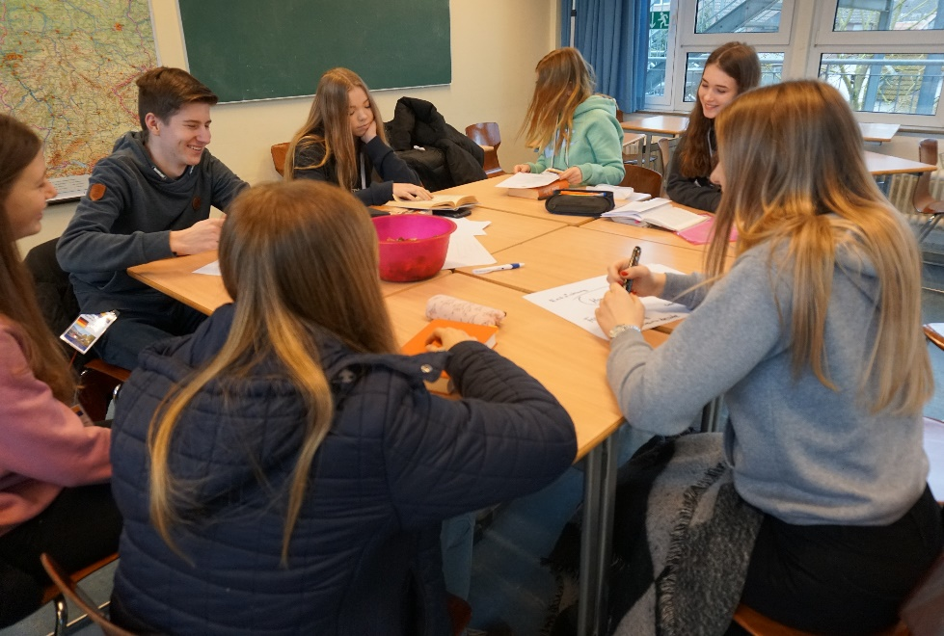
Projekttreffen in Buxtehude
Project meeting in Buxtehude
We had
a good time at work.

Slide 6
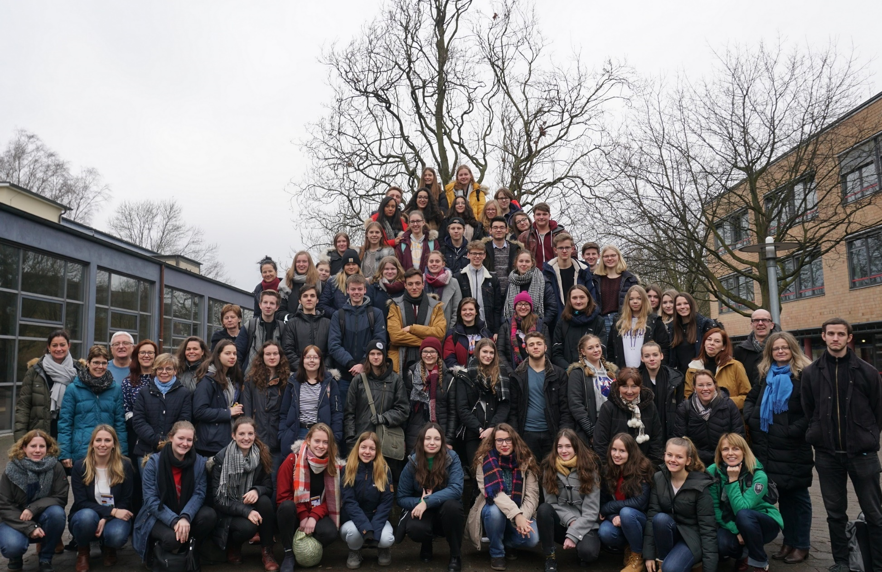
Projekttreffen in Buxtehude
Project meeting in Buxtehude
The intercultural class was a great experience for us.

Slide 7
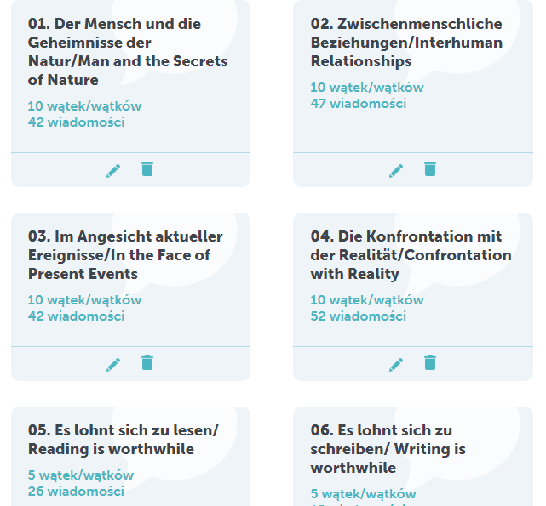
Interkultureller Dialog in TwinSpace
Intercultural dialogue
in TwinSpace
* 7 articles
(4 of them in both languages of the project)
* 27 comments in German
* 39 comments in English

Slide 8
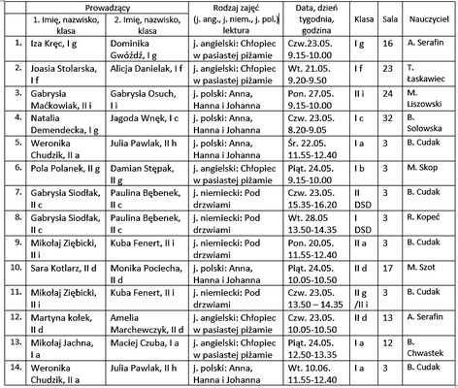
Lesekampagne „Lies mit uns!”
Reading campaign
‚Read with us!’
The second campaign took place in May instead of April.
We conducted 14 lessons
in our school.

Slide 9
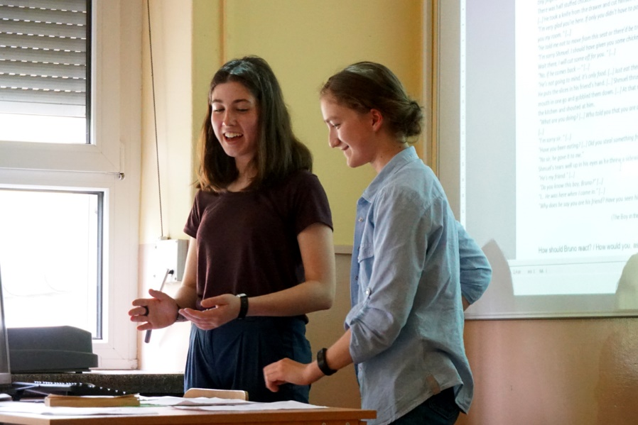
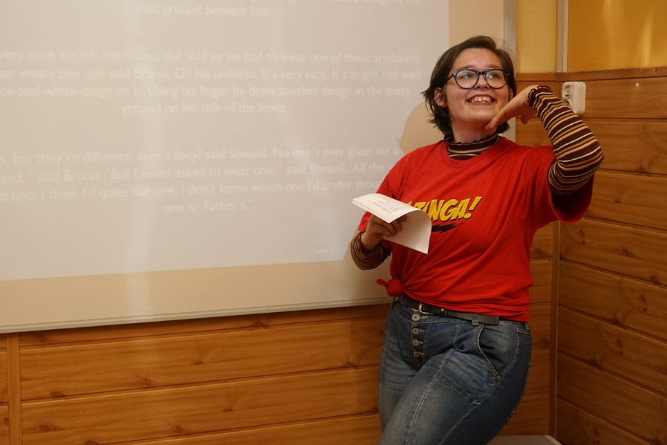
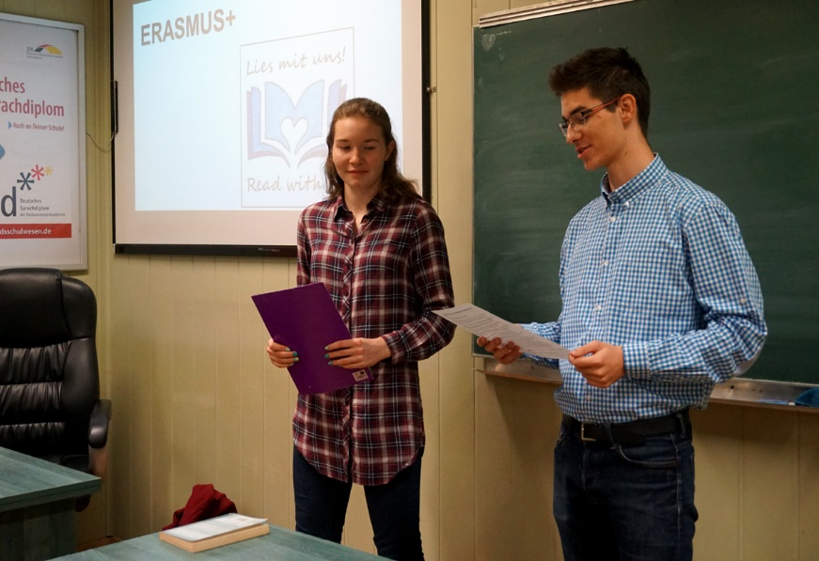
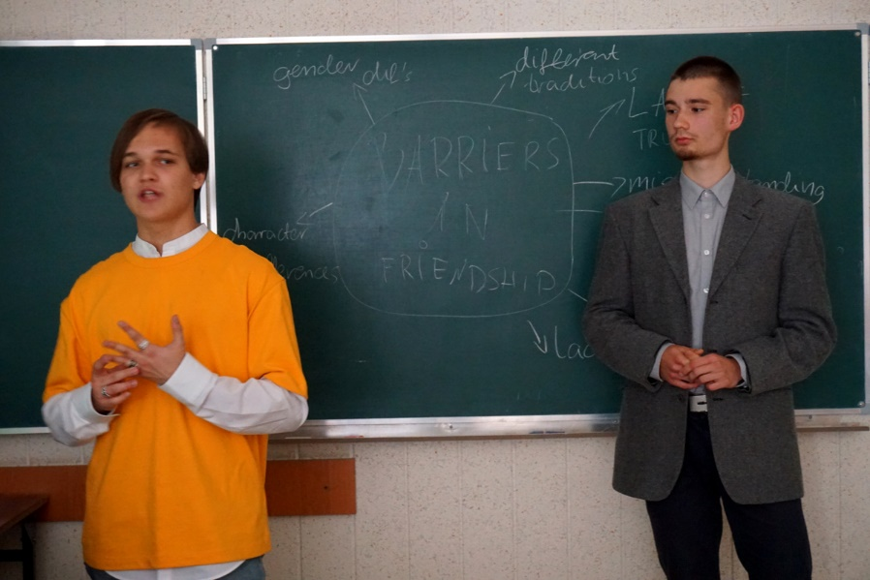
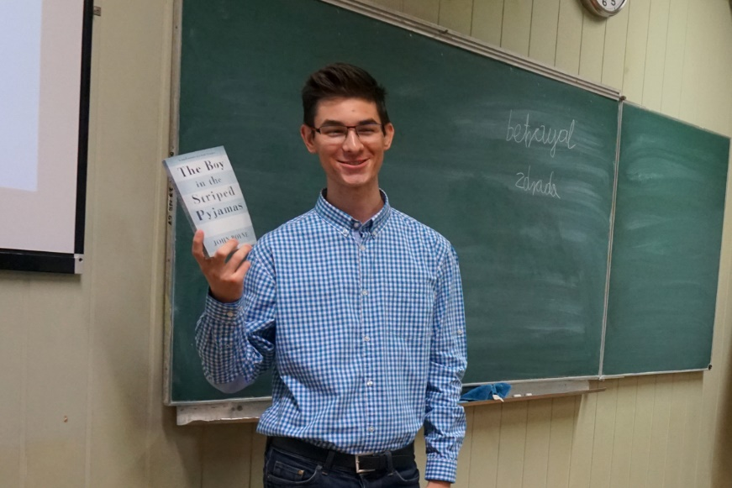
Lesekampagne „Lies mit uns!”
Reading campaign
5 English lessons,
based on „The boy in striped pajamas” by J. Boyne

Slide 10
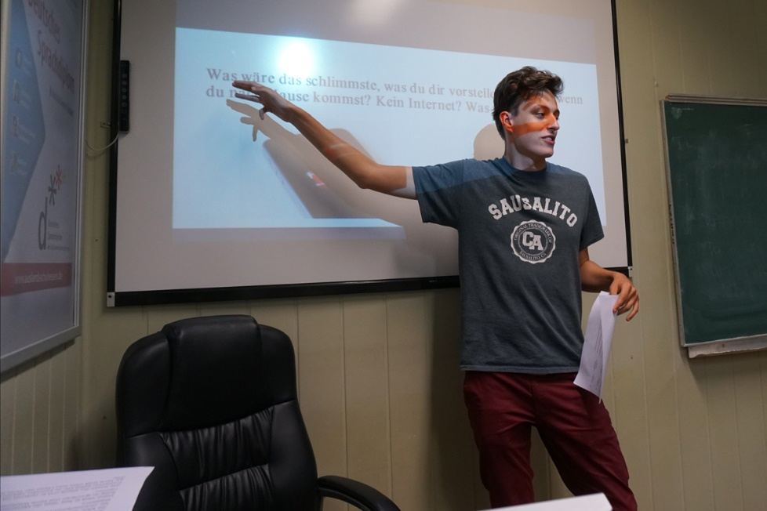
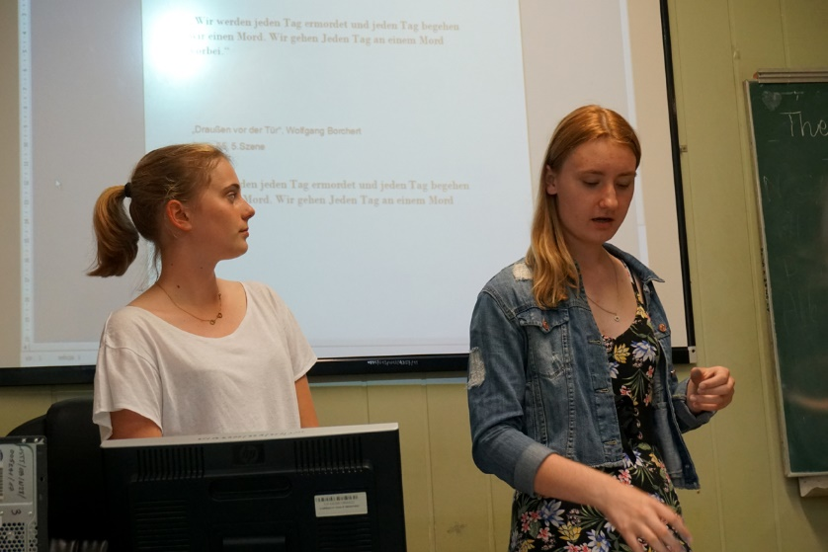
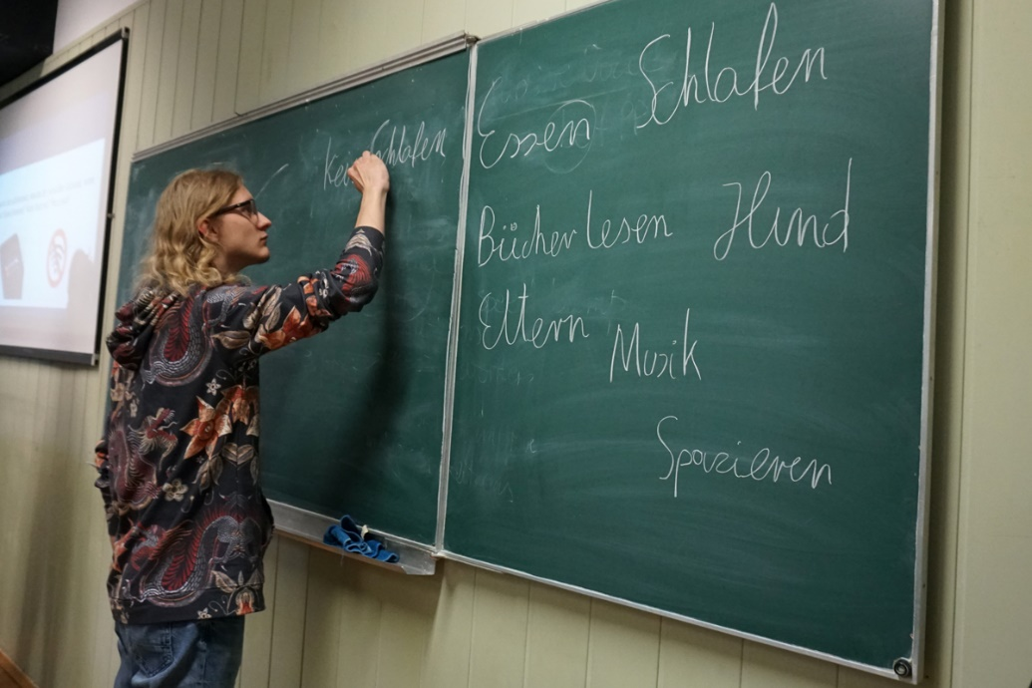
Lesekampagne „Lies mit uns!”
Reading campaign
4 German lessons, based on the drama "Outside the door" by W. Borchert .

Slide 11
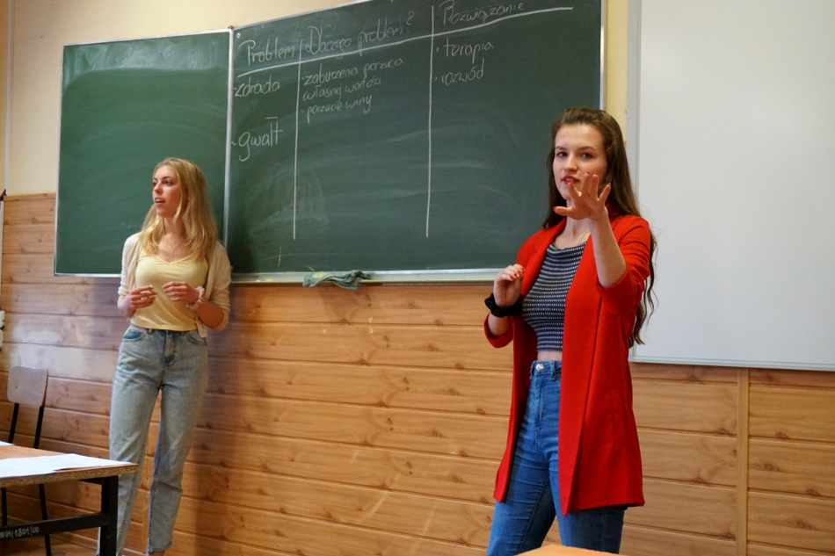
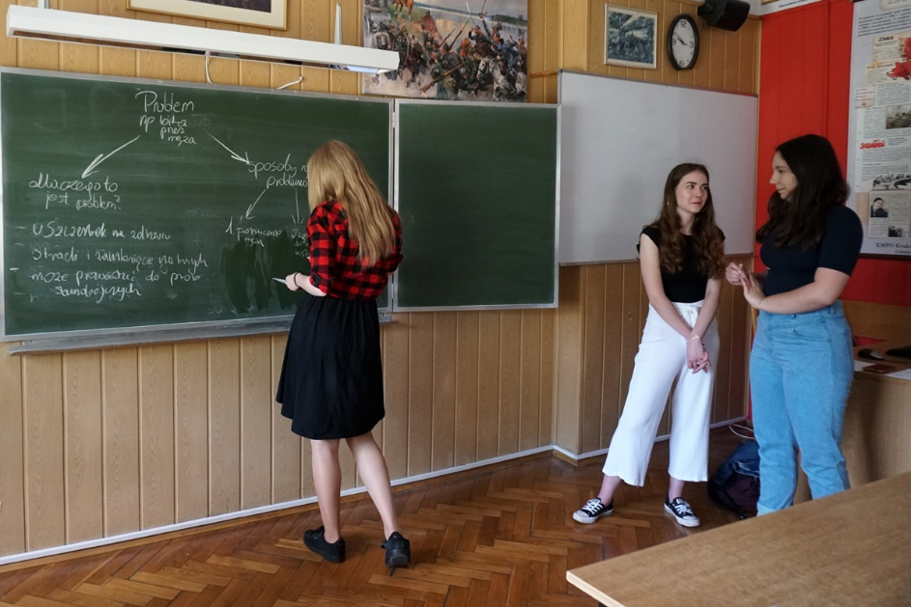
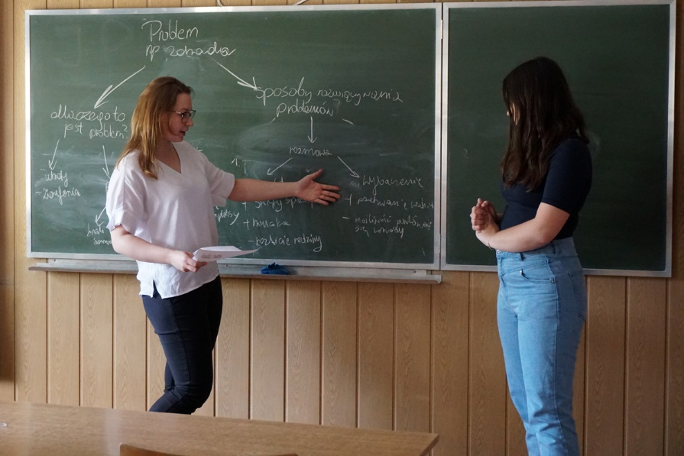
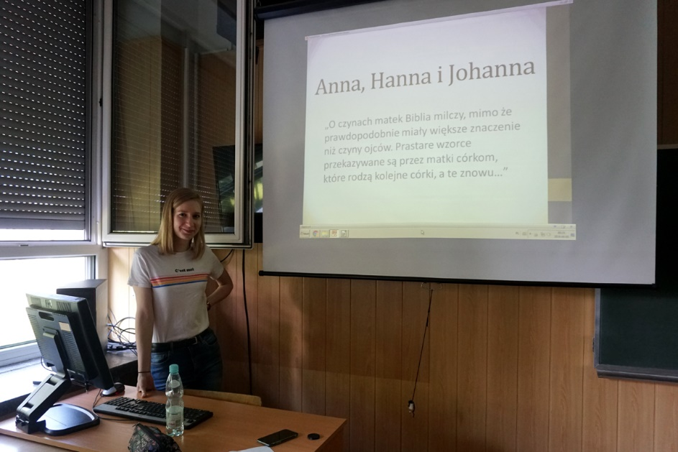
Lesekampagne „Lies mit uns!”
Reading campaign
5 Lessons in the mother tongue based on the novel "Hanna's daughters" by M. Fredriksson

Slide 12
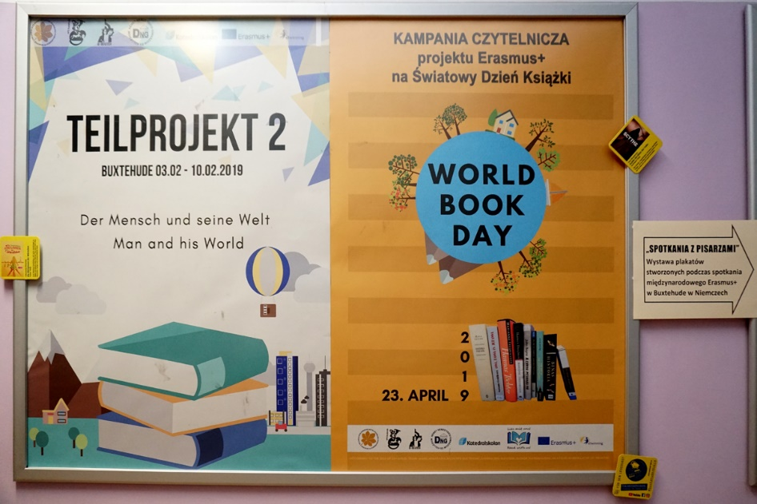
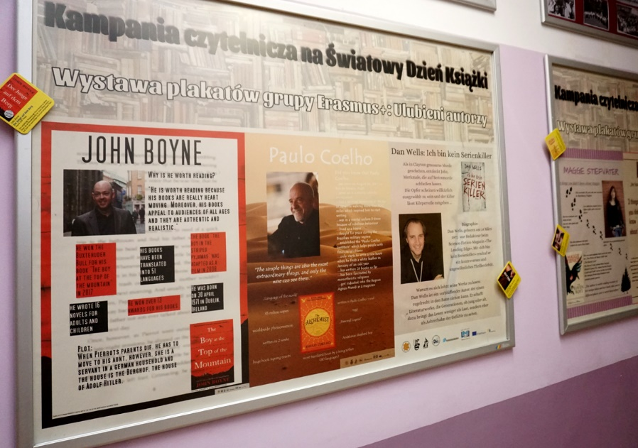
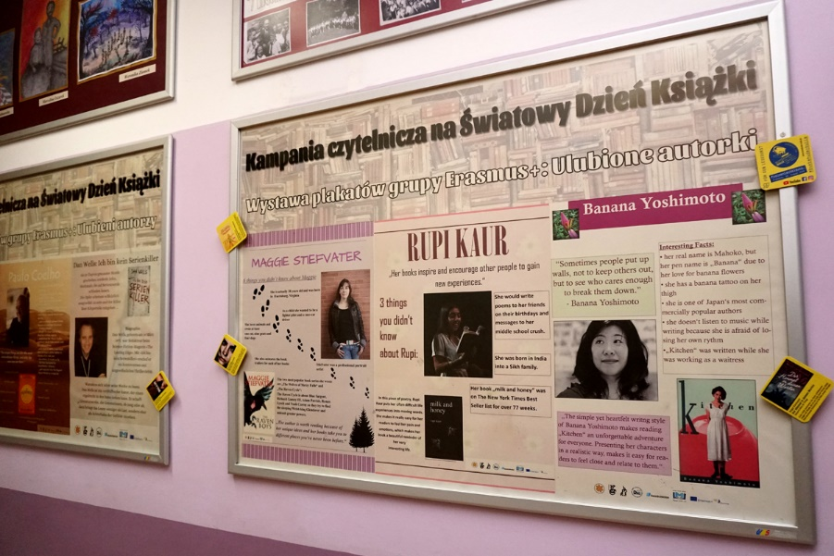
Lesekampagne „Lies mit uns!”
Reading campaign
We have also presented jointly developed materials in the school corridor.

Slide 13
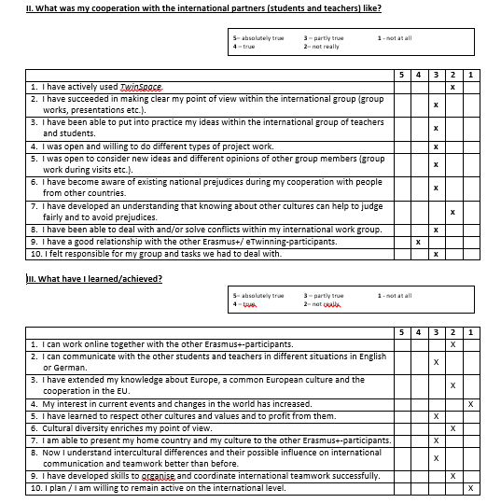
Umfrage „Meine interkulturelle Kompetenz”
Each Erasmus + / eTwinning student from VIII LO made a self-assessment of their work based on the questionnaire "My intercultural competences"
Conclusion:
There is still a long way to go.

Slide 14
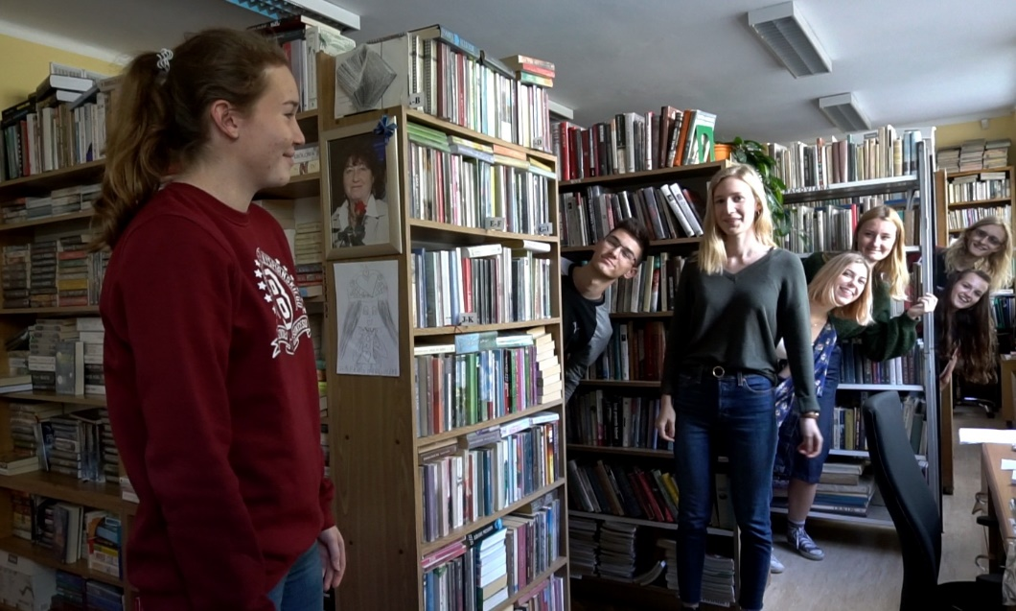
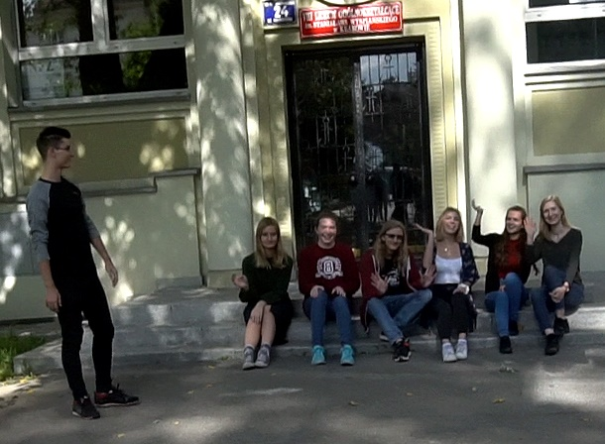
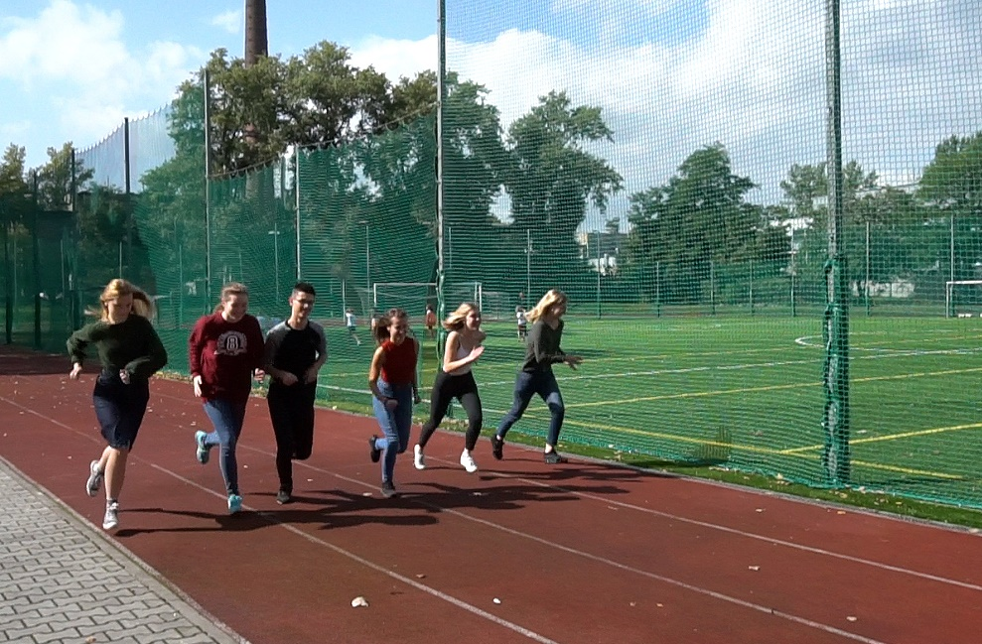
Vorbereitungen auf das Projekttreffen in Växjö
Preparations
for the project meeting in Växjö
We have read the books of the project canon and prepared all presentations.

Slide 15
Jetzt sind wir darauf gespannt, was in Växjö geschehen wird!
Now we are curious
what will happen in Växjö!
VIII LO Erasmus+/eTwinning Schulteam

