Slide 2
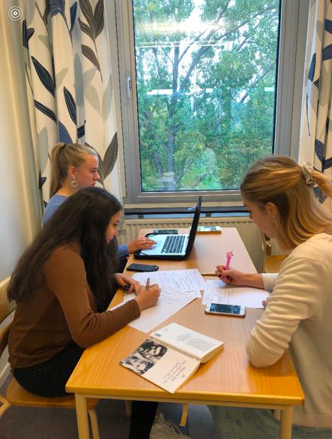
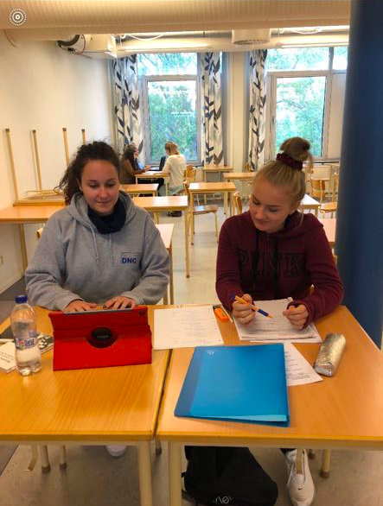
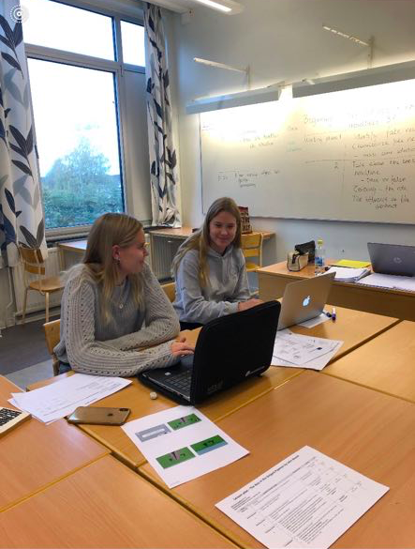
The process of creating a lesson plan
Brainstormed what we could use the book for
We made an outline
Divided the group to be more efficient
The small groups presented their results
We changed the outline depending on what we concluded

Slide 3
Work process evaluation
Reflections
- Efficient work
- Good cooperation
- Everyone were committed to the work
What we have learned
- Work in different consultations and different languages
- Different ways of viewing perspectives
- How to plan a lesson

Slide 4
Details
Topic
- Fake news
Age
- 16-17
Lesson time
- 45 minutes
Objects
- Inspire them to read the book
- Define fake news
Material
- Powerpoint
- Pictures and headlines to discuss
- An abstract from the book to discuss

Slide 5
The lesson plan
Beginning
Introduce ourselves and the Erasmus+ project
Headlines, real or fake?
Phase 1
Let them discuss questions about fake news
Phase 2
Presenting book and Katharina
Questions to the headline
Worksheed
Phase 3
Questions based on extract
Ending
Effect of social media today: Do social media contains fake-news?

Slide 6
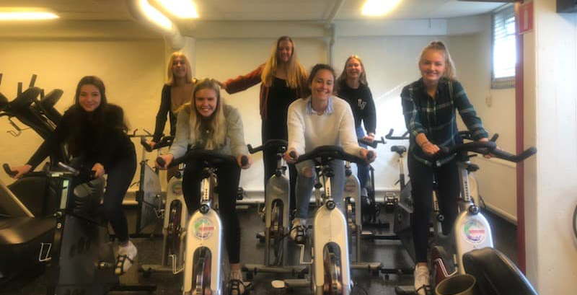
The creators:

