Slide 1
Tradition und Modernität Tradition and modernity
Zusammenfassung des Teilprojekt 3/ Summary of Subproject 3

Slide 2
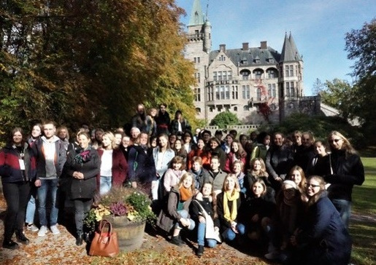
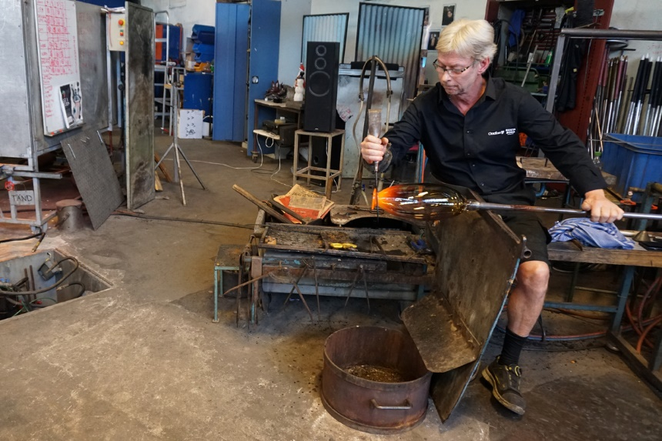
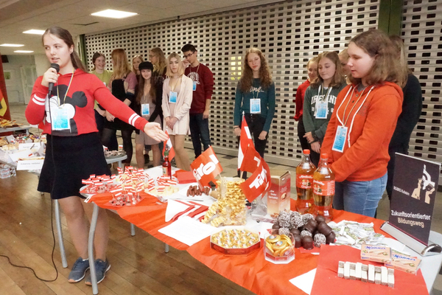
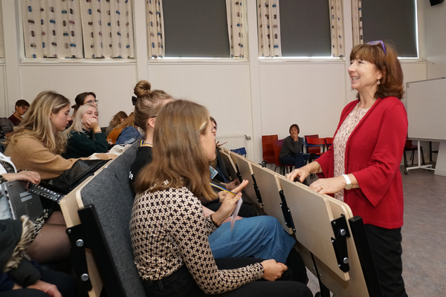
Projekttreffen in Växjö
Project meeting in Växjö
That's how we got to know the Swedish culture and traditions of the partner countries.

Slide 3
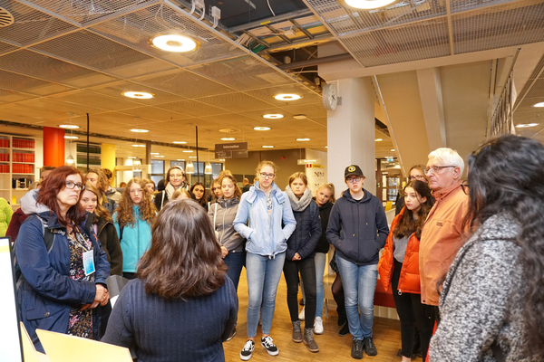
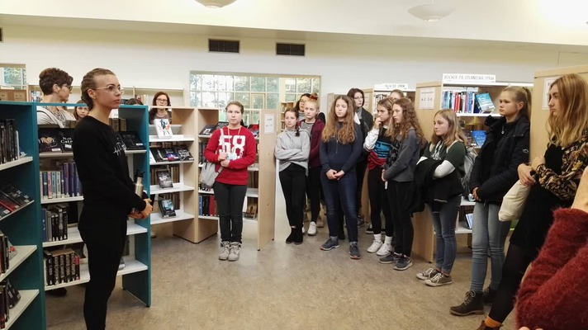
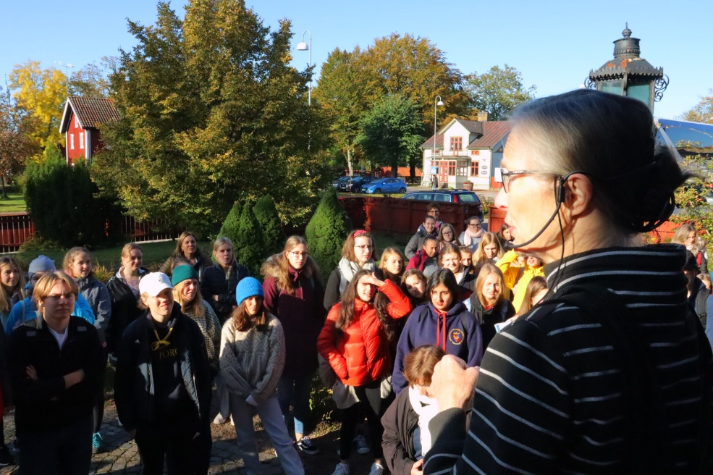
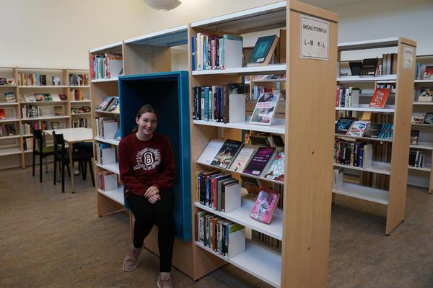
Projekttreffen in Växjö
Project meeting in Växjö
Visit to
the Linné University
Visit
to the Ljungby
Visit to
the school library

Slide 4
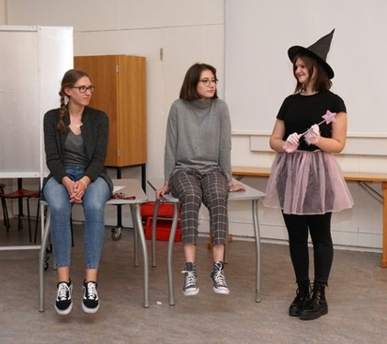
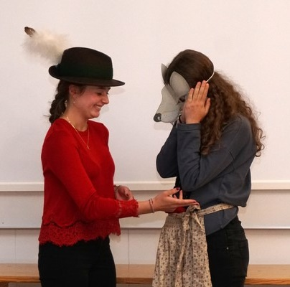
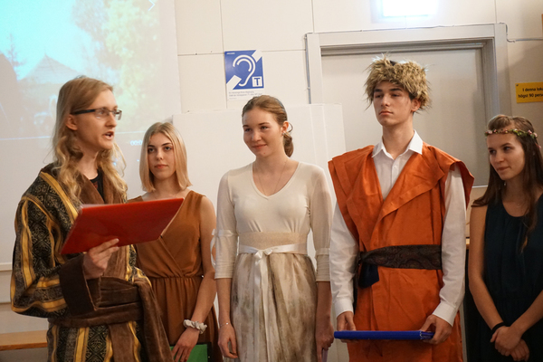
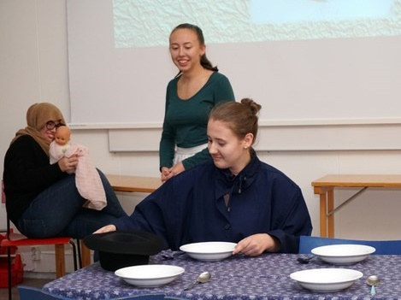
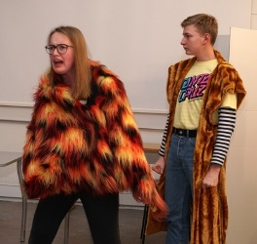
Projekttreffen in Växjö
Project meeting in Växjö
All performances on the literary evening brought many impressions.

Slide 5
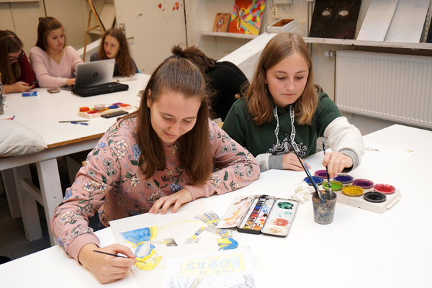
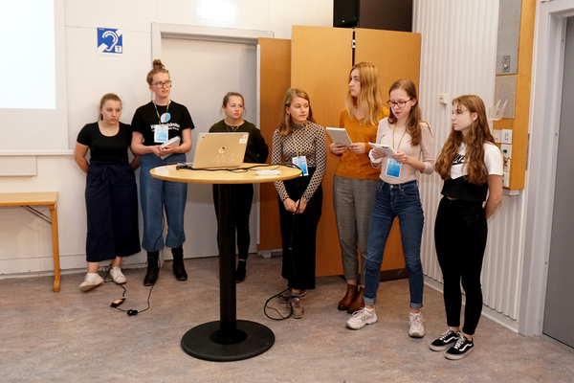
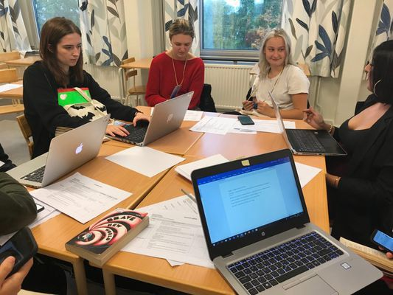
Projekttreffen in Växjö
Project meeting in Växjö
Ouer
project work

Slide 6
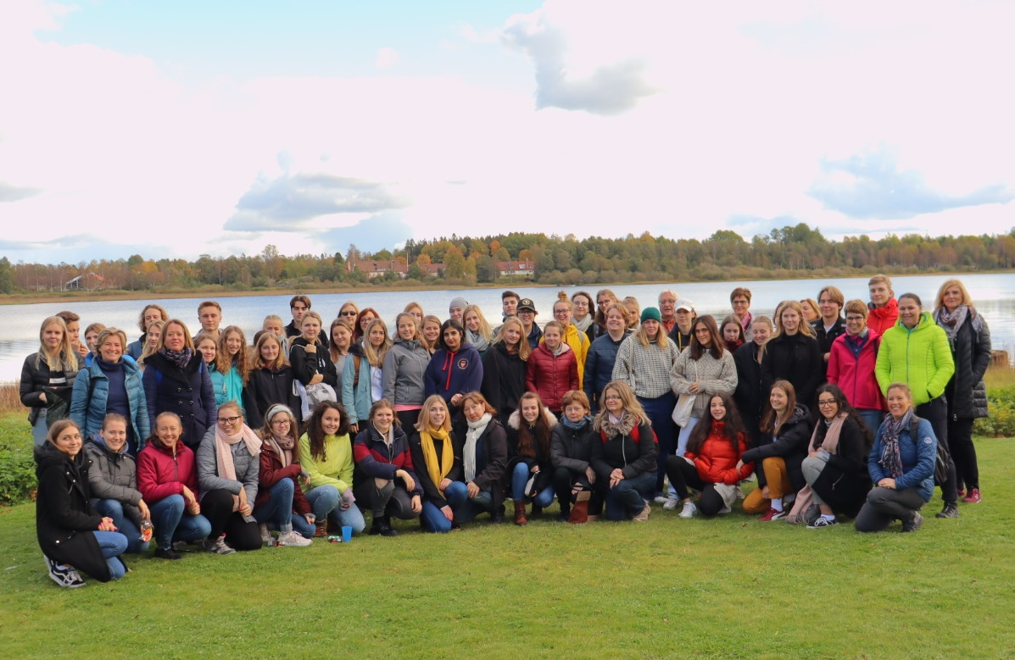
Projekttreffen in Växjö
Project meeting in Växjö
Everyone felt good in the intercultural class.

Slide 7
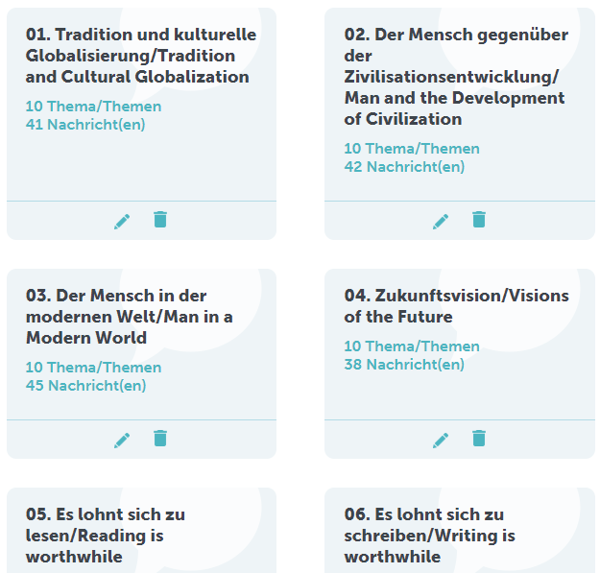
Interkultureller Dialog in TwinSpace
Intercultural dialogue
in TwinSpace
* 7 articles
(4 of them in both languages of the project)
* 29 comments in German
* 17 comments in English

Slide 8
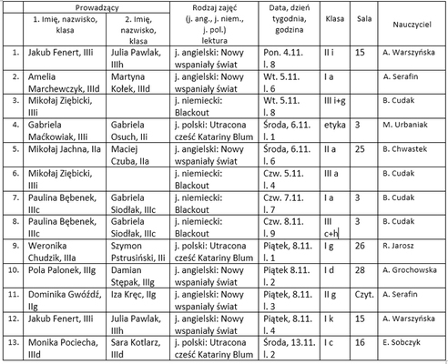
Lesekampagne „Lies mit uns!”
Reading campaign
‚Read with us!’
The third campaign took place in November.
We conducted 13 lessons
in our school.

Slide 9
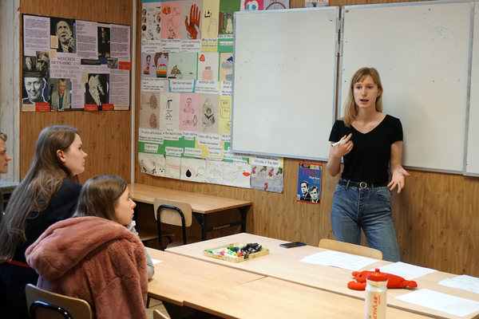
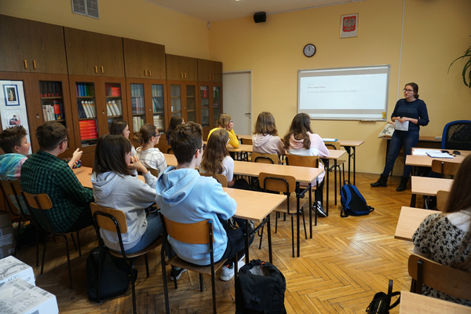
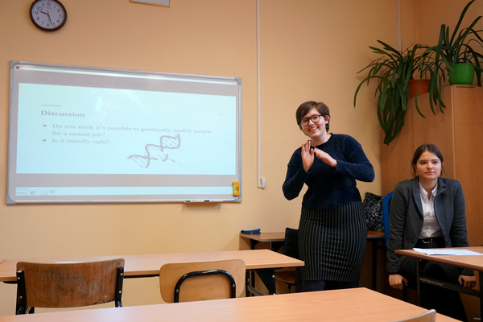
Lesekampagne „Lies mit uns!”
Reading campaign
6 English lessons, based on „Brave New World" by Aldous Huxley

Slide 10
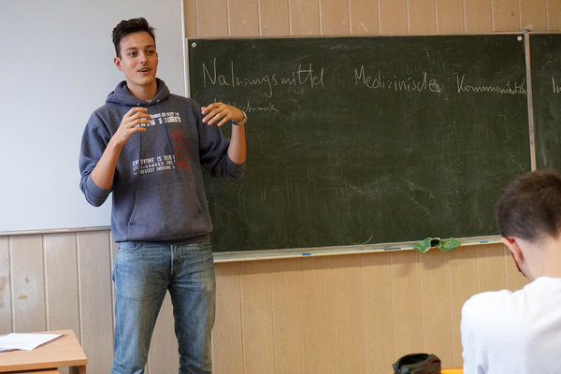
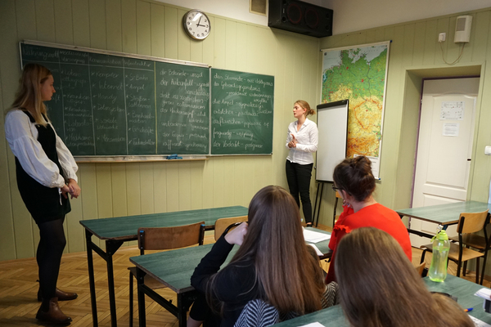
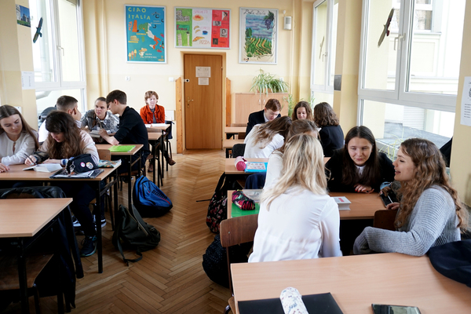
Lesekampagne „Lies mit uns!”
Reading campaign
4 German lessons, based on the „Blackout"
by M. Elsberg .

Slide 11
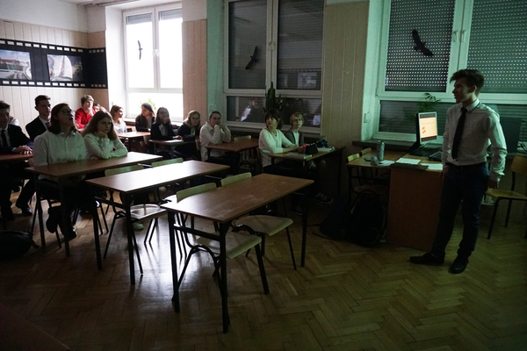
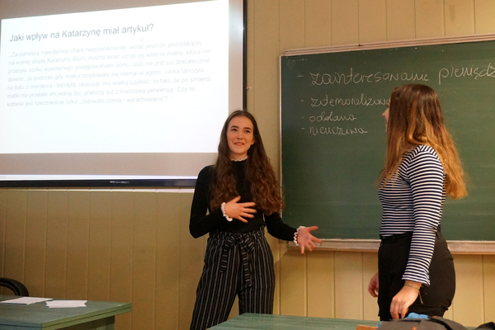
Lesekampagne „Lies mit uns!”
Reading campaign
3 Lessons in the mother tongue based on
the „The Lost Honour of Katharina Blum” by H. Böll

Slide 12
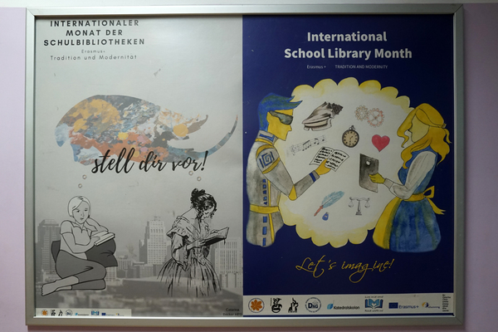
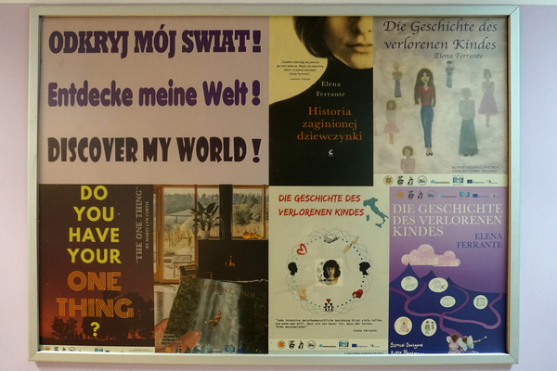
Lesekampagne „Lies mit uns!”
Reading campaign
We have also presented jointly developed materials in the school corridor.

Slide 13
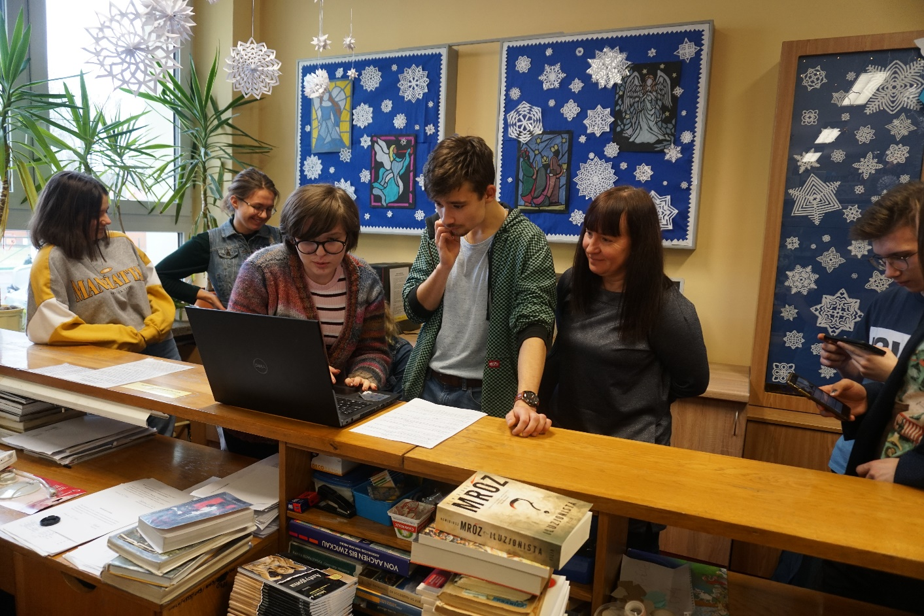
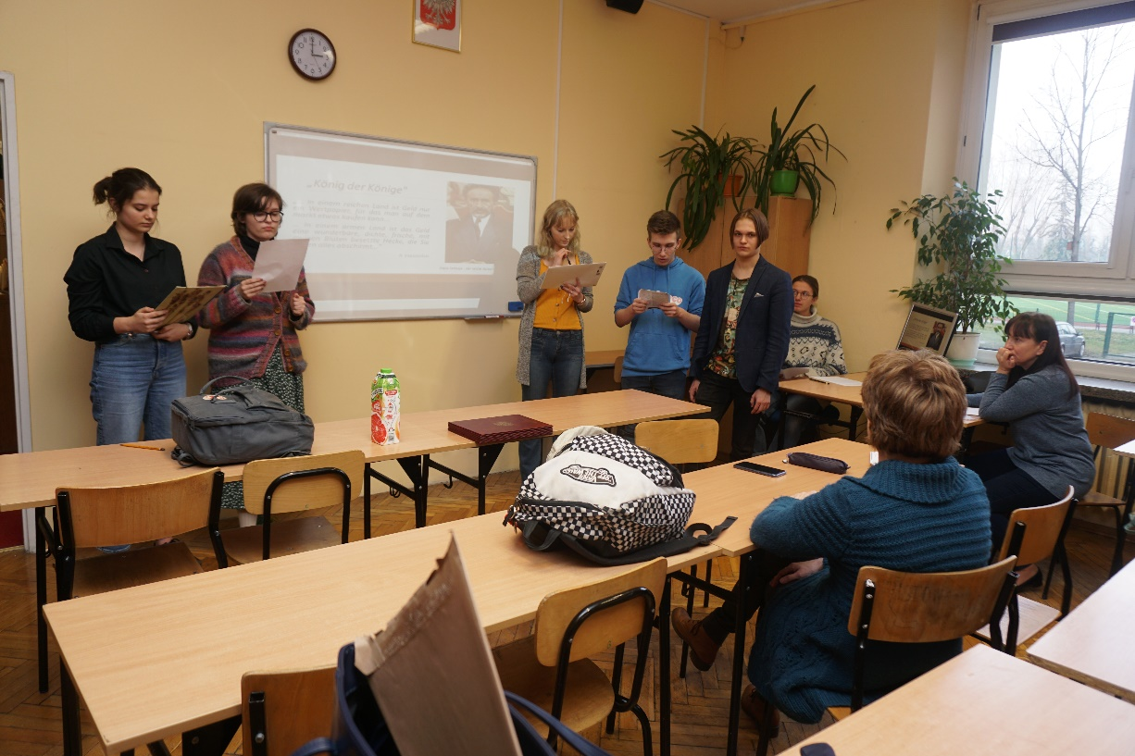
Vorbereitungen auf das Projekttreffen in Kufstein
Preparations
for the project meeting in Kufstein
We prepared step by step for the meeting in Kufstein

Slide 14
Wir freuen uns auf die nächsten Tage mit euch!
We are looking forward to spending this week with you!
VIII LO Erasmus+/eTwinning Schulteam

